Slide 1
TOX680
Unveiling the Transcriptome using RNA-seq
Jinze Liu

Slide 2
Outline
What is the transcriptome?
Measuring the transcriptome
Sampling the transcriptome using short reads
Alignment of reads to a reference genome
Splice graph representation of RNA-seq data
Reconstructing the transcriptome
Differential analysis of the transcriptome

Slide 3
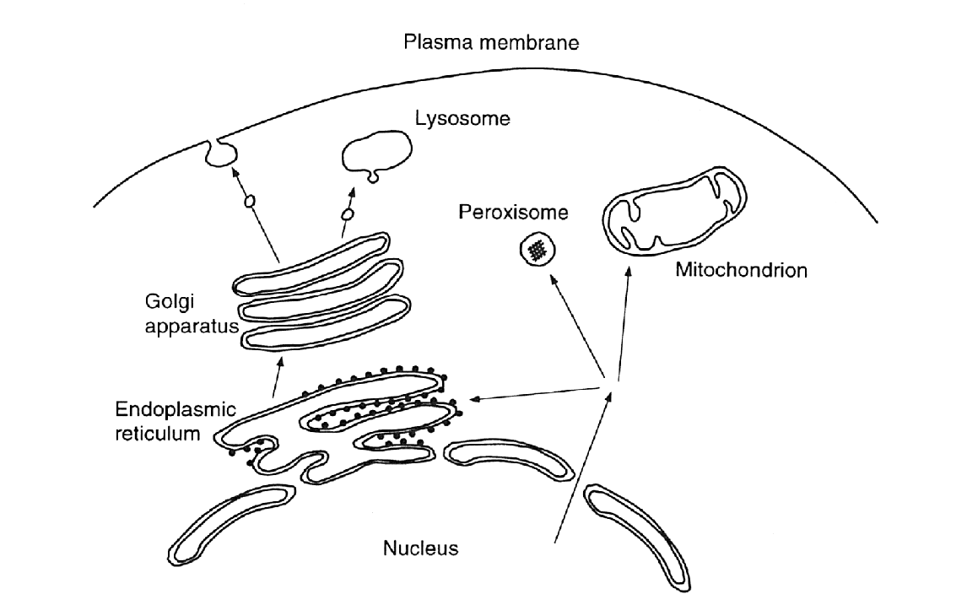
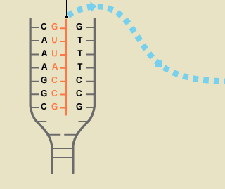
Genome, Transcriptome, Proteome
Schematic illustration
of a eukaryotic cell
Proteins
Proteome
The transcriptome is
all RNA molecules
transcribed from DNA
RNA
cell
nucleus
DNA
Genome
Notes:
Different kinds of RNA. Translation into protein (including mRNA, tRNA) , and noncoding RNA with regulation, post-transcriptional modification (catalytic) functions. DNA as program, RNA as execution analogy. The DNA is the genotype and the RNA is a most basic phenotype. i.e. reflects behavior of the cell as a result of interaction with its environment.

Slide 4
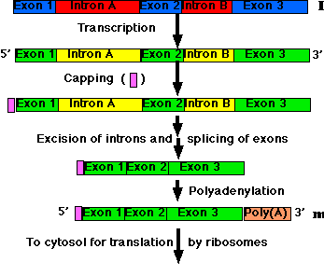
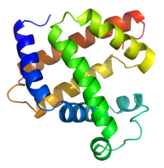
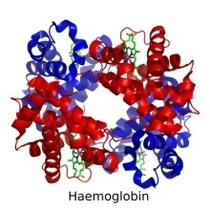
Dynamics of the Transcriptome
Cells with the same genome may produce a different transcriptome … how?
Two main mechanisms
(1) differential gene expression
(2) differential gene transcription
DNA
DNA
pre-mRNA
mRNA transcripts
Proteins
mRNA
Proteins
Notes:
Example: Hemoglobin protein is made in red blood cells, while Myosins are made in muscle cells.
Differential Gene expression – a variety of temporary and permanent conditions influence the ability for polymerase to start transcription at the promotor site for a gene.
Differential gene transcription - the size and selection of introns and exons spliced can vary by regulation through regulation of the spliceosome

Slide 5
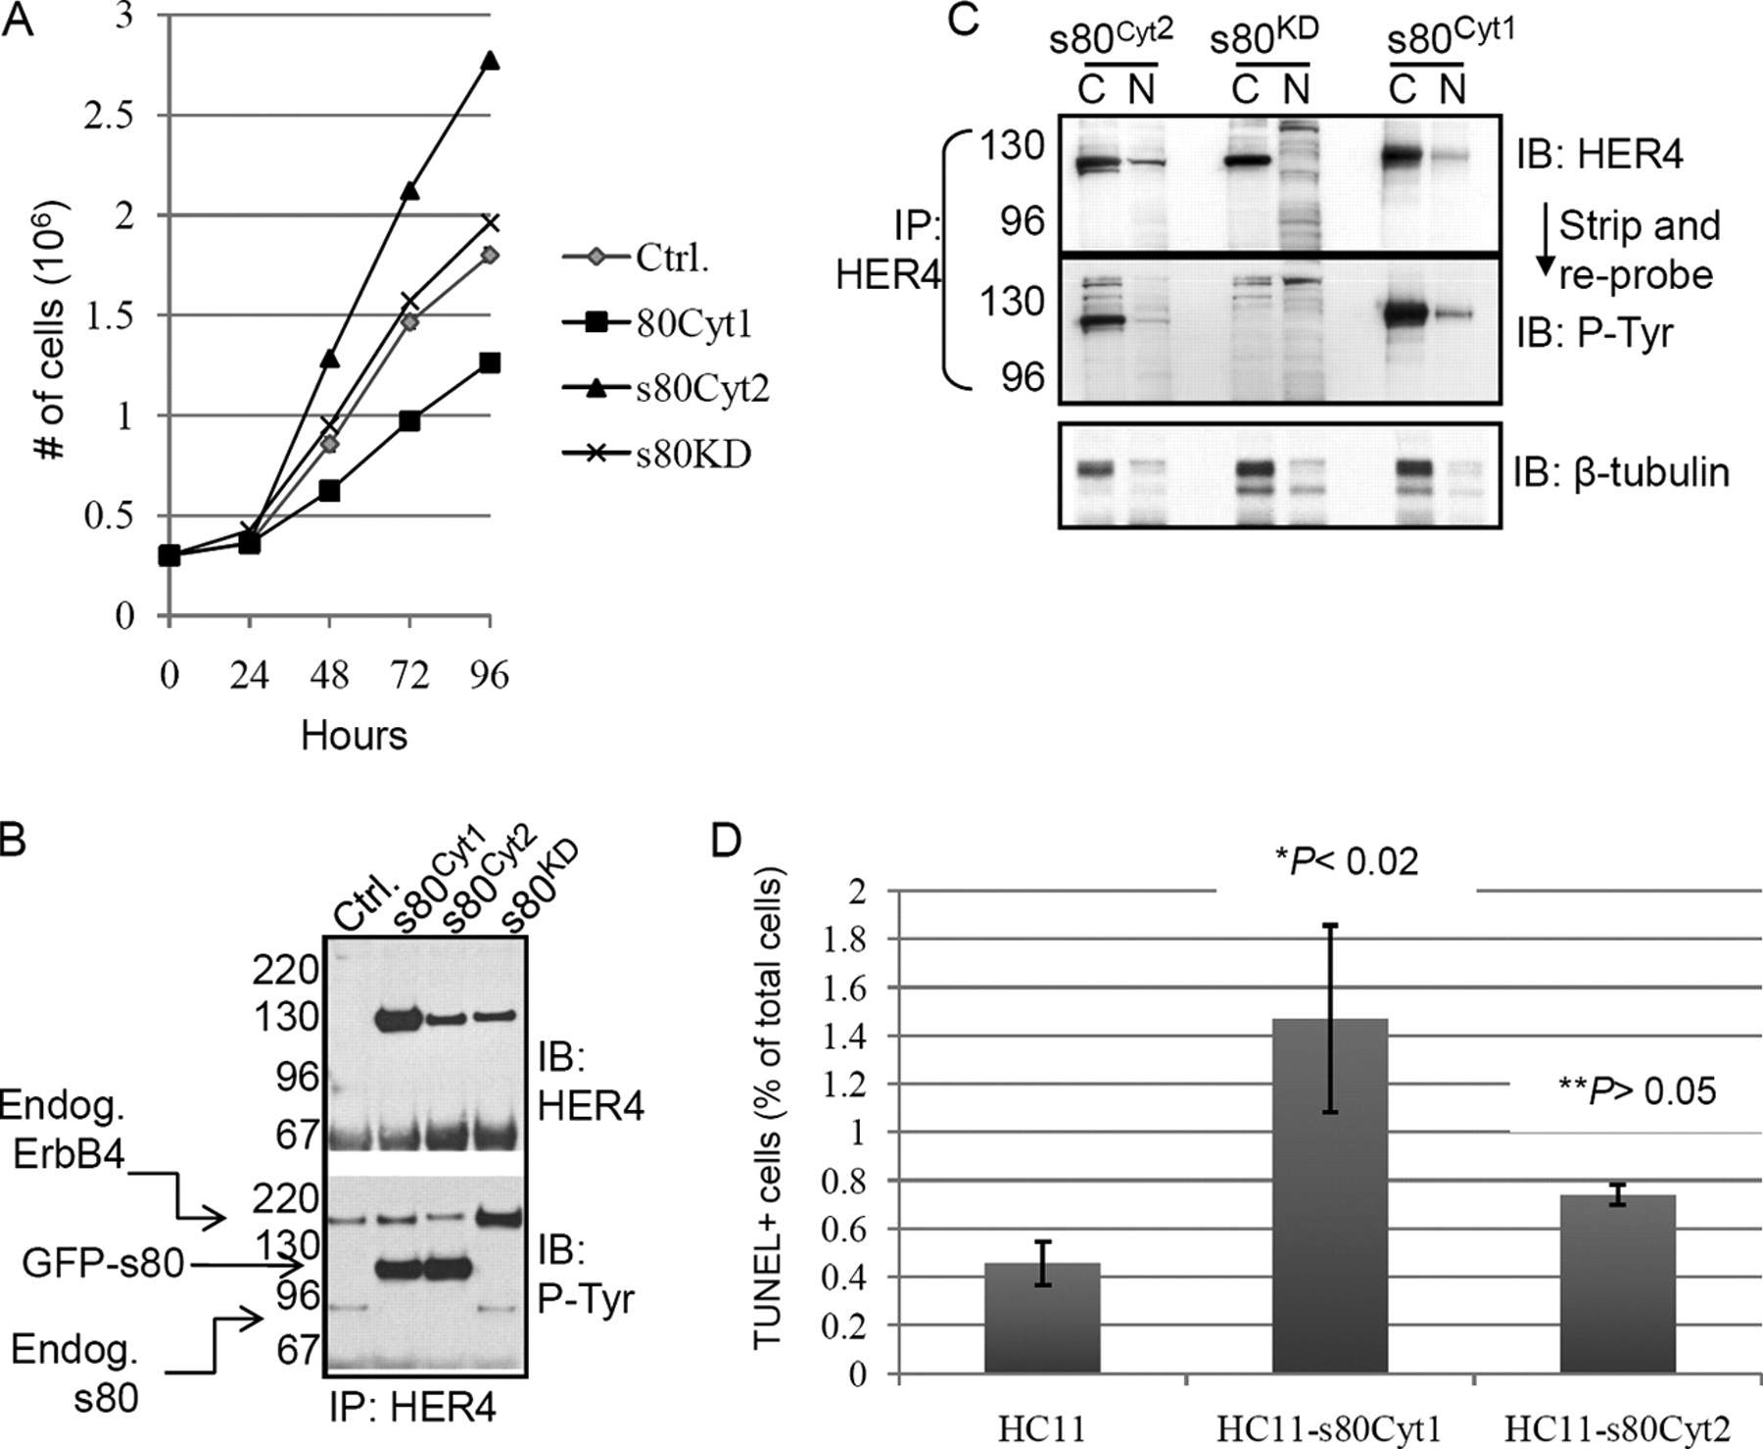
Alternate transcription
multiple mRNA transcript “isoforms” within one gene
  proteins with different functions may be produced
  e.g. skipped exon in CYT-2 isoform of ERBB4 leads to increased cell proliferation
CYT-2: deletes 16 amino acids
(WW domain binding motif)
Muraoka-Cook et al. (2009) Mol Cell Biol
Notes:
Two different isoforms Cyt-1 and Cyt-2. How to read the transcript structure from UCSC genome browswer. CYT-2 deletes a sequence that in the protein expressed by Cyt-1 ends up binding a WW domain which inhibits cell proliferation. Consequently the Cyt-2 variant leads to increased cell proliferation.

Slide 6
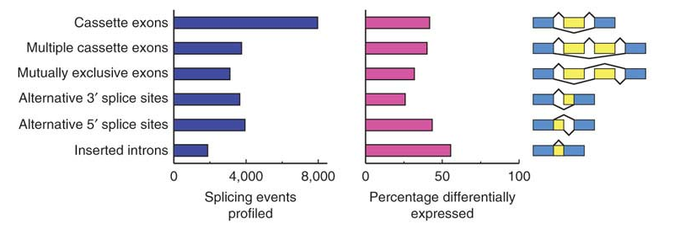
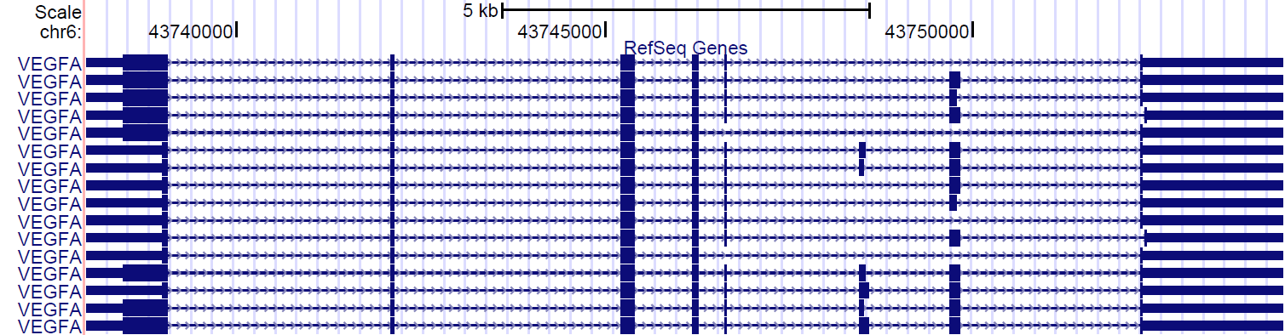
Forms of alternative splicing
Castle et al. (2008) Nature Genetics
Gene VEGFA combines multiple alternative splicing forms (not independently!) ….
2
2
3
3
2
Notes:
multiple forms of alternative splicing combined in VEGFA, and not in an independent way! (16 identified transcript isoforms and 72 combinations)

Slide 7
How to measure the transcriptome?
Ideally, given a sample of RNA
  which transcripts are present?
  how much of each?
Given two samples of RNA
  which transcripts are differentially expressed?
Notes:
This is a transcript-centric view, but in the end when we say a gene is highly expressed, we really need to know which transcripts in the gene are highly expressed.

Slide 8
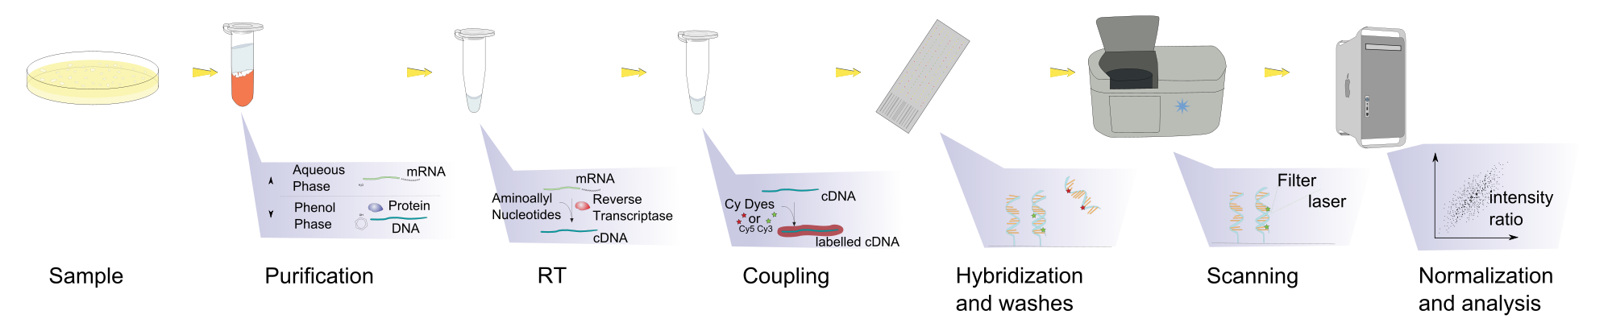
Microarrays
Most common technique for measuring transcriptome
  hybridized probes detect the presence and abundance of specific known transcripts
    difficult to observe different
    transcript isoforms
    abundance has limited
    dynamic range
Notes:
Microarrays represent most recent incarnation of a long evolution of techniques. mRNA -> cDNA labeled with fluorescent molecule, hybridize with probes, scan for amount of fluorescence. Difficult or expensive to design probes to detect many similar isoforms, and low abundance is a show stopper.

Slide 9
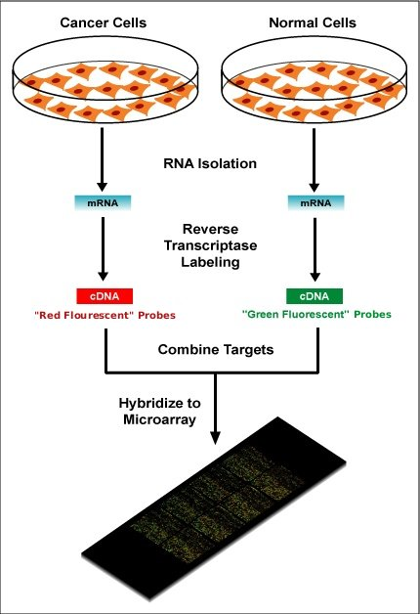
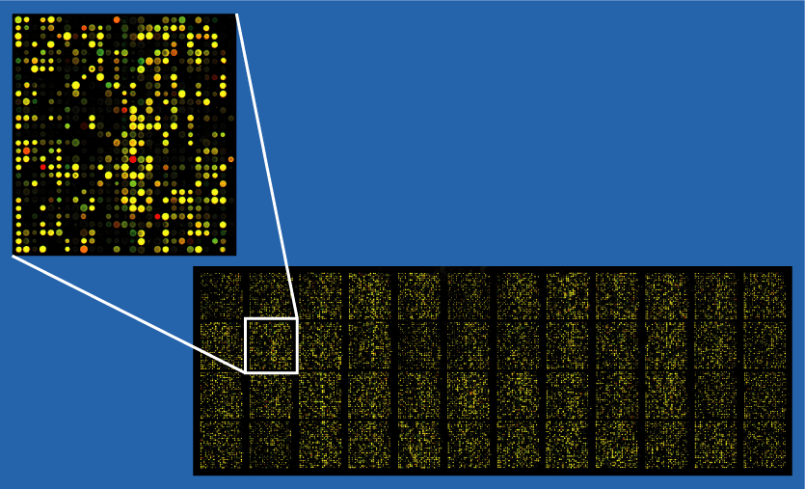
Differential gene expression
Identify transcriptome differences between two samples
Notes:
Really best for gross expression differences between genes, not good for detailed analysis of transcript isoforms

Slide 10
Outline
What is the transcriptome
Measuring the transcriptome
Sampling the transcriptome using short reads
Alignment of reads to a reference genome
Splice graph representation of RNA-seq data
Reconstructing the transcriptome
Differential analysis of the transcriptome

Slide 11
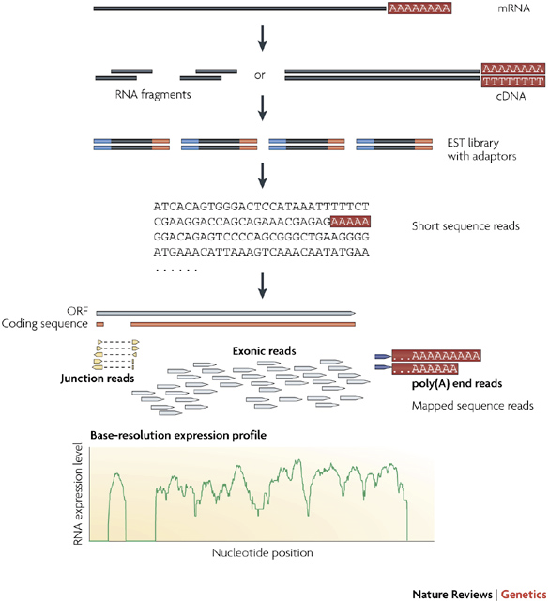
The RNA-seq protocol
Protocol
  mRNA is reverse transcribed to cDNA
  cDNA is randomly fragmented
  adapters are added to the fragments
  fragments are sequenced using HT sequencing technology
    e.g. Illumina: up to a billion 100bp reads sequenced in a single run
Each sequence is a randomly sampled fragment of the transcriptome
  identity determined by
  alignment to a transcript
  library or to a reference
  genome
  the number of alignments to
  a genomic locus is a measure of
  abundance
Nature Review | Genetics
Notes:
mRNAs are first converted into a library of cDNA fragments through either RNA fragmentation or DNA fragmentation. Sequencing adaptors (blue) are subsequently added to each cDNA fragment and a short sequence is obtained from each cDNA using high-throughput sequencing technology. The resulting sequence reads are aligned with the reference genome or transcriptome, and classified as three types: exonic reads, junction reads and poly(A) end-reads. These three types are used to generate a base-resolution expression profile for each gene, as illustrated at the bottom; a yeast ORF with one intron is shown.

Slide 12
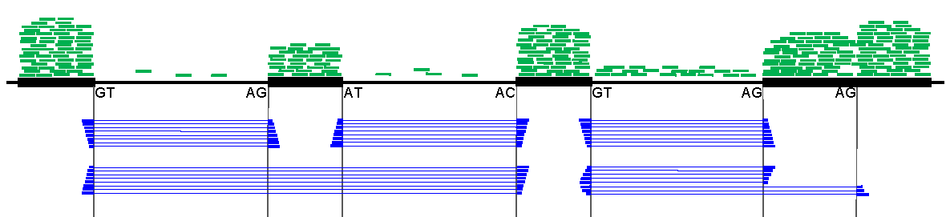
RNA-seq view of transcriptome
Issues
  non-random fragmentation
  sequencing bias
  DNA or pre-mRNA contamination
Spliced alignments
  not a problem if aligning to a transcript library
  challenging if aligning to the genome
Notes:
green – exonic alignments, blue – gapped alignments == spliced alignment. This view implicates a skipped exon, and an alternative 3’ splice site or possibly, and possibly a retained intron. However there are many reasons why we might not see these events so clearly.

Slide 13
Outline
What is the transcriptome
Measuring the transcriptome
Sampling the transcriptome using short reads
Alignment of reads to a reference genome
Splice graph representation of RNA-seq data
Reconstructing the transcriptome
Differential analysis of the transcriptome

Slide 14
Spliced alignment strategies
Annotation based discovery
  contiguous alignment of reads to existing EST/cDNA sequences with known splice junctions
  contiguous alignment of reads to paired exons from database of known or suspected junctions (Mortazavi et al. 2008, Wang et al. 2008)
Ab initio discovery by alignment to reference genome
  QPalma (Bona et al. 2008)
    supervised splice site prediction and gapped alignment algorithm for aligning spliced reads
  TopHat (Trapnell et al. 2009)
    detect potential junctions based on structural features of introns, e.g. GT – AG dinucleotide sequences flanking the exons
    test alignment of reads to candidate exon pairs

Slide 15
Improved splice detection
Issues
  Can not easily find non-canonical splices or long-range splices
  Single long reads may include multiple splice junctions
  Spurious alignment is a serious problem
MapSplice: a second generation ab initio method
  alignment of reads
    does not depend on any structural features
    finds multiple candidate alignments
  splice inference
    leverages the quality and diversity of read alignments to disambiguate true junctions from spurious junctions
  efficient and scalable

Slide 16

Finding spliced alignments
t₁
t₂
t₃
t₄
mRNA tag T
k
j₁
k
j₂
h
Genome
exon 1
exon 2
exon 3
Example: 100 bp tag T is split into 25bp segments
  segments are tested for (approximate) alignment to the genome
  unaligned segments implicate splices
  find splices by searching from neighboring aligned segments
    Theorem: if no exon is shorter than 2k, then at least one segment must align in every pair of consecutive length k segments.
Notes:
Hatched areas can be aligned to genome using fast approximate aligner (BWA or bowtie). At 25bp and modest error tolerance we do not get too many spurious alignments, but we do get multiple alignments to homologous genes, repeats, low complexity regions, etc. Theorem about exon short exon detection.

Slide 17
MapSplice algorithm (1)
INPUTS
set of RNA-Seq reads
T₁
…
T₂
Reference genome
T_{i}
(1) Segmentation
of reads
t₁
t₂
t_{j}
t_{n}
T_{i}
…
…
(2) Segment exonic alignment
(3) Segment spliced alignment
t_{j}
t_{j+1}
t_{j+2}
Contiguous
5’
3’
5’
t_{j}
t_{j+1}
3’
Missed alignment
double anchored
? t_{j+1}
? t_{j+1}
t_{j}
t_{j+2}
t_{j}
t_{j+2}
5’
3’
? t_{j+1}
Missed alignment
single anchored
t_{j}
? t_{j+1}
t_{j}
s_{(j+1)}

Slide 18
MapSplice algorithm (2)
(4) Segment assembly
t₁
t₂
t_{j}
t_{j+1}
t_{n-1}
t_{n}
…
…
5’
3’
T_{i}
…
…
(5) Junction inference
Alignment quality
Anchor significance
Entropy
T_{i2}
T_{i}
T_{i}
T_{i3}
T_{i4}
5’
High Confidence
Low confidence
3’
(6) Identify best alignment for tags
OUTPUTS:
Splices and splice coverage
Read alignments
T_{i}
5’
3’

Slide 19
Validating the algorithm
How can we tell if it is working well?
  comparison against transcriptome library alignment
  but how do we know that novel alignments are valid?
    run on synthetic transcriptome for which we know ground truth!
unaligned 10.2%
BWA
MPS
identically
aligned
80.4%
BWA
aligned
only
1.2%
MapSplice
aligned
only
5.0% /6.8%
by both
81.4%
Notes:
Transcriptome match picks one at random. We check that we have the same one among our list of top alignments.

Slide 20
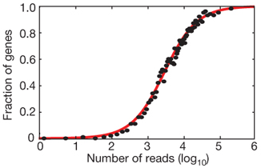
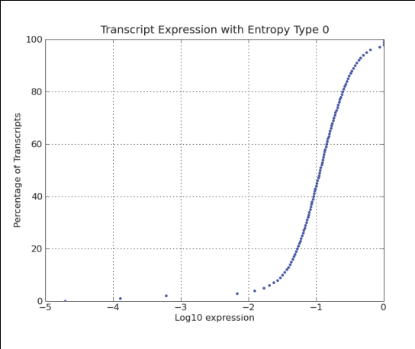
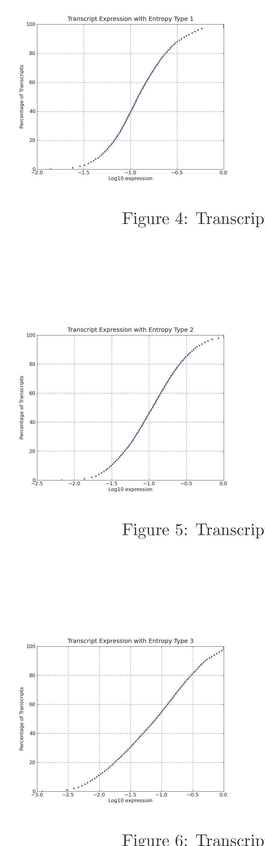
Synthetic Transcriptome
Sample each gene’s ABUNDANCE from Wang et al. (2008)
Choose a DISTRIBUTION across annotated transcript isoforms in RefSeq
Randomly pick the START position for each read (& introduce errors)
Align reads with MapSplice and analyze performance.
Notes:
According to an empirical study in Chris Burge’s lab

Slide 21
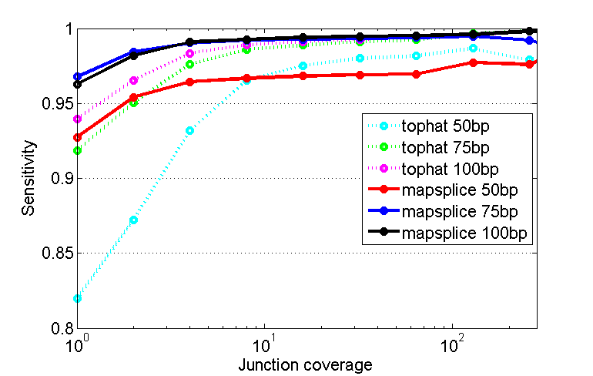
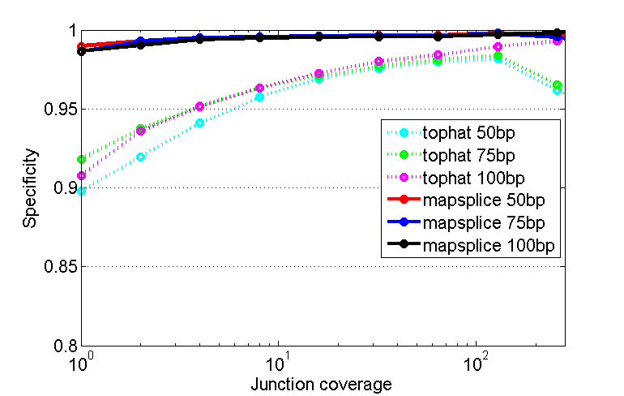
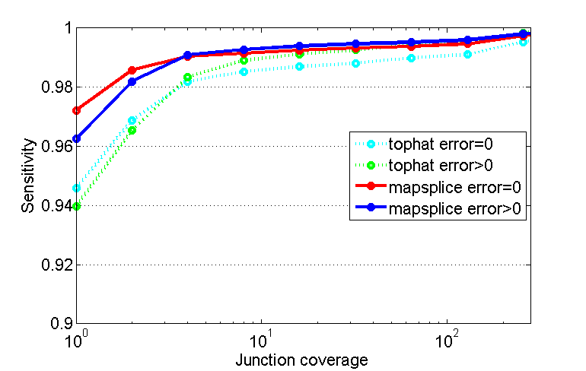
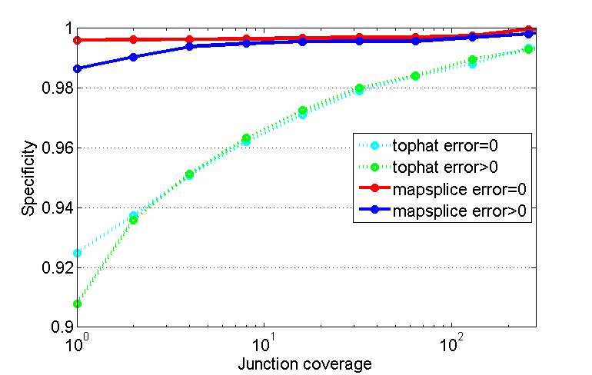
MapSplice performance
Notes:
Performance as a function of read length
Performance when tolerating alignment errors

Slide 22
Improved accuracy from multiple criteria in junction classification

Slide 23
Outline
What is the transcriptome
Measuring the transcriptome
Sampling the transcriptome using short reads
Alignment of reads to a reference genome
Splice graph representation of RNA-seq data
Reconstructing the transcriptome
Differential analysis of the transcriptome

Slide 24
Transcriptome changes in response to time, disease, etc
Characteristics of a transcriptome
  Qualitatively, which transcripts are expressed
  Quantitatively, what are their expression levels
Splicing Ratio
1
2
3
4
Transcript Abundance
1
2
3
4
1
3
4
transcript α
transcript β
Protein Expression
Protein α
Protein β

Slide 25
Transcriptome changes in response to time, disease, etc
Differential Splicing: alternative splicing events that exhibit significantly different splicing ratios between different samples
Normal
Tumor
Splicing Ratio
Differential Splicing
1
2
3
4
1
2
3
4
Transcript Abundance
1
2
3
4
1
3
4
1
2
3
4
1
3
4
transcript α
transcript β
transcript α
transcript β
Protein Expression
Protein α
Protein β
Protein α
Protein β

Slide 26
Differential Splicing: why important?
  Understanding of cell differentiation and development
  Identification of disease biomarkers
Normal
Tumor
Splicing Ratio
Differential Splicing
1
2
3
4
1
2
3
4
Transcript Abundance
1
2
3
4
1
3
4
1
2
3
4
1
3
4
transcript α
transcript β
transcript α
transcript β
Protein Expression
Protein α
Protein β
Protein α
Protein β

Slide 27
DiffSplice – Unified Graph Representation
RNA-seq read alignment
5’
Reference genome
3’
A1
Observed read coverage
Group A
A2
B1
Group B
B2
J1
J2
J4
Splice structure
E1
E2
E3
E4
E5
J3
J5
Unify structural information (exons and junctions) from all samples

Slide 28
DiffSplice – Unified Graph Representation
J1
J2
J4
E1
E2
E3
E4
E5
Splice structure
J3
J5
J1
J2
J4
Unified Expression-weighted Splice Graph (ESG)
TS
E1
E2
E3
E4
E5
TE
J3
J5
Differentiate samples by the weights
Weighted DAG (Directed Acyclic Graph)
Vertex – Exonic segment
Edge – Splice junction
Weight – Expression level
E1
J1
E2
A1
94.9
91
95.2
Group A
A2
83.7
84
88.1
B1
56.1
57
55.7
Group B
B2
62.2
64
65.6

Slide 29
DiffSplice – Alternative Splicing Modules (ASMs)
J1
J2
J4
ESG
TS
E1
E2
E3
E4
E5
TE
J3
J5
ASM
immed. pre-dominator
immed. pre-dominator
E1
E3
E3
TE
immed. post-dominator
immed. post-dominator
ASM1
J1
J2
ASM2
J4
E1
E2
E3
E3
E4
E5
TE
source
sink
source
sink
J3
J5

Slide 30
DiffSplice – Alternative Splicing Modules (ASMs)
J1
J2
J4
ESG
Level 0
TS
E1
E2
E3
E4
E5
TE
J3
J5
ASM1
ASM2
ASM
path 1
path 1
ASM1
J1
J2
ASM2
J4
Level 1
E1
E2
E3
E3
E4
E5
TE
source
sink
source
sink
J3
J5
path 2
path 2

Slide 31
DiffSplice – Isoform Abundance Estimation
ASM1 in sample A1
path 1
N, q
J1
91
J2
93
Poisson dist’n
observed expression
E1
E2
E3
T₁
T₂
92.1
Normal dist’n
94.9
95.2
J3
3
w(E1)
w(E2)
w(E3)
w(J1)
w(J2)
w(J3)
path 2
path 1
estimated expression
J1
J2
?
(?%)
E1
E2
E3
J3
?
(?%)
path 2

Slide 32
DiffSplice – Isoform Abundance Estimation
ASM1 in sample A1
path 1
J1
91
J2
93
observed expression
E1
E2
92.1
E3
94.9
95.2
J3
3
path 2
path 1
alternative path proportion
estimated expression
J1
J2
92.0
(96.7%)
96.7%
3.3%
E1
E2
E3
estimated expression of ASM1
J3
3.1
(3.3%)
95.1
path 2

