Slide 1
TOX 680: Bioinformatics I
April 29
Jinze Liu

Slide 2
Outline
The past, present, and future of DNA sequencing.
Two Bioinformatics problems
DNA assembly
Mutation calling

Slide 3
DNA sequencing:
Determining the number and order of nucleotides that make up a given molecule of DNA.
Credit to Dan Russell

Slide 4
(Relevant) Trivia
How many base pairs (bp) are there in a human genome?
How much did it cost to sequence the first human genome?
How long did it take to sequence the first human genome?
When was the first human genome sequence complete?
Whose genome was it?

Slide 5
(Relevant) Trivia
How many base pairs (bp) are there in a human genome?
How much did it cost to sequence the first human genome?
How long did it take to sequence the first human genome?
When was the first human genome sequence complete?
Whose genome was it?
~3 billion (haploid)
~$2.7 billion
~13 years
2000-2003
Several people’s, but actually mostly a dude from Buffalo

Slide 6
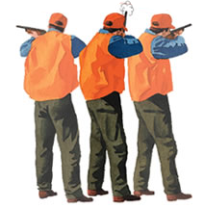
Shotgun Genome Sequencing
Complete genome copies
Fragmented genome chunks

Slide 7
Shotgun Genome Sequencing
Fragmented genome chunks
NOT REALLY DONE BY DUCK HUNTERS
Hydroshearing, sonication, enzymatic shearing
Notes:
Fragment sizes differ for different seq platforms.

Slide 8
Sequencing Technology Overview
The Past: Sanger
The Present: Next-Gen (Illumina, Ion Torrent, PacBio)
The Future: ? (Nanopore, MinION, Single-molecule)

Slide 9
Comparing Different Technologies
Sanger Sequencing
Advantages | Disadvantages
Lowest error rate Long read length (~750 bp) Can target a primer | High cost per base Long time to generate data Need for cloning Amount of data per run

Slide 10
Comparing Different Technologies
454 Sequencing
Advantages | Disadvantages
Low error rate Medium read length (~400-600 bp) | Relatively high cost per base Must run at large scale Medium/high startup costs

Slide 11
Comparing Different Technologies
Ion Torrent Sequencing
Advantages | Disadvantages
Low startup costs Scalable (10 – 1000 Mb of data per run) Medium/low cost per base Low error rate Fast runs (<3 hours) | New, developing technology Cost not as low as Illumina Read lengths only ~100-200 bp so far

Slide 12
Comparing Different Technologies
Illumina Sequencing
Advantages | Disadvantages
Low error rate Lowest cost per base Tons of data | Must run at very large scale Short read length (50-75 bp) Runs take multiple days High startup costs De Novo assembly difficult

Slide 13
Comparing Different Technologies
PacBio Sequencing
Advantages | Disadvantages
Can use single molecule as template Potential for very long reads (several kb+) | High error rate (~10-15%) Medium/high cost per base High startup costs

Slide 14
Method | Read Length
Sanger
454
Illumina
Ion Torrent

Slide 15
Method | Read Length
Sanger | 600-1000 bp
454
Illumina
Ion Torrent

Slide 16
Method | Read Length
Sanger | 600-1000 bp
454 | 300-500 bp
Illumina
Ion Torrent

Slide 17
Method | Read Length
Sanger | 600-1000 bp
454 | 300-500 bp
Illumina | ~100 bp
Ion Torrent

Slide 18
Method | Read Length
Sanger | 600-1000 bp
454 | 300-500 bp
Illumina | ~100 bp
Ion Torrent | ~200 bp
But…
Phage Genome: 30,000 to 500,000 bp
Bacteria: Several million bp
Human: 3 billion bp

Slide 19
All the King’s horses and all the King’s men…
Assembly, aka
17 bp
ATTGTTCCCACAGACCG
CGGCGAAGCATTGTTCC
ACCGTGTTTTCCGACCG
AGCTCGATGCCGGCGAAG
TTGTTCCCACAGACCGTG
TTTCCGACCGAAATGGC
ATGCCGGCGAAGCATTGT
ACAGACCGTGTTTCCCGA
TAATGCGACCTCGATGCC
AAGCATTGTTCCCACAG
TGTTTTCCGACCGAAAT
TGCCGGCGAAGCCTTGT
CCGACCGAAATGGCTCC
66 bp

Slide 20
Assembly
Consensus:
TAATGCGACCTCGATGCCGGCGAAGCATTGTTCCCACAGACCGTGTTTTCCGACCGAAATGGCTCC
ATTGTTCCCACAGACCG
CGGCGAAGCATTGTTCC
ACCGTGTTTTCCGACCG
AGCTCGATGCCGGCGAAG
TTGTTCCCACAGACCGTG
TTTCCGACCGAAATGGC
ATGCCGGCGAAGCATTGT
ACAGACCGTGTTTCCCGA
TAATGCGACCTCGATGCC
AAGCATTGTTCCCACAG
TGTTTTCCGACCGAAAT
TGCCGGCGAAGCCTTGT
CCGACCGAAATGGCTCC

Slide 21
Assembly
Consensus:
TAATGCGACCTCGATGCCGGCGAAGCATTGTTCCCACAGACCGTGTTTTCCGACCGAAATGGCTCC
ATTGTTCCCACAGACCG
CGGCGAAGCATTGTTCC
ACCGTGTTTTCCGACCG
AGCTCGATGCCGGCGAAG
TTGTTCCCACAGACCGTG
TTTCCGACCGAAATGGC
ATGCCGGCGAAGCATTGT
ACAGACCGTGTTTCCCGA
TAATGCGACCTCGATGCC
AAGCATTGTTCCCACAG
TGTTTTCCGACCGAAAT
TGCCGGCGAAGCCTTGT
CCGACCGAAATGGCTCC
Coverage: # of reads underlying the consensus

Slide 22
Assembly
Consensus:
TAATGCGACCTCGATGCCGGCGAAGCATTGTTCCCACAGACCGTGTTTTCCGACCGAAATGGCTCC
ATTGTTCCCACAGACCG
CGGCGAAGCATTGTTCC
ACCGTGTTTTCCGACCG
AGCTCGATGCCGGCGAAG
TTGTTCCCACAGACCGTG
TTTCCGACCGAAATGGC
ATGCCGGCGAAGCATTGT
ACAGACCGTGTTTCCCGA
TAATGCGACCTCGATGCC
AAGCATTGTTCCCACAG
TGTTTTCCGACCGAAAT
TGCCGGCGAAGCCTTGT
CCGACCGAAATGGCTCC
6x coverage
100% identity
Coverage: # of reads underlying the consensus

Slide 23
Assembly
Consensus:
TAATGCGACCTCGATGCCGGCGAAGCATTGTTCCCACAGACCGTGTTTTCCGACCGAAATGGCTCC
ATTGTTCCCACAGACCG
CGGCGAAGCATTGTTCC
ACCGTGTTTTCCGACCG
AGCTCGATGCCGGCGAAG
TTGTTCCCACAGACCGTG
TTTCCGACCGAAATGGC
ATGCCGGCGAAGCATTGT
ACAGACCGTGTTTCCCGA
TAATGCGACCTCGATGCC
AAGCATTGTTCCCACAG
TGTTTTCCGACCGAAAT
TGCCGGCGAAGCCTTGT
CCGACCGAAATGGCTCC
5x coverage
80% identity
Coverage: # of reads underlying the consensus

Slide 24
Assembly
Consensus:
TAATGCGACCTCGATGCCGGCGAAGCATTGTTCCCACAGACCGTGTTTTCCGACCGAAATGGCTCC
ATTGTTCCCACAGACCG
CGGCGAAGCATTGTTCC
ACCGTGTTTTCCGACCG
AGCTCGATGCCGGCGAAG
TTGTTCCCACAGACCGTG
TTTCCGACCGAAATGGC
ATGCCGGCGAAGCATTGT
ACAGACCGTGTTTCCCGA
TAATGCGACCTCGATGCC
AAGCATTGTTCCCACAG
TGTTTTCCGACCGAAAT
TGCCGGCGAAGCCTTGT
CCGACCGAAATGGCTCC
2x coverage
50% identity
Coverage: # of reads underlying the consensus

Slide 25
Assembly
Consensus:
TAATGCGACCTCGATGCCGGCGAAGCATTGTTCCCACAGACCGTGTTTTCCGACCGAAATGGCTCC
ATTGTTCCCACAGACCG
CGGCGAAGCATTGTTCC
ACCGTGTTTTCCGACCG
AGCTCGATGCCGGCGAAG
TTGTTCCCACAGACCGTG
TTTCCGACCGAAATGGC
ATGCCGGCGAAGCATTGT
ACAGACCGTGTTTCCCGA
TAATGCGACCTCGATGCC
AAGCATTGTTCCCACAG
TGTTTTCCGACCGAAAT
TGCCGGCGAAGCCTTGT
CCGACCGAAATGGCTCC
1x coverage
Coverage: # of reads underlying the consensus

Slide 26
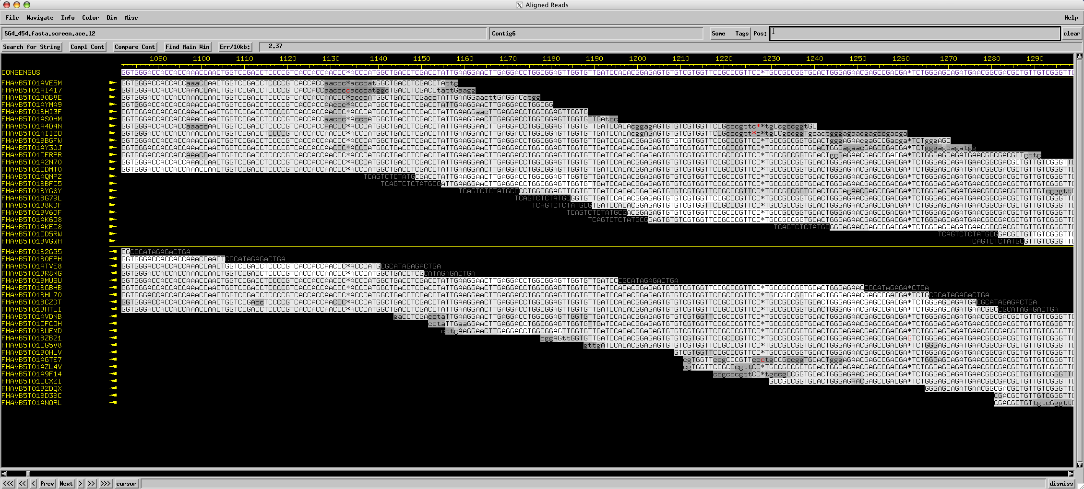
Assembly

Slide 27
What is a WGS sequence assembly?
WGS assembly is the reconstruction of sequence up to chromosome length, through over-sampling such that reads overlap.
Groups reads into contigs, and contigs into scaffolds
Contigs document a multiple sequence alignment of reads into a contiguous consensus
Scaffolds are gapped sequences composed of ordered and oriented contigs with inferred gaps indicated as indeterminate bases (N’s)
Notes:
a

Slide 28
Confounding factors for NGS WGS assembly
Assembly of NGS reads is generally limited by the fact that read lengths are much shorter than even the smallest genome. Random oversampling of the target tries to overcome this limitation however…
All current NGS technologies are intrinsically error prone hence imperfect alignments are tolerated in assembly algorithms, but…
Target genomes are generally full of subtly divergent repetitive content of diverse nature, generally of a length longer than NGS read lengths, it is not easy to always know what is sequencing error versus a sequence variant

Slide 29
Opportunity cost of sequencing errors…
Software must tolerate imperfect sequence alignments to avoid missing true joins, however, this error tolerance may introduce false-positive joins of reads that induce chimeric assemblies

Slide 30
Opportunity cost of sequencing errors
In practice, tolerance for sequencing error makes it difficult to resolve a wide range of genomic variation:
Polymorphic repeats
Polymorphic differences between non-clonal asexual individuals
Polymorphic differences between non-inbred sexual individuals
Polymorphic haplotypes from one non-inbred individual

Slide 31
Other Limitations in Assemblies
Assembly is also confounded by non-uniform coverage of the target
Cellular copy number variation in source molecules.
Remember too that this kind of variation may have intrinsic scientific interest: e.g. estimation of gene expression via NGS transcriptome assembly (RNA-Seq)
Compositional biases of sequencing technology (e.g. paucity of representation of AT rich and/or GC rich fragments in NGS templates)

Slide 32
NGS Contig & Scaffold Assembly
Strive for proper experimental design for libraries (e.g. sample quality, mate pair insert sizes, etc.)
Transfer raw read data into analysis environment (it may be a non-trivial task to load the enormous raw read files into the computer for the analysis)
Perform bulk statistical analysis of raw read data to ascertain overall dataset quality
Filter out and trim reads based on low quality thresholds
Select a k-mer size
Perform assembly based on selected k-mer size (and perhaps, mate pair library insert size).
Measure quality of assembly. Iterate on other k-mer sizes to improve quality. Use multiple assembly programs and compare results.

Slide 33
Measuring the quality of an assembly
The most common (and crude) metric of assembly “quality” is N50, which is a weighted median of lengths of items equal to the length of the longest item i such that the sum of the lengths of items greater than or equal in length to i is greater than or equal to half of the length of all of the items.
The items in question are generally specified: either the contigs or scaffolds of the assembly.
A number of additional metrics have now been developed by the bioinformatics community*.
(*) Earl DA et al. 2011 Assemblathon 1: A competitive assessment of de novo short read assembly methods. http://genome.cshlp.org/content/early/2011/09/16/gr.126599.111

Slide 34
Two Classes of Assembly
Map-based WGS assembly refers to reconstruction of the underlying sequence facilitated by alignments to a previously resolved reference sequences.
de novo WGS assembly refers to reconstruction of the underlying sequence without a previously resolved reference sequence.

Slide 35
Map-Based Assembly

Slide 36
Map alignment assembly of short reads
Strategy: index the reference genome sequence and search it efficiently
For this purpose, map-alignment sequence assembly approaches generally use a computing strategy called Burrows–Wheeler indexing to notablyreduce compute time and memory usage, see http://bio-bwa.sourceforge.net
MAQ – Mapping and Assembly with Quality Heng Li, Sanger Centre http://maq.sourceforge.net/maq-man.shtml
Bowtie - An ultrafast memory-efficient short read aligner Ben Langmead and Cole Trapnell, University of Maryland http://bowtie-bio.sourceforge.net/
SOAPAligner from SOAP (Short Oligonucleotide Analysis Package) http://soap.genomics.org.cn/soapaligner.html

Slide 37
de novo Assemblies

Slide 38
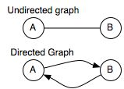
Graph Theory
The mathematical concept(*) of a graph is a topographical data abstraction which is a set of nodes (vertices) are connected by a set of edges (arcs).
Nodes are some object in a collection and edges are their relationships
This is a widely used data structure in computing science, used to represent many diverse computational problems (and used in many computing algorithms)
(*) First defined by the great mathematician Leonhard Euler in 1735, as a tool to solve the 'Bridges of Königsberg problem’. See http://en.wikipedia.org/wiki/Graph_theory

Slide 39
What is a k-mer?
For efficiency, all NGS assembly software relies to some extent on the notion of a k-mer.
A k-mer is a contiguous sequence of k base calls, where k is any positive integer.
Intuitively, sequence reads with high similarity must share k-mers in their overlapping regions
Fast detection (by indexing) of shared k-mer content is computationally far less expensive than “all-against-all” sequence alignment detection of variable length sequence overlaps.

Slide 40
de Bruijn Graphs of k-mer
de Bruijn graphs were developed outside of the field of sequence assembly as a data representation for arbitrary strings spanning a finite alphabet.
The nodes of a de Bruijn graph represent all possible fixed length strings. The edges represent suffix-to-prefix perfect overlaps.
Graphs of all k-mers and their fixed length overlaps observed in a target nucleotide sequence (or a sequence sampling of that target), is a kind of de Bruijn graph
The primary advantage of de Bruijn graphs is that their size is generally delimited by the complexity of the underlying genome, not by the total number (“depth”) of reads
The primary disadvantage is that different sequences (i.e. reads) can theoretically resolve to identical de Bruijn graphs due to internal repeat content (cycles in the graph)
See: Compeau PEC, Pevzner PA and Tesler G. 2011. How to apply de Bruijn graphs to genome assembly. Nature Biotechnology 29, 987–991. doi:10.1038/nbt.2023

Slide 41
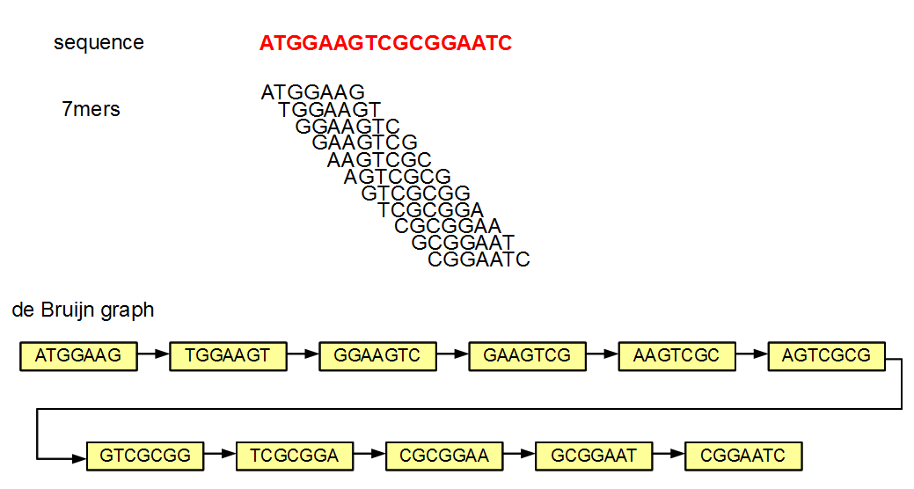
Example of a DNA Sequence de Bruijn Graph
From http://www.homolog.us/blogs/2011/07/28/de-bruijn-graphs-i/ accessed 30/4/2012

Slide 42
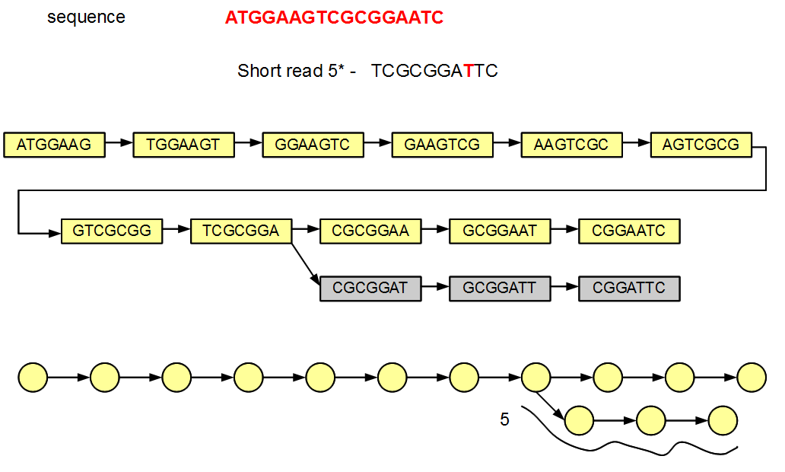
Sequencing Errors Generate Lightly Travelled Divergent Paths in de Bruijn graphs
Sequence assembly algorithms can prune such lightly travelled paths but reconstruct the genome from heavily traversed paths.

Slide 43
Repeat Content in Targets Add Graph Cycles

Slide 44
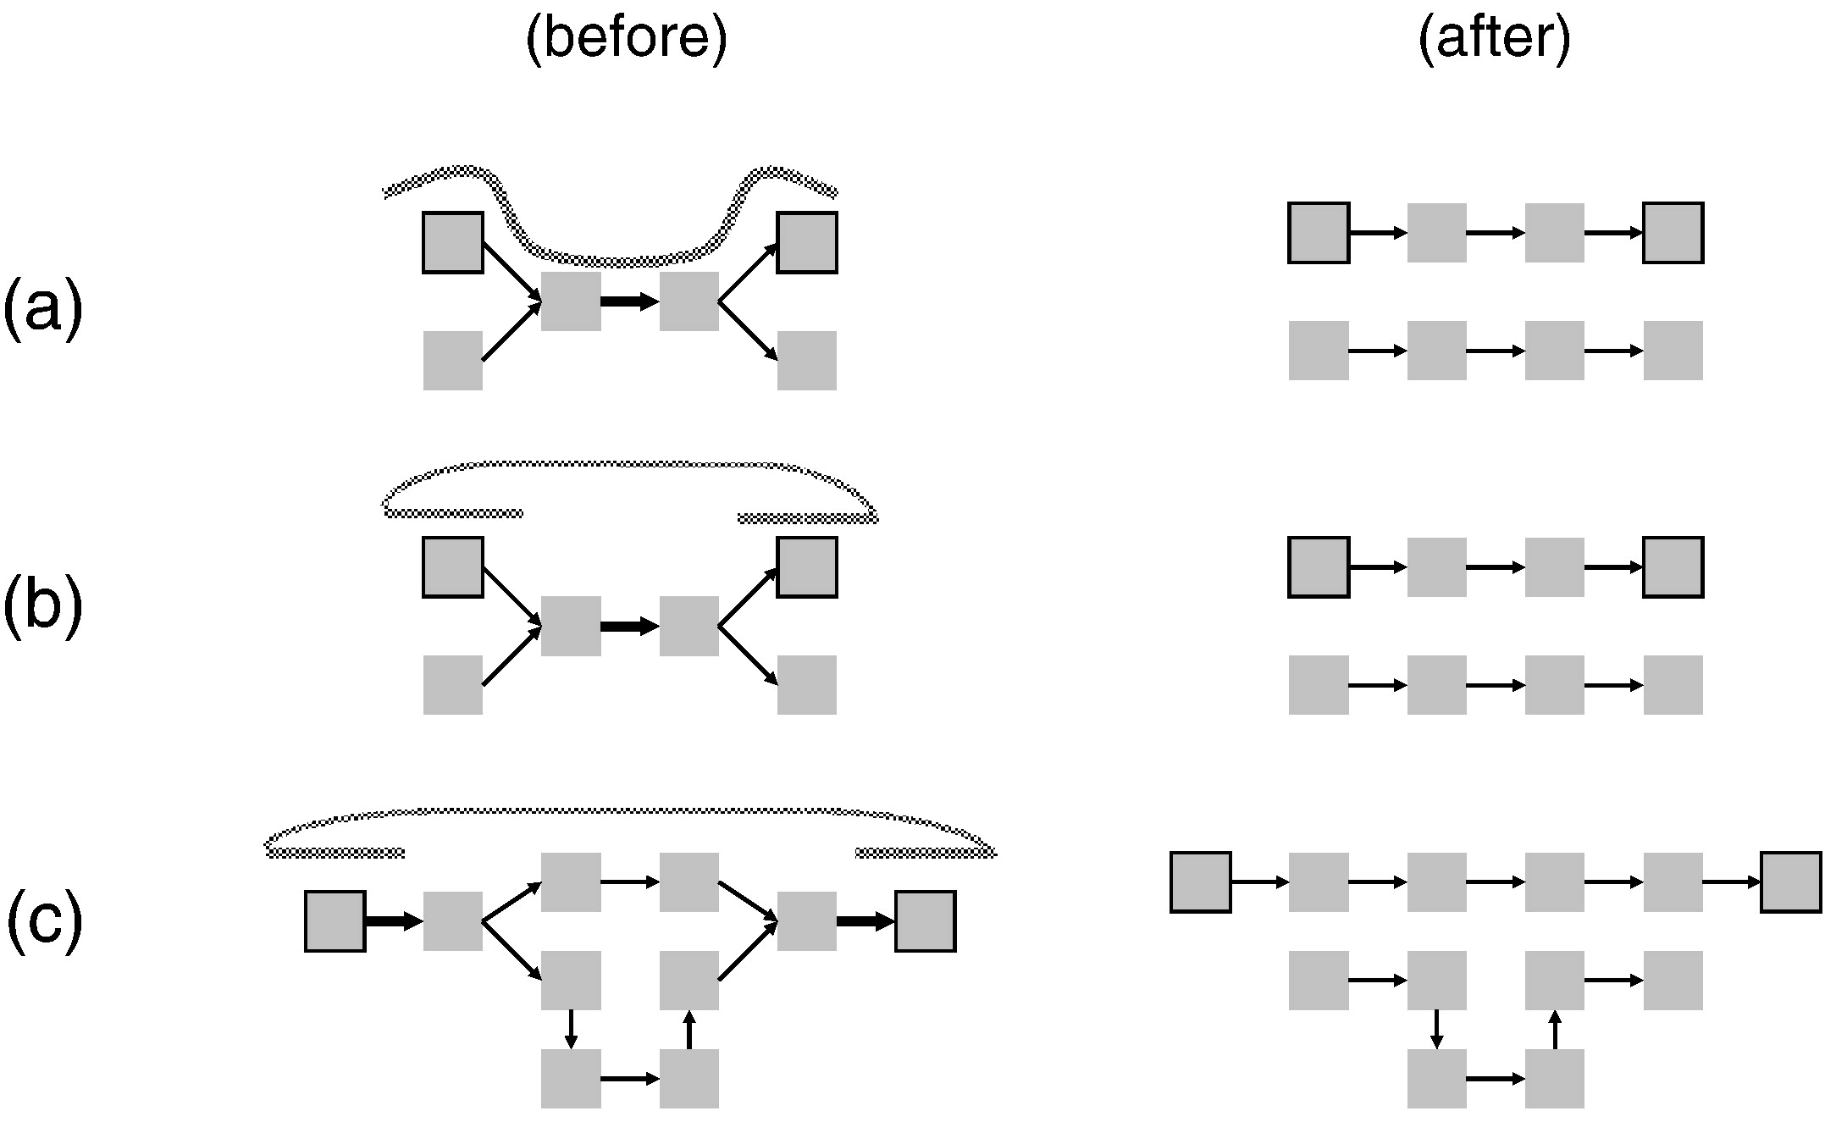
Spanning or Mate-Pair Reads Resolve Complexity

Slide 45
The Computational Challenge of Assembly
Sequencing generates enormous data sets with highly heterogeneous sequence reads. This is especially true of NGS.
This adds complexity to computation: graph processing algorithms are in the category of NP complete computing problems (=> really hard!) hence rely heavily on heuristics to solve (but still demand a significant number of CPU cycles)
de Bruijn graphs constructed to merge read data are inherently very large – due to the observed number of distinct k-mers in the target sequences - hence require significant computer memory to hold the constructed graph

Slide 46
De novo NGS WGS assembly of short reads
Velvet Daniel Zerbino and Ewan Birney, EMBL-EBI http://www.ebi.ac.uk/~zerbino/velvet/
ABySS Inanç Birol, Shaun Jackman, Steve Jones and others, GSC http://www.bcgsc.ca/platform/bioinfo/software/abyss
ALLPATHS-LG
Jaffe et al CRD, Broad Institute
http://www.broadinstitute.org/software/allpaths-lg/blog/
SOAPdenovo
Li et al. Beijing Genome Institute
http://soap.genomics.org.cn/soapdenovo.html
Additional software listed in the Earl DA et al. 2011. Assemblathon 1: A competitive assessment of de novo short read assembly methods. http://genome.cshlp.org/content/early/2011/09/16/gr.126599.111

Slide 47
Transcriptome Assembly has Additional Considerations
Transcripts from highly similar paralogous loci is another instance of the repetitive sequence problem
Alternate splicing also generates branching de Bruijn graphs
Catch-22:
Assembly efficacy biased by gene expression variation in the numbers of raw reads (i.e. especially for transcripts with low gene expression).
Gene expression estimates from NGS sequencing (“RNA-Seq”) confounded by NGS sequence technology compositional biases and the above graph resolution issues

Slide 49
Detection of Sequence Variants is a Challenge
Sequencing errors can masquerade as variation
Gene copy number polymorphism, segmental duplication, resolution of linkage haplotypes, etc. are special cases of the repeat duplication problem

Slide 50
Summary of DNA-sequencing
DNA sequencing is becoming vastly faster and more affordable
Generating data is no longer the bottleneck, understanding it is
Bioinformatics types should be in high demand in the near future

Slide 51
Why call variants?
TCGA Program Overview
“There are at least 200 forms of cancer, and many more subtypes. Each of these is caused by errors in DNA that cause cells to grow uncontrolled. Identifying the changes in each cancer’s complete set of DNA – its genome – and understanding how such changes interact to drive the disease will lay the foundation for improving cancer prevention, early detection and treatment.”

Slide 52
Types of Genetic Variation
Cancer is driven by genomic alterations like:
Single Nucleotide Aberrations
Single Nucleotide Polymorphisms (SNPs) - mutations shared amongst a population
Single Nucleotide Variations (SNVs) - private mutations
Short Insertions or Deletions (indels)
Copy Number Variations (CNVs)
Larger Structural Variations (SVs)

Slide 53
SNPs vs. SNVs
Both are aberrations at a single nucleotide
SNP
Aberration expected at the position for any member in the species (well-characterized)
Occur in population at some frequency so expected at a given locus
Validated in population
Catalogued in dbSNP (http://www.ncbi.nlm.nih.gov/snp)
SNV
Aberration seen in only one individual (not well characterized)
Occur at low frequency so not common
Not validated in population
Really a matter of frequency of occurrence

Slide 54
SNVs of interest
Non-synonymous mutations
Result in amino acid change
Impact protein sequence
Missense and nonsense mutations
Somatic mutations in cancer
Tumor-specific mutations

Slide 55
Catalogs of human genetic variation
The 1000 Genomes Project
http://www.1000genomes.org/
SNPs and structural variants
genomes of about 2500 unidentified people from about 25 populations around the world will be sequenced using NGS technologies
HapMap
http://hapmap.ncbi.nlm.nih.gov/
identify and catalog genetic similarities and differences
dbSNP
http://www.ncbi.nlm.nih.gov/snp/
Database of SNPs and multiple small-scale variations that include indels, microsatellites, and non-polymorphic variants
COSMIC
http://www.sanger.ac.uk/genetics/CGP/cosmic/
Catalog of Somatic Mutations in Cancer
TCGA
http://cancergenome.nih.gov/
The Cancer Genome Atlas researchers are mapping the genetic changes in 20 selected cancers

Slide 56
Challenges of accurate somatic variant calling
Not as simple as identifying sites with a variant allele in the tumor not present in the normal
Artifacts from PCR amplification or targeted (exome) capture
Machine sequencing errors
Incorrect local alignment of reads
Tumor heterogeneity
Tumor-normal cross-contamination

Slide 57
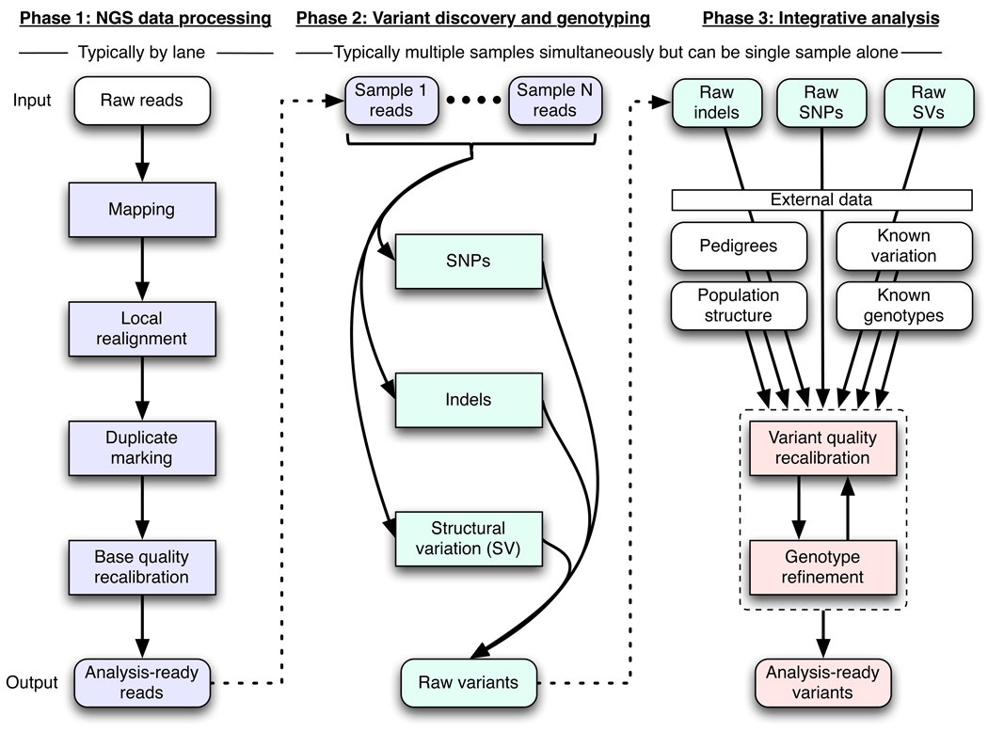
A framework for variation discovery
DePristo, M.A. et al. A framework for variation discovery and genotyping using next-generation DNA sequencing data. Nat Genet. 43(5):491-8. PMID: 21478889 (2011).

Slide 58
A framework for variation discovery
Phase 1: Mapping
Place reads with an initial alignment on the reference genome using mapping algorithms
Refine initial alignments
local realignment around indels
molecular duplicates are eliminated
Generate the technology-independent SAM/BAM alignment map format
Accurate mapping crucial for variation discovery
DePristo, M.A. et al. A framework for variation discovery and genotyping using next-generation DNA sequencing data. Nat Genet. 43(5):491-8. PMID: 21478889 (2011).

Slide 59
A framework for variation discovery
Phase 2: Discovery of raw variants
Analysis-ready SAM/BAM files are analyzed to discover all sites with statistical evidence for an alternate allele present among the samples
SNPs, SNVs, short indels, and SVs
SNVs
DePristo, M.A. et al. A framework for variation discovery and genotyping using next-generation DNA sequencing data. Nat Genet. 43(5):491-8. PMID: 21478889 (2011).

Slide 60
A framework for variation discovery
Phase 3: Discovery of analysis-ready variants
technical covariates, known sites of variation, genotypes for individuals, linkage disequilibrium, and family and population structure are integrated with the raw variant calls from Phase 2 to separate true polymorphic sites from machine artifacts
at these sites high-quality genotypes are determined for all samples
SNVs
DePristo, M.A. et al. A framework for variation discovery and genotyping using next-generation DNA sequencing data. Nat Genet. 43(5):491-8. PMID: 21478889 (2011).

Slide 61
SNV Filtering
Strand Bias
Pre-processing in the mapping phase and SNV filtering help minimize false positives
Absent in dbSNP
Exclude LOH events
Retain non-synonymous
Sufficient depth of read coverage
SNV present in given number of reads
High mapping and SNV quality
SNV density in a given bp window
SNV greater than a given bp from a predicted indel
Strand balance/bias
Concordance across various SNV callers
Bentley, D.R. et al. Accurate whole human genome sequencing using reversible terminator chemistry. Nature 456, 53–59 (2008).
Wheeler, D.A. et al. The complete genome of an individual by massively parallel DNA sequencing. Nature 452, 872–876 (2008).
Larson, D.E. et al. SomaticSniper: Identification of Somatic Point Mutations in Whole Genome Sequencing Data. Bioinformatics Advance Access (2011).

Slide 62
SomaticSniper: Standard somatic detection filter
Filter using SAMtools (Li, et al., 2009) calls from the tumor.
Sites are retained if they meet all of the following rules:
(1) Site is greater than 10bp from a predicted indel of quality ≥ 50
(2) Maximum mapping quality at the site is ≥ 40
(3) < 3 SNV calls in a 10 bp window around the site
(4) Site is covered by ≥ 3 reads
(5) Consensus quality ≥ 20
(6) SNP quality ≥ 20
SomaticSniper predictions passing the filters are then intersected with calls from dbSNP and sites matching both the position and allele of known dbSNPs are removed.
Sites where the normal genotype is heterozygous and the tumor genotype is homozygous and overlaps with the normal genotype are removed as probable loss of heterozygosity (LOH) events.
Li, H. et al. The Sequence alignment/map (SAM) format and SAMtools. Bioinformatics, 25, 2078-9 (2009).
Larson, D.E. et al. SomaticSniper: Identification of Somatic Point Mutations in Whole Genome Sequencing Data. Bioinformatics Advance Access (2011).

Slide 63
Variant calling methods
> 15 different algorithms
Three categories
Allele counting
Probabilistic methods, e.g. Bayesian model
to quantify statistical uncertainty
Assign priors based on observed allele frequency of multiple samples
Heuristic approach
Based on thresholds for read depth, base quality, variant allele frequency, statistical significance
SNP
variant
Ref
A
Ind1
G/G
Ind2
A/G
Nielsen R, Paul JS, Albrechtsen A, Song YS. Genotype and SNP calling from next-generation sequencing data. Nat Rev Genet. 2011 Jun;12(6):443-51. PMID: 21587300.
http://seqanswers.com/wiki/Software/list

Slide 64
Some variant callers
Name | Category | Tumor/Normal Pairs | Metric | Reference
JointSNVMix (Fisher) | Allele Counting | Yes | Somatic probability | Roth, A. et al. (2012)
SomaticSniper | Heuristic | Yes | Somatic Score | Larson, D.E. et al. (2012)
VarScan 2 | Heuristic | Yes | Somatic p-value | Koboldt, D. et al. (2012)
GATK UnifiedGenotyper | Bayesian | No | Phred QUAL | DePristo, M.A. et al. (2011)
Strelka | Bayesian | Yes | Somatic probability | Saunders, C.T. et al. (2012)
MuTect | Bayesian | Yes | Log odds score (LOD) | Cibulskis, K. et al. (2013)
Roth, A. et al. JointSNVMix : A Probabilistic Model For Accurate Detection Of Somatic Mutations In Normal/Tumour Paired Next Generation Sequencing Data. Bioinformatics (2012).
Larson, D.E. et al. SomaticSniper: identification of somatic point mutations in whole genome sequencing data. Bioinformatics. 28(3):311-7 (2012).
Koboldt, D. et al. VarScan 2: Somatic mutation and copy number alteration discovery in cancer by exome sequencing. Genome Res. 22(3):568-76. doi: 10.1101/gr.129684.111 (2012).
DePristo, M.A. et al. A framework for variation discovery and genotyping using next-generation DNA sequencing data. Nat Genet. 43(5):491-8. PMID: 21478889 (2011).
Saunders, C.T. et al. Strelka: accurate somatic small-variant calling from sequenced tumor-normal sample pairs. Bioinformatics 28(14):1811-7. doi : 10.1093/bioinformatics/bts271 (2012).
Cibulskis, K. et al. Sensitive detection of somatic point mutations in impure and heterogeneous cancer samples. Nat Biotechnol. 31(3):213-9. doi : 10.1038/nbt.2514 (2013).

Slide 65
Allele Counting Example
JointSNVMix (Fisher’s Exact Test)
Allele count data from the normal and tumor compared using a two tailed Fisher’s exact test
If the counts are significantly different the position is labeled as a variant position (e.g., p-value < 0.001)
2x2 Contingency Table
G6PC2
hg19
chr2:169764377
A>G Asn286Asp
 | REF allele | ALT allele | Total
Tumor | 15 | 16 | 31
Normal | 25 | 0 | 25
Totals | 40 | 16 | 56
The two-tailed for the Fisher’s Exact Test P value is < 0.0001
The association between rows (groups) and columns (outcomes) is considered to be extremely statistically significant.

Slide 66
REF allele
G6PC2
hg19
chr2:169764377
A>G Asn286Asp
Normal
Depth=25
REF=25
ALT=0
Tumor
Depth=31
REF=15
ALT=16

Slide 67
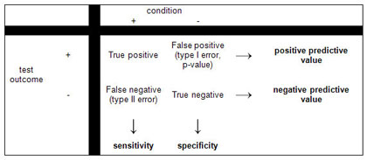
Which variant caller to use?
Substantial discrepancies exist among the calls from different callers.
Callers appear to be less concordant for calling somatic SNVs than germline SNPs.
Sensitivity and Specificity not only vary across callers but also along the genome within any caller.
Depend on factors like depth of sequence coverage in the tumor and matched normal, the local sequencing error rate, the allelic fraction of the mutation and the evidence thresholds used to declare a mutation
MuTect claims to be more sensitive than other methods for low-allelic-fraction and low read support events while remaining highly specific.
Multiple variant callers needed in pipeline (e.g., reduce false negatives).
)
Pabinger, S. et al. A survey of tools for variant analysis of next-generation genome sequencing data. Brief. Bioinform. doi: 10.1093/bib/bbs086 (2013).
O'Rawe, J. et al. Low concordance of multiple variant-calling pipelines: practical implications for exome and genome sequencing. Genome Medicine, 5:28 doi:10.1186/gm432 (2013).

Slide 68
Variant Annotation
SeattleSeq
annotation of known and novel SNPs
includes dbSNP rs ID, gene names and accession numbers, SNP functions (e.g., missense), protein positions and amino-acid changes, conservation scores, HapMap frequencies, PolyPhen predictions, and clinical association
Annovar
Gene-based annotation
Region-based annotations
Filter-based annotation
http://snp.gs.washington.edu/SeattleSeqAnnotation/
http://www.openbioinformatics.org/annovar/

Slide 69
Why study Structural Variation
Common in “normal” human genomes - major cause of phenotypic variation
Common in certain diseases, particularly cancer
Now showing up in rare disease; autism, schizophrenia
Zang, Z.J. et al. Genetic and Structural Variation in the Gastric Cancer Kinome Revealed through Targeted Deep Sequencing. Cancer Res January 1, 71; 29 (2011).
Shibayama, A. et al. MECP2 Structural and 30-UTR Variants in Schizophrenia, Autism and Other Psychiatric Diseases: A Possible Association With Autism. American Journal of Medical Genetics Part B (Neuropsychiatric Genetics) 128B:50–53 (2004).

Slide 70
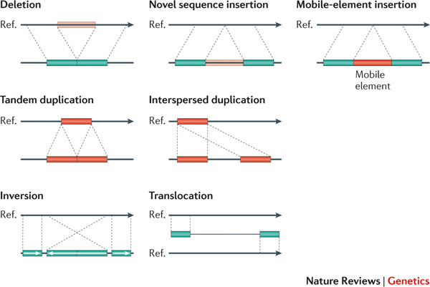
Classes of structural variation
Alkan, C. et al. Genome structural variation discovery and genotyping. Nature Reviews Genetics 12, 363-376 (2011).

Slide 71
Software Tools
Name | Detects | Strategy | Reference
BreakDancer | indels, inversions, translocations | read-pair mapping | Chen, K. et al (2009)
Pindel | indels | split-read analysis | Ye, K. et al. (2009)
CNVnator | CNVs | read-depth analysis | Abyzov, A. et al. (2011)
BreakSeq | indels | junction mapping | Lam, H.Y.K. et al (2010)
Chen, K. et al. BreakDancer: an algorithm for high-resolution mapping of genomic structural variation. Nature Methods 6, 677 - 681 (2009).
Ye, K. et al. Pindel: a pattern growth approach to detect break points of large deletions and medium sized insertions from paired-end short reads. Bioinformatics 25 (21): 2865-2871 (2009).
Abyzov, A. et al. CNVnator: An approach to discover, genotype, and characterize typical and atypical CNVs from family and population genome sequencing. Genome Res. 21: 974-984 (2011).
Lam, H.Y.K. et al. Nucleotide-resolution analysis of structural variants using BreakSeq and a breakpoint library. Nature Biotechnology 28, 47–55 (2010).

Slide 72
BreakDancer
BreakDancerMax
Detects anomalous read pairs indicative of deletions, insertions, inversions, intrachromosomal and interchromosomal translocations
A pair of arrows represents the location and the orientation of a read pair
A dotted line represents a chromosome in the analyzed genome
A solid line represents a chromosome in the reference genome.
BreakDancerMini
focuses on detecting small indels (typically 10–100 bp) that are not routinely detected by BreakDancerMax
Chen, K. et al. BreakDancer: an algorithm for high-resolution mapping of genomic structural variation. Nature Methods 6, 677 - 681 (2009).

Slide 73
BreakDancerMax Workflow
Chen, K. et al. BreakDancer: an algorithm for high-resolution mapping of genomic structural variation. Nature Methods 6, 677 - 681 (2009).

Slide 74
Summary
Accurate mapping and processing of NGS data are critical for analysis-ready reads and for downstream variant calling.
Variant filtering is needed to reduce false positives.
Multiple variant callers are needed in pipeline to reduce false negatives.
Variant annotation helps determine biologically relevant variants.
Variant calling pipeline should include the right set of tools and filters for the job.

