Slide 1
CS 685G:
Special Topics in Data Mining
K-means
Hierarchical Clustering Analysis
BIRCH
DBSCAN
Jinze Liu

Slide 2
Cluster Analysis
What is Cluster Analysis?
Types of Data in Cluster Analysis
A Categorization of Major Clustering Methods
Partitioning Methods
Hierarchical Methods
Density-Based Methods
Grid-Based Methods
Subspace Clustering/Bi-clustering
Model-Based Clustering

Slide 3
What is Cluster Analysis?
Finding groups of objects such that the objects in a group will be similar (or related) to one another and different from (or unrelated to) the objects in other groups
Inter-cluster distances are maximized
Intra-cluster distances are minimized

Slide 4
What is Cluster Analysis?
Cluster: a collection of data objects
  Similar to one another within the same cluster
  Dissimilar to the objects in other clusters
Cluster analysis
  Grouping a set of data objects into clusters
Clustering is unsupervised classification: no predefined classes
Clustering is used:
  As a stand-alone tool to get insight into data distribution
    Visualization of clusters may unveil important information
  As a preprocessing step for other algorithms
    Efficient indexing or compression often relies on clustering

Slide 5
Some Applications of Clustering
Pattern Recognition
Image Processing
  cluster images based on their visual content
Bio-informatics
WWW and IR
  document classification
  cluster Weblog data to discover groups of similar access patterns

Slide 6
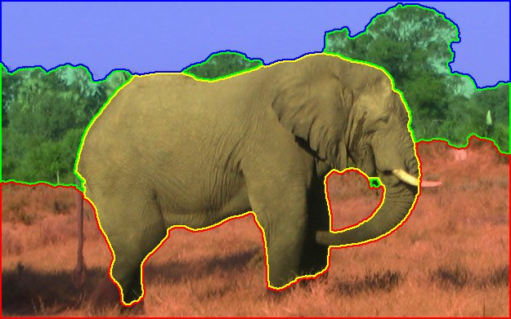
Image Segmentation

Slide 7
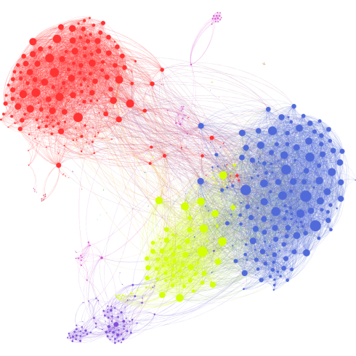
Clusters in Social Network

Slide 8
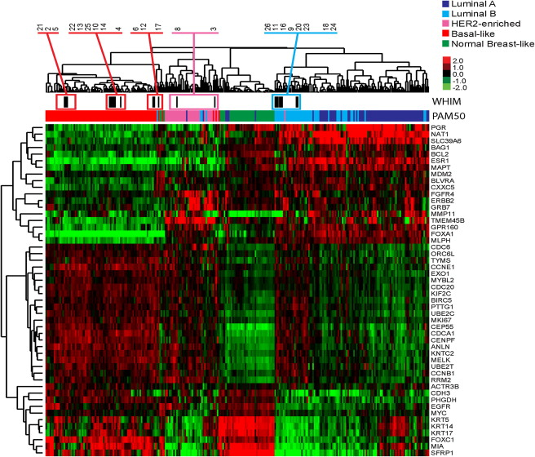
Clustering of Microarray (Bioinformatics)

Slide 9
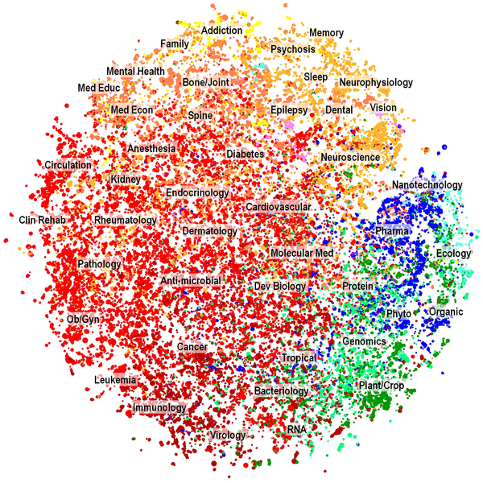
Document Clustering

Slide 10
What Is Good Clustering?
A good clustering method will produce high quality clusters with
  high intra-class similarity
  low inter-class similarity
The quality of a clustering result depends on both the similarity measure used by the method and its implementation.
The quality of a clustering method is also measured by its ability to discover some or all of the hidden patterns.

Slide 11
Outliers
Outliers are objects that do not belong to any cluster or form clusters of very small cardinality
In some applications we are interested in discovering outliers, not clusters (outlier analysis)
cluster
outliers

Slide 12
Requirements of Clustering in Data Mining
Scalability
Ability to deal with different types of attributes
Discovery of clusters with arbitrary shape
Minimal requirements for domain knowledge to determine input parameters
Able to deal with noise and outliers
Insensitive to order of input records
High dimensionality
Incorporation of user-specified constraints
Interpretability and usability

Slide 13
Data Structures
attributes/dimensions
data matrix
  (two modes)
dissimilarity or distance matrix
  (one mode)
the “classic” data input
tuples/objects
objects
Assuming simmetric distance d(i,j) = d(j, i)
objects

Slide 14
Measuring Similarity in Clustering
Dissimilarity/Similarity metric:
  The dissimilarity d(i, j) between two objects i and j is expressed in terms of a distance function, which is typically a metric:
  d(i, j)≥0 (non-negativity)
  d(i, i)=0 (isolation)
  d(i, j)= d(j, i) (symmetry)
  d(i, j) ≤ d(i, h)+d(h, j) (triangular inequality)
The definitions of distance functions are usually different for interval-scaled, boolean, categorical, ordinal and ratio-scaled variables.
Weights may be associated with different variables based on applications and data semantics.

Slide 15
Type of data in cluster analysis
Interval-scaled variables
  e.g., salary, height
Binary variables
  e.g., gender (M/F), has_cancer(T/F)
Nominal (categorical) variables
  e.g., religion (Christian, Muslim, Buddhist, Hindu, etc.)
Ordinal variables
  e.g., military rank (soldier, sergeant, lutenant, captain, etc.)
Ratio-scaled variables
  population growth (1,10,100,1000,...)
Variables of mixed types
  multiple attributes with various types

Slide 16
Similarity and Dissimilarity Between Objects
Distance metrics are normally used to measure the similarity or dissimilarity between two data objects
The most popular conform to Minkowski distance:
  where i = (x_{i1}, x_{i2}, …, x_{in}) and j = (x_{j1}, x_{j2}, …, x_{jn}) are two n-dimensional data objects, and p is a positive integer
If p = 1, L₁ is the Manhattan (or city block) distance:

Slide 17
Similarity and Dissimilarity Between Objects (Cont.)
If p = 2, L₂ is the Euclidean distance:
  Properties
    d(i,j) ≥ 0
    d(i,i) = 0
    d(i,j) = d(j,i)
    d(i,j) ≤ d(i,k) + d(k,j)
Also one can use weighted distance:

Slide 18
Binary Variables
A binary variable has two states: 0 absent, 1 present
A contingency table for binary data
Simple matching coefficient distance (invariant, if the binary variable is symmetric):
Jaccard coefficient distance (noninvariant if the binary variable is asymmetric):
object j
i= (0011101001)
J=(1001100110)
object i

Slide 19
Binary Variables
Another approach is to define the similarity of two objects and not their distance.
In that case we have the following:
  Simple matching coefficient similarity:
  Jaccard coefficient similarity:
Note that: s(i,j) = 1 – d(i,j)

Slide 20
Dissimilarity between Binary Variables
Example (Jaccard coefficient)
  all attributes are asymmetric binary
  1 denotes presence or positive test
  0 denotes absence or negative test

Slide 21
A simpler definition
Each variable is mapped to a bitmap (binary vector)
  Jack: 101000
  Mary: 101010
  Jim: 110000
Simple match distance:
Jaccard coefficient:

Slide 22
Variables of Mixed Types
A database may contain all the six types of variables
  symmetric binary, asymmetric binary, nominal, ordinal, interval and ratio-scaled.
One may use a weighted formula to combine their effects.

Slide 23
Major Clustering Approaches
Partitioning algorithms: Construct random partitions and then iteratively refine them by some criterion
Hierarchical algorithms: Create a hierarchical decomposition of the set of data (or objects) using some criterion
Density-based: based on connectivity and density functions
Grid-based: based on a multiple-level granularity structure
Model-based: A model is hypothesized for each of the clusters and the idea is to find the best fit of that model to each other

Slide 24
Partitioning Algorithms: Basic Concept
Partitioning method: Construct a partition of a database D of n objects into a set of k clusters
  k-means (MacQueen’67): Each cluster is represented by the center of the cluster
  k-medoids or PAM (Partition around medoids) (Kaufman & Rousseeuw’87): Each cluster is represented by one of the objects in the cluster

Slide 25
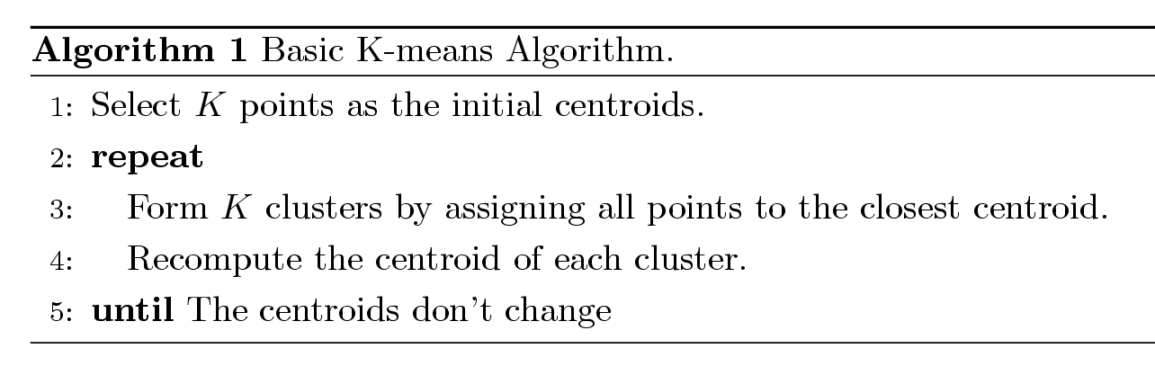
K-means Clustering
Partitional clustering approach
Each cluster is associated with a centroid (center point)
Each point is assigned to the cluster with the closest centroid
Number of clusters, K, must be specified
The basic algorithm is very simple

Slide 26
K-means Clustering – Details
Initial centroids are often chosen randomly.
  Clusters produced vary from one run to another.
The centroid is (typically) the mean of the points in the cluster.
‘Closeness’ is measured by Euclidean distance, cosine similarity, correlation, etc.
Most of the convergence happens in the first few iterations.
  Often the stopping condition is changed to ‘Until relatively few points change clusters’
Complexity is O( n * K * I * d )
  n = number of points, K = number of clusters,
  I = number of iterations, d = number of attributes

Slide 27
Two different K-means Clusterings
Original Points
Optimal Clustering
Sub-optimal Clustering

Slide 28
Evaluating K-means Clusters
  For each point, the error is the distance to the nearest cluster
  To get SSE, we square these errors and sum them.
  x is a data point in cluster C_{i} and m_{i} is the representative point for cluster C_{i}
    can show that m_{i} corresponds to the center (mean) of the cluster
  Given two clusters, we can choose the one with the smallest error

Slide 29
Solutions to Initial Centroids Problem
Multiple runs
  Helps, but probability is not on your side
Sample and use hierarchical clustering to determine initial centroids
Select more than k initial centroids and then select among these initial centroids
  Select most widely separated
Postprocessing
Bisecting K-means
  Not as susceptible to initialization issues

Slide 30
Limitations of K-means
K-means has problems when clusters are of differing
  Sizes
  Densities
  Non-spherical shapes
K-means has problems when the data contains outliers. Why?

Slide 31
The K-Medoids Clustering Method
Find representative objects, called medoids, in clusters
PAM (Partitioning Around Medoids, 1987)
  starts from an initial set of medoids and iteratively replaces one of the medoids by one of the non-medoids if it improves the total distance of the resulting clustering
  PAM works effectively for small data sets, but does not scale well for large data sets
CLARA (Kaufmann & Rousseeuw, 1990)
CLARANS (Ng & Han, 1994): Randomized sampling

Slide 32
PAM (Partitioning Around Medoids) (1987)
PAM (Kaufman and Rousseeuw, 1987), built in statistical package S+
Use a real object to represent the a cluster
  Select k representative objects arbitrarily
  For each pair of a non-selected object h and a selected object i, calculate the total swapping cost TC_{ih}
  For each pair of i and h,
    If TC_{ih} < 0, i is replaced by h
    Then assign each non-selected object to the most similar representative object
  repeat steps 2-3 until there is no change

Slide 33
PAM Clustering: Total swapping cost TC_{ih}=∑_{j}C_{jih}
i is a current medoid, h is a non-selected object
Assume that i is replaced by h in the set of medoids
TC_{ih} = 0;
For each non-selected object j ≠ h:
  TC_{ih} += d(j,new_med_{j})-d(j,prev_med_{j}):
    new_med_{j} = the closest medoid to j after i is replaced by h
    prev_med_{j} = the closest medoid to j before i is replaced by h

Slide 34
PAM Clustering: Total swapping cost TC_{ih}=∑_{j}C_{jih}
t
j
t
j
i
h
h
i
h
j
i
i
t
h
j
t

Slide 35
CLARA (Clustering Large Applications)
CLARA (Kaufmann and Rousseeuw in 1990)
  Built in statistical analysis packages, such as S+
It draws multiple samples of the data set, applies PAM on each sample, and gives the best clustering as the output
Strength: deals with larger data sets than PAM
Weakness:
  Efficiency depends on the sample size
  A good clustering based on samples will not necessarily represent a good clustering of the whole data set if the sample is biased

Slide 36
CLARANS (“Randomized” CLARA)
CLARANS (A Clustering Algorithm based on Randomized Search) (Ng and Han’94)
CLARANS draws sample of neighbors dynamically
The clustering process can be presented as searching a graph where every node is a potential solution, that is, a set of k medoids
If the local optimum is found, CLARANS starts with new randomly selected node in search for a new local optimum
It is more efficient and scalable than both PAM and CLARA
Focusing techniques and spatial access structures may further improve its performance (Ester et al.’95)

Slide 37
Hierarchical Clustering
Build a tree-based hierarchical taxonomy (dendrogram) from a set of documents.
animal
vertebrate
invertebrate
fish reptile amphib. mammal worm insect crustacean
How could you do this with k-means?

Slide 38
Hierarchical Clustering algorithms
Agglomerative (bottom-up):
  Start with each document being a single cluster.
  Eventually all documents belong to the same cluster.
Divisive (top-down):
  Start with all documents belong to the same cluster.
  Eventually each node forms a cluster on its own.
  Could be a recursive application of k-means like algorithms
Does not require the number of clusters k in advance
Needs a termination/readout condition

Slide 39
Hierarchical Agglomerative Clustering (HAC)
Assumes a similarity function for determining the similarity of two instances.
Starts with all instances in a separate cluster and then repeatedly joins the two clusters that are most similar until there is only one cluster.
The history of merging forms a binary tree or hierarchy.

Slide 40
Dendogram: Hierarchical Clustering
  Clustering obtained by cutting the dendrogram at a desired level: each connected component forms a cluster.

Slide 41
Hierarchical Agglomerative Clustering (HAC)
Starts with each doc in a separate cluster
  then repeatedly joins the closest pair of clusters, until there is only one cluster.
The history of merging forms a binary tree or hierarchy.
How to measure distance of clusters??

Slide 42
Closest pair of clusters
Many variants to defining closest pair of clusters
Single-link
  Distance of the “closest” points (single-link)
Complete-link
  Distance of the “furthest” points
Centroid
  Distance of the centroids (centers of gravity)
(Average-link)
  Average distance between pairs of elements

Slide 43
Single Link Agglomerative Clustering
Use maximum similarity of pairs:
Can result in “straggly” (long and thin) clusters due to chaining effect.
After merging c_{i} and c_{j}, the similarity of the resulting cluster to another cluster, c_{k}, is:

Slide 44
Single Link Example

Slide 45
Complete Link Agglomerative Clustering
Use minimum similarity of pairs:
Makes “tighter,” spherical clusters that are typically preferable.
After merging c_{i} and c_{j}, the similarity of the resulting cluster to another cluster, c_{k}, is:
C_{i}
C_{j}
C_{k}

Slide 46
Complete Link Example

Slide 47
Key notion: cluster representative
We want a notion of a representative point in a cluster
Representative should be some sort of “typical” or central point in the cluster, e.g.,
  point inducing smallest radii to docs in cluster
  smallest squared distances, etc.
  point that is the “average” of all docs in the cluster
    Centroid or center of gravity

Slide 48
Centroid-based Similarity
Always maintain average of vectors in each cluster:
Compute similarity of clusters by:
For non-vector data, can’t always make a centroid

Slide 49
Computational Complexity
In the first iteration, all HAC methods need to compute similarity of all pairs of n individual instances which is O(mn²).
In each of the subsequent n−2 merging iterations, compute the distance between the most recently created cluster and all other existing clusters.
Maintaining of heap of distances allows this to be O(mn²logn)

Slide 50
DIANA (DIvisive ANAlysis)
Initially, all objects are in one cluster
Step-by-step splitting clusters until each cluster contains only one object

Slide 51
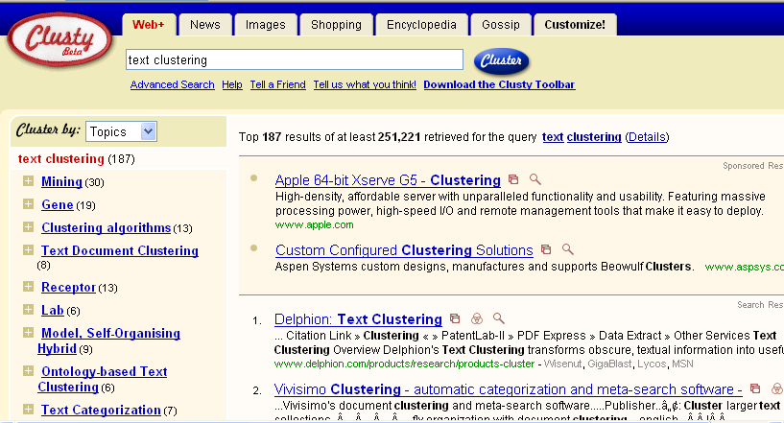
Clustering: Navigation of search results
For grouping search results thematically
  clusty.com / Vivisimo

Slide 52
Major issue - labeling
After clustering algorithm finds clusters - how can they be useful to the end user?
Need pithy label for each cluster
  In search results, say “Animal” or “Car” in the jaguar example.
  In topic trees, need navigational cues.
    Often done by hand, a posteriori.
How would you do this?

Slide 53
How to Label Clusters
Show titles of typical documents
  Titles are easy to scan
  Authors create them for quick scanning!
  But you can only show a few titles which may not fully represent cluster
Show words/phrases prominent in cluster
  More likely to fully represent cluster
  Use distinguishing words/phrases
    Differential labeling
  But harder to scan

Slide 54
Labeling
Common heuristics - list 5-10 most frequent terms in the centroid vector.
  Drop stop-words; stem.
Differential labeling by frequent terms
  Within a collection “Computers”, clusters all have the word computer as frequent term.
  Discriminant analysis of centroids.
Perhaps better: distinctive noun phrase

Slide 55
Comparison
 | Partitioning Clustering | Hierarchical Clustering
Time Complexity | O(n) | O(n²) or O(n³)
Pros | Easy to use and Relatively efficient | Outputs a dendrogram that is desired in many applications.
Cons | Sensitive to initialization; bad initialization might lead to bad results. Need to store all data in memory. | higher time complexity; Need to store all data in memory.
Notes:
1.The time complexity of computing the distance between every pair of data instances is O(n²).
2. The time complexity to create the sorted list of inter-cluster distances is O(n²log n).
Obviously, the algorithms in these regards are failed to effectively handle large datasets that space and time are considered.

Slide 56
Other Alternatives
Integrating hierarchical clustering with other techniques
  BIRCH, CURE, CHAMELEON, ROCK

Slide 57
BIRCH
Balanced Iterative Reducing and Clustering using Hierarchies

Slide 58
Introduction to BIRCH
Designed for very large data sets
  Time and memory are limited
  Incremental and dynamic clustering of incoming objects
  Only one scan of data is necessary
  Does not need the whole data set in advance
Two key phases:
  Scans the database to build an in-memory tree
  Applies clustering algorithm to cluster the leaf nodes

Slide 59
BIRCH: The Idea by example
Data Objects
Clustering Process (build a tree)
1
Leaf node
2
3
4
1
2
5
Cluster1
6
If cluster 1 becomes too large (not compact) by adding object 2,
then split the cluster

Slide 60
BIRCH: The Idea by example
Data Objects
Clustering Process (build a tree)
1
entry 1
entry 2
Leaf node
2
3
4
1
2
5
Cluster1
Cluster2
6
Leaf node with two entries

Slide 61
BIRCH: The Idea by example
Data Objects
Clustering Process (build a tree)
1
entry 1
entry 2
Leaf node
2
3
4
1
3
2
5
Cluster1
Cluster2
6
entry1 is the closest to object 3
If cluster 1 becomes too large by adding object 3,
then split the cluster

Slide 62
BIRCH: The Idea by example
Data Objects
Clustering Process (build a tree)
1
entry 1
entry 2
entry 3
Leaf node
2
3
4
1
3
2
5
Cluster1
Cluster3
Cluster2
6
Leaf node with three entries

Slide 63
BIRCH: The Idea by example
Data Objects
Clustering Process (build a tree)
1
entry 1
entry 2
entry 3
Leaf node
2
3
4
1
3
2
4
5
Cluster2
Cluster1
Cluster3
Cluster2
6
entry3 is the closest to object 4
Cluster 2 remains compact when adding object 4
then add object 4 to cluster 2

Slide 64
BIRCH: The Idea by example
Data Objects
Clustering Process (build a tree)
1
entry 1
entry 2
entry 3
Leaf node
2
3
4
1
3
5
2
4
5
Cluster1
Cluster3
Cluster2
6
entry2 is the closest to object 5
Cluster 3 becomes too large by adding object 5
then split cluster 3?
BUT there is a limit to the number of entries a node can have
Thus, split the node

Slide 65
BIRCH: The Idea by example
Data Objects
Clustering Process (build a tree)
1
Non-Leaf node
2
entry 1
entry 2
3
4
entry 1.1
entry 1.2
entry 2.1
entry 2.2
5
Leaf node
Leaf node
6
1
3
5
2
4
Cluster1
Cluster3
Cluster4
Cluster2

Slide 66
BIRCH: The Idea by example
Data Objects
Clustering Process (build a tree)
1
Non-Leaf node
2
entry 1
entry 2
3
4
entry 1.1
entry 1.2
entry 2.1
entry 2.2
5
Leaf node
Leaf node
6
1
3
6
5
2
4
Cluster3
Cluster4
Cluster2
Cluster1
Cluster3
entry1.2 is the closest to object 6
Cluster 3 remains compact when adding object 6
then add object 6 to cluster 3

Slide 67
BIRCH: Key Components
Clustering Feature (CF)
  Summary of the statistics for a given cluster: the 0-th, 1st and 2nd moments of the cluster from the statistical point of view
  Used to compute centroids, and measures the compactness and distance of clusters
CF-Tree
  height-balanced tree
  two parameters:
    number of entries in each node
    The diameter of all entries in a leaf node
  Leaf nodes are connected via prev and next pointers

Slide 68
Clustering Feature
Clustering Feature (CF): CF = (N, LS, SS)
N: Number of data points
LS: linear sum of N points:
SS: square sum of N points:
CF3=CF1+CF2= ⟨3+3, (9+35, 10+36), (29+417 , 38+440)⟩ = ⟨6, (44,46), (446 ,478)⟩
Cluster3
Cluster 1
(2,5)
(3,2)
(4,3)
Cluster 2
CF₂= ⟨3, (35,36), (417 ,440)⟩
CF₁= ⟨3, (2+3+4 , 5+2+3), (2²+3²+4² , 5²+2²+3²)⟩ = ⟨3, (9,10), (29 ,38)⟩

Slide 69
Some Characteristics of CFVs
Two CFVs can be aggregated.
  Given CF1=(N1, LS1, SS1), CF2 = (N2, LS2, SS2),
  If combined into one cluster, CF=(N1+N2, LS1+LS2, SS1+SS2).
The centroid and radius can both be computed from CF.
  centroid is the center of the cluster
  radius is the average distance between an object and the centroid.
  X0 = LS/N
  R = 1/N * sqrt(N*SS-LS^2)

Slide 70
Clustering Feature
Clustering feature:
  Summarize the statistics for a subcluster
    the 0th, 1st and 2nd moments of the subcluster
  Register crucial measurements for computing cluster and utilize storage efficiently

Slide 71
CF-tree in BIRCH
A CF tree: a height-balanced tree storing the clustering features for a hierarchical clustering
  A nonleaf node in a tree has descendants or “children”
  The nonleaf nodes store sums of the CFs of children

Slide 72
CF Tree
CF₁
CF₂
CF₃
CF₆
Root
B = 7
L = 6
child₁
child₂
child₃
child₆
Non-leaf node
CF₁
CF₂
CF₃
CF₅
child₁
child₂
child₃
child₅
Leaf node
Leaf node
prev
CF₁
CF₂
CF₆
next
prev
CF₁
CF₂
CF₄
next

Slide 73
Parameters of A CF-tree
Branching factor: the maximum number of children
Threshold: max diameter of sub-clusters stored at the leaf nodes

Slide 74
CF Tree Insertion
Identifying the appropriate leaf: recursively descending the CF tree and choosing the closest child node according to a chosen distance metric
Modifying the leaf: test whether the leaf can absorb the node without violating the threshold. If there is no room, split the node
Modifying the path: update CF information up the path.

Slide 75
Example of the BIRCH Algorithm
New subcluster
sc4
sc5
sc8
sc6
sc7
sc3
LN3
sc1
LN2
sc2
Root
LN1
LN2
LN3
LN1
sc8
sc3
sc5
sc6
sc7
sc1
sc2
sc4

Slide 76
Insertion Operation in BIRCH
If the branching factor of a leaf node can not exceed 3, then LN1 is split
sc1
sc4
sc5
sc3
sc6
sc2
sc7
sc8
LN2
LN1”
LN3
LN1’
Root
LN1’
LN2
LN3
LN1”
sc8
sc3
sc5
sc6
sc7
sc1
sc2
sc4

Slide 77
Insertion Operation in BIRCH
If the branching factor of a non-leaf node can not exceed 3, then the root is split and the height of the CF Tree increases by one
sc3
sc1
sc4
sc6
Root
sc2
sc7
NLN1
sc5
sc8
LN3
LN2
NLN2
LN1’
LN1”
LN1’
LN1”
LN2
LN3
sc8
sc1
sc3
sc4
sc6
sc7
sc2
sc5

Slide 78
Birch Clustering Algorithm (1)
Phase 1: Scan all data and build an initial in-memory CF tree.
Phase 2: condense into desirable length by building a smaller CF tree.
Phase 3: Global clustering
Phase 4: Cluster refining – this is optional, and requires more passes over the data to refine the results

Slide 79
Pros & Cons of BIRCH
Linear scalability
  Good clustering with a single scan
  Quality can be further improved by a few additional scans
Can handle only numeric data
Sensitive to the order of the data records

Slide 80
3.3.4 ROCK: for Categorical Data
Experiments show that distance functions do not lead to high quality clusters when clustering categorical data
Most clustering techniques assess the similarity between points to create clusters
At each step, points that are similar are merged into a single cluster
Localized approach prone to errors
ROCK: used links instead of distances

Slide 81
Example: Compute Jaccard Coefficient
  Transaction items: a,b,c,d,e,f,g
  Two clusters of transactions
  Compute Jaccard coefficient between transactions
  Cluster1. <a, b, c, d, e>
  {a, b, c}
  {a, b, d}
  {a, b, e}
  {a, c, d}
  {a, c, e}
  {a, d, e}
  {b, c, d}
  {b, c, e}
  {b, d, e}
  {c, d, e}
  Sim({a,b,c},{b,d,e})=1/5=0.2
  Jaccard coefficient between transactions of Cluster1 ranges from 0.2 to 0.5
  Jaccard coefficient between transactions belonging to different clusters can also reach 0.5
  Sim({a,b,c},{a,b,f})=2/4=0.5
  Cluster2. <a, b, f, g>
  {a, b, f}
  {a, b, g}
  {a, f, g}
  {b, f, g}

Slide 82
Example: Using Links
  Transaction items: a,b,c,d,e,f,g
  Two clusters of transactions
  The number of links between T_{i} and T_{j} is the number of common neighbors
  T_{i} and T_{j} are neighbors if
  Sim(Ti,Tj)>θ
  Consider θ=0.5
  Link({a,b,f}, {a,b,g}) = 5
  (common neighbors)
  Link({a,b,f},{a,b,c})=3
  (common neighbors)
  Cluster1. <a, b, c, d, e>
  {a, b, c}
  {a, b, d}
  {a, b, e}
  {a, c, d}
  {a, c, e}
  {a, d, e}
  {b, c, d}
  {b, c, e}
  {b, d, e}
  {c, d, e}
  Cluster2. <a, b, f, g>
  {a, b, f}
  {a, b, g}
  {a, f, g}
  {b, f, g}
Link is a better measure
than Jaccard coefficient

Slide 83
ROCK
ROCK: Robust Clustering using linKs
Major Ideas
  Use links to measure similarity/proximity
  Not distance-based
  Computational complexity
    m_{a}: average number of neighbors
    m_{m}: maximum number of neighbors
    n: number of objects
Algorithm
  Sampling-based clustering
  Draw random sample
  Cluster with links
  Label data in disk

Slide 84
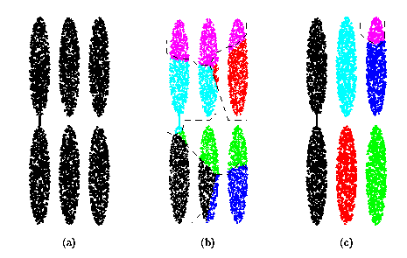
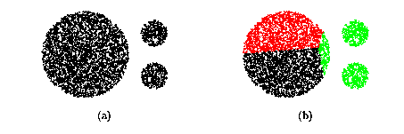
Drawbacks of Square Error Based Methods
One representative per cluster
  Good only for convex shaped having similar size and density
A number of clusters parameter k
  Good only if k can be reasonably estimated

Slide 85
Drawback of Distance-based Methods
Hard to find clusters with irregular shapes
Hard to specify the number of clusters
Heuristic: a cluster must be dense

Slide 86
DBSCAN – Density-Based Spatial Clustering of Applications with Noise
Reference:
M.Ester, H.P.Kriegel, J.Sander and Xu.
A density-based algorithm for discovering clusters in large spatial databases, Aug 1996

Slide 87
DBSCAN
Density-based Clustering locates regions of high density that are separated from one another by regions of low density.
  Density = number of points within a specified radius (Eps)
DBSCAN is a density-based algorithm.
  A point is a core point if it has more than a specified number of points (MinPts) within Eps
    These are points that are at the interior of a cluster
  A border point has fewer than MinPts within Eps, but is in the neighborhood of a core point

Slide 88
DBSCAN
  A noise point is any point that is not a core point or a border point.
  Any two core points are close enough– within a distance Eps of one another – are put in the same cluster
  Any border point that is close enough to a core point is put in the same cluster as the core point
  Noise points are discarded

Slide 89
Border & Core
Outlier
Border
Core
ε = 1unit
MinPts = 5

Slide 90
Concepts: ε-Neighborhood
ε-Neighborhood - Objects within a radius of ε from an object. (epsilon-neighborhood)
Core objects - ε-Neighborhood of an object contains at least MinPts of objects
ε-Neighborhood of p
ε
ε
ε-Neighborhood of q
q
p
p is a core object (MinPts = 4)
q is not a core object

Slide 91
Concepts: Reachability
Directly density-reachable
  An object q is directly density-reachable from object p if q is within the ε-Neighborhood of p and p is a core object.
q is directly density-reachable from p
p is not directly density- reachable from q?
ε
ε
q
p

Slide 92
Concepts: Reachability
Density-reachable:
  An object p is density-reachable from q w.r.t ε and MinPts if there is a chain of objects p₁,…,p_{n}, with p₁=q, p_{n}=p such that p_{i+1}is directly density-reachable from p_{i} w.r.t ε and MinPts for all 1 <= i <= n
q is density-reachable from p
p is not density- reachable from q?
Transitive closure of direct density-Reachability, asymmetric
q
p

Slide 93
Concepts: Connectivity
Density-connectivity
  Object p is density-connected to object q w.r.t ε and MinPts if there is an object o such that both p and q are density-reachable from o w.r.t ε and MinPts
P and q are density-connected to each other by r
Density-connectivity is symmetric
q
r
p

Slide 94
Concepts: cluster & noise
Cluster: a cluster C in a set of objects D w.r.t ε and MinPts is a non empty subset of D satisfying
  Maximality: For all p, q if p ∈ C and if q is density-reachable from p w.r.t ε and MinPts, then also q ∈ C.
  Connectivity: for all p, q ∈ C, p is density-connected to q w.r.t ε and MinPts in D.
  Note: cluster contains core objects as well as border objects
Noise: objects which are not directly density-reachable from at least one core object.

Slide 95
(Indirectly) Density-reachable:
p
p₁
q
Density-connected
p
q
o

Slide 96
DBSCAN: The Algorithm
  select a point p
  Retrieve all points density-reachable from p wrt ε and MinPts.
  If p is a core point, a cluster is formed.
  If p is a border point, no points are density-reachable from p and DBSCAN visits the next point of the database.
  Continue the process until all of the points have been processed.
  Result is independent of the order of processing the points

Slide 97
An Example
MinPts = 4
ε
C₁
C₁
ε
ε
C₁

Slide 98
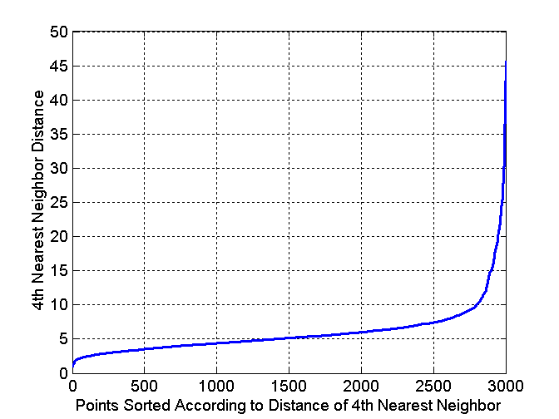
DBSCAN: Determining EPS and MinPts
Idea is that for points in a cluster, their k^{th} nearest neighbors are at roughly the same distance
Noise points have the k^{th} nearest neighbor at farther distance
So, plot sorted distance of every point to its k^{th} nearest neighbor

Slide 99
DBSCAN: Determining EPS and MinPts
Distance from a point to its k^{th} nearest neighbor=>k-dist
For points that belong to some clusters, the value of k-dist will be small if k is not larger than cluster size
For points that are not in a cluster such as noise points, the k-dist will be relatively large
Compute k-dist for all points for some k
Sort them in increasing order and plot sorted values
A sharp change at the value of k-dist that corresponds to suitable value of eps and the value of k as MinPts

Slide 100
DBSCAN: Determining EPS and MinPts
A sharp change at the value of k-dist that corresponds to suitable value of eps and the value of k as MinPts
  Points for which k-dist is less than eps will be labeled as core points while other points will be labeled as noise or border points.
If k is too large=> small clusters (of size less than k) are likely to be labeled as noise
If k is too small=> Even a small number of closely spaced that are noise or outliers will be incorrectly labeled as clusters

Slide 101
Directly Density Reachable
p
Parameters
  Eps: Maximum radius of the neighborhood
  MinPts: Minimum number of points in an Eps-neighborhood of that point
  NEps(p): {q | dist(p,q) ≤Eps}
Core object p: |Neps(p)|≥MinPts
Point q directly density-reachable from p iff q ∈Neps(p) and p is a core object
MinPts = 3 Eps = 1 cm
q

Slide 102
Density-Based Clustering: Background (II)
p
Density-reachable
  Directly density reachable p₁→p₂, p₂→p₃, …, p_{n-1}→ p_{n} ➔ p_{n} density-reachable from p₁
Density-connected
  Points p, q are density-reachable from o ➔ p and q are density-connected
p₁
q
p
q
o

Slide 103
DBSCAN
A cluster: a maximal set of density-connected points
  Discover clusters of arbitrary shape in spatial databases with noise
Outlier
Border
Eps = 1cm
MinPts = 5
Core

Slide 104
DBSCAN: the Algorithm
Arbitrary select a point p
Retrieve all points density-reachable from p wrt Eps and MinPts
If p is a core point, a cluster is formed
If p is a border point, no points are density-reachable from p and DBSCAN visits the next point of the database
Continue the process until all of the points have been processed

Slide 105
Problems of DBSCAN
Different clusters may have very different densities
Clusters may be in hierarchies

Slide 106
OPTICS: A Cluster-ordering Method
OPTICS: ordering points to identify the clustering structure
“Group” points by density connectivity
  Hierarchies of clusters
Visualize clusters and the hierarchy

Slide 107
DENCLUE: Using Density Functions
DENsity-based CLUstEring
Major features
  Solid mathematical foundation
  Good for data sets with large amounts of noise
  Allow a compact mathematical description of arbitrarily shaped clusters in high-dimensional data sets
  Significantly faster than existing algorithms (faster than DBSCAN by a factor of up to 45)
  But need a large number of parameters

