Slide 1
CS 685G:
Special Topics in Data Mining
Hierarchical Clustering Analysis
Jinze Liu

Slide 2
Clustering Presentation Topics
Topic 1
  X-means
  Learning the k in k-means
  https://papers.nips.cc/paper/2526-learning-the-k-in-k-means.pdf
Topic 2
  Co-clustering
  https://pdfs.semanticscholar.org/4a3e/b95f17a88e14227b05a590639e8cd3346a99.pdf
Topic 3
  https://web.cse.ohio-state.edu/~jwdavis/Publications/cvpr11a.pdf

Slide 3
Outline
What is clustering
Partitioning methods
Hierarchical methods
Density-based methods
Grid-based methods
Model-based clustering methods
Outlier analysis

Slide 4
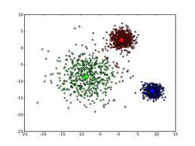
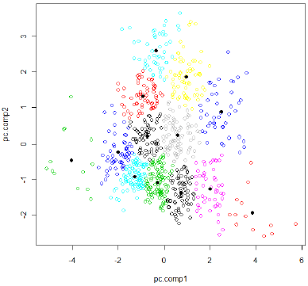
Recap of K-Means

Slide 5
Hierarchical Clustering
Build a tree-based hierarchical taxonomy (dendrogram) from a set of documents.
animal
vertebrate
invertebrate
fish reptile amphib. mammal worm insect crustacean
How could you do this with k-means?

Slide 6
Hierarchical Clustering algorithms
Agglomerative (bottom-up):
  Start with each document being a single cluster.
  Eventually all documents belong to the same cluster.
Divisive (top-down):
  Start with all documents belong to the same cluster.
  Eventually each node forms a cluster on its own.
  Could be a recursive application of k-means like algorithms
Does not require the number of clusters k in advance
Needs a termination/readout condition

Slide 7
Hierarchical Agglomerative Clustering (HAC)
Assumes a similarity function for determining the similarity of two instances.
Starts with all instances in a separate cluster and then repeatedly joins the two clusters that are most similar until there is only one cluster.
The history of merging forms a binary tree or hierarchy.

Slide 8
Dendogram: Hierarchical Clustering
  Clustering obtained by cutting the dendrogram at a desired level: each connected component forms a cluster.

Slide 9
Hierarchical Agglomerative Clustering (HAC)
Starts with each doc in a separate cluster
  then repeatedly joins the closest pair of clusters, until there is only one cluster.
The history of merging forms a binary tree or hierarchy.
How to measure distance of clusters??

Slide 10
Closest pair of clusters
Many variants to defining closest pair of clusters
Single-link
  Distance of the “closest” points (single-link)
Complete-link
  Distance of the “furthest” points
Centroid
  Distance of the centroids (centers of gravity)
(Average-link)
  Average distance between pairs of elements

Slide 11
Single Link Agglomerative Clustering
Use maximum similarity of pairs:
Can result in “straggly” (long and thin) clusters due to chaining effect.
After merging c_{i} and c_{j}, the similarity of the resulting cluster to another cluster, c_{k}, is:

Slide 12
Single Link Example

Slide 13
Complete Link Agglomerative Clustering
Use minimum similarity of pairs:
Makes “tighter,” spherical clusters that are typically preferable.
After merging c_{i} and c_{j}, the similarity of the resulting cluster to another cluster, c_{k}, is:
C_{i}
C_{j}
C_{k}

Slide 14
Complete Link Example

Slide 15
Key notion: cluster representative
We want a notion of a representative point in a cluster
Representative should be some sort of “typical” or central point in the cluster, e.g.,
  point inducing smallest radii to docs in cluster
  smallest squared distances, etc.
  point that is the “average” of all docs in the cluster
    Centroid or center of gravity

Slide 16
Centroid-based Similarity
Always maintain average of vectors in each cluster:
Compute similarity of clusters by:
For non-vector data, can’t always make a centroid

Slide 17
Computational Complexity
In the first iteration, all HAC methods need to compute similarity of all pairs of n individual instances which is O(mn²).
In each of the subsequent n−2 merging iterations, compute the distance between the most recently created cluster and all other existing clusters.
Maintaining of heap of distances allows this to be O(mn²logn)

Slide 18
DIANA (DIvisive ANAlysis)
Initially, all objects are in one cluster
Step-by-step splitting clusters until each cluster contains only one object

Slide 19
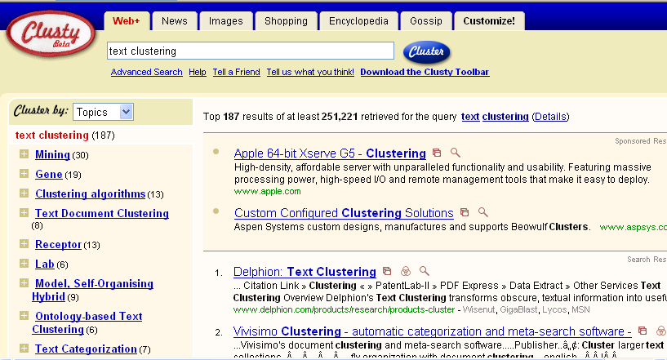
Clustering: Navigation of search results
For grouping search results thematically
  clusty.com / Vivisimo

Slide 20
Major issue - labeling
After clustering algorithm finds clusters - how can they be useful to the end user?
Need pithy label for each cluster
  In search results, say “Animal” or “Car” in the jaguar example.
  In topic trees, need navigational cues.
    Often done by hand, a posteriori.
How would you do this?

Slide 21
How to Label Clusters
Show titles of typical documents
  Titles are easy to scan
  Authors create them for quick scanning!
  But you can only show a few titles which may not fully represent cluster
Show words/phrases prominent in cluster
  More likely to fully represent cluster
  Use distinguishing words/phrases
    Differential labeling
  But harder to scan

Slide 22
Labeling
Common heuristics - list 5-10 most frequent terms in the centroid vector.
  Drop stop-words; stem.
Differential labeling by frequent terms
  Within a collection “Computers”, clusters all have the word computer as frequent term.
  Discriminant analysis of centroids.
Perhaps better: distinctive noun phrase

Slide 23
Comparison
 | Partitioning Clustering | Hierarchical Clustering
Time Complexity | O(n) | O(n²) or O(n³)
Pros | Easy to use and Relatively efficient | Outputs a dendrogram that is desired in many applications.
Cons | Sensitive to initialization; bad initialization might lead to bad results. Need to store all data in memory. | higher time complexity; Need to store all data in memory.
Notes:
1.The time complexity of computing the distance between every pair of data instances is O(n²).
2. The time complexity to create the sorted list of inter-cluster distances is O(n²log n).
Obviously, the algorithms in these regards are failed to effectively handle large datasets that space and time are considered.

Slide 24
Other Alternatives
Integrating hierarchical clustering with other techniques
  BIRCH, CURE, CHAMELEON, ROCK

Slide 25
BIRCH
Balanced Iterative Reducing and Clustering using Hierarchies

Slide 26
Introduction to BIRCH
Designed for very large data sets
  Time and memory are limited
  Incremental and dynamic clustering of incoming objects
  Only one scan of data is necessary
  Does not need the whole data set in advance
Two key phases:
  Scans the database to build an in-memory tree
  Applies clustering algorithm to cluster the leaf nodes

Slide 27
BIRCH: The Idea by example
Data Objects
Clustering Process (build a tree)
1
Leaf node
2
3
4
1
2
5
Cluster1
6
If cluster 1 becomes too large (not compact) by adding object 2,
then split the cluster

Slide 28
BIRCH: The Idea by example
Data Objects
Clustering Process (build a tree)
1
entry 1
entry 2
Leaf node
2
3
4
1
2
5
Cluster1
Cluster2
6
Leaf node with two entries

Slide 29
BIRCH: The Idea by example
Data Objects
Clustering Process (build a tree)
1
entry 1
entry 2
Leaf node
2
3
4
1
3
2
5
Cluster1
Cluster2
6
entry1 is the closest to object 3
If cluster 1 becomes too large by adding object 3,
then split the cluster

Slide 30
BIRCH: The Idea by example
Data Objects
Clustering Process (build a tree)
1
entry 1
entry 2
entry 3
Leaf node
2
3
4
1
3
2
5
Cluster1
Cluster3
Cluster2
6
Leaf node with three entries

Slide 31
BIRCH: The Idea by example
Data Objects
Clustering Process (build a tree)
1
entry 1
entry 2
entry 3
Leaf node
2
3
4
1
3
2
4
5
Cluster2
Cluster1
Cluster3
Cluster2
6
entry3 is the closest to object 4
Cluster 2 remains compact when adding object 4
then add object 4 to cluster 2

Slide 32
BIRCH: The Idea by example
Data Objects
Clustering Process (build a tree)
1
entry 1
entry 2
entry 3
Leaf node
2
3
4
1
3
5
2
4
5
Cluster1
Cluster3
Cluster2
6
entry2 is the closest to object 5
Cluster 3 becomes too large by adding object 5
then split cluster 3?
BUT there is a limit to the number of entries a node can have
Thus, split the node

Slide 33
BIRCH: The Idea by example
Data Objects
Clustering Process (build a tree)
1
Non-Leaf node
2
entry 1
entry 2
3
4
entry 1.1
entry 1.2
entry 2.1
entry 2.2
5
Leaf node
Leaf node
6
1
3
5
2
4
Cluster1
Cluster3
Cluster4
Cluster2

Slide 34
BIRCH: The Idea by example
Data Objects
Clustering Process (build a tree)
1
Non-Leaf node
2
entry 1
entry 2
3
4
entry 1.1
entry 1.2
entry 2.1
entry 2.2
5
Leaf node
Leaf node
6
1
3
6
5
2
4
Cluster3
Cluster4
Cluster2
Cluster1
Cluster3
entry1.2 is the closest to object 6
Cluster 3 remains compact when adding object 6
then add object 6 to cluster 3

Slide 35
BIRCH: Key Components
Clustering Feature (CF)
  Summary of the statistics for a given cluster: the 0-th, 1st and 2nd moments of the cluster from the statistical point of view
  Used to compute centroids, and measures the compactness and distance of clusters
CF-Tree
  height-balanced tree
  two parameters:
    number of entries in each node
    The diameter of all entries in a leaf node
  Leaf nodes are connected via prev and next pointers

Slide 36
Clustering Feature
Clustering Feature (CF): CF = (N, LS, SS)
N: Number of data points
LS: linear sum of N points:
SS: square sum of N points:
CF3=CF1+CF2= ⟨3+3, (9+35, 10+36), (29+417 , 38+440)⟩ = ⟨6, (44,46), (446 ,478)⟩
Cluster3
Cluster 1
(2,5)
(3,2)
(4,3)
Cluster 2
CF₂= ⟨3, (35,36), (417 ,440)⟩
CF₁= ⟨3, (2+3+4 , 5+2+3), (2²+3²+4² , 5²+2²+3²)⟩ = ⟨3, (9,10), (29 ,38)⟩

Slide 37
Some Characteristics of CFVs
Two CFVs can be aggregated.
  Given CF1=(N1, LS1, SS1), CF2 = (N2, LS2, SS2),
  If combined into one cluster, CF=(N1+N2, LS1+LS2, SS1+SS2).
The centroid and radius can both be computed from CF.
  centroid is the center of the cluster
  radius is the average distance between an object and the centroid.
  X0 = LS/N
  R = 1/N * sqrt(N*SS-LS^2)

Slide 38
Clustering Feature
Clustering feature:
  Summarize the statistics for a subcluster
    the 0th, 1st and 2nd moments of the subcluster
  Register crucial measurements for computing cluster and utilize storage efficiently

Slide 39
CF-tree in BIRCH
A CF tree: a height-balanced tree storing the clustering features for a hierarchical clustering
  A nonleaf node in a tree has descendants or “children”
  The nonleaf nodes store sums of the CFs of children

Slide 40
CF Tree
CF₁
CF₂
CF₃
CF₆
Root
B = 7
L = 6
child₁
child₂
child₃
child₆
Non-leaf node
CF₁
CF₂
CF₃
CF₅
child₁
child₂
child₃
child₅
Leaf node
Leaf node
prev
CF₁
CF₂
CF₆
next
prev
CF₁
CF₂
CF₄
next

Slide 41
Parameters of A CF-tree
Branching factor: the maximum number of children
Threshold: max diameter of sub-clusters stored at the leaf nodes

Slide 42
CF Tree Insertion
Identifying the appropriate leaf: recursively descending the CF tree and choosing the closest child node according to a chosen distance metric
Modifying the leaf: test whether the leaf can absorb the node without violating the threshold. If there is no room, split the node
Modifying the path: update CF information up the path.

Slide 43
Example of the BIRCH Algorithm
New subcluster
sc4
sc5
sc8
sc6
sc7
sc3
LN3
sc1
LN2
sc2
Root
LN1
LN2
LN3
LN1
sc8
sc3
sc5
sc6
sc7
sc1
sc2
sc4

Slide 44
Insertion Operation in BIRCH
If the branching factor of a leaf node can not exceed 3, then LN1 is split
sc1
sc4
sc5
sc3
sc6
sc2
sc7
sc8
LN2
LN1”
LN3
LN1’
Root
LN1’
LN2
LN3
LN1”
sc8
sc3
sc5
sc6
sc7
sc1
sc2
sc4

Slide 45
Insertion Operation in BIRCH
If the branching factor of a non-leaf node can not exceed 3, then the root is split and the height of the CF Tree increases by one
sc3
sc1
sc4
sc6
Root
sc2
sc7
NLN1
sc5
sc8
LN3
LN2
NLN2
LN1’
LN1”
LN1’
LN1”
LN2
LN3
sc8
sc1
sc3
sc4
sc6
sc7
sc2
sc5

Slide 46
Birch Clustering Algorithm (1)
Phase 1: Scan all data and build an initial in-memory CF tree.
Phase 2: condense into desirable length by building a smaller CF tree.
Phase 3: Global clustering
Phase 4: Cluster refining – this is optional, and requires more passes over the data to refine the results

Slide 47
Pros & Cons of BIRCH
Linear scalability
  Good clustering with a single scan
  Quality can be further improved by a few additional scans
Can handle only numeric data
Sensitive to the order of the data records

Slide 48
3.3.4 ROCK: for Categorical Data
Experiments show that distance functions do not lead to high quality clusters when clustering categorical data
Most clustering techniques assess the similarity between points to create clusters
At each step, points that are similar are merged into a single cluster
Localized approach prone to errors
ROCK: used links instead of distances

Slide 49
Example: Compute Jaccard Coefficient
  Transaction items: a,b,c,d,e,f,g
  Two clusters of transactions
  Compute Jaccard coefficient between transactions
  Cluster1. <a, b, c, d, e>
  {a, b, c}
  {a, b, d}
  {a, b, e}
  {a, c, d}
  {a, c, e}
  {a, d, e}
  {b, c, d}
  {b, c, e}
  {b, d, e}
  {c, d, e}
  Sim({a,b,c},{b,d,e})=1/5=0.2
  Jaccard coefficient between transactions of Cluster1 ranges from 0.2 to 0.5
  Jaccard coefficient between transactions belonging to different clusters can also reach 0.5
  Sim({a,b,c},{a,b,f})=2/4=0.5
  Cluster2. <a, b, f, g>
  {a, b, f}
  {a, b, g}
  {a, f, g}
  {b, f, g}

Slide 50
Example: Using Links
  Transaction items: a,b,c,d,e,f,g
  Two clusters of transactions
  The number of links between T_{i} and T_{j} is the number of common neighbors
  T_{i} and T_{j} are neighbors if
  Sim(Ti,Tj)>θ
  Consider θ=0.5
  Link({a,b,f}, {a,b,g}) = 5
  (common neighbors)
  Link({a,b,f},{a,b,c})=3
  (common neighbors)
  Cluster1. <a, b, c, d, e>
  {a, b, c}
  {a, b, d}
  {a, b, e}
  {a, c, d}
  {a, c, e}
  {a, d, e}
  {b, c, d}
  {b, c, e}
  {b, d, e}
  {c, d, e}
  Cluster2. <a, b, f, g>
  {a, b, f}
  {a, b, g}
  {a, f, g}
  {b, f, g}
Link is a better measure
than Jaccard coefficient

Slide 51
ROCK
ROCK: Robust Clustering using linKs
Major Ideas
  Use links to measure similarity/proximity
  Not distance-based
  Computational complexity
    m_{a}: average number of neighbors
    m_{m}: maximum number of neighbors
    n: number of objects
Algorithm
  Sampling-based clustering
  Draw random sample
  Cluster with links
  Label data in disk

Slide 52
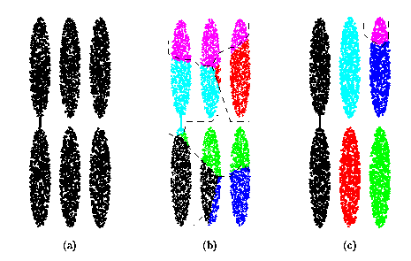
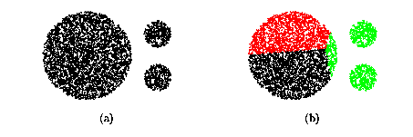
Drawbacks of Square Error Based Methods
One representative per cluster
  Good only for convex shaped having similar size and density
A number of clusters parameter k
  Good only if k can be reasonably estimated

Slide 53
Drawback of Distance-based Methods
Hard to find clusters with irregular shapes
Hard to specify the number of clusters
Heuristic: a cluster must be dense

Slide 54
DBSCAN – Density-Based Spatial Clustering of Applications with Noise
Reference:
M.Ester, H.P.Kriegel, J.Sander and Xu.
A density-based algorithm for discovering clusters in large spatial databases, Aug 1996

Slide 55
DBSCAN
Density-based Clustering locates regions of high density that are separated from one another by regions of low density.
  Density = number of points within a specified radius (Eps)
DBSCAN is a density-based algorithm.
  A point is a core point if it has more than a specified number of points (MinPts) within Eps
    These are points that are at the interior of a cluster
  A border point has fewer than MinPts within Eps, but is in the neighborhood of a core point

Slide 56
DBSCAN
  A noise point is any point that is not a core point or a border point.
  Any two core points are close enough– within a distance Eps of one another – are put in the same cluster
  Any border point that is close enough to a core point is put in the same cluster as the core point
  Noise points are discarded

Slide 57
Border & Core
Outlier
Border
Core
ε = 1unit
MinPts = 5

Slide 58
Concepts: ε-Neighborhood
ε-Neighborhood - Objects within a radius of ε from an object. (epsilon-neighborhood)
Core objects - ε-Neighborhood of an object contains at least MinPts of objects
ε-Neighborhood of p
ε
ε
ε-Neighborhood of q
q
p
p is a core object (MinPts = 4)
q is not a core object

Slide 59
Concepts: Reachability
Directly density-reachable
  An object q is directly density-reachable from object p if q is within the ε-Neighborhood of p and p is a core object.
q is directly density-reachable from p
p is not directly density- reachable from q?
ε
ε
q
p

Slide 60
Concepts: Reachability
Density-reachable:
  An object p is density-reachable from q w.r.t ε and MinPts if there is a chain of objects p₁,…,p_{n}, with p₁=q, p_{n}=p such that p_{i+1}is directly density-reachable from p_{i} w.r.t ε and MinPts for all 1 <= i <= n
q is density-reachable from p
p is not density- reachable from q?
Transitive closure of direct density-Reachability, asymmetric
q
p

Slide 61
Concepts: Connectivity
Density-connectivity
  Object p is density-connected to object q w.r.t ε and MinPts if there is an object o such that both p and q are density-reachable from o w.r.t ε and MinPts
P and q are density-connected to each other by r
Density-connectivity is symmetric
q
r
p

Slide 62
Concepts: cluster & noise
Cluster: a cluster C in a set of objects D w.r.t ε and MinPts is a non empty subset of D satisfying
  Maximality: For all p, q if p ∈ C and if q is density-reachable from p w.r.t ε and MinPts, then also q ∈ C.
  Connectivity: for all p, q ∈ C, p is density-connected to q w.r.t ε and MinPts in D.
  Note: cluster contains core objects as well as border objects
Noise: objects which are not directly density-reachable from at least one core object.

Slide 63
(Indirectly) Density-reachable:
p
p₁
q
Density-connected
p
q
o

Slide 64
DBSCAN: The Algorithm
  select a point p
  Retrieve all points density-reachable from p wrt ε and MinPts.
  If p is a core point, a cluster is formed.
  If p is a border point, no points are density-reachable from p and DBSCAN visits the next point of the database.
  Continue the process until all of the points have been processed.
  Result is independent of the order of processing the points

Slide 65
An Example
MinPts = 4
ε
C₁
C₁
ε
ε
C₁

Slide 66
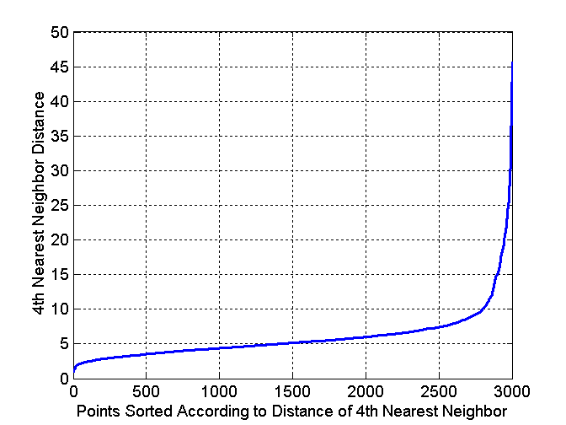
DBSCAN: Determining EPS and MinPts
Idea is that for points in a cluster, their k^{th} nearest neighbors are at roughly the same distance
Noise points have the k^{th} nearest neighbor at farther distance
So, plot sorted distance of every point to its k^{th} nearest neighbor

Slide 67
DBSCAN: Determining EPS and MinPts
Distance from a point to its k^{th} nearest neighbor=>k-dist
For points that belong to some clusters, the value of k-dist will be small if k is not larger than cluster size
For points that are not in a cluster such as noise points, the k-dist will be relatively large
Compute k-dist for all points for some k
Sort them in increasing order and plot sorted values
A sharp change at the value of k-dist that corresponds to suitable value of eps and the value of k as MinPts

Slide 68
DBSCAN: Determining EPS and MinPts
A sharp change at the value of k-dist that corresponds to suitable value of eps and the value of k as MinPts
  Points for which k-dist is less than eps will be labeled as core points while other points will be labeled as noise or border points.
If k is too large=> small clusters (of size less than k) are likely to be labeled as noise
If k is too small=> Even a small number of closely spaced that are noise or outliers will be incorrectly labeled as clusters

Slide 69
Directly Density Reachable
p
Parameters
  Eps: Maximum radius of the neighborhood
  MinPts: Minimum number of points in an Eps-neighborhood of that point
  NEps(p): {q | dist(p,q) ≤Eps}
Core object p: |Neps(p)|≥MinPts
Point q directly density-reachable from p iff q ∈Neps(p) and p is a core object
MinPts = 3 Eps = 1 cm
q

Slide 70
Density-Based Clustering: Background (II)
p
Density-reachable
  Directly density reachable p₁→p₂, p₂→p₃, …, p_{n-1}→ p_{n} ➔ p_{n} density-reachable from p₁
Density-connected
  Points p, q are density-reachable from o ➔ p and q are density-connected
p₁
q
p
q
o

Slide 71
DBSCAN
A cluster: a maximal set of density-connected points
  Discover clusters of arbitrary shape in spatial databases with noise
Outlier
Border
Eps = 1cm
MinPts = 5
Core

Slide 72
DBSCAN: the Algorithm
Arbitrary select a point p
Retrieve all points density-reachable from p wrt Eps and MinPts
If p is a core point, a cluster is formed
If p is a border point, no points are density-reachable from p and DBSCAN visits the next point of the database
Continue the process until all of the points have been processed

Slide 73
Problems of DBSCAN
Different clusters may have very different densities
Clusters may be in hierarchies

Slide 74
OPTICS: A Cluster-ordering Method
OPTICS: ordering points to identify the clustering structure
“Group” points by density connectivity
  Hierarchies of clusters
Visualize clusters and the hierarchy

Slide 75
DENCLUE: Using Density Functions
DENsity-based CLUstEring
Major features
  Solid mathematical foundation
  Good for data sets with large amounts of noise
  Allow a compact mathematical description of arbitrarily shaped clusters in high-dimensional data sets
  Significantly faster than existing algorithms (faster than DBSCAN by a factor of up to 45)
  But need a large number of parameters

