Slide 1
CS 685G – Spring 2017
Special Topics in Data mining
Instructor: Dr. Jinze Liu

Slide 2
Welcome!
Instructor: Jinze Liu
  Homepage: http://www.cs.uky.edu/~liuj
  Office: 235 Hardymon Building
  Email: liuj@cs.uky.edu

Slide 3
Overview
Time: TR 9:30am - 10:45am
Office hour: By Appointment
Credit: 3
Preferred Prerequisite:
  At least one of the following:
    Data structure, Algorithms, Database, Statistics.

Slide 4
Overview
Textbook:
  Data Mining and Analysis:
    http://www.dataminingbook.info/
Other References
  Mining of Massive Datasets. Can be accessed for free at
    http://infolab.stanford.edu/~ullman/mmds/book.pdf
  Data Mining --- Concepts and techniques, by Han and Kamber, Morgan Kaufmann. (ISBN:1-55860-901-6)
  Principles of Data Mining, by Hand, Mannila, and Smyth, MIT Press. (ISBN:0-262-08290-X)

Slide 5
Overview
Grading scheme
3 Homeworks | 30%
1 Exam | 20%
1 Presentation | 20%
1 Project | 30%

Slide 6

Data + Mining
Data: Plural of Datum
Information, especially in a scientific or computational context, or with the implication that it is organized
representation of facts or ideas in a formalized manner capable of being communicated or manipulated by some process.
Mining:
The activity of removing solid valuables from the earth
Any activity that extracts or undermines
The activity of placing explosives underground, rigged to explode
Day-Ta
data
Dah-Ta

Slide 7
Promise of Data
Data revolution: Massive amounts of data being collected in different disciplines
Data Driven Science
Digital Government & Humanities
Smart Health, Smart Cities, etc.
Speaking to Data and Letting Data Speak!

Slide 8
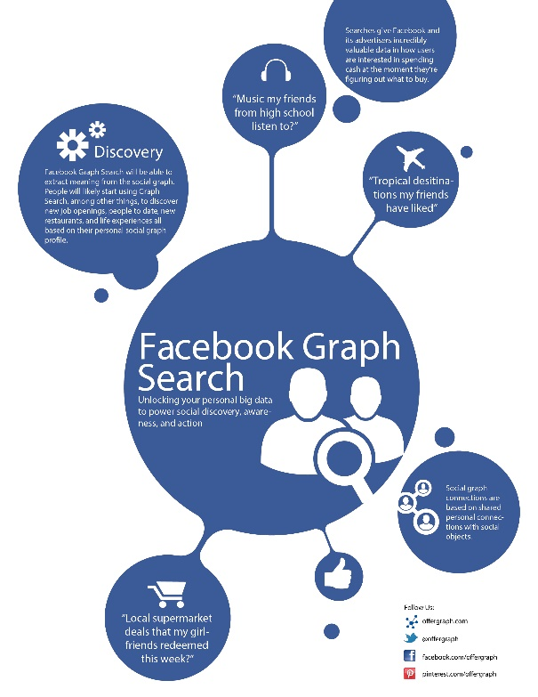

Social Media
Facebook Statistics
1.35 Billion active monthly users
864 Million daily active users
21minutes per day on average
300 Petabytes of user data
300 friends on avg for teens
Age group:15-34 (66%), 12-17 (28%)
Twitter Statistics
1 Billion registered users
100 Million daily active users
208 followers on avg per tweet
http://www.internetlivestats.com/twitter-statistics/

Slide 9


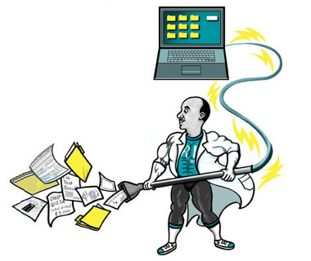
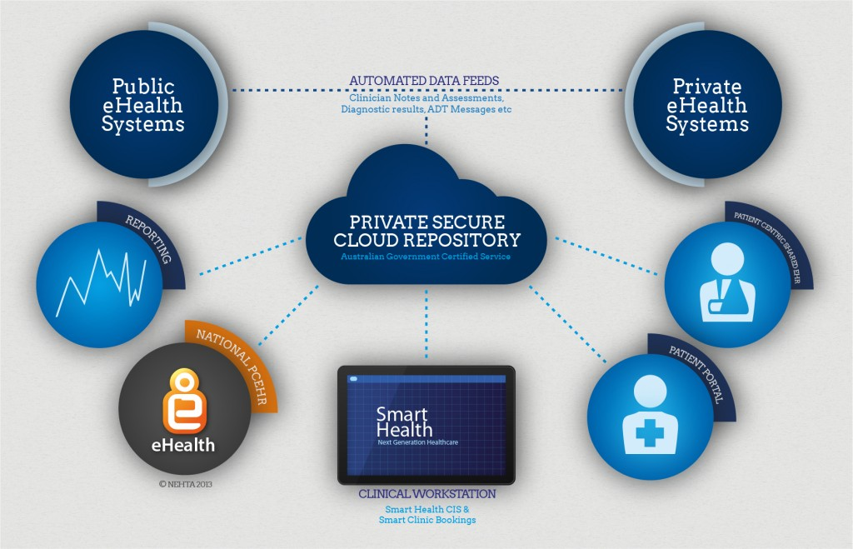
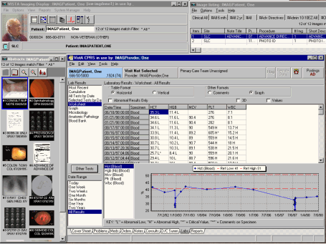
Smart Health
Notes:
Fitbit – everybody?

Slide 10
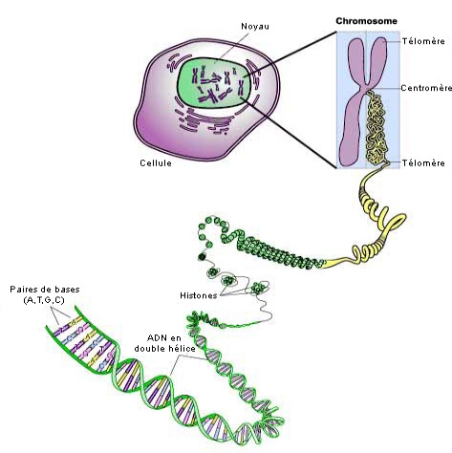
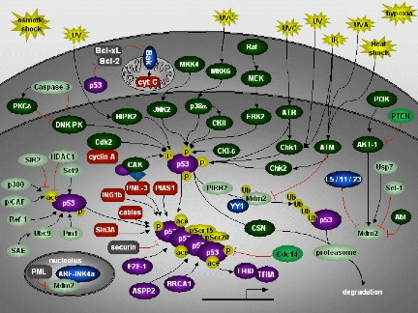
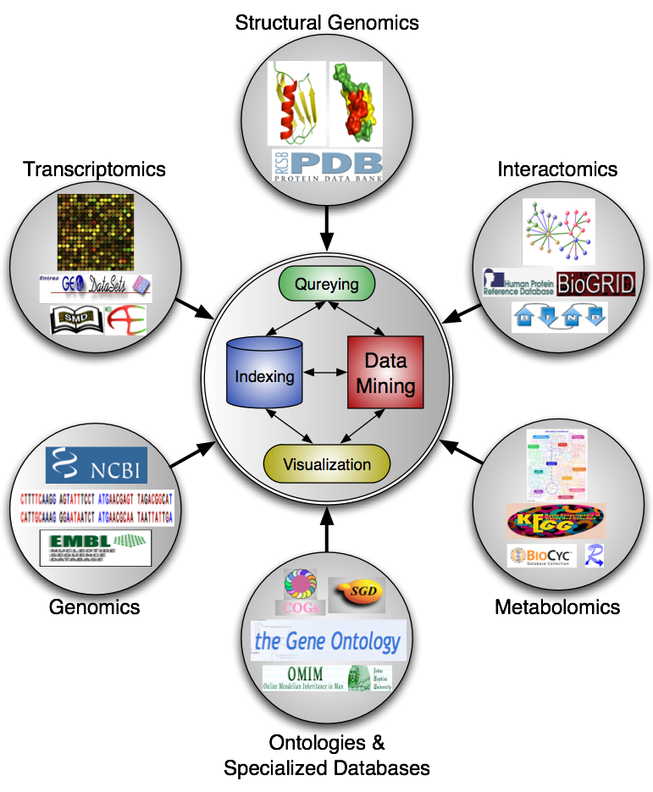
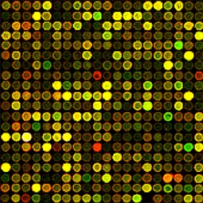
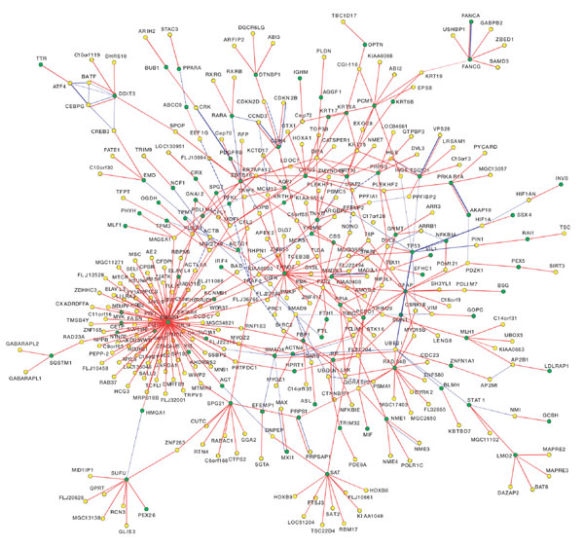
Bioinformatics

Slide 11
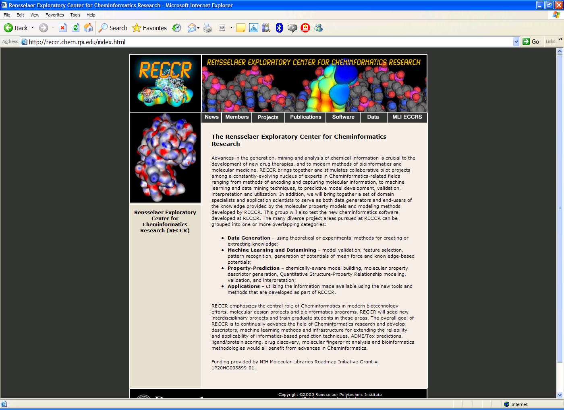

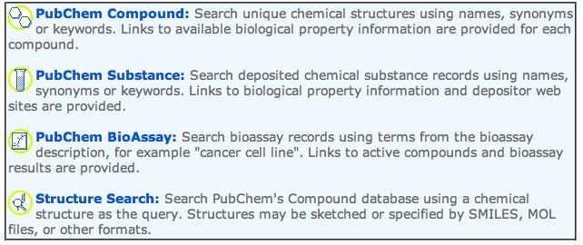
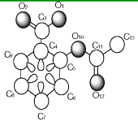
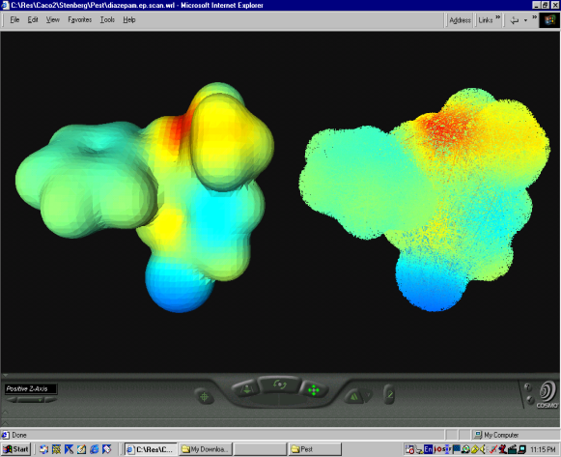
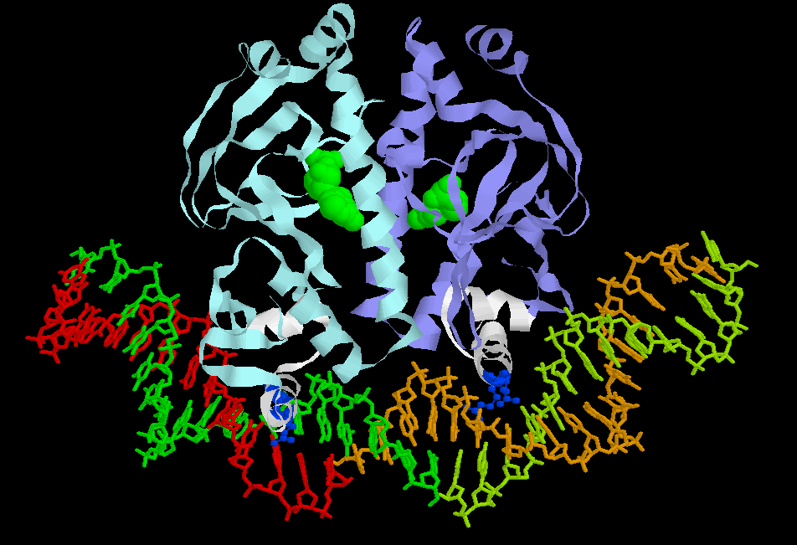
Chem-informatics
Structural Descriptors
Physiochemical Descriptors
Topological Descriptors
Geometrical Descriptors
AAACCTCATAGGAAGCATACCAGGAATTACATCA…

Slide 12
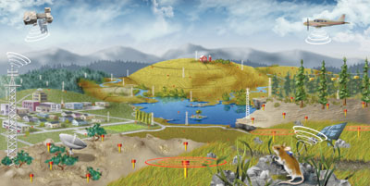

Eco-informatics
Analyze complex ecological data from a highly-distributed set of field stations, laboratories, research sites, and individual researchers

Slide 13
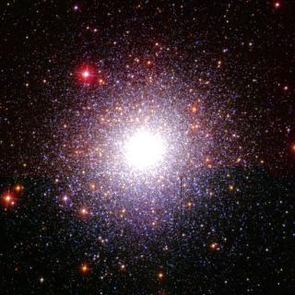
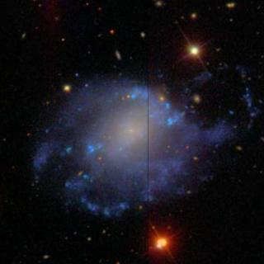
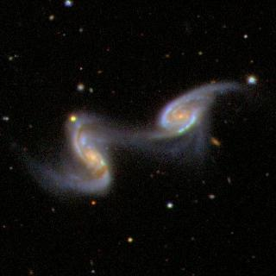
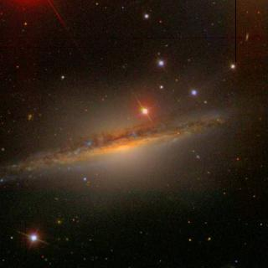
Astro-Informatics
New Astronomy
  Local vs. Distant Universe
  Rare/exotic objects
  Census of active galactic nuclei
  Search extra-solar planets
National Virtual Observatory: Rise of the citizen scientist!

Slide 14
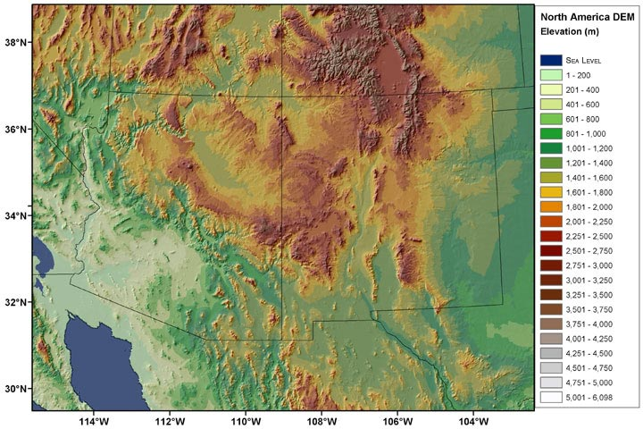
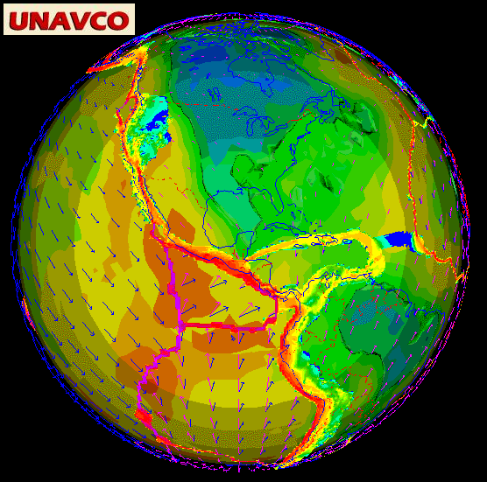
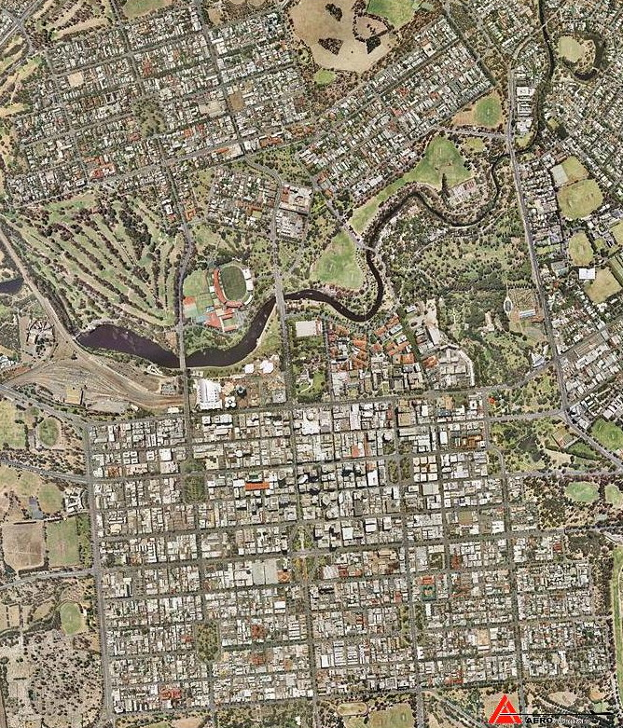
Geo-Informatics location-based services, humanitarian efforts
Notes:
What is data with geo-science?

Slide 15
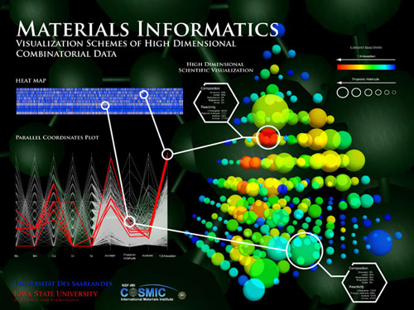
Materials Informatics
(Materials Genome Initiative)

Slide 16
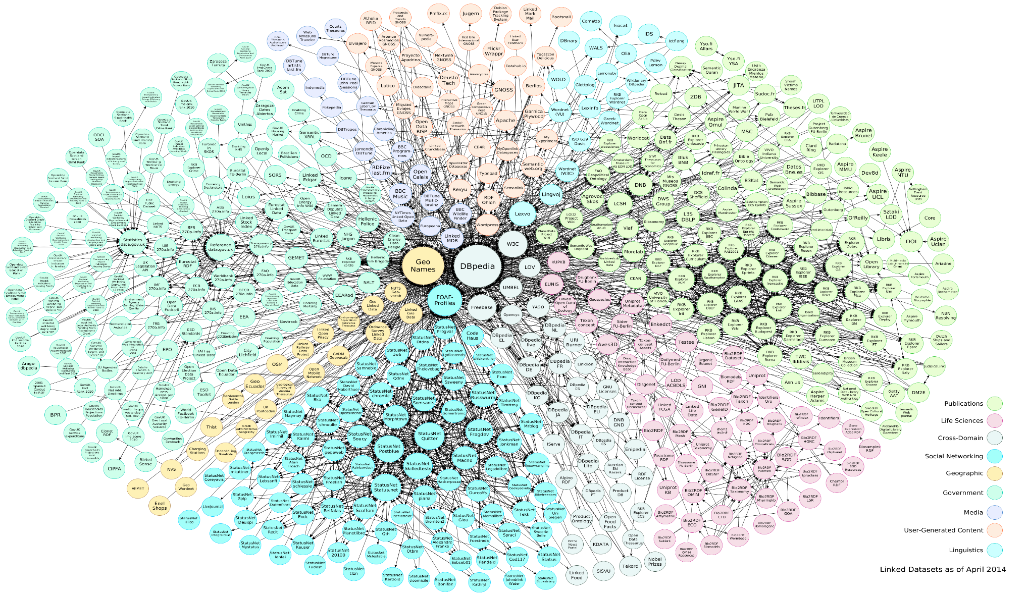
Linked Open Data
570 Datasets and 2909 Interconnections

Slide 17


The Data Deluge: Rise of
Complex Interlinked Data
Massive amounts of DATA
Various modalities: Tables, Text, Images, Video, Ontologies, Graphs
Enriched Data: Weighted, Multi-labeled, Temporal/spatial attributes
Distributed, Uncertain, Dynamic
Massive: Tera/peta-scale & beyond
Data Data Everywhere, Not Any Drop of Insight!

Slide 18
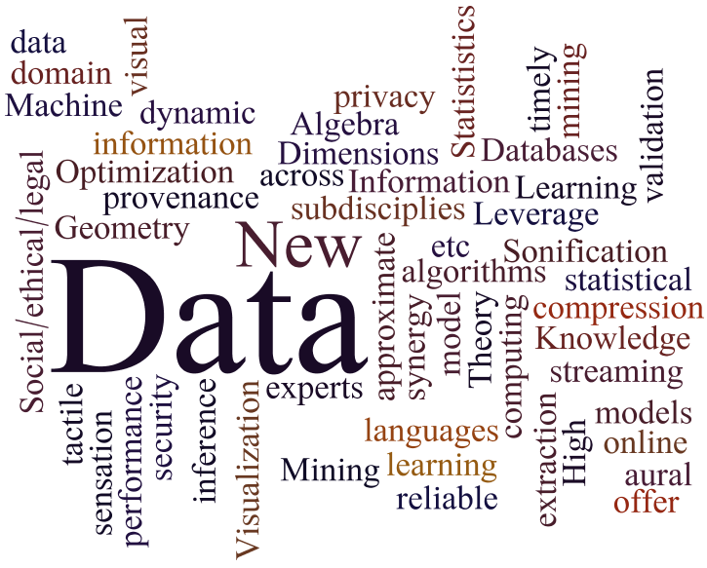
Data Mining
Enabling the New Science of Data
Study of DATA in its own right
Develop methods and frameworks across various fields
New data models: dynamic, streaming, etc.
New mining algorithms that offer timely and reliable inference and information extraction: online, approximate
Self-aware, intelligent continuous data analysis and mining
Data Language(s)
Data and model compression
Data provenance
Data security and privacy
Data sensation: visual, aural, tactile

Slide 19
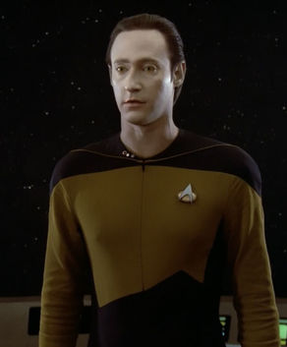
From Data Mining To Data Meaning: Metaphors
  Think MATLAB for matrices
  Think Web 2.0 for web mash-up
      Content Mgmt Systems
      Pinterest, Evernote, etc.
      Twitter, Facebook, etc.
  Think Wolfram Alpha
  Think Star Trek’s Data
DATA: storage 100 PB, compute 60 TeraFLOPs

Slide 20
What is Data Mining?
The iterative and interactive process of discovering valid, novel, useful, and understandable patterns or models in Massive databases

Slide 21
What is Data Mining?
Valid: generalize to the future
Novel: what we don't know
Useful: be able to take some action
Understandable: leading to insight
Iterative: takes multiple passes
Interactive: human in the loop

Slide 22
Data mining: Main Goals
Prediction
  What?
  Opaque
Description
  Why?
  Transparent
Age
Model
Salary
High/Low Risk
CarType
outlier

Slide 23
Data Mining: Main Techniques
Classification: assign a new data record to one of several predefined categories or classes. Also called supervised learning.
Regression: deals with predicting real-valued fields.
Clustering: partition the dataset into subsets or groups such that elements of a group share a common set of properties, with high within group similarity and small inter-group similarity. Also called unsupervised learning.

Slide 24
Data Mining: Main Techniques
Pattern Mining: detect set, sequence, or interlinked/graph patterns among entities and their attributes. Discover rules. For example, people who buy book X, also buy book Y. Or patterns of website visit, or social search.
Outlier/anomaly detection: find the record(s) that is (are) the most different from the other records, i.e., find all outliers. These may be thrown away as noise or may be the “interesting” ones.

Slide 25
Data Mining Process
Interpretation
Data Mining
Transformation
Preprocessing
Knowledge
Selection
Patterns
Transformed
Data
Preprocessed
Data
Original
Data
Target
Data

Slide 26
Data Mining Process
Understand application domain
  Prior knowledge, user goals
Create target dataset
  Select data, focus on subsets
Data cleaning and transformation
  Remove noise, outliers, missing values
  Select features, reduce dimensions
Interpretation
Data Mining
Transformation
Preprocessing
Knowledge
Selection
Patterns
Transformed
Data
Preprocessed
Data
Original
Data
Target
Data

Slide 27
Data Mining Process
Apply data mining algorithm
  Associations, sequences, classification, clustering, etc.
Interpret, evaluate and visualize patterns
  What's new and interesting?
  Iterate if needed
Manage discovered knowledge
  Close the loop
Interpretation
Data Mining
Transformation
Preprocessing
Knowledge
Selection
Patterns
Transformed
Data
Preprocessed
Data
Original
Data
Target
Data

Slide 28
Components of Data Mining Methods
Representation: language for patterns/models, expressive power
Evaluation: scoring methods for deciding what is a good fit of model to data
Search: method for enumerating patterns/models

Slide 29
Kaggle: Data Science Challenges

Slide 30
Data Mining Tasks
Prediction Methods
  Use some variables to predict unknown or future values of other variables.
Description Methods
  Find human-interpretable patterns that describe the data.
From [Fayyad, et.al.] Advances in Knowledge Discovery and Data Mining, 1996

Slide 31
Data Mining Tasks...
Classification [Predictive]
Clustering [Descriptive]
Association Rule Discovery [Descriptive]
Regression [Predictive]
Semi-supervised Learning
  Semi-supervised Clustering
  Semi-supervised Classification

Slide 32
Data Mining Tasks Cover in this Course
Classification [Predictive]
Association Rule Discovery [Descriptive]
Clustering [Descriptive]
Deviation Detection [Predictive]
Semi-supervised Learning
  Semi-supervised Clustering
  Semi-supervised Classification

Slide 33
Survey
Why are you taking this course?
What would you like to gain from this course?
What topics are you most interested in learning about from this course?
Any other suggestions?

Slide 34
Reading assignment
Chapter 1: data mining and analysis

