Slide 1
Validation

Slide 2
Introduction
Validation addresses the problem of over-fitting.
Internal Validation: Validate your model on your current data set (cross-validation)
External Validation: Validate your model on a completely new dataset

Slide 3
Holdout validation
One way to validate your model is to fit your model on half your dataset (your “training set”) and test it on the remaining half of your dataset (your “test set”).
If over-fitting is present, the model will perform well in your training dataset but poorly in your test dataset.
Of course, you “waste” half your data this way, and often you don’t have enough data to spare…

Slide 4
Alternative strategies:
Leave-one-out validation (leave one observation out at a time; fit the model on the remaining training data; test on the held out data point).
K-fold cross-validation—what we will discuss today.

Slide 5
When is cross-validation used?
Anytime you want to prove that your model is not over-fit, that it will have good prediction in new datasets.

Slide 6
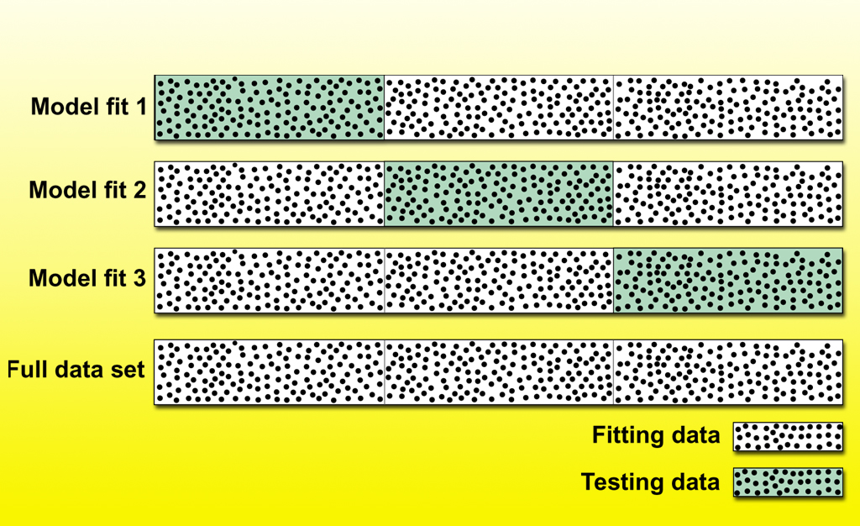
Division of Data for Cross-Validation with Disjoint Test Subsets

Slide 7
10-fold cross-validation (one example of K-fold cross-validation)
1. Randomly divide your data into 10 pieces, 1 through k.
2. Treat the 1st tenth of the data as the test dataset. Fit the model to the other nine-tenths of the data (which are now the training data).
3. Apply the model to the test data.
4. Repeat this procedure for all 10 tenths of the data.
5. Calculate statistics of model accuracy and fit (e.g., ROC curves) from the test data only.

