Slide 1
Animal Shelter Adoption
Best attribute for predicting outcome?
Ryan Taber
Hunter O’Rourke

Slide 2
The Data
Size of Data: 26730 Animals with 10 attributes
Type of Data: Categorical:
AnimalID | Name | DateTime | OutcomeType | OutcomeSubtype | AnimalType | SexuponOutcome | AgeuponOutcome | Breed | Color
A671945 | Hambone | 2014-02-12 18:22:00 | Return_to_owner | Foster | Dog | Neutered Male | 1 year | Shetland Sheepdog Mix | Brown / White
A656520 | Emily | 2013-10-13 12:44:00 | Euthanasia | Suffering | Cat | Spayed Female | 1 year | Domestic Shorthair Mix | Cream Tabby

Slide 3
The Data (cont)
Missing values:
  Names: Sometimes
  OutcomeSubtype: Sometimes
  SexuponOutcome: value = Unknown
Data used:
  SVM: Looking primarily at AgeuponOutcome, Breed, and Color
  Bayes: Ignored AnimalID, Name, DateTime, and OutcomeSubtype

Slide 4
Data Mining Tasks (Bayes)
Which attributes give the highest accuracy in predicting outcome?
Naiive Bayes
AnimalType | SexuponOutcome | AgeuponOutcome | Breed | Color
39.5% | 40.1% | 52.3% | 31.2% | 39.5%

Slide 5
Data Mining Tasks (Bayes)
Reasons why it didn’t work well
  Unique breed 1200+
  Unique colors 350+
  Data needs significant preprocessing before it becomes useful

Slide 6
Data Mining Tasks (SVM)
Followed template of homework 4.1
Using svm.SVC
  Linear, Poly, RBF and Sigmoid kernels
  ovo, ovr
Main questions:
  Age,Breed,Color combination on outcome
  Most impactful attribute on outcome
  Ideal feature adoption feature vector

Slide 7
Data Mining Tasks (SVM) - Process
Convert categorical variables to numerical
Ran on all AnimalTypes and Type-specific
Initial results for Age/Breed & Breed/Color
  Only for training data set
Minimize Breed and Color sets
  Breeds --> ~1200 to ~350
  Colors --> TBD

Slide 8
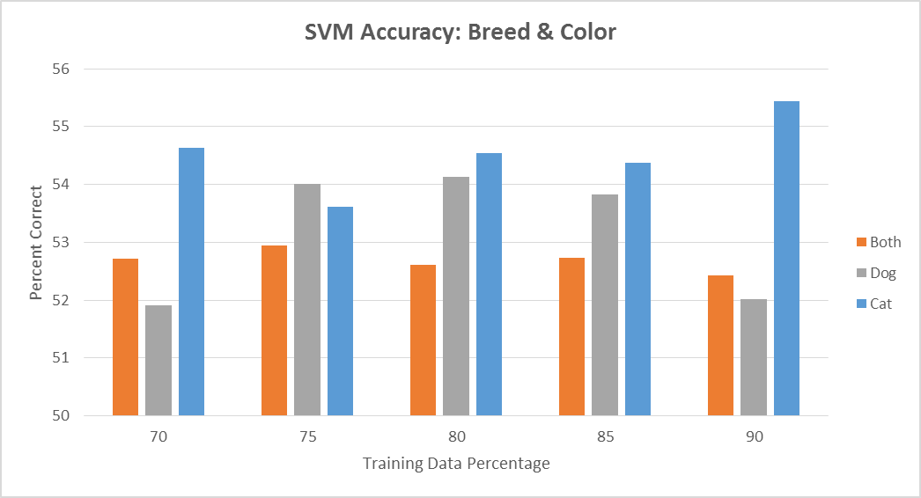
Data Mining Tasks (SVM)

Slide 9
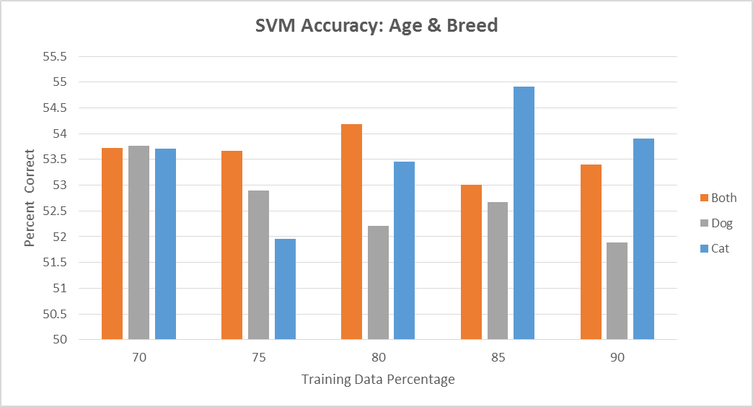
Data Mining Tasks (SVM)

Slide 10
Data Mining Tasks (SVM)
Moving to Dog Exclusively (because they are better)
  Train: ~16000
  Test: ~6650
Currently starting to ‘predict’ test data outcomes
  Very limited success so far
  Having trouble with prediction mainly

Slide 11
SVM vs Bayes
Ultimately, final Kaggle test data classification is the best
evaluation tool --> uses multi-class log loss grading function
Could run k-folds cross validation on the training data

Slide 12
Other’s Findings
In order variable importance using Random Forest
  AgeinDays
  Intact
  Hour
  Color
  Month
  Weekday
  HasName

Slide 13
Future Work
Significantly more preprocessing
  Dates -> season, weekday/end, times, etc.
  Name -> has name, male/female/uni, etc..
    Having Name + Age threshold more likely to be returned to Owner?
  Breeds -> reduce to dog types, short/long hair, etc..
  Color -> simpler colors ex. light, dark, ginger

