Slide 1
Presidential Tweets
Alijah Green and Ryan Shah

Slide 2
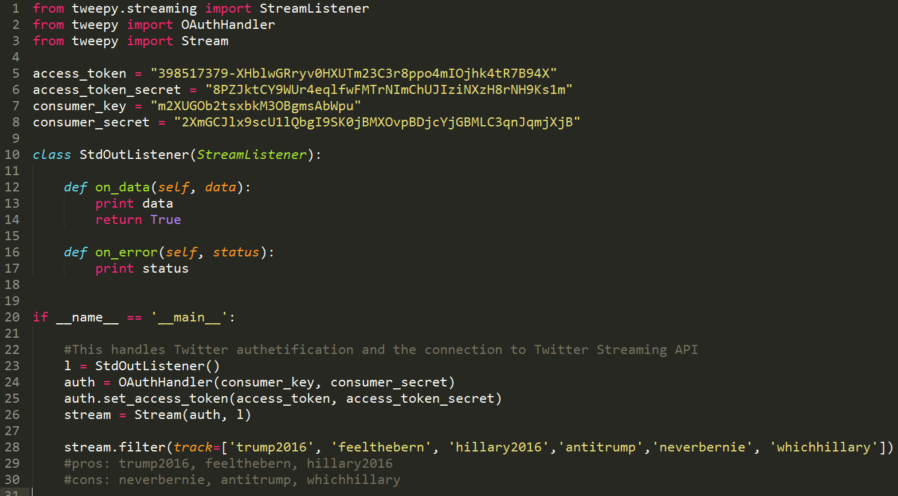
Gathering Data

Slide 3
Data – JSONs
{"created_at":"Fri Apr 22 06:32:35 +0000 2016","id":723399082052456448,"id_str":"723399082052456448","text":"RT @NationalNurses: You must register as a \"Democrat\" or \"No Party Preference\" to vote for @BernieSanders in CA. #FeelTheBern #CAPrimary ht\u2026","source":"\u003ca href=\"http:\/\/twitter.com\/download\/android\" rel=\"nofollow\"\u003eTwitter for Android\u003c\/a\u003e","truncated":false,"in_reply_to_status_id":null,"in_reply_to_status_id_str":null,"in_reply_to_user_id":null,"in_reply_to_user_id_str":null,"in_reply_to_screen_name":null,"user":{"id":166707534,"id_str":"166707534","name":"Pamela Gwynn","screen_name":"madcat44","location":"Blue in Red State Indiana","url":null,"description":"Liberal,Progressive #Obama\/Biden #UniteBlue I block RWNJs. Ex-GOP, won't go back. Sorry, I live in IN. #Colts","protected":false,"verified":false,"followers_count":2966,"friends_count":3271,"listed_count":91,"favourites_count":5627,"statuses_count":29008,"created_at":"Wed Jul 14 20:28:49 +0000 2010","utc_offset":-14400,"time_zone":"Eastern Time (US & Canada)","geo_enabled":true,"lang":"en","contributors_enabled":false,"is_translator":false,"profile_background_color":"000000","profile_background_image_url":"http:\/\/abs.twimg.com\/images\/themes\/theme4\/bg.gif","profile_background_image_url_https":"https:\/\/abs.twimg.com\/images\/themes\/theme4\/bg.gif","profile_background_tile":false,"profile_link_color":"3B94D9","profile_sidebar_border_color":"000000","profile_sidebar_fill_color":"000000","profile_text_color":"000000","profile_use_background_image":false,"profile_image_url":"http:\/\/pbs.twimg.com\/profile_images\/511380947824934913\/U2TQQDAR_normal.png","profile_image_url_https":"https:\/\/pbs.twimg.com\/profile_images\/511380947824934913\/U2TQQDAR_normal.png","profile_banner_url":"https:\/\/pbs.twimg.com\/profile_banners\/166707534\/1353038735","default_profile":false,"default_profile_image":false,"following":null,"follow_request_sent":null,"notifications":null},"geo":null,"coordinates":null,"place":null,"contributors":null,"retweeted_status":{"created_at":"Fri Apr 22 01:08:43 +0000 2016","id":723317578613952512,"id_str":"723317578613952512","text":"You must register as a \"Democrat\" or \"No Party Preference\" to vote for @BernieSanders in CA. #FeelTheBern #CAPrimary https:\/\/t.co\/q1AO0UyamR","source":"\u003ca href=\"http:\/\/twitter.com\" rel=\"nofollow\"\u003eTwitter Web Client\u003c\/a\u003e","truncated":false,"in_reply_to_status_id":null,"in_reply_to_status_id_str":null,"in_reply_to_user_id":null,"in_reply_to_user_id_str":null,"in_reply_to_screen_name":null,"user":{"id":21146733,"id_str":"21146733","name":"NationalNursesUnited","screen_name":"NationalNurses","location":"United States of America","url":"http:\/\/www.nationalnursesunited.org","description":"National Nurses United: The largest RN Union in U.S. history, with more than 185,000 nurses nationwide. Executive Director is @RoseAnnDeMoro","protected":false,"verified":false,"followers_count":21381,"friends_count":2785,"listed_count":631,"favourites_count":1612,"statuses_count":14237,"created_at":"Tue Feb 17 23:38:56 +0000 2009","utc_offset":-25200,"time_zone":"Pacific Time (US & Canada)","geo_enabled":true,"lang":"en","contributors_enabled":false,"is_translator":false,"profile_background_color":"990000","profile_background_image_url":"http:\/\/pbs.twimg.com\/profile_background_images\/563801070430728192\/VXrz1VHg.png","profile_background_image_url_https":"https:\/\/pbs.twimg.com\/profile_background_images\/563801070430728192\/VXrz1VHg.png","profile_background_tile":false,"profile_link_color":"990000","profile_sidebar_border_color":"FFFFFF","profile_sidebar_fill_color":"F3F3F3","profile_text_color":"4A4037","profile_use_background_image":true,"profile_image_url":"http:\/\/pbs.twimg.com\/profile_images\/649255865678036992\/d-EniETJ_normal.png","profile_image_url_https":"https:\/\/pbs.twimg.com\/profile_images\/649255865678036992\/d-EniETJ_normal.png","profile_banner_url":"https:\/\/pbs.twimg.com\/profile_banners\/21146733\/1423256641","default_profile":false,"default_profile_image":false,"following":null,"follow_request_sent":null,"notifications":null},"geo":null,"coordinates":null,"place":{"id":"3b77caf94bfc81fe","url":"https:\/\/api.twitter.com\/1.1\/geo\/id\/3b77caf94bfc81fe.json","place_type":"city","name":"Los Angeles","full_name":"Los Angeles, CA","country_code":"US","country":"United States","bounding_box":{"type":"Polygon","coordinates":[[[-118.668404,33.704538],[-118.668404,34.337041],[-118.155409,34.337041],[-118.155409,33.704538]]]},"attributes":{}},"contributors":null,"is_quote_status":false,"retweet_count":193,"favorite_count":142,"entities":{"hashtags":[{"text":"FeelTheBern","indices":[93,105]},{"text":"CAPrimary","indices":[106,116]}],"urls":[],"user_mentions":[{"screen_name":"BernieSanders","name":"Bernie Sanders","id":216776631,"id_str":"216776631","indices":[71,85]}],"symbols":[],"media":[{"id":723317578131595265,"id_str":"723317578131595265","indices":[117,140],"media_url":"http:\/\/pbs.twimg.com\/media\/Cgm9gUhUYAECIiL.jpg","media_url_https":"https:\/\/pbs.twimg.com\/media\/Cgm9gUhUYAECIiL.jpg","url":"https:\/\/t.co\/q1AO0UyamR","display_url":"pic.twitter.com\/q1AO0UyamR","expanded_url":"http:\/\/twitter.com\/NationalNurses\/status\/723317578613952512\/photo\/1","type":"photo","sizes":{"small":{"w":340,"h":340,"resize":"fit"},"thumb":{"w":150,"h":150,"resize":"crop"},"large":{"w":1024,"h":1024,"resize":"fit"},"medium":{"w":600,"h":600,"resize":"fit"}}}]},"extended_entities":{"media":[{"id":723317578131595265,"id_str":"723317578131595265","indices":[117,140],"media_url":"http:\/\/pbs.twimg.com\/media\/Cgm9gUhUYAECIiL.jpg","media_url_https":"https:\/\/pbs.twimg.com\/media\/Cgm9gUhUYAECIiL.jpg","url":"https:\/\/t.co\/q1AO0UyamR","display_url":"pic.twitter.com\/q1AO0UyamR","expanded_url":"http:\/\/twitter.com\/NationalNurses\/status\/723317578613952512\/photo\/1","type":"photo","sizes":{"small":{"w":340,"h":340,"resize":"fit"},"thumb":{"w":150,"h":150,"resize":"crop"},"large":{"w":1024,"h":1024,"resize":"fit"},"medium":{"w":600,"h":600,"resize":"fit"}}}]},"favorited":false,"retweeted":false,"possibly_sensitive":false,"filter_level":"low","lang":"en"},"is_quote_status":false,"retweet_count":0,"favorite_count":0,"entities":{"hashtags":[{"text":"FeelTheBern","indices":[113,125]},{"text":"CAPrimary","indices":[126,136]}],"urls":[],"user_mentions":[{"screen_name":"NationalNurses","name":"NationalNursesUnited","id":21146733,"id_str":"21146733","indices":[3,18]},{"screen_name":"BernieSanders","name":"Bernie Sanders","id":216776631,"id_str":"216776631","indices":[91,105]}],"symbols":[],"media":[{"id":723317578131595265,"id_str":"723317578131595265","indices":[139,140],"media_url":"http:\/\/pbs.twimg.com\/media\/Cgm9gUhUYAECIiL.jpg","media_url_https":"https:\/\/pbs.twimg.com\/media\/Cgm9gUhUYAECIiL.jpg","url":"https:\/\/t.co\/q1AO0UyamR","display_url":"pic.twitter.com\/q1AO0UyamR","expanded_url":"http:\/\/twitter.com\/NationalNurses\/status\/723317578613952512\/photo\/1","type":"photo","sizes":{"small":{"w":340,"h":340,"resize":"fit"},"thumb":{"w":150,"h":150,"resize":"crop"},"large":{"w":1024,"h":1024,"resize":"fit"},"medium":{"w":600,"h":600,"resize":"fit"}},"source_status_id":723317578613952512,"source_status_id_str":"723317578613952512","source_user_id":21146733,"source_user_id_str":"21146733"}]},"extended_entities":{"media":[{"id":723317578131595265,"id_str":"723317578131595265","indices":[139,140],"media_url":"http:\/\/pbs.twimg.com\/media\/Cgm9gUhUYAECIiL.jpg","media_url_https":"https:\/\/pbs.twimg.com\/media\/Cgm9gUhUYAECIiL.jpg","url":"https:\/\/t.co\/q1AO0UyamR","display_url":"pic.twitter.com\/q1AO0UyamR","expanded_url":"http:\/\/twitter.com\/NationalNurses\/status\/723317578613952512\/photo\/1","type":"photo","sizes":{"small":{"w":340,"h":340,"resize":"fit"},"thumb":{"w":150,"h":150,"resize":"crop"},"large":{"w":1024,"h":1024,"resize":"fit"},"medium":{"w":600,"h":600,"resize":"fit"}},"source_status_id":723317578613952512,"source_status_id_str":"723317578613952512","source_user_id":21146733,"source_user_id_str":"21146733"}]},"favorited":false,"retweeted":false,"possibly_sensitive":false,"filter_level":"low","lang":"en","timestamp_ms":"1461306755923"}

Slide 4
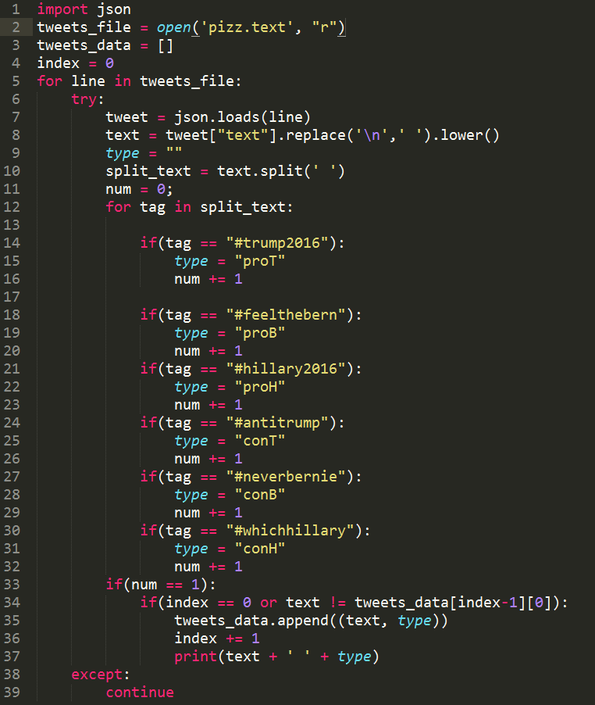
Data Processing
Python JSON library
42600 Tweets
14789 usable tweets

Slide 5
Processed Data
because #hillaryistrump #feelthebern #bernieorbust #imwithher https://t.co/vt3awgox4z proB
#feelthebern https://t.co/zh2mq4xypk proB
rt @picbernie2016: #feelthebern #notmeus #stillsanders #iwillnotyield #politicalrevolution #demdebate https://t.co/jkzaqsrdsh proB
actions speak louder than words. #feelthebern #election2016 #bernieforpresident https://t.co/rwwestce0d proB
hillary clinton was just mentioned on msnbc #hillaryclinton #hillary2016 read more: https://t.co/bwehtrgwfy proH
looks just like a .@hillaryclinton email. #stillsanders #releasethehotsauce #feelthebern https://t.co/rqgdxskflg proB
rt @ncforbernie: busted: pro-clinton super pac caught spending $1 million on social media trolls https://t.co/5vdj5e8zqm #feelthebern proB
@dylanratigan's departure from now #msdnc was its greatest moral loss of the past decade. #feelthebern https://t.co/jznxjwsiza proB
rt @klsouth: #trump2016 #trump https://t.co/lah3ulby1o proT
rt @myriamwinner: @mygianluca @chriskyleband @drjamescabot @ericbolling @women4trump @1luckylady_ vote #trump2016 #maga proT

Slide 6
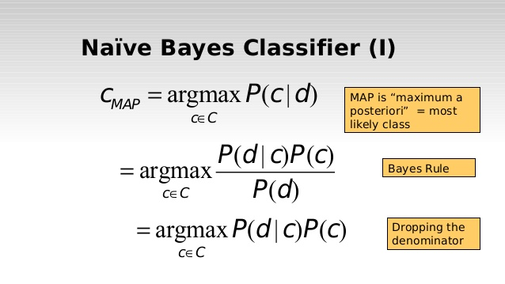
Naïve Bayes
Reading the data
  Stripping unnecessary characters/words
  Separating important words
Training the Classification Model
Predicting Results
  Accuracy of Predictions

Slide 7
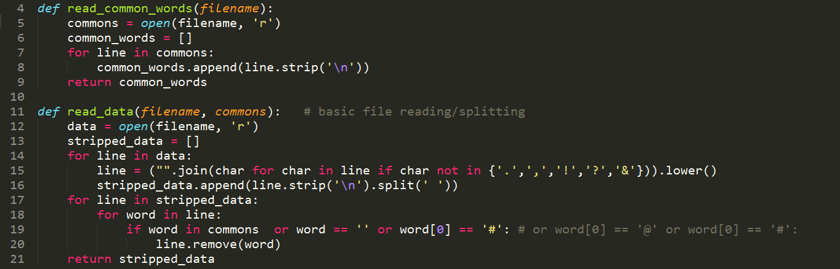
Reading Data

Slide 8
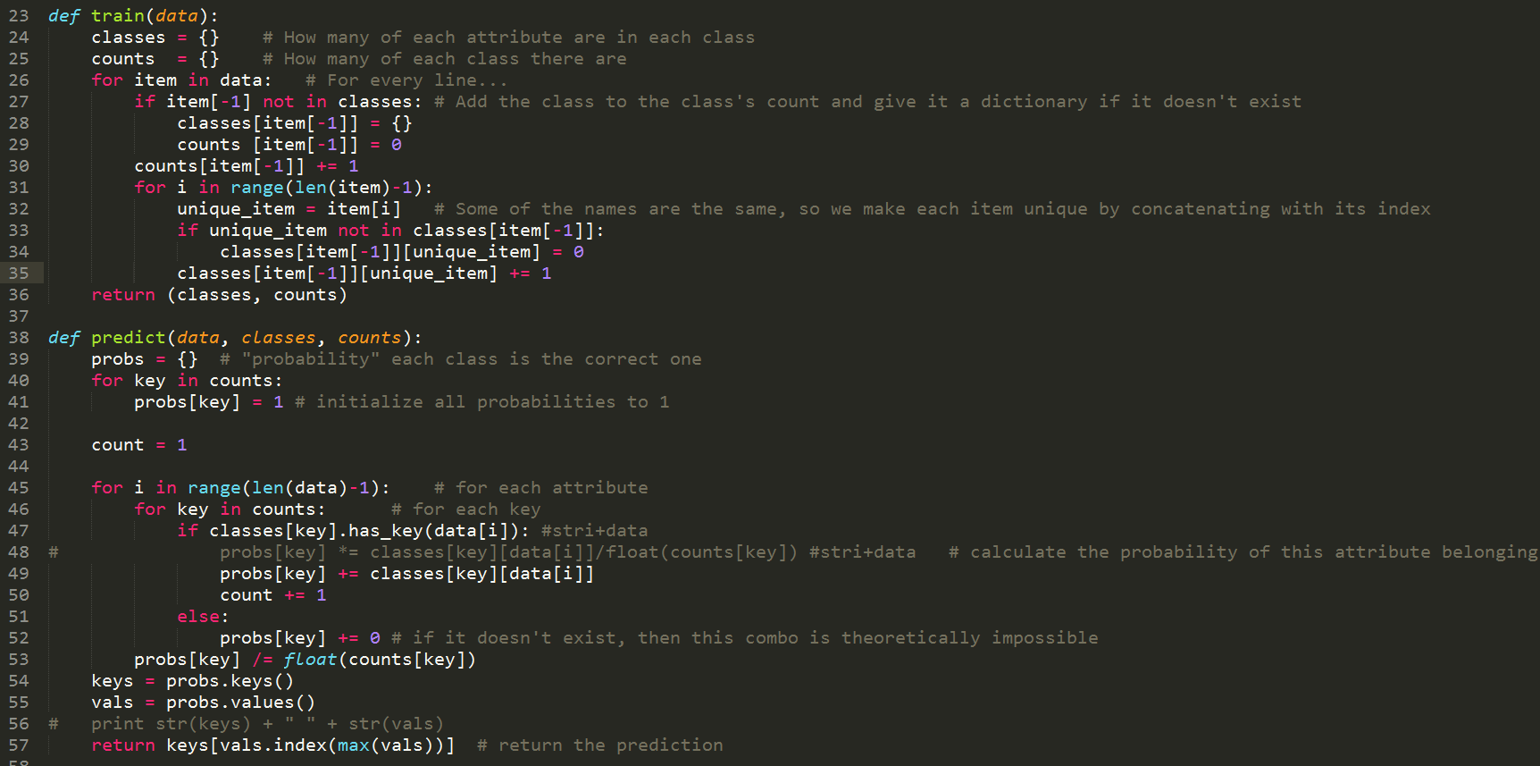
Training and Prediction

Slide 9
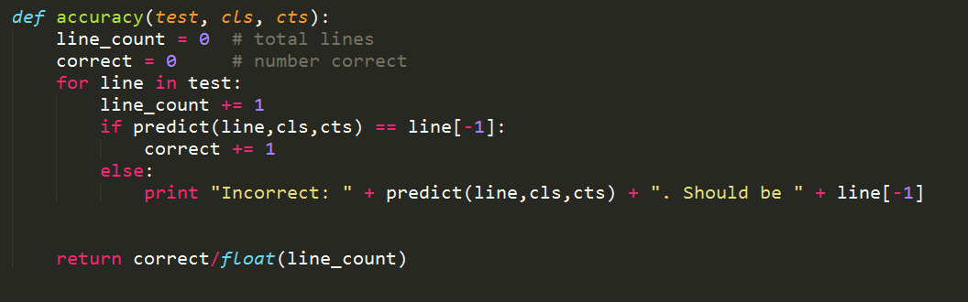
Determining Accuracy

Slide 10
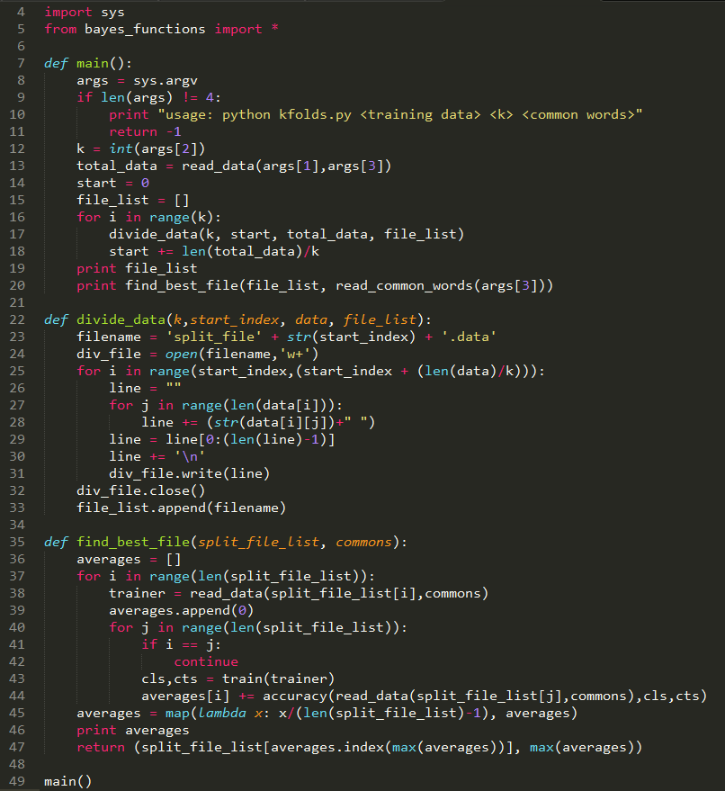
K-Folds

Slide 11
RESULTS
python naive_bayes.py xaa read_data.txt common_words.txt
  0.885320170397
python kfolds.py read_data.txt 4 common_words.txt
  ('split_file11091.data', 0.6040032458750338)
python naive_bayes.py split_file11091.data read_data.txt common_words.txt
  0.614984109811
python kfolds.py read_data.txt 10 common_words.txt
  ('split_file7390.data', 0.7979251240414976)
python naive_bayes.py split_file7390.data read_data.txt common_words.txt
  0.858813983366

Slide 12

Questions and Future Applications

