Slide 1
SHELTER ANIMAL OUTCOMES DATASET
By: James Alford-Golojuch
Kirk Hardy
Taran Stuckman

Slide 2
Naïve Bayes Classifier

Slide 3
Dataset Size
26727 Items in Training dataset
11 Provided Attributes
9 Attributes Used in Training
11456 Items in Testing dataset
9 Provided Attributes
8 Attributes Used in Testing

Slide 4
Attributes Used
Attributes:
Pet Name
Date/Time of Outcome
Outcome Type (Training Data only)
Animal Type
Sex of Animal
Age upon Outcome
Breed
Color
Intact/Neutered

Slide 5
Missing/Unknown Values
For Outcome Subtype Attribute:
Not used
Only 50% contained known values
In other attributes
Classified unknown age as 2-5 year old category
Other unknown values added as own separate category

Slide 6
Naïve Bayes Classifier
What is it for?:
To see if we can predict the future of an animal in a shelter through classification.
Why Naïve Bayes?:
Many items for training so outliers don’t have large impact on probabilities
Many different attributes to take into account for prediction/classification

Slide 7
Naïve Bayes Classifier
N=5 classes for classification
K=8 Symptoms to determine classification
Each K has M=2-12 possible values
Symptoms are:
If animal has name
Month of outcome
Animal type (Dog or Cat)
Sex of Animal
Age at outcome
Breed of animal
Color of fur
Has animal been neutered/spayed

Slide 8
Naïve Bayes Classifier
Determining accuracy (90% for training, 10% for testing accuracy)
Accuracy expectations:
Better than random (20% accuracy)
Attempting to get at least 50% accuracy

Slide 9
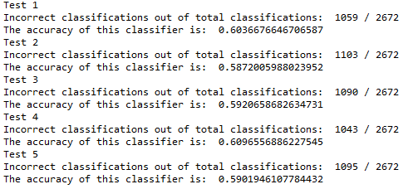
Naïve Bayes Classifier
Results for accuracy:
Accuracy of about 60%

Slide 10
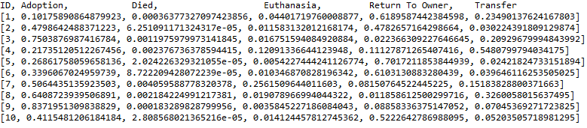
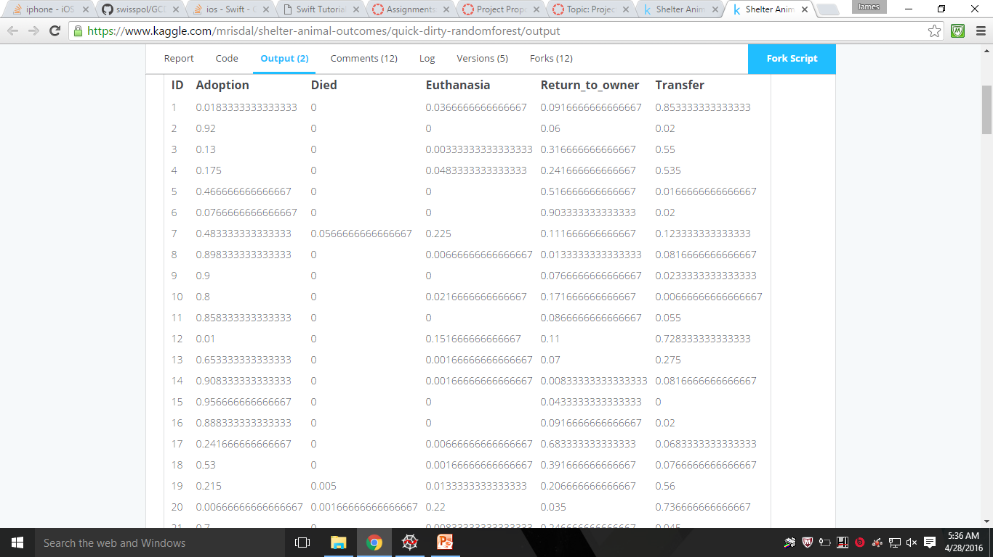
Naïve Bayes Classifier
Results using test Data:
Other Kaggle Submission:

Slide 11
Naïve Bayes Classifier
Final Test Prediction Numbers
Our Naïve Bayes Classifier:
Adoption - 4403
Died - 0
Euthanasia - 41
Return to owner - 3808
Transfer - 3204
Other user’s Random Forest Classification:
Adoption - 5688
Died - 11
Euthanasia - 167
Return to owner - 1856
Transfer - 3734

Slide 12
Naïve Bayes Classifier
Challenges from project:
Deciding how to classify breeds for cat/dog
How to classify and group colors
Improving accuracy of classifier
Improvements
Find other ways to classify attributes and add more attributes ex. Add an attribute categorizing breeds based on popularity

Slide 13
Apriori Association Rules

Slide 14
Apriori Association Rules
Can we use association rules to predict adoption vs non adoption? (are there key factors to adoption likelihood of an animal)
Is there anything else Association Rules will tell us?

Slide 15
Apriori Association Rules
Challenges; data format difficult to load and deal with initially, required preprocessing
Python string comparison is very time consuming, dataset is 26,000 lines
Dataset is generally lacking (missing values, unimportant values, wide range of types of data)

Slide 16
Apriori Association Rules
A lot of things we weren’t asking for
Rule: ('s', 'm', 'g') ==> ('o',) , 0.885
Or already knew
Rule: ('sh',) ==> ('c',) , 0.997

Slide 17
Apriori Association Rules
Rule: ('s', 'z') ==> ('a',) , 0.854
accuracy: 0.7352660841938046
Rule: ('s', 'c') ==> ('a',) , 0.664
accuracy: 0.6538686131386862

Slide 18
Apriori Association Rules
Limitations:
Items in transactions are not of equal weight, (we only really care about one outcome)
Improvements:
Cut out meaningless data
Target specific groups of animals

Slide 19
Decision Tree

Slide 20
Decision Tree
What attributes appear to affect the adoption outcome of these animals?
Method: Decision Tree Analysis
Software: c4.5, c4.5rules

Slide 21
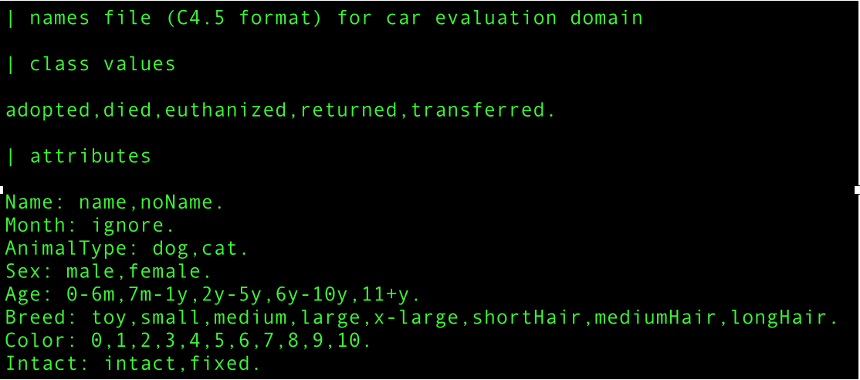
Decision Tree
Classifications:
Adopted, Died, Euthanized, Returned, Transferred
Attributes:
Name, Month*, Animal Type, Sex, Age, Breed, Color, Intact - (All Categorical)

Slide 22
Decision Tree
Changes:
-Removed all items where ‘Sex’ or ‘Intact’ were unknown.
-Similar to partners’ preprocessed data but with meaningful names instead of numerical identifiers.
Final Size:
Training -> 20,496 items
Test -> 5,123 items

Slide 23
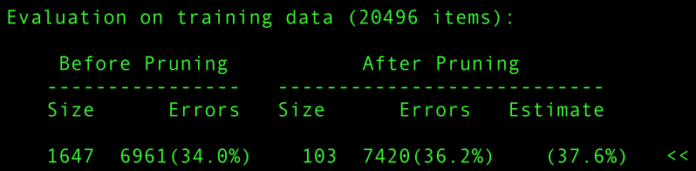
Decision Tree
Tree Results
Before Pruning: After Pruning:
Size: 1647 Size: 103
Error Rate: 34% Error Rate: 36.2%
Overfitting????

Slide 24
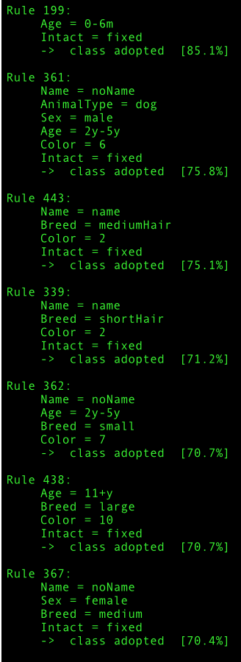
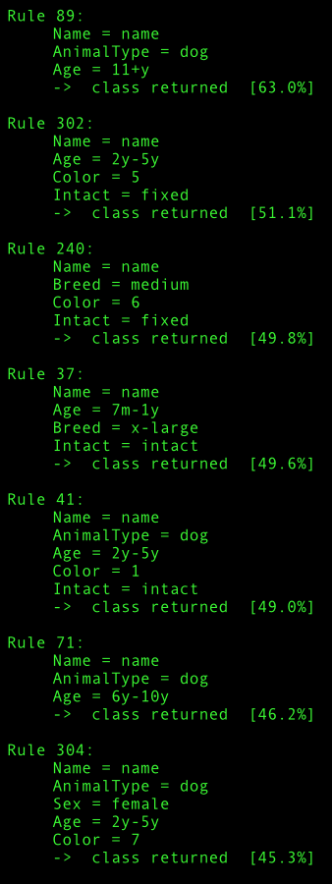
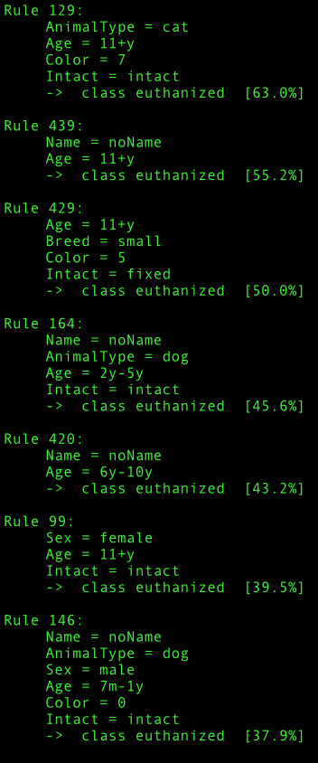
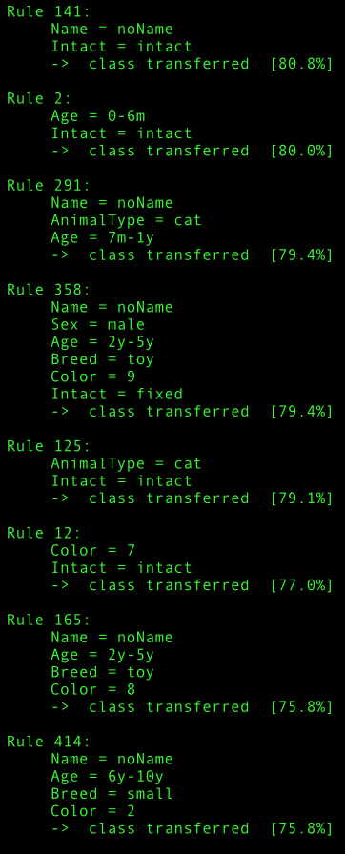
Decision Tree
Generated Rules

Slide 25
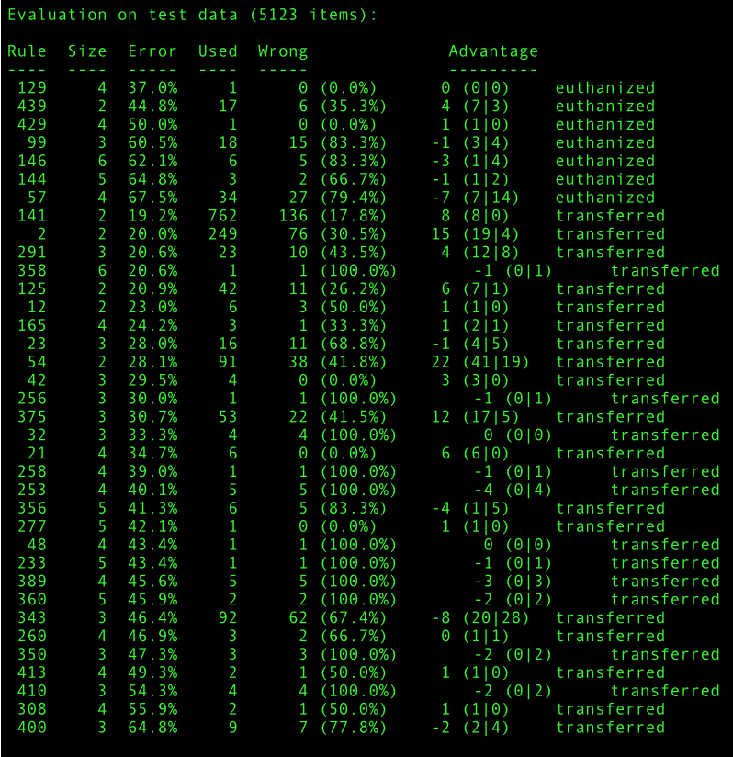
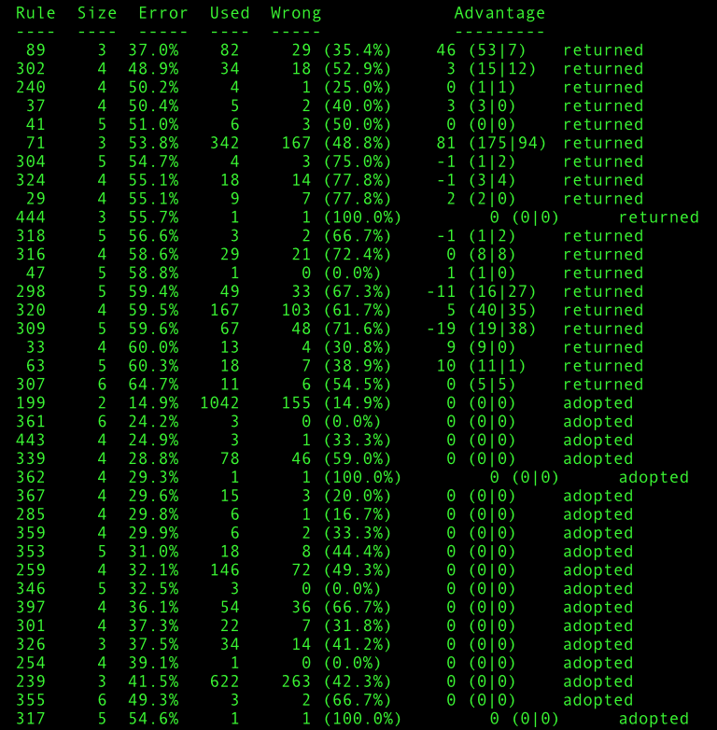
Decision Tree
Generated Rules

Slide 26
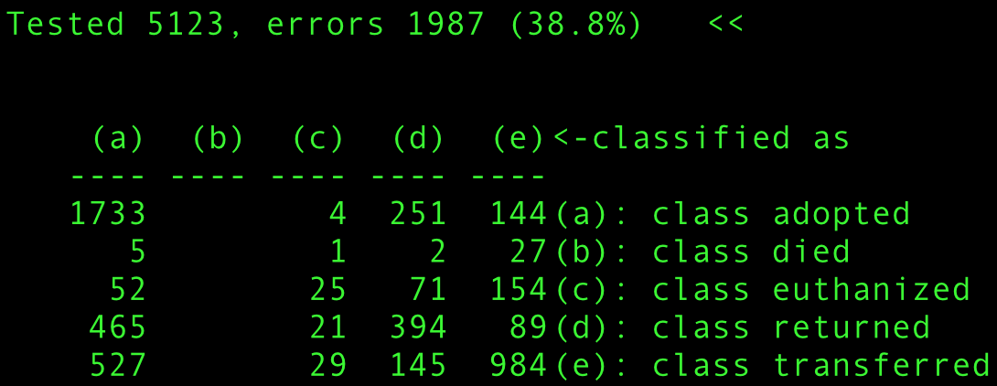
Decision Tree
Generated Rules

Slide 27
Decision Tree
Challenges:
-Working with c4.5 which has limited documentation and almost no community support on forums.
-Pre-processing data to work with c4.5
-Manipulating data to reduce error rate

Slide 28
Decision Tree
Improvements

