Slide 1
Iris Dataset Question
Samuel Cunningham
Mingdi Gao

Slide 2
The Data
150 samples
  Sepal Length and Width (Continuous)
  Petal Length and Width (Continuous)
  The species (Setosa, Versicolor, Virginica)

Slide 3
What to find?
Which two attributes would be best to use to predict the species?
Do these two attributes contain enough information that all other attributes can be ignored?
  2 dimensional dataset
  linearly separable with two lines)

Slide 4
Algorithms
Decision Tree
  DecisionTreeClassifier
  Gini and Information Gain
SVM
  Scikit learn’s nuSVC
  Kernal: rbf

Slide 5
Training and Prediction results
Decision Tree:
  Recall = 1.0
  Precision = 1.0
SVM:
  Recall = 0.97
  Precision = 0.98

Slide 6
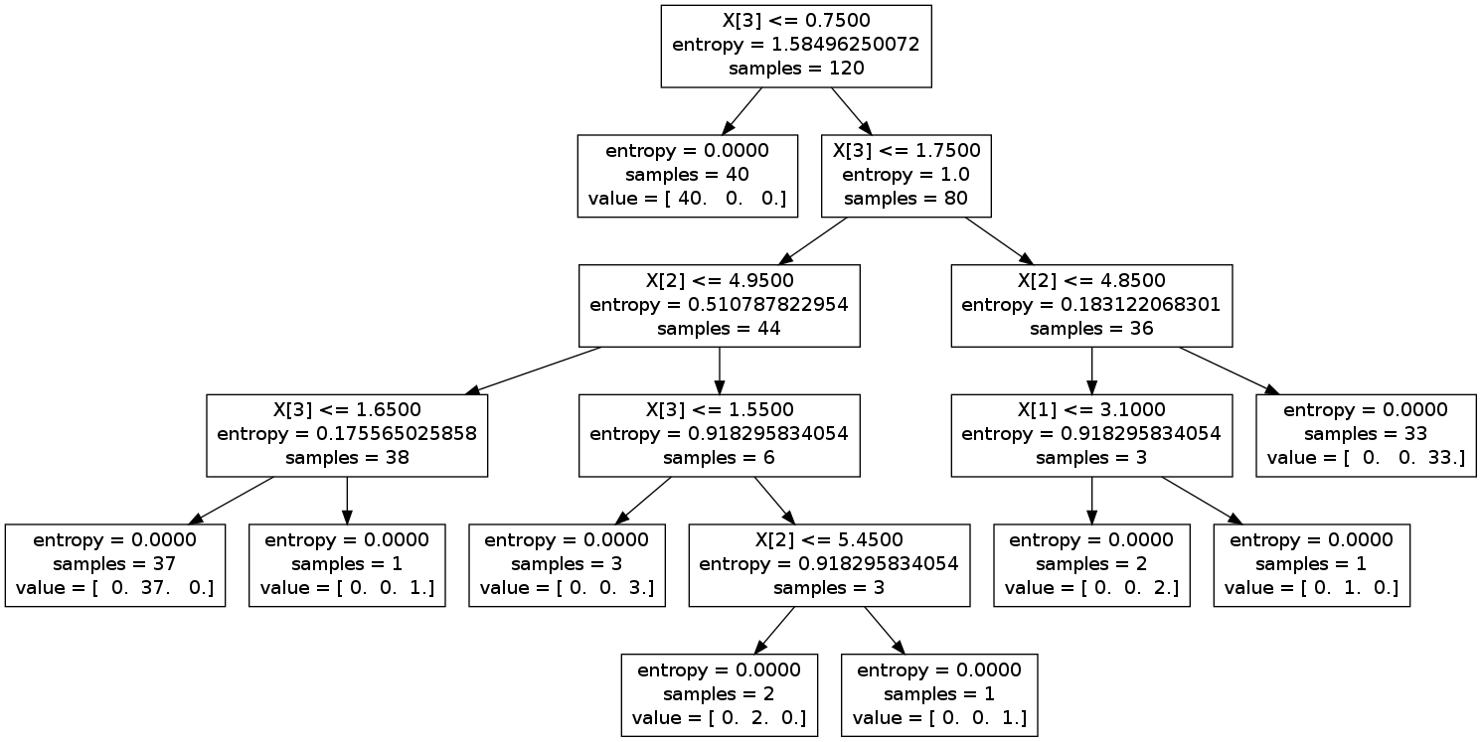
Tree Visualization(Info Gain)
X[3](Petal Width) appears as the best-split-feature and appear the most. X[2] also appear 3 time while X[1] appear only once and X[0] is not even here.

Slide 7
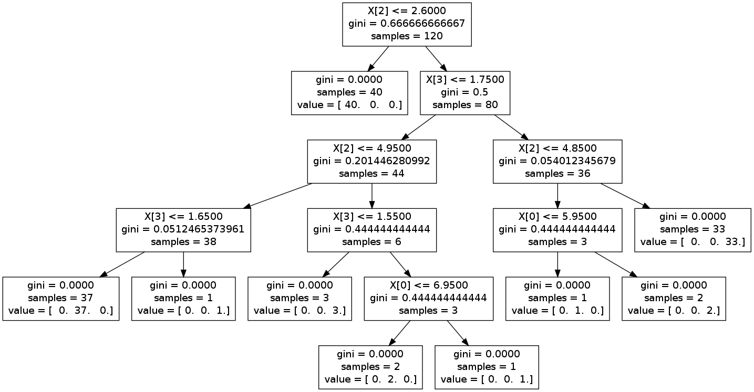
Tree Visualization(Gini)
X[2](Petal Length) appears as the best-split-feature and appear the most. X[3] also appear 3 time while X[0] appear only once and X[0] is not even here.

Slide 8
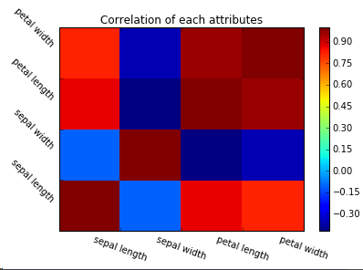
Attribute Correlation
Covariance of two variables divided by the product of their standard deviations. (Pearson product-moment correlation coefficient)

Slide 9
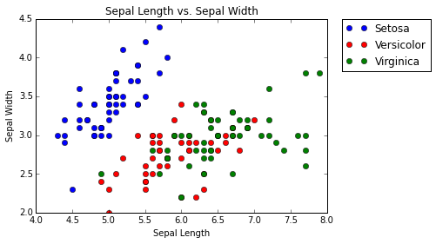
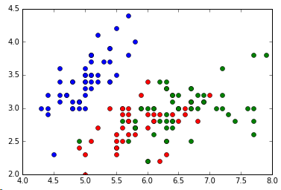
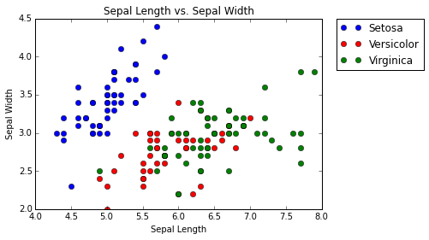
Sepal Length vs. Sepal Width
 | SVM | Tree
Actual
Predicted

Slide 10
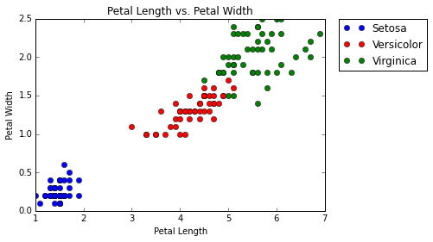
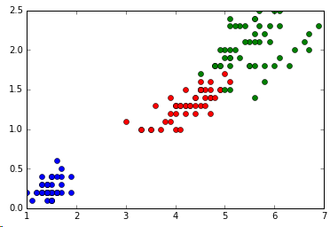

Petal Length vs. Petal Width
 | SVM | Tree
Actual
Predicted

Slide 11
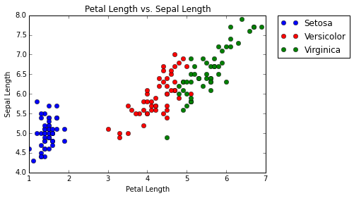
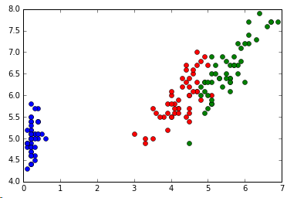

Petal Length vs. Sepal Length
 | SVM | Tree
Actual
Predicted

Slide 12
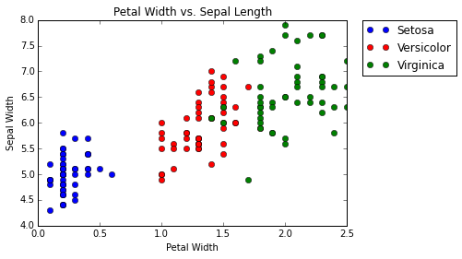
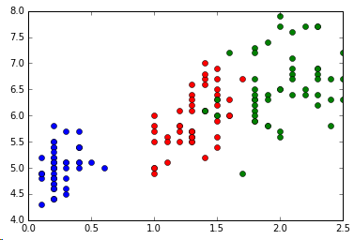

Petal Width vs. Sepal Length
 | SVM | Tree
Actual
Predicted

Slide 13
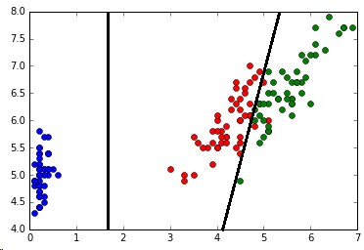
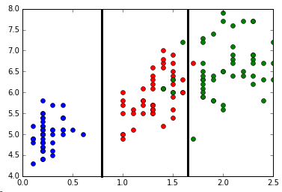
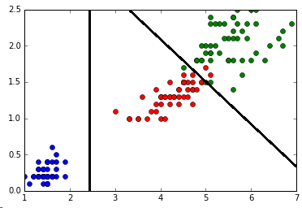
Separate Attributes
Petal Length vs. Sepal Length
Petal Width vs. Sepal Width
Petal Length vs. Petal Width

Slide 14
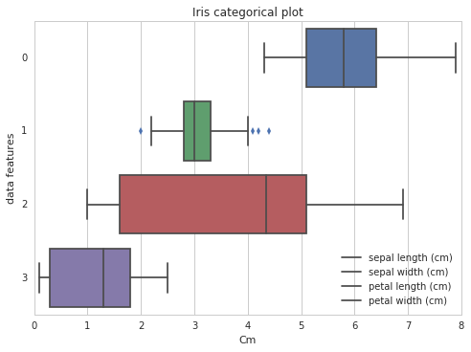
Kaggle visualizations
https://www.kaggle.com/jrskane/d/uciml/iris/iris-practice

Slide 15
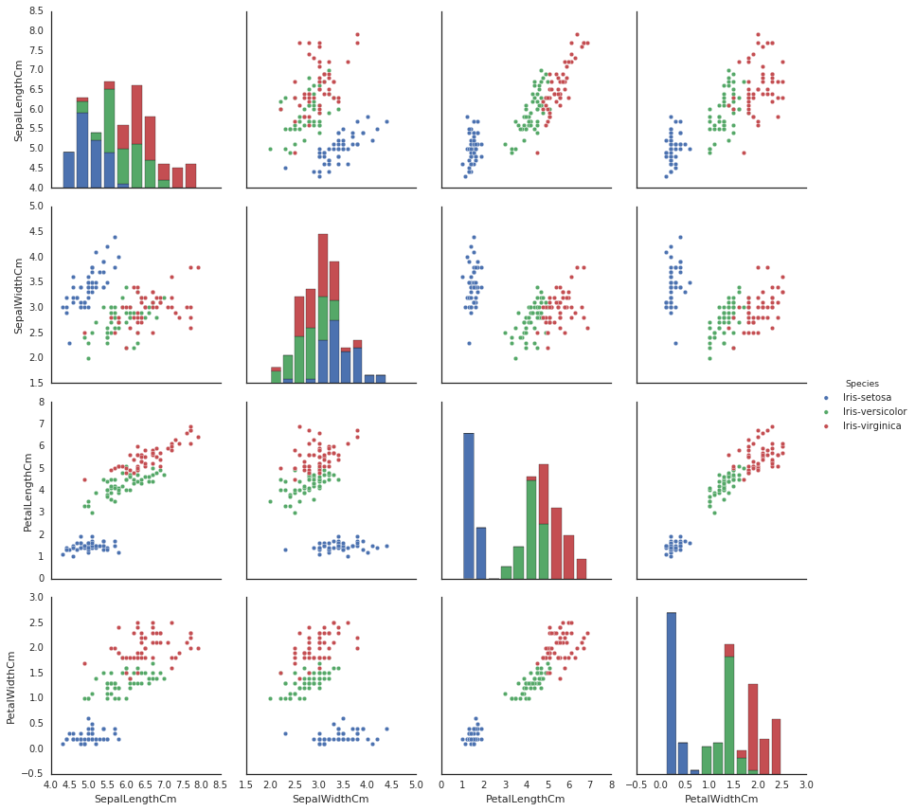
Kaggle visualizations
https://www.kaggle.com/benhamner/d/uciml/iris/python-data-visualizations

Slide 16
Conclusion
Petal Width / Petal Length
  Contain the most information
Not exactly linearly separable
  two stages (lines)

Slide 17
Challenges
The Question
Python
Visualizations

Slide 18
Reference
•http://scikit-learn.org/stable/modules/tree.html#tre
•http://stackoverflow.com/questions/10570042/visualizing-a-decision-tree-example-f rom-scikit-lea

