Slide 1
Shelter Animal Outcomes
Ethan Miller
Notes:
Project is about

Slide 2
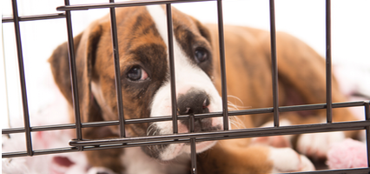
Purpose
Every year 7.6 million animals are brought into shelters
2.7 million are euthanized every year
We want to increase the probability of finding forever homes for these pets!

Slide 3
Goals
There were three main goals in this project
Find trends in shelter animal outcomes
Find possible ways to increase adoption rates
Predict outcomes for current shelter animals

Slide 4
Datasets
This project included two different datasets:
Train.csv
  26,729 entries
  10 attributes
Test.csv
  11,456 entries
  8 attributes

Slide 5
Train.csv
AnimalId - Unused for training process
Name - Categorical; name of animal (blank if there is no name)
DateTime - Unused; timestamp for data input
OutcomeType - Categorical; Tells if animal was adopted, euthanized, etc.
OutcomeSubtype - categorical; gives more detail on what happened to the animal, note that it is mostly blank
AnimalType - Categorical; Tells if the animal was a dog or a cat
SexuponOutcome - Categorical; tells if animal was male, female, spayed, or neutered.
AgeuponOutcome - continuous; tells how old the animal was
Breed - categorical; breed description of animal
Color - categorical; describes color of animal

Slide 6
Test.csv
ID - continuous; ID label for each animal
Name - Categorical; name of animal (blank if there is no name)
DateTime - continous; unused timestamp for data
AnimalType - Categorical; Tells if the animal was a dog or a cat
SexuponOutcome - Categorical; tells if animal was male, female, spayed, or neutered.
AgeuponOutcome - continuous; tells how old the animal was
Breed - categorical; breed description of animal
Color - categorical; describes color of animal

Slide 7
Tasks
My first task was to visualize the data and look for trends in the data.
Several major trends I found included:
  Age plays a major factor in adoption rates
  Certain breeds have significantly higher adoption rates
  Gender of the animal is significant
  Names make a difference!

Slide 8
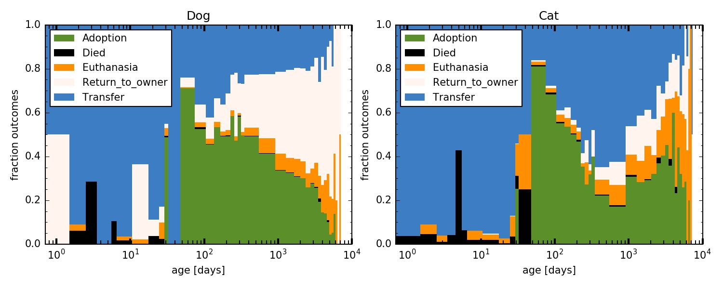
Age Visualization
Adoption rates peak with young animals
Old dogs usually returned to owners, cats are usually euthanized

Slide 9
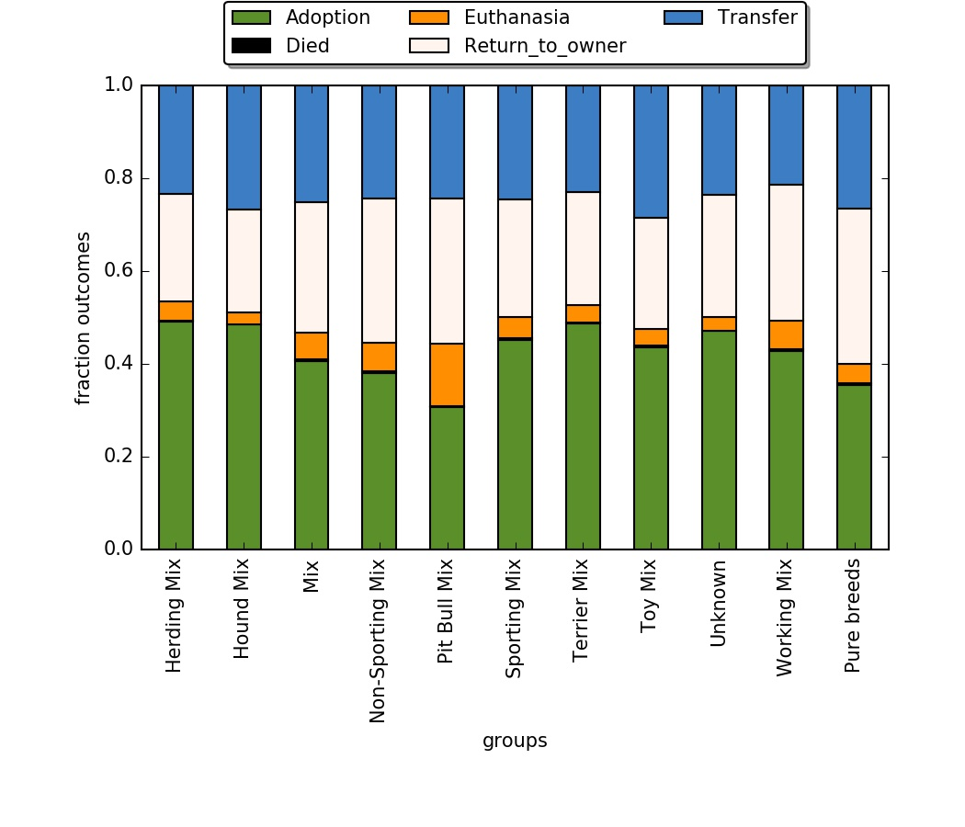
Breed Visualization
Instead of viewing by breed, I visualized based on breed groupings

Slide 10
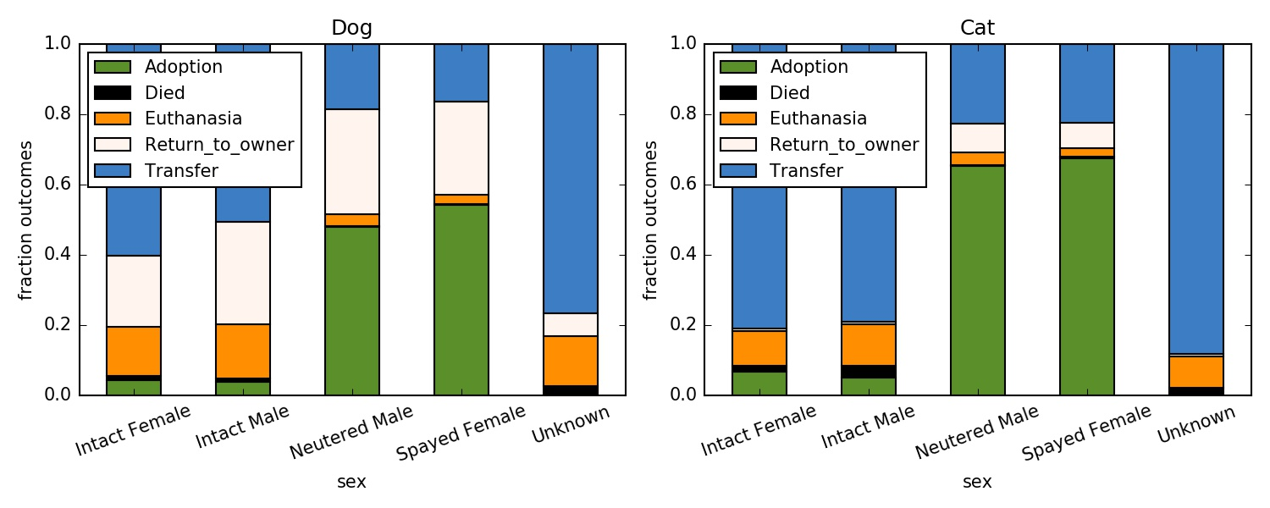
Gender Visualization
Spayed & Neutered animals are much more likely to be adopted!

Slide 11
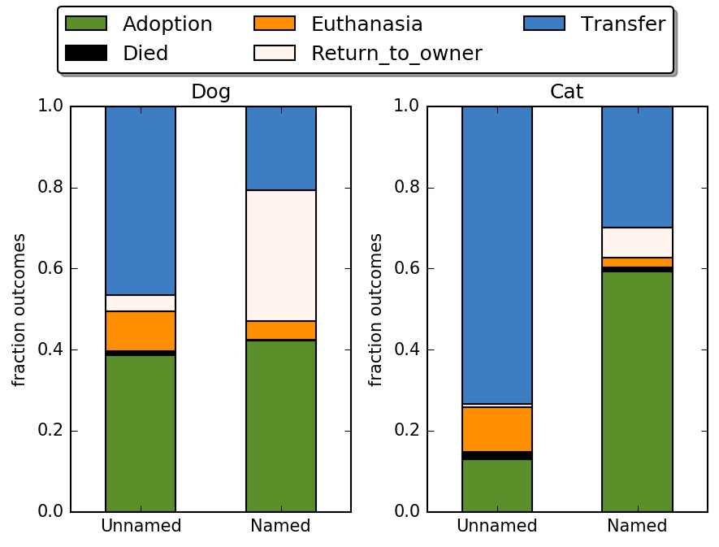
Name Visualization
Names have a strangely significant effect on adoption rates

Slide 12
Actionable Data
Based on the trends mentioned, there are a few simple ways to increase adoption rates:
Name the pets
Spay & Neuter the pets when possible
Encourage adoption of older animals

Slide 13
Data mining process
Question: What is the probability of each outcome for the animals?
Methods: Used adaptive boosting classifier seemed to yield the best results
Results: A .csv file listing animal ID as well as the probability of each outcome for that animal

Slide 14
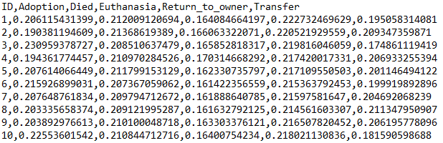
File Output
File outputted is a .csv file, giving the animal ID as well as the probabilities for each outcome

Slide 15
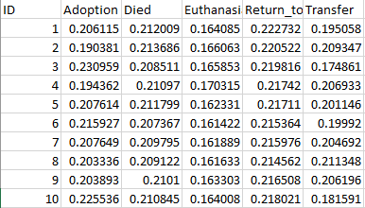
File Output
Note that Microsoft Excel can open these files without any additional formatting:

Slide 16
Compared to other competitors
Data entry and categories compared were nearly identical amongst competitors
Many competitors used random forest classification techniques
Many people used attributes such as color as well, which did seem to yield more accurate results

Slide 17
Challenges
Time
Computer difficulties
No partner to help brainstorm & code

Slide 18
Future Developments
Would like to search for more trends and add them in to increase prediction accuracy
Need to play with Adaptive-Boosting inputs to increase accuracy of predictions

