Slide 1

Iris Dataset
Erich Smith
Coleman Platt

Slide 2
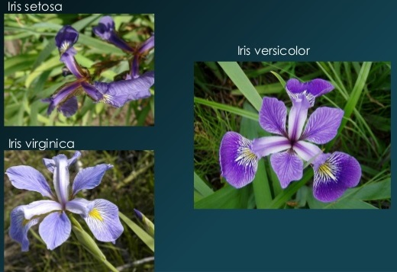
Summary
Introduced by statistician Ronald Fisher in 1936
Widely used in machine learning examples
Three species of Iris flower:
  Iris-setosa
  Iris-versicolor
  Iris-virginica
Four continuous attributes:
  Length & width of petals (cm)
  Length & width of sepals (cm)
150 total data points
  50 from each species

Slide 3
Questions to Answer
How to distinguish between the three species based on measurements of their petals and sepals
Accurately classify species that have multiple crossover attributes

Slide 4
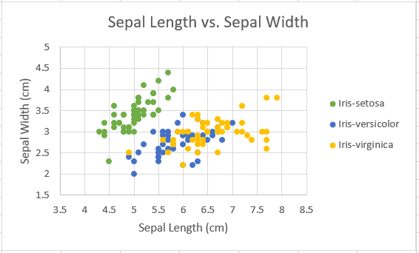
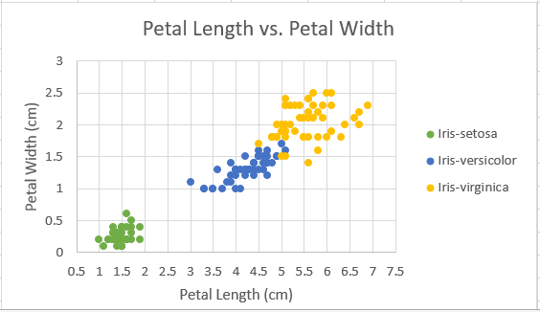
Challenges
Clustering not a good candidate due to attribute crossover
Iris-setosa is linearly separable, but the other two are not
Converting original data to format compatible with algorithm
Deciding best cut off between training and test data

Slide 5
Methods
Classification algorithms such as decision tree perform well with this data set
We use C4.5
C4.5 is easy to use and interpret, and accurate even when given very small training data set

Slide 6
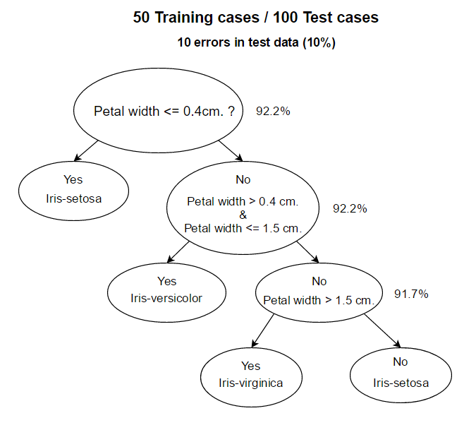
Results

Slide 7
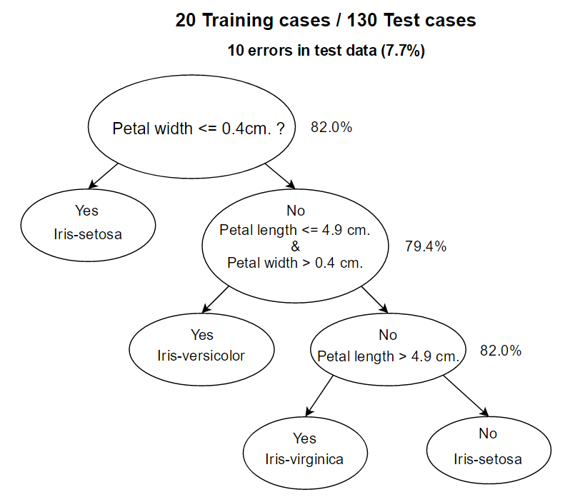
Results

Slide 8
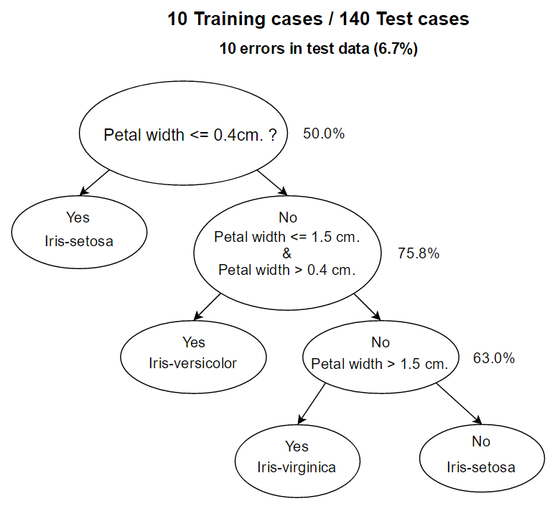
Results

Slide 9
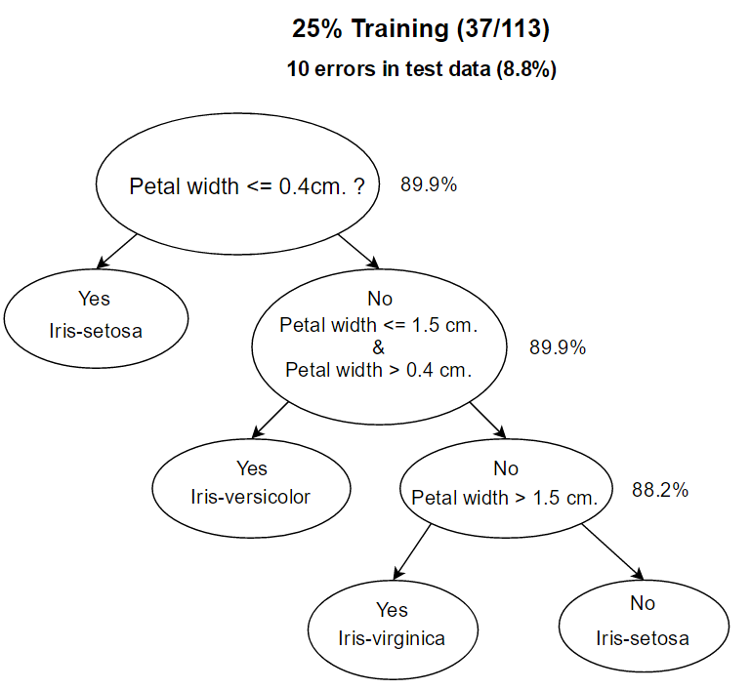
Results

Slide 10
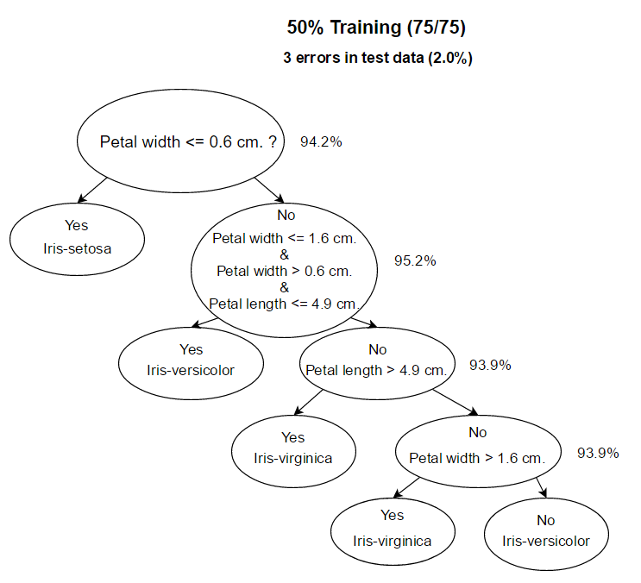
Results

Slide 11
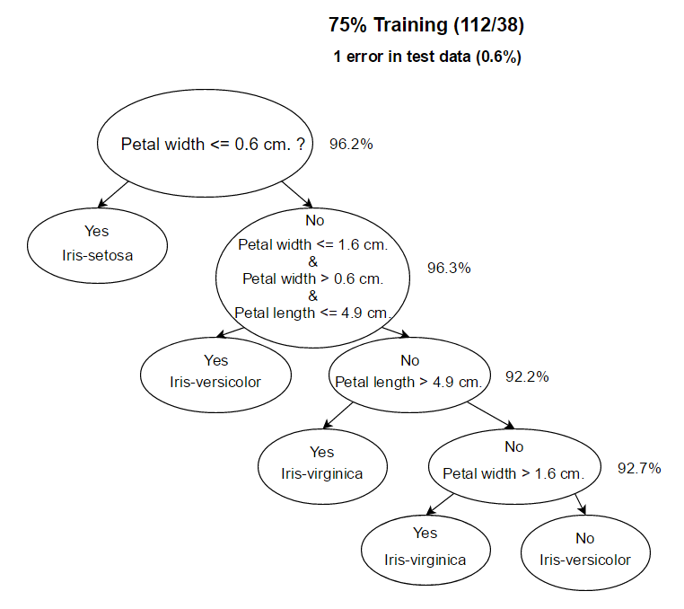
Results

Slide 12
Results
Predictably, the program is more accurate when given bigger percentage of data set as training data
However, still very accurate when given only 10 training cases, producing only 6.7% error rate in test data
Error rate stays approximately < 10% until given 50% or more of the data as training data

Slide 13
Related Work
Comparing Classification Methods by DerekElliot
2 methods: Linear Regression v.s. Random Forest
Linear Regression was a better fit for the data by a small margin
Random Forest was off because of cleanliness of the data
Linear regression correctly predicts that our decision tree was based on the pedal size.

Slide 14
Disciussion
The data mining methods we used were able to satisfy our questions
More data needed, combine data classification methods
Making data compatible with algorithm, not simple

Slide 15
References
Compare classification methods:2016. https://www.kaggle.com/saywhat1/d/uciml/iris/compare-classification-methods/notebook.Accessed:4/27/2016
C4.5Tutorial:1992. http://www2.cs.uregina.ca/~dbd/cs831/notes/ml/dtrees/c4.5/tutorial.html. Accessed:4/23/2016
Iris Data Set: 1988. http://archive.ics.uci.edu/ml/datasets/Iris. Accessed: 4/23/2016

