Slide 1
CS 485 Datamining Final Project
By: Dylan Wise, Carmon Zachary Almon

Slide 2
Dataset
Our team chose the Animal Shelter Dataset
The dataset contains 26729 records
There are 10 attributes in the raw dataset

Slide 3
Attributes
So what are the properties of these attributes?
Most of the data we are given is categorical
The only continuous attributes are AgeuponOutcome and DateTime
There is some debate of whether a date is categorical or continuous
We handled the Date data in a similar way that you would handle continuous data

Slide 4
Missing Values
Name and OutcomeSubtype both contain values that are empty
How do we handle this?
For names we decided that any animal that didn’t have a name would be assigned the value “NoName”
For subtype we did something similar, we gave anything with a missing subtype the value “NoSubtype”

Slide 5
What else did we do to the data?
For names simply replacing empty names with “NoName” was not enough
We decided that it was more helpful to replace the value of animals with names to “Named”
  Names by themselves aren’t very useful, but knowing if an animal has a name could be
Animal ID isn’t really useful for datamining methods since its unique to every record
Because of this Animal ID was dropped entirely

Slide 6
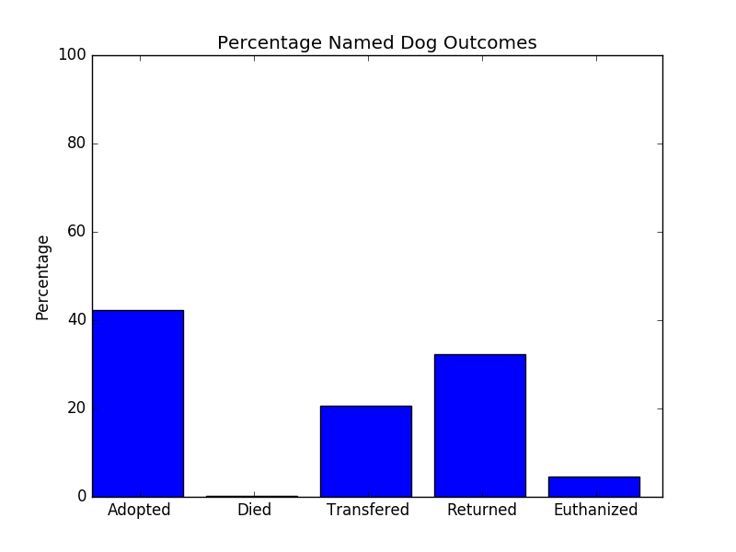
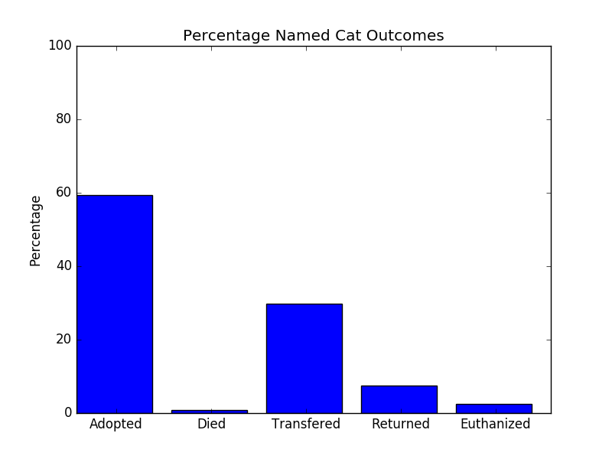
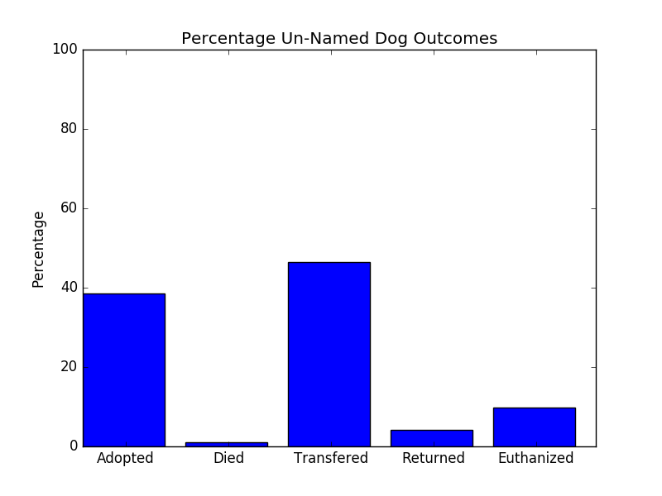
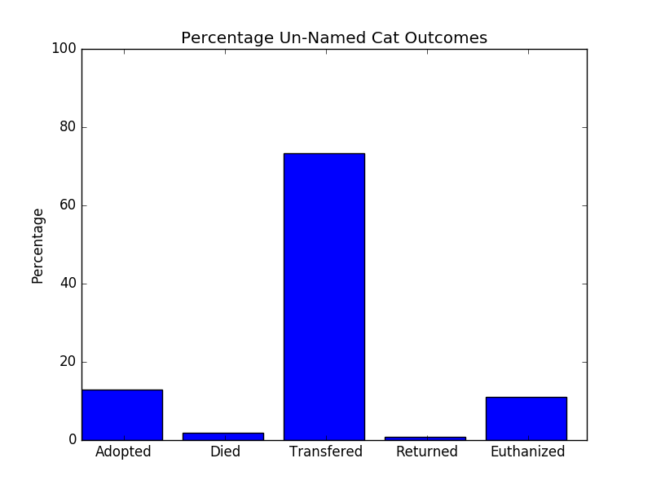

Slide 7
Breed and Color?
Dogs have many more breeds (in this data) than cats do.
However we were interested in if Purebreds are adopted more than mixes
For color we could only think of separating the data into mixed color and solid color
This would be based on if there was a ‘/’ in the string.
This is not a perfect since there is a chance that there would be a non-solid color in the solid category.
It might be worth thinking about discarding color altogether.

Slide 8
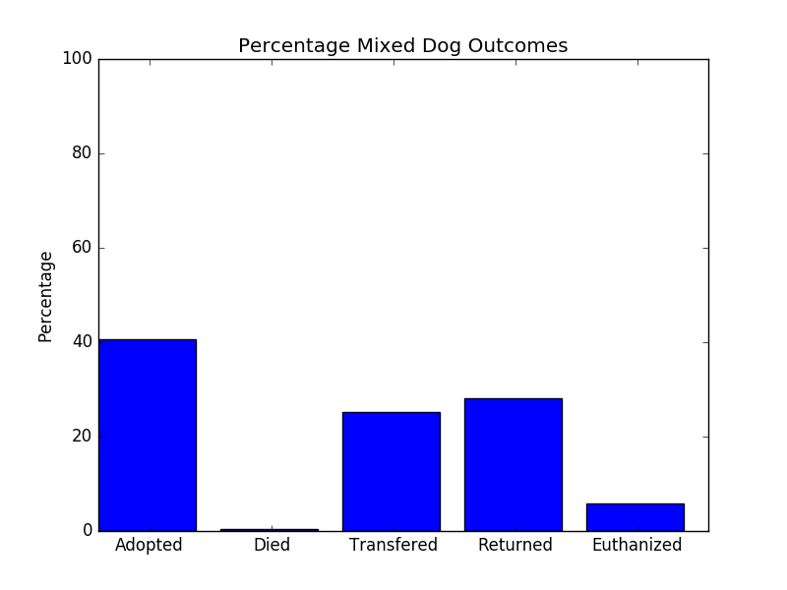
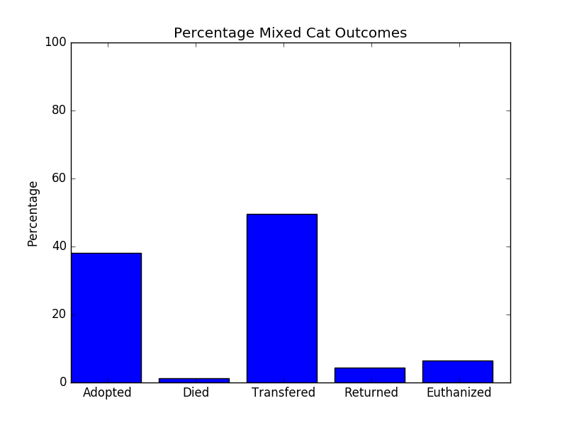
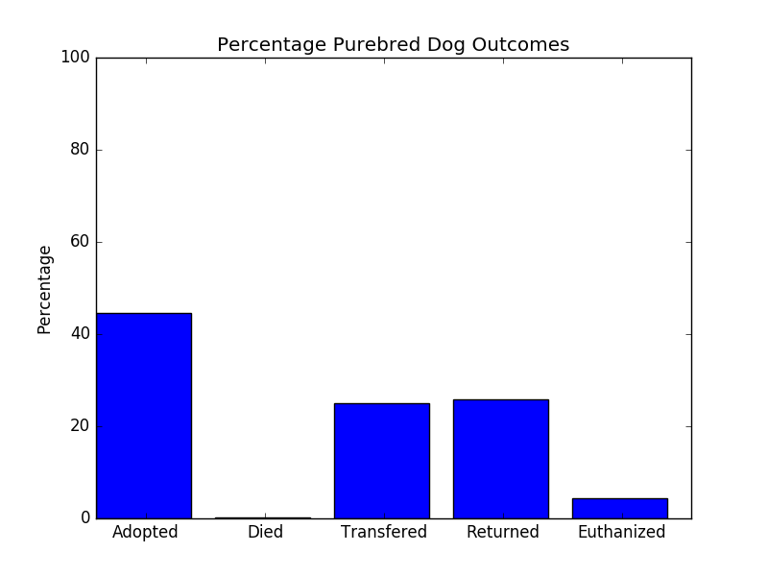
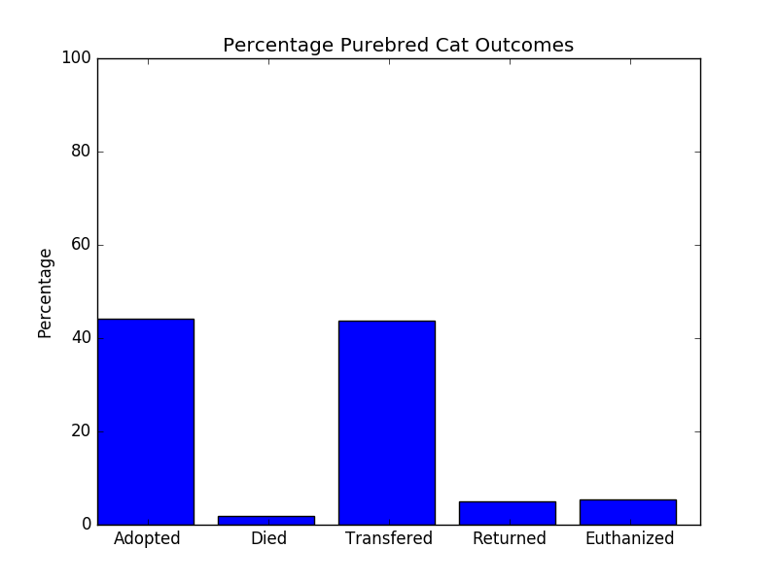

Slide 9
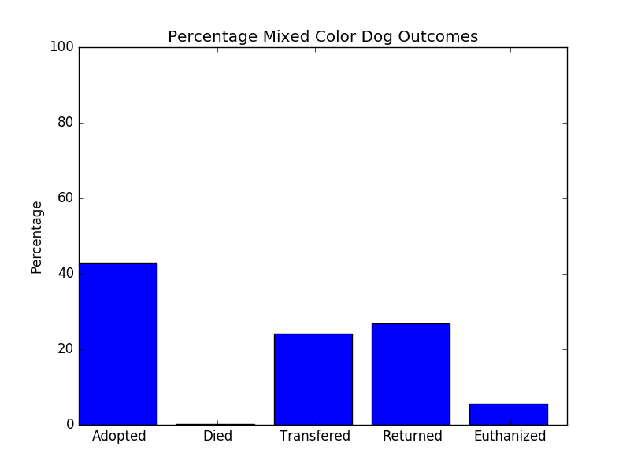
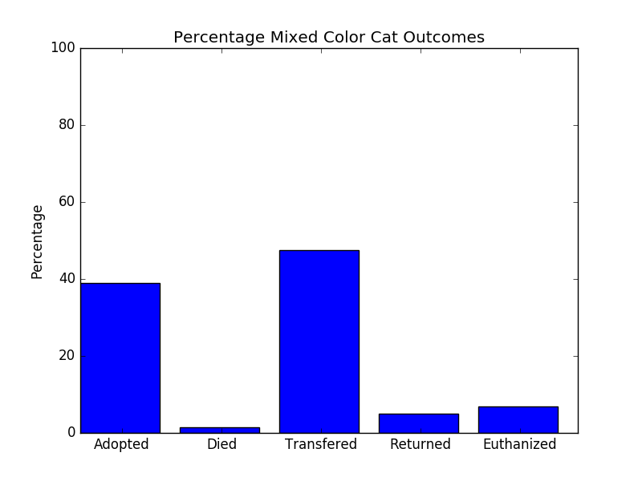
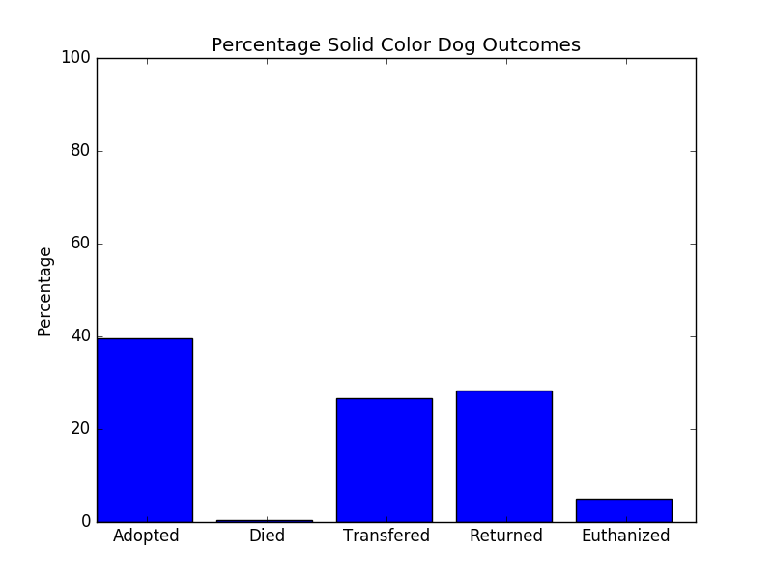
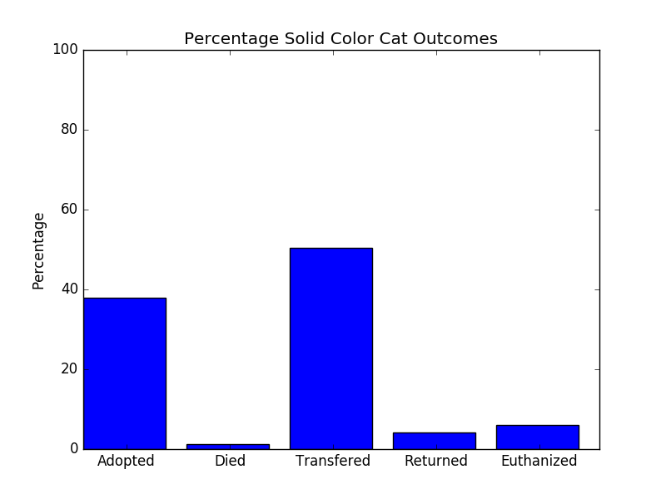

Slide 10
How can we change DateTime?
Decided to split DateTime into two unique columns
These columns are now “Season” and “TimeOfDay”
Season is fairly straight forward. Look at the month and decide the season.
TimeOfDay was originally separated into 4 groups, “Early Morning”, “Morning”, “Afternoon” and “Night” however there were only 12 “Early Morning” that occurred for the time specified for 01:00 – 06:59
Early Morning and Morning were combined after that. Making morning from 01:00 – 12:59. Afternoon 13:00 – 18:59 and night the rest of the time

Slide 11
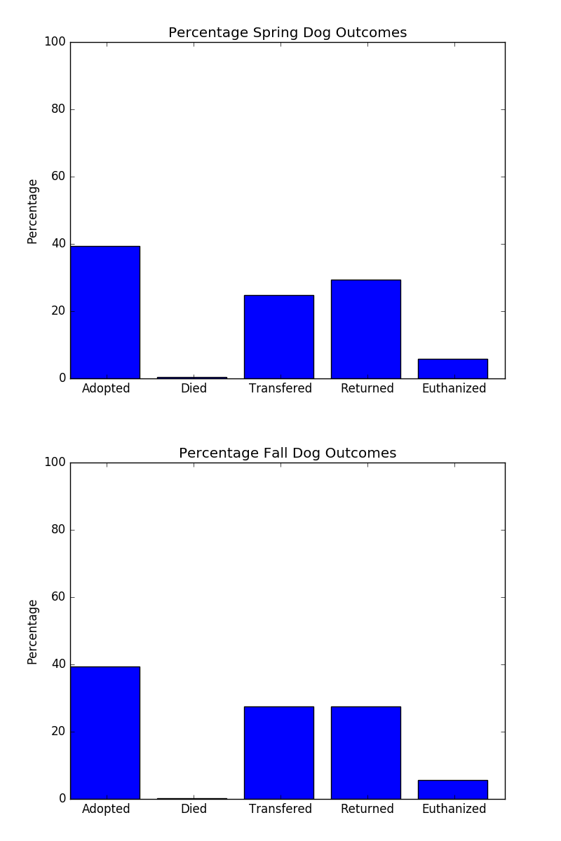

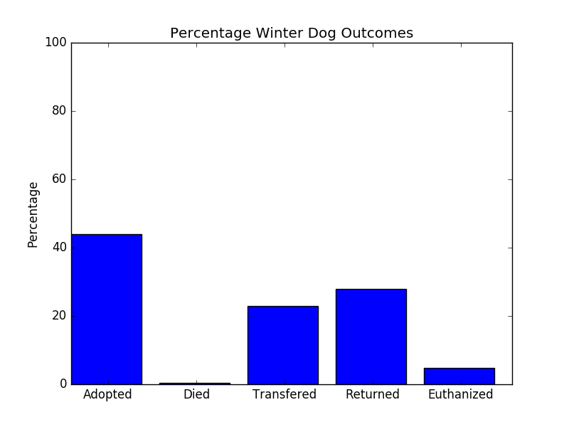

Slide 12
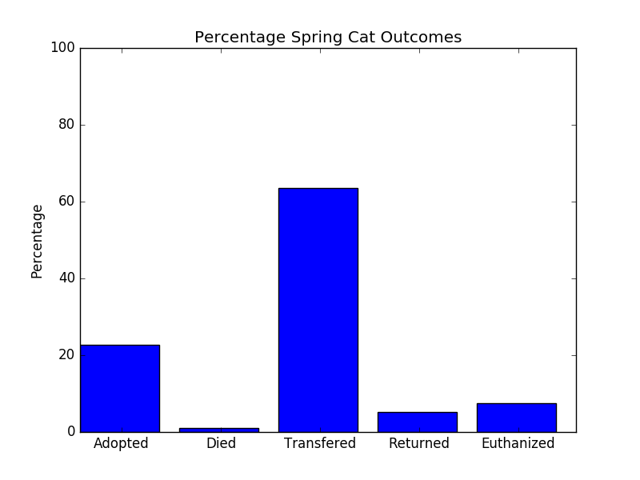
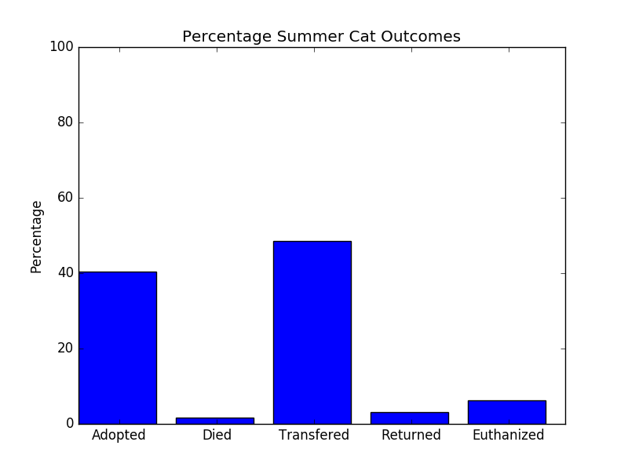
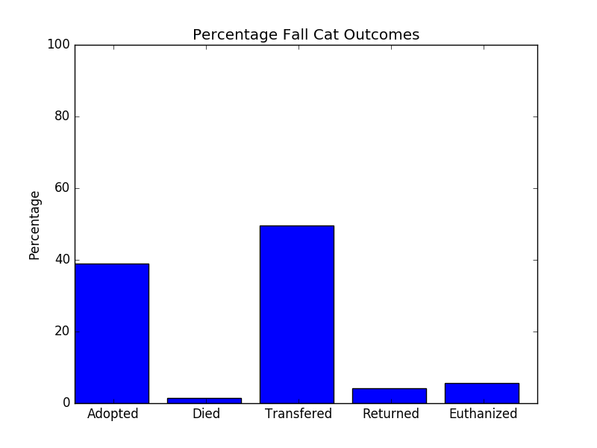
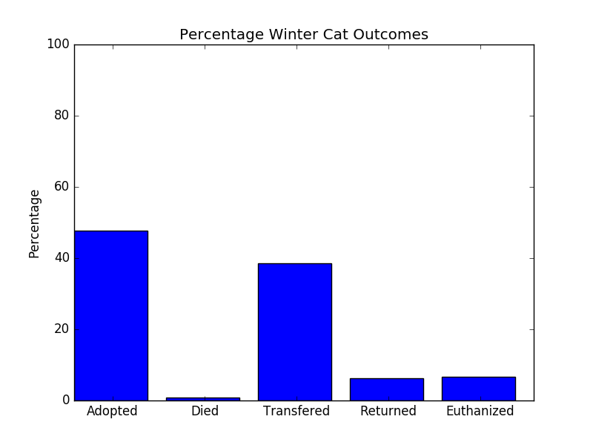

Slide 13
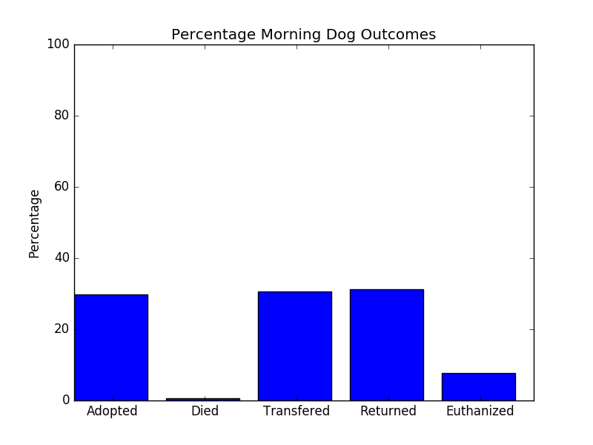
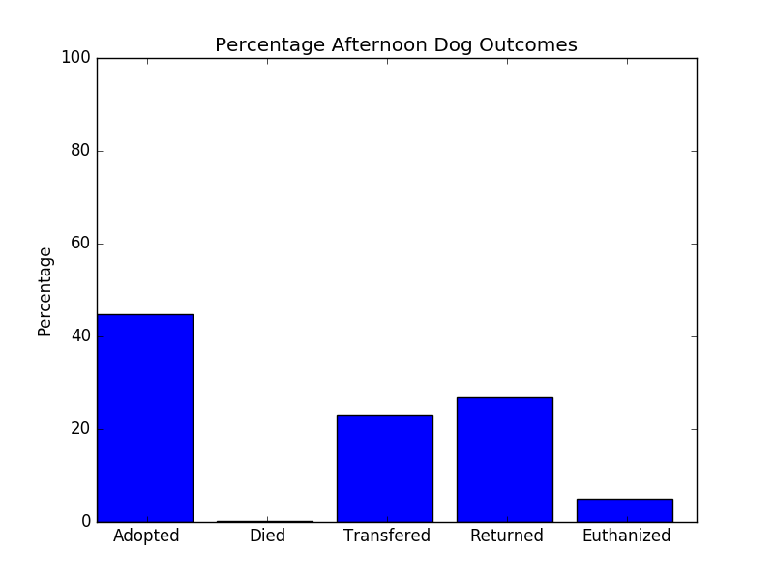
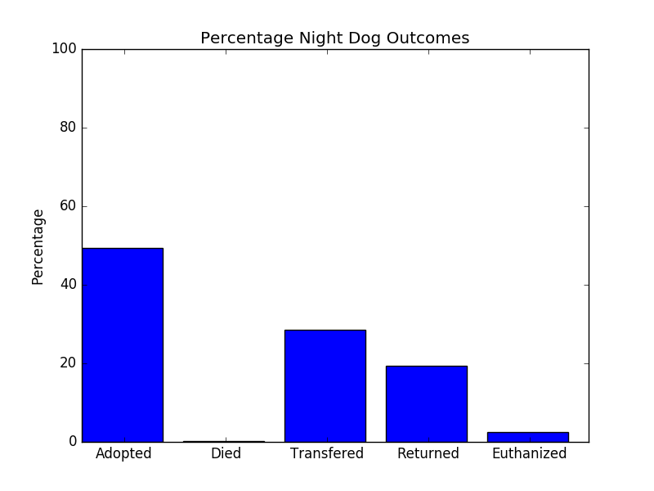

Slide 14
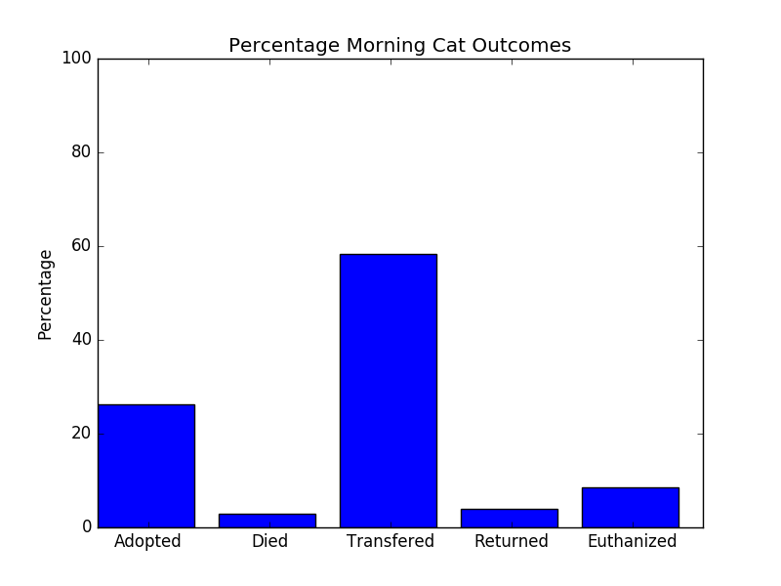
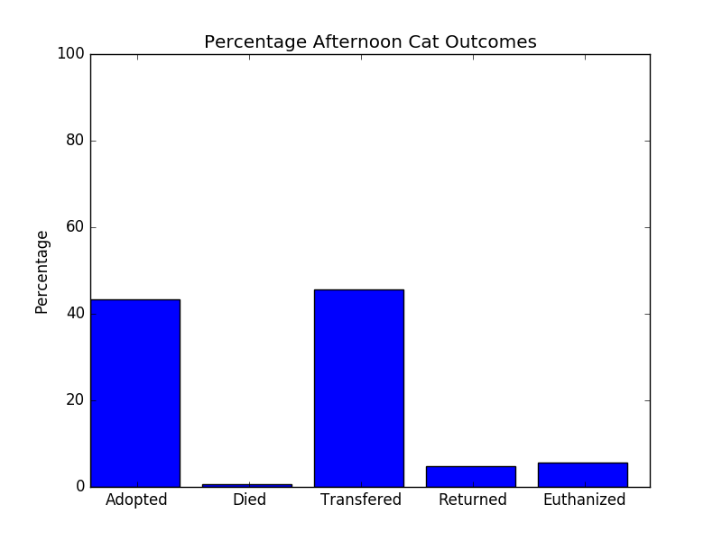
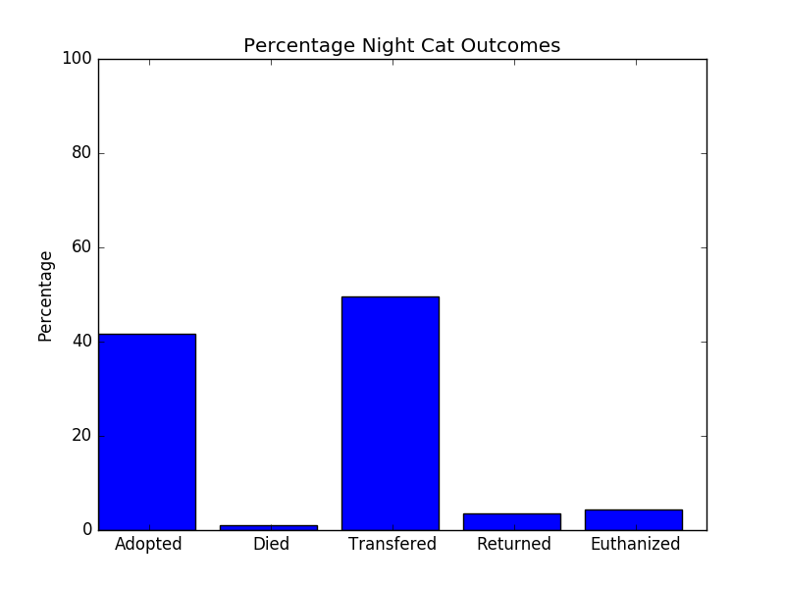

Slide 15
Age
I think most would assume that age has a vital role in deciding on whether a pet is adopted or not
Adopting a pet that will only live for a few years is pretty undesirable
This will absolutely have a great effect on the outcomes, but how large is the effect?
We split age into 3 categories
  Young: 0 to 4 years
  Middle Aged: 5 to 9 years
  Old: 10+

Slide 16

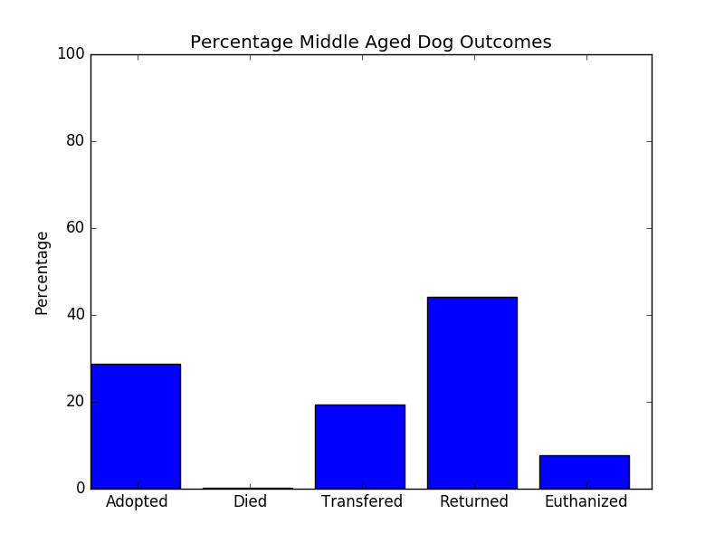
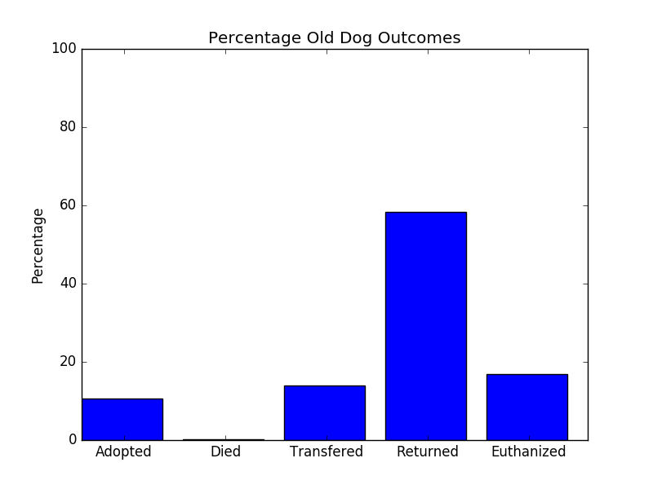

Slide 17
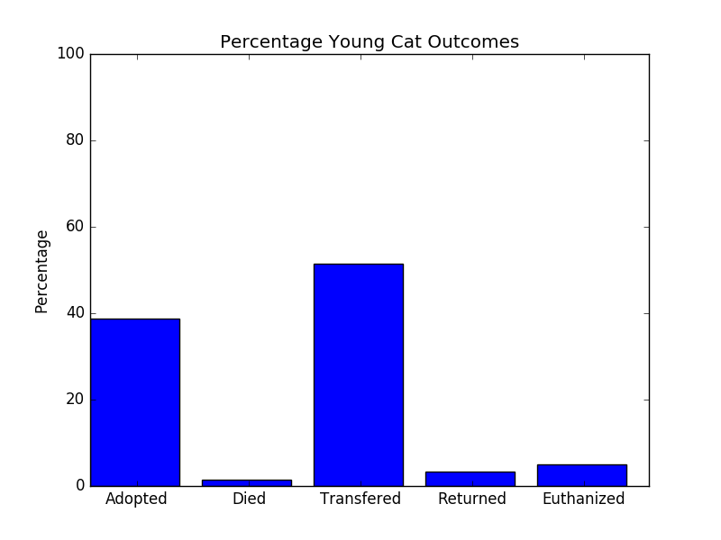
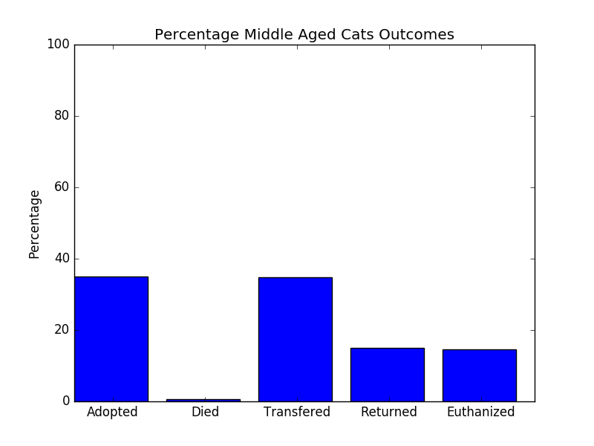
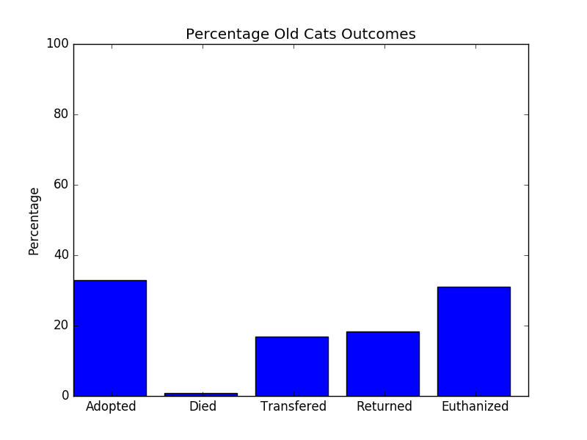

Slide 18
So why?
We need to find out which attributes heavily influence an animal to be adopted
Knowing what attributes make an animal more likely to be adopted can help us focus a little more on animals that might have a bit harder time to be adopted
Example: We know that young animals are going to be adopted just because they are young, because of this we should focus our resources more on making older animals look better for adoption since the young ones will likely be adopted anyway regardless
Ultimately you would want to find an attribute or combination of attributes that are shown to be great for adoption or not great for adoption and react accordingly

Slide 19
Naïve Bayes
Now that preprocessing is done its time to tackle one of our datamining methods
Naïve Bayes is what we chose
It does require the data to be numerical (at least scikit learn’s implementation does)
However that was a simple process
We decided that a simple 80/20 split for training and testing would be good

Slide 20
Naïve Bayes Results
Using the parameters specified last slide we were able to achieve an accuracy of about 67% average
While not amazing, it is a far cry away from randomly choosing the result
However, there is a problem

Slide 21
Subtype
The 67% accuracy that was calculated was from a training dataset that included subtype as part of its model. This is very flawed.
Return_to_owner and Died would never have a subtype. And Euthanasia only get the subtype Aggressive.
Not only should we not be including subtype in the model it would very much be increasing our accuracy unfairly
Removing the subtype column from the model creation lowers our model accuracy to 57%. Ouch.
While not super, it is, again, better than a guess so that is something I suppose.

Slide 22
Association Rules (Apriori)
Due to how much data appears very little in the dataset a high support really restricts what can be seen.
For subtypes even lowering the support to 10% only allows one subtype to even appear
So there needs to be a good balance of support and rule confidence to gather meaningful data
We tried a mix of support and confidence but quickly realized we would need a lower support to get much data for outcomes at all.
Many of the subtypes appeared so sparsely that we would need to lower support to much lower than 1% to start seeing any returns

Slide 23
Noteable Rules
Transfer <- Partner (Support 29.2416%, Rule Confidence 100%)
  Every time that partner appeared in the dataset it was always paired with transfer
Adoption <- Cat NoSubtype Named (Support 9.82828%, Rule Confidence 85.1264%)
  Names for cats have a very high influence on adoption
Named <- Purebred NoSubtype Dog (Support 9.19226%, Rule Confidence 90.033%)
  A purebred dog usually has a name, likely because it was previously owned
Named <- Return_to_owner NoSubtype Dog (Support 15.6272%, Rule Confidence 97.4568%)
  If you are a dog getting returned to your owner you more than likely have a name
<5years <- Adoption (Support 36.0058%, Rule Confidence 89.3676%)
  If you got adopted, you are probably young

Slide 24
So what?
What we ultimately got from our Association Rules is that a name (for cats) and age (for both dogs and cats but less so in cats) have a high influence on whether an animal is adopted
You can’t really change the age of an animal but you can give it a name
The problem is we don’t know if these unnamed animals truly didn’t have a name or that it just wasn’t provided
All we do know is that there is a significant change in adoption rates for cats with a name

Slide 25
Other Kaggle submissions
Many of the Kaggle submissions used Random Forest
Checking the results of a few of the submissions came to similar results
Age and Name seems to be the major players in the outcome
We found another submission that separated breed into purebred and mix and they also found that being a mix or not had very little effect similarly to us.

Slide 26
Main Challenges
Deciding how to handle DateTime caused quite a bit of debate between us
We really didn’t want to split it into two attributes but ultimately we though we had to
  In the end it may have been more worthwhile to drop it
Color and Breed also made us scratch our heads a bit
Breed especially probably could have been handled much better
  Example: There are many fewer breeds of cats than dogs, it might have been a better idea to keep their breed intact but split dog into mix and purebred
Time. Many classes had projects as well for us. Sometimes it was hard to balance.

Slide 27
What would you change?
Probably use a datamining technique that would be more suited to this data.
Many on Kaggle used Random Forest so maybe it was just better for this dataset?
Better preprocessing techniques, I really think the way we handled preprocessing is ultimately what made the model for Naïve Bayes so poor.
  However it could just be really hard to predict
Maybe separate outcomes into adopted and not adopted?
Definitely find more optimal settings for our association rules

