Slide 1
Iris Data Mining Project
Devin Wright
Joe’Docei Hill

Slide 2
Project Background
Size of data: 150 records, 5 attributes (ID, Sepal Length, Sepal Width, Petal Length, Petal Width), 3 classifications (Iris-setosa, Iris-versicolor, Iris-virginica)
Properties of the attributes: Continuous
Missing values: None
Are all attributes used or only a subset? : Excluded ID because it’s not informative
Other important information: n/a

Slide 3
Data Mining Task #1
Question: How does the Iris data react when ran through the kmeans algorithm?
Methods applied: kmeans algorithm

Slide 4
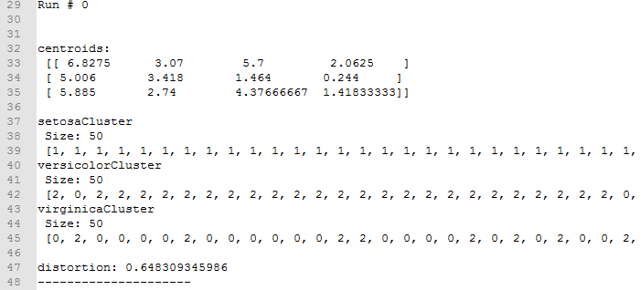
Data Mining Task #1 (cont...)
Results
Run samples

Slide 5
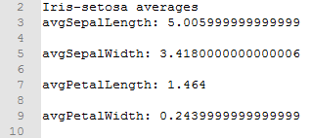
Data Mining Task #1 (cont...)
Results
Computed averages

Slide 6
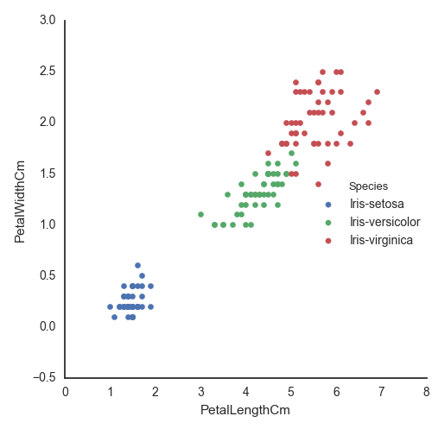
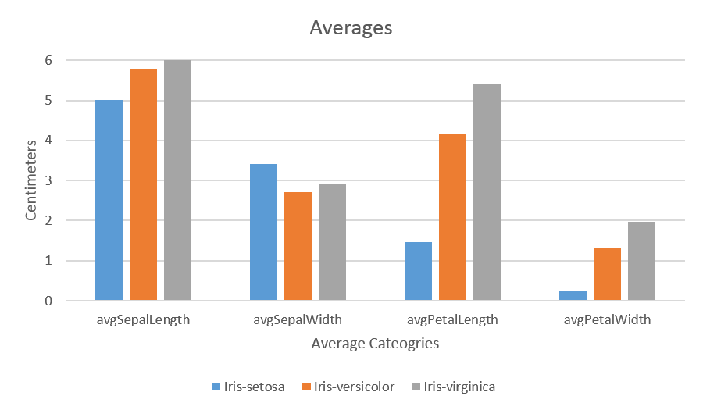
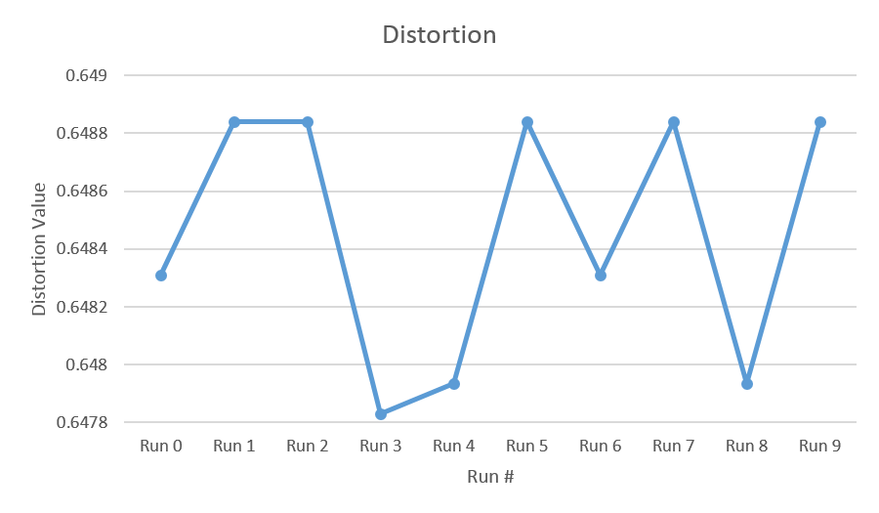
Data Mining Task #1 (cont...)
Informational graphs

Slide 7
Data Mining Task #2
Question: How does the Iris data react when ran through the hierarchical algorithm with several different distance metrics and linkages?
euclidean
cityblock
sqeuclidean
cosine
seuclidean
Complete linkage
Single linkage
Ward linkage
Methods applied: hierarchical algorithm

Slide 8
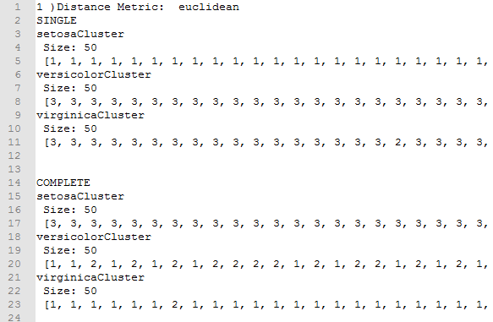
Data Mining Task #2 (cont...)
Results
3 Linkage clusters per distance metric

Slide 9
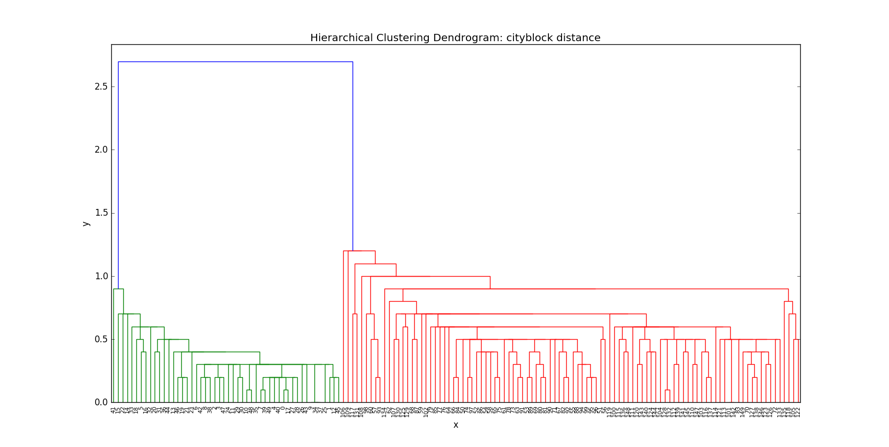
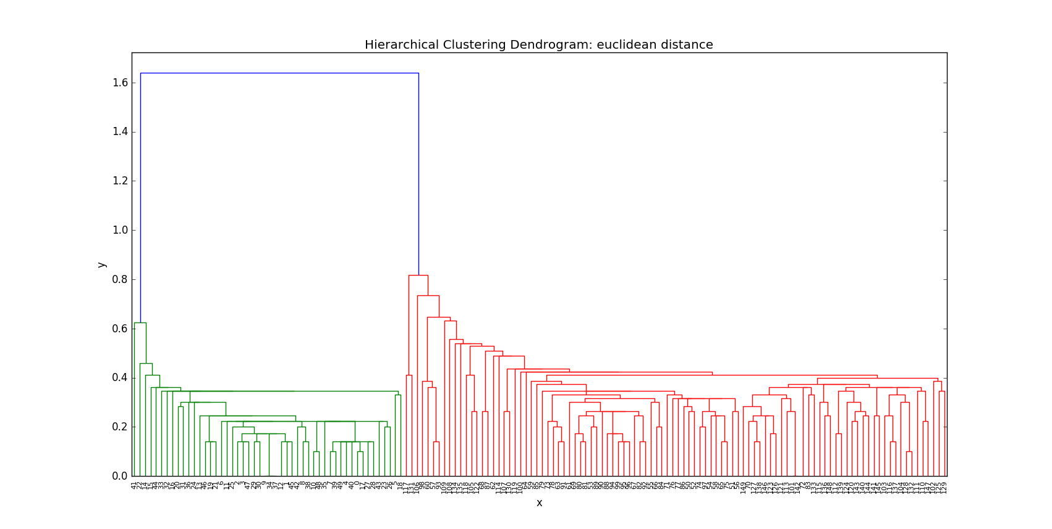
Data Mining Task #2 (cont...)
Results
Dendrograms

Slide 10
Data Mining Task #2 (cont...)
Question: Which yields better results? Kmeans or hierarchical with the euclidean distance metric?
Average overlap in Kmeans cluster: 39% - 43%
Average overlap in Hierarchical with the euclidean distance:
  Complete: 54%
  Ward: 32%
Answer: Hierarchical with the euclidean distance and ward linkage

Slide 11
Data Mining Task #3
Question: When using the Naive Bayes algorithm, does random versus semi-random training sets greatly affect the accuracy?
Methods used: Naive Bayes algorithm

Slide 12
Results
Interpretation
Semi-Random
Total right: 52 Out of: 60
Accuracy: 86.67%
Random
Total right: 53 Out of: 60
Accuracy: 88.33%
No but kind of
K-Fold shows that it does matter

Slide 13
Data Mining Task #4
Question: How do the runs of Naive Bayes compare to the various kernel runs of SVM (linear, poly, rbf, sigmoid)?
Methods used: SVM algorithm

Slide 14
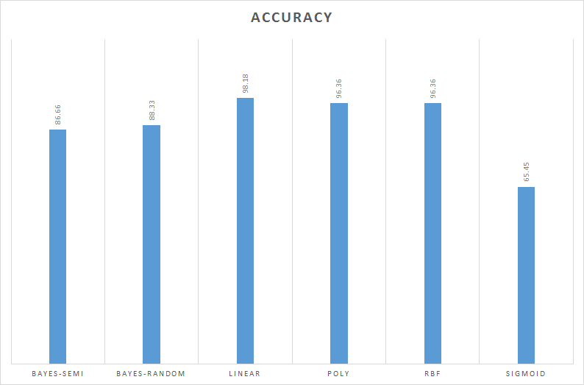
Results
SVM beats Bayes in all kernels except Sigmoid. SVM is probably better in the long run except…
The preprocessing is a pain compared to the easy use of Naive Bayes with similar results

Slide 15
Data Mining Task Conclusions
Result comparison with Kaggle
90% of Kaggle python submissions are for visualizations
Very little data mining code
Challenges
Interpreting results
Fully understanding algorithm
Visualizing Results (Thanks Kaggle!)

Slide 16
Data Mining Task Conclusions
Additional tasks to win competition?
We do not believe there is much of a competition for this dataset since there seems to be no real problem to solve

Slide 17
Questions?

