Slide 1
Using Data Mining Techniques to Evaluate Countries’ Quality of Living.
Brett Barbara
Satrio Husodo
4/28/16

Slide 2
Our Dataset
World Development Indicators
  This dataset contains over a thousand indicators/attributes of from all countries of the world
    248 countries to be exact.
Attribute types
  Economy
  Social structure
  Education
  Environment
  Industry
  Health

Slide 3
What was our goal?
Using data mining techniques we have learned about in this class we wanted to be able to group these countries into different standards of living based on the attributes available to us.
We also wanted to predict standard of living using a few attributes using classification.

Slide 4
Data Mining Techniques
Clustering
  Hierarchical vs. K-means
Classification
  PCA & decision tree

Slide 5
Part I: Clustering
Since there were over a thousand attributes available to us, we choose a smaller number of attributes to use, those included:
  Unemployment
  CO2 emission
  Infant mortality rate
  Income shared by 10%
  Improved water source
  Central government debt

Slide 6
Hierarchical Clustering
Used scipy’s linkage method to do the clustering
Gives user many different linkage method options, single, complete, average, ward, and others.
I ran the dataset with each of these options, and produced a dendrogram for each .

Slide 7
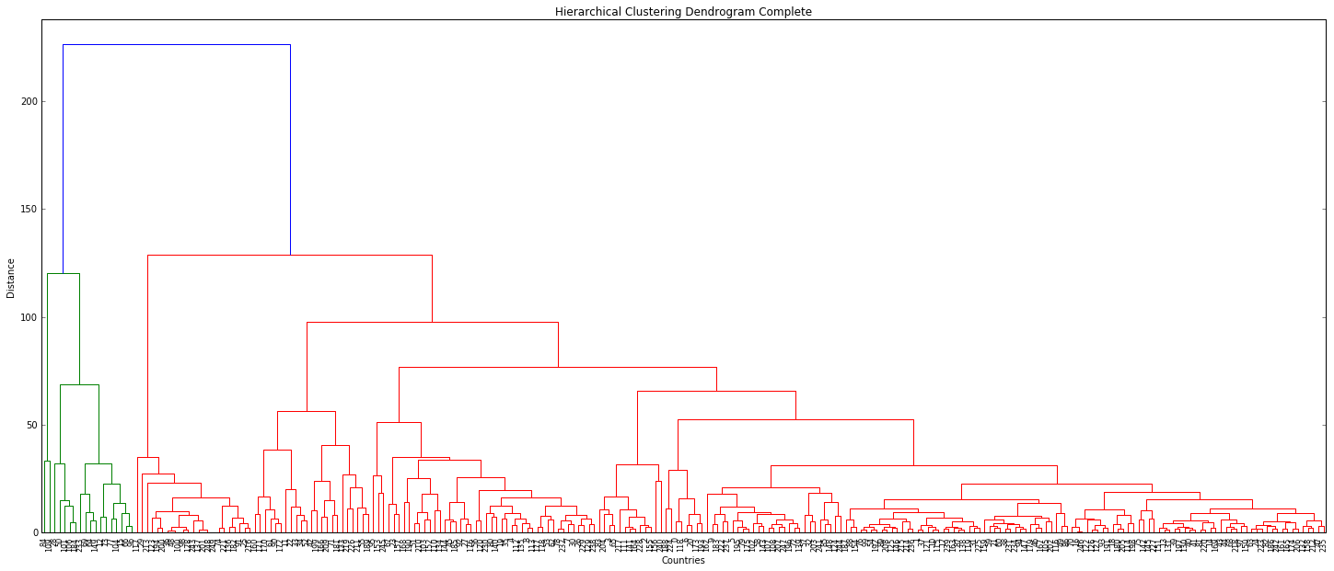
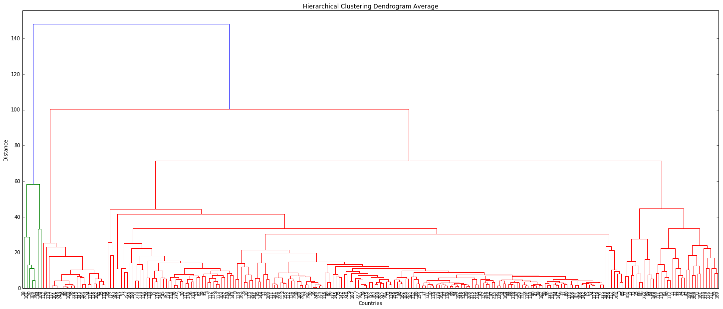
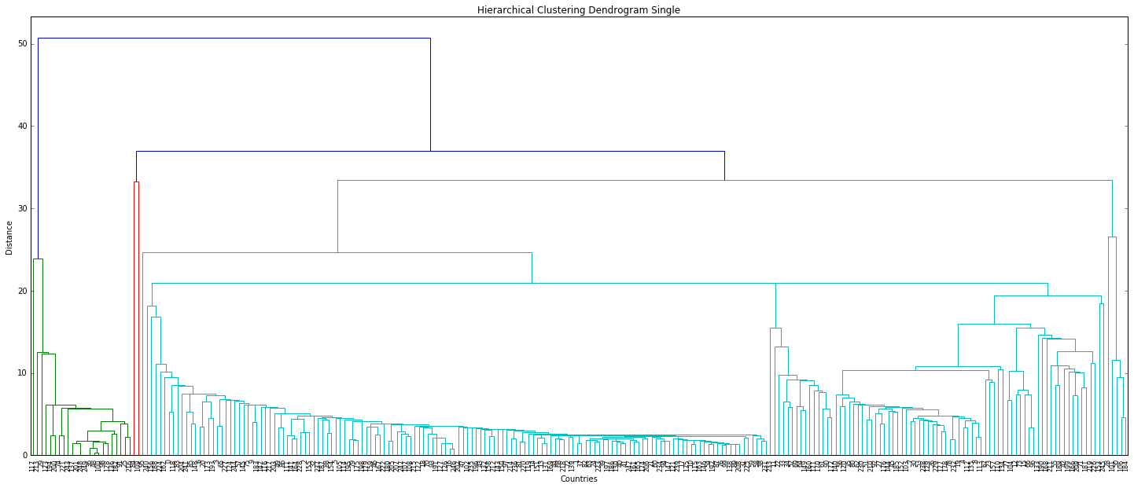
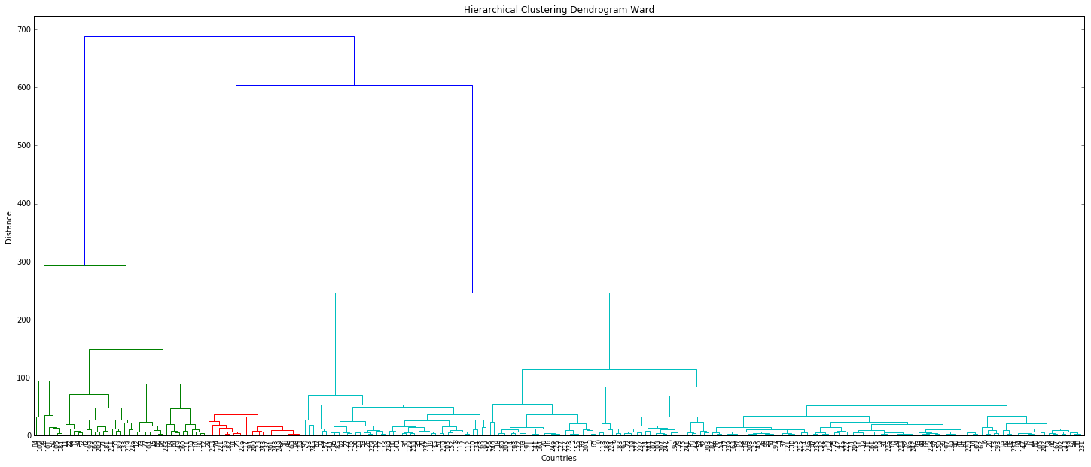
Dendrograms

Slide 8
Ward Clustering
Alternative clustering approach, better for quantitative data.
Treats each datapoint as a cluster, so it starts out with n clusters of size one
It then works its way down until the entire set of data is a cluster
From a tree perspective, starts at leaves, looks for groups of leaves that turn into braches, the branches into limbs, and the limbs to the trunk.

Slide 9
Ward Dendrogram

Slide 10
Why I Choose Ward
I found the results most interesting based on how we classify countries
We know we have 1st, 2nd, and 3rd world countries.
Since this dendrogram showed the 3 clusters based on my data, I thought it was interesting it classified them in almost the same way as we classify countries.

Slide 11
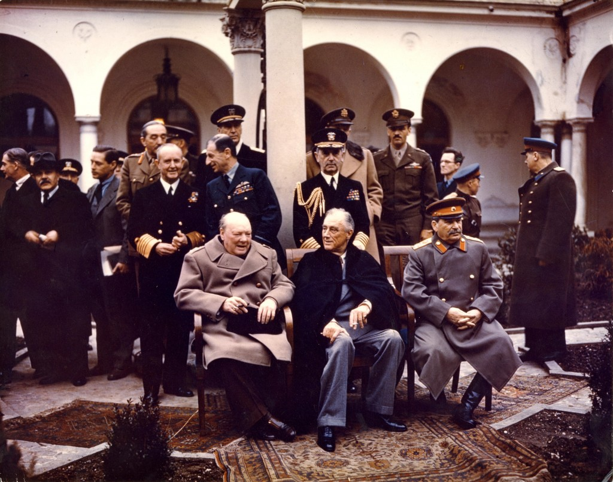
Comparing my results with “Three Worlds”
The “three worlds” classification isn’t completely based on quality of living.
This was created during the cold war to describe allies of the US (1st world), allies of the Soviet Union (2nd world), and neutral countries (3rd world).
So my data did not exactly match up with what we classify as 1st, 2nd, and 3rd world.

Slide 12
K-means
As we know, they results from K-means can very based on the initial points chosen.
When running k-means on my dataset, with k set to 3 my results were very different.
Each time I ran k-means I would get different clusters with countries clustered together that did not make much sense.
My results from k-means were disappointing to say the least.

Slide 13
Issues I Encountered
With implementation and creating the dendrograms I had very few issues.
My main issue was how to handle missing data points
  First thought was to just put 0, if a country did not keep track of a certain attribute then they would have a low quality of living
  Well, my first thought was wrong, some countries just did not report some of their data.
  Also adding 0 gave me confusing results
  Ending up taking the mean of the data the countries had, and using that as the missing data points. This gave me the expected results.

Slide 14
Conclusion I
For my data and the question I had, hierarchical clustering was the best method.
Since I used very few attributes and my data set was not exactly huge, I had no issues with the performance of hierarchical clustering.

Slide 15
Part II: Classification
Goal: Can we predict one important attribute from other attributes?
Selected GDP per capita as the attribute to be predicted
Among all the different attributes, can we figure out which ones are most important in determining a country’s GDP?
How accurate is the model built with these select attributes?
Trained with 2011 data, and tested with other years

Slide 16
Classification methods
Tools:
  scikit-learn: PCA, CART decision tree, random forest
  Wbdata: Fetches data automatically
  Pandas: Easy database manipulation

Slide 17
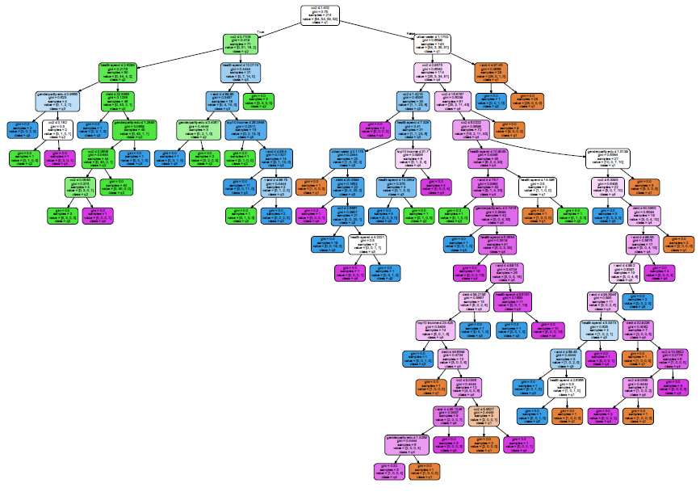
Decision Tree
Used hand-picked attributes
Classified GDP per capita into quartiles
Decided to improve upon this by selecting better attributes
1st Quartile
2nd Quartile
3rd Quartile
4th Quartile

Slide 18
Improving attribute selection
Selected a few attributes within industry, health, social groupings
Deleted those with high # of missing values
Selected the “best” ones from each major group via PCA
Final attributes :
SL.TLF.ACTI.1524.ZS Labor force participation rate for ages 15-24, total (%)
SP.DYN.LE00.MA.IN Life expectancy at birth, male (years)
SP.DYN.TO65.FE.ZS Survival to age 65, female (% of cohort)
SP.URB.GROW Urban population growth (annual %)
SH.XPD.PRIV.ZS Health expenditure, private (% of GDP)
SH.H2O.SAFE.UR.ZS Improved water source, urban (% of urban population with access)

Slide 19
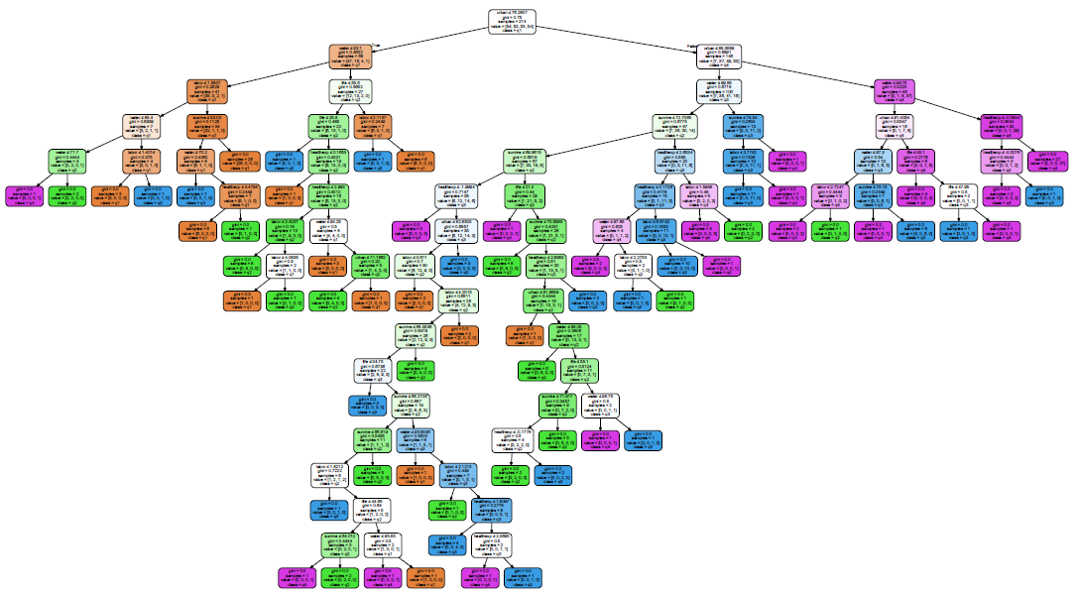
1st Quartile
2nd Quartile
3rd Quartile
4th Quartile

Slide 20
Key features
Countries with the highest GDP have more urbanization and best water quality
Countries with lowest water quality are easily those with lowest GDP
Among low and medium-low GDP classes, those with higher labor participation rate for ages 15-24 tend to have lower GDP
Health expenditure, life expectancy, are less deterministic attributes (lower in tree), but still important in separating two classes

Slide 21
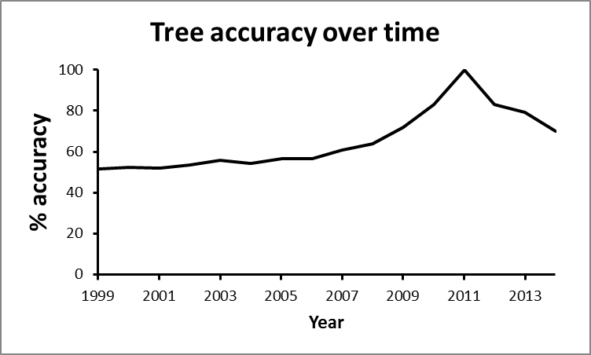
Accuracy
Tree was trained using 2011 data
Decrease in accuracy shows overfitting for years near 2011

Slide 22
Challenges/issues during analysis
Many empty attributes
  Deleted those below threshold of 0.85
  Filled missing values with mean
PCA
  Most “important” axes do not necessarily imply the best attributes to choose
  Variation for different attributes have different significance (normalization?)
Biggest issue: running time
  Impacted attribute selection
Could not get random forest to work properly
Possible improvement: Test on random data from all the years

Slide 23
Conclusion II
A handful of attributes perform well in predicting GDP (>70% accuracy)
Finding what attributes to choose was difficult but fun
  PCA is key in selecting attributes
  Some subjectivity still involved in the selection
  …More data would be nice
Be cautious about overfitting and implying causation

