Slide 1
PDF, Normal Distribution and Linear Regression

Slide 2
Uses of regression
Amount of change in a dependent variable that results from changes in the independent variable(s) – can be used to estimate elasticities, returns on investment in human capital, etc.
Attempt to determine causes of phenomena.
Support or negate theoretical model.
Modify and improve theoretical models and explanations of phenomena.

Slide 3
Income | hrs/week |  | Income | hrs/week
8000 | 38 |  | 8000 | 35
6400 | 50 |  | 18000 | 37.5
2500 | 15 |  | 5400 | 37
3000 | 30 |  | 15000 | 35
6000 | 50 |  | 3500 | 30
5000 | 38 |  | 24000 | 45
8000 | 50 |  | 1000 | 4
4000 | 20 |  | 8000 | 37.5
11000 | 45 |  | 2100 | 25
25000 | 50 |  | 8000 | 46
4000 | 20 |  | 4000 | 30
8800 | 35 |  | 1000 | 200
5000 | 30 |  | 2000 | 200
7000 | 43 |  | 4800 | 30
Notes:
Discuss cleaning the data.
– 0 incomes out
– income and 0 hours out
– The 200 hours?

Slide 5
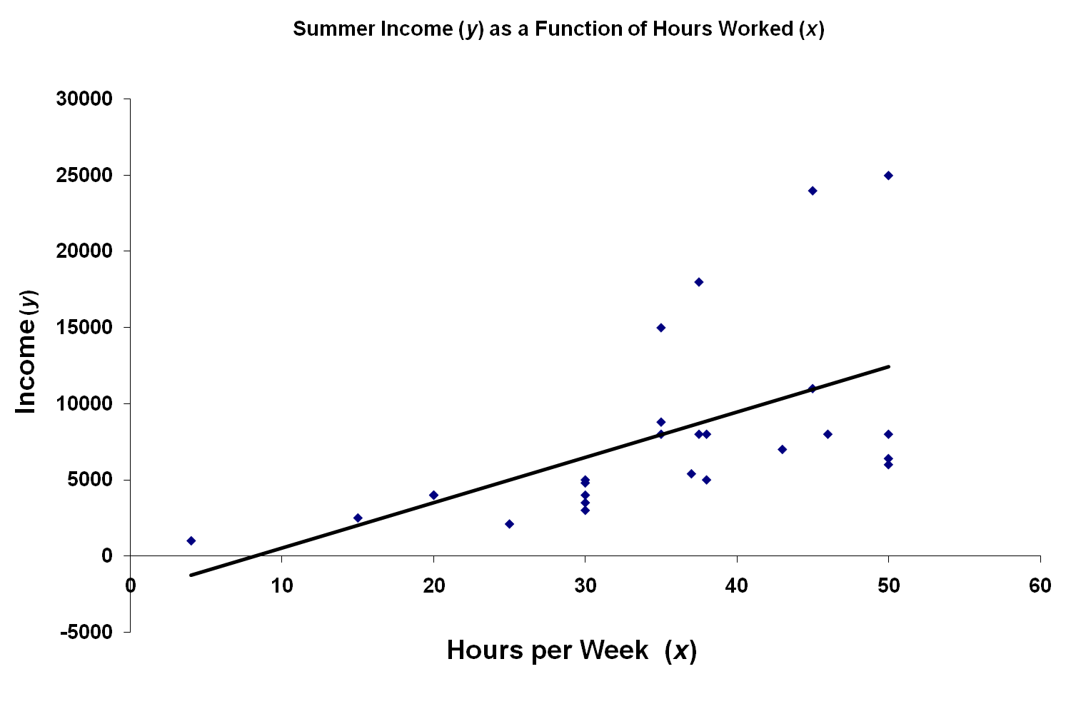
R² = 0.311
Significance = 0.0031
Notes:
Trendline shows the positive relationship.
Evidence of other variables?

Slide 6
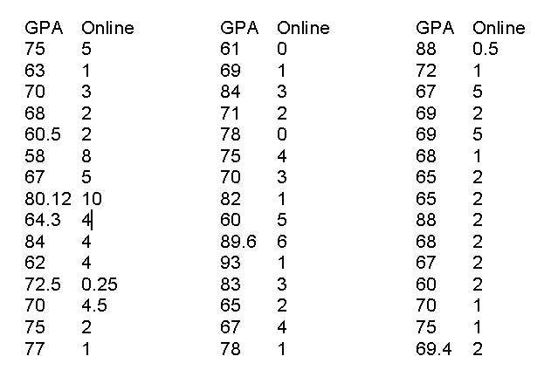
Notes:
Selected only.

Slide 7
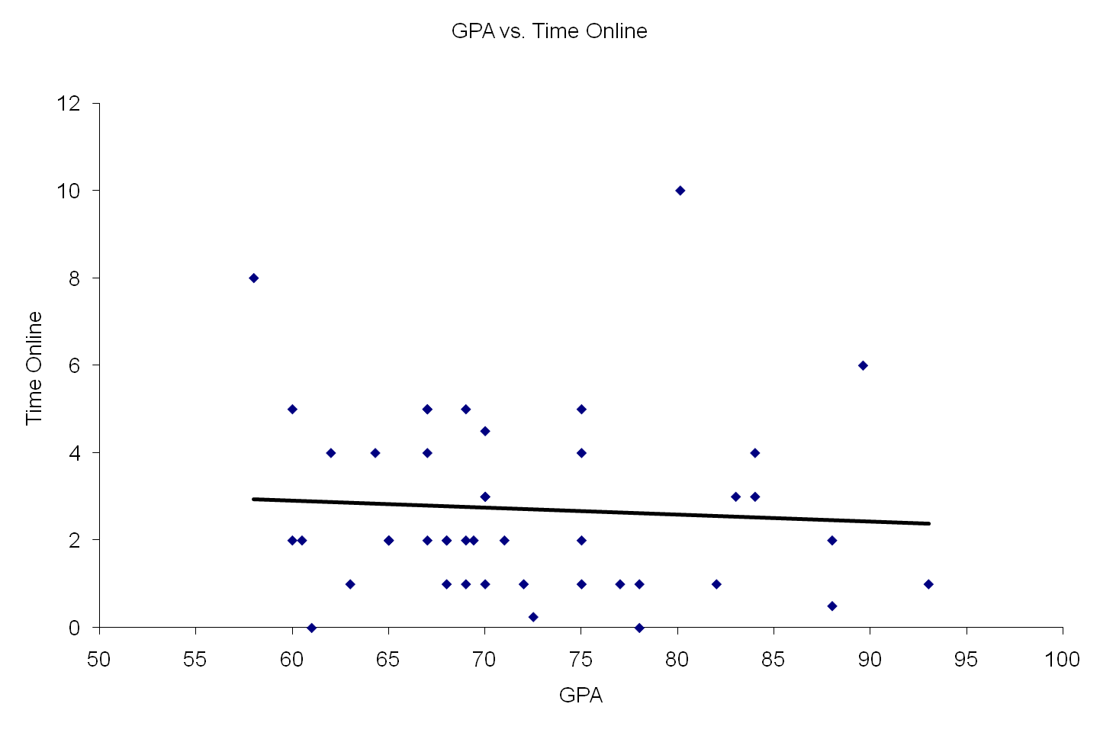
Notes:
The role of the two significant observations

Slide 8
Outliers
Rare, extreme values may distort the outcome.
  Could be an error.
  Could be a very important observation.
Outlier: more than 3 standard deviations from the mean.
Notes:
If you see one, check if it is a mistake.

Slide 9
Notes:
The role of the two significant observations

Slide 10
Notes:
The role of the two significant observations

Slide 11
Probability Densities in Data Mining
Why we should care
Notation and Fundamentals of continuous PDFs
Multivariate continuous PDFs
Combining continuous and discrete random variables

Slide 12
Why we should care
Real Numbers occur in at least 50% of database records
Can’t always quantize them
So need to understand how to describe where they come from
A great way of saying what’s a reasonable range of values
A great way of saying how multiple attributes should reasonably co-occur

Slide 13
Why we should care
Can immediately get us Bayes Classifiers that are sensible with real-valued data
You’ll need to intimately understand PDFs in order to do kernel methods, clustering with Mixture Models, analysis of variance, time series and many other things
Will introduce us to linear and non-linear regression

Slide 14
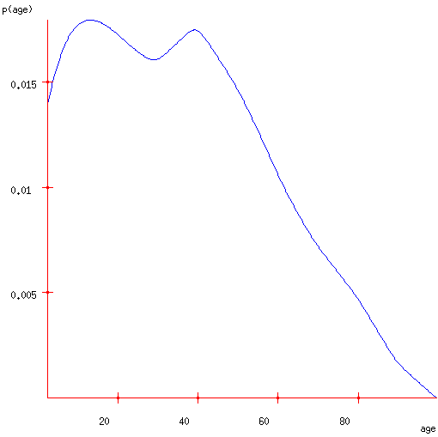
A PDF of American Ages in 2000

Slide 15
A PDF of American Ages in 2000
Let X be a continuous random variable.
If p(x) is a Probability Density Function for X then…
= 0.36

Slide 16
Expectations
E[X] = the expected value of random variable X
= the average value we’d see if we took a very large number of random samples of X

Slide 17
Expectations
E[X] = the expected value of random variable X
= the average value we’d see if we took a very large number of random samples of X
E[age]=35.897
= the first moment of the shape formed by the axes and the blue curve
= the best value to choose if you must guess an unknown person’s age and you’ll be fined the square of your error

Slide 18
Expectation of a function
μ=E[f(X)] = the expected value of f(x) where x is drawn from X’s distribution.
= the average value we’d see if we took a very large number of random samples of f(X)
Note that in general:

Slide 19
Variance
σ² = Var[X] = the expected squared difference between x and E[X]
= amount you’d expect to lose if you must guess an unknown person’s age and you’ll be fined the square of your error, and assuming you play optimally

Slide 20
Standard Deviation
σ² = Var[X] = the expected squared difference between x and E[X]
= amount you’d expect to lose if you must guess an unknown person’s age and you’ll be fined the square of your error, and assuming you play optimally
σ = Standard Deviation = “typical” deviation of X from its mean

Slide 21
The Normal Distribution
f(X)
Changing μ shifts the distribution left or right.
Changing σ increases or decreases the spread.
σ
μ
X

Slide 22
The Normal Distribution: as mathematical function (pdf)
This is a bell shaped curve with different centers and spreads depending on μ and σ
Note constants:
π=3.14159
e=2.71828

Slide 23
The Normal PDF
It’s a probability function, so no matter what the values of μ and σ, must integrate to 1!

Slide 24
Normal distribution is defined by its mean and standard dev.
E(X)=μ =
Var(X)=σ² =
Standard Deviation(X)=σ

Slide 25
**The beauty of the normal curve:
No matter what μ and σ are, the area between μ-σ and μ+σ is about 68%; the area between μ-2σ and μ+2σ is about 95%; and the area between μ-3σ and μ+3σ is about 99.7%. Almost all values fall within 3 standard deviations.

Slide 26
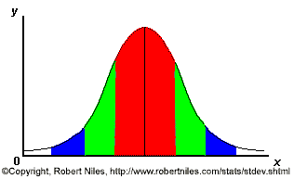
68-95-99.7 Rule
68% of the data
95% of the data
99.7% of the data
Notes:
SAY: within 1 standard deviation either way of the mean
within 2 standard deviations of the mean
within 3 standard deviations either way of the mean
WORKS FOR ALL NORMAL CURVES NO MATTER HOW SKINNY OR FAT

Slide 27
68-95-99.7 Rule in Math terms…

Slide 28
How good is rule for real data?
Check some example data:
The mean of the weight of the women = 127.8
The standard deviation (SD) = 15.5

Slide 29
68% of 120 = .68x120 = ~ 82 runners
In fact, 79 runners fall within 1-SD (15.5 lbs) of the mean.
112.3
127.8
143.3

Slide 30
95% of 120 = .95 x 120 = ~ 114 runners
In fact, 115 runners fall within 2-SD’s of the mean.
96.8
127.8
158.8

Slide 31
99.7% of 120 = .997 x 120 = 119.6 runners
In fact, all 120 runners fall within 3-SD’s of the mean.
81.3
127.8
174.3

Slide 32
Example
Suppose SAT scores roughly follows a normal distribution in the U.S. population of college-bound students (with range restricted to 200-800), and the average math SAT is 500 with a standard deviation of 50, then:
  68% of students will have scores between 450 and 550
  95% will be between 400 and 600
  99.7% will be between 350 and 650

Slide 33
Single-Parameter Linear Regression

Slide 34
Linear Regression
DATASET
inputs | outputs
x₁ = 1 | y₁ = 1
x₂ = 3 | y₂ = 2.2
x₃ = 2 | y₃ = 2
x₄ = 1.5 | y₄ = 1.9
x₅ = 4 | y₅ = 3.1
↑
w
↓
← 1 →
Linear regression assumes that the expected value of the output given an input, E[y|x], is linear.
Simplest case: Out(x) = wx for some unknown w.
Given the data, we can estimate w.

Slide 35
1-parameter linear regression
Assume that the data is formed by
y_{i} = wx_{i} + noise_{i}
where…
the noise signals are independent
the noise has a normal distribution with mean 0 and unknown variance σ²
p(y|w,x) has a normal distribution with
mean wx
variance σ²

Slide 36
Bayesian Linear Regression
p(y|w,x) = Normal (mean wx, var σ²)
We have a set of datapoints (x₁,y₁) (x₂,y₂) … (x_{n},y_{n}) which are EVIDENCE about w.
We want to infer w from the data.
p(w|x₁, x₂, x₃,…x_{n}, y₁, y₂…y_{n})

Slide 37
Maximum likelihood estimation of w
Asks the question:
“For which value of w is this data most likely to have happened?”
<=>
For what w is
p(y₁, y₂…y_{n} |x₁, x₂, x₃,…x_{n}, w) maximized?
<=>
For what w is

Slide 38
For what w is
For what w is
For what w is
For what w is

Slide 39
Linear Regression
The maximum likelihood w is the one that minimizes sum-of-squares of residuals
E(w)
w
We want to minimize a quadratic function of w.

Slide 40
Linear Regression
Easy to show the sum of squares is minimized when
The maximum likelihood model is
We can use it for prediction

Slide 41
Linear Regression
Easy to show the sum of squares is minimized when
p(w)
w
Note: In Bayesian stats you’d have ended up with a prob dist of w
And predictions would have given a prob dist of expected output
Often useful to know your confidence. Max likelihood can give some kinds of confidence too.
The maximum likelihood model is
We can use it for prediction

