Slide 1
CS485G Data Mining
Recommendation Systems
Netflix Challenge

Slide 2
Recommendations
Search
Recommendations
Items
Products, web sites, blogs, news items, …

Slide 3
From scarcity to abundance
Shelf space is a scarce commodity for traditional retailers
  Also: TV networks, movie theaters,…
The web enables near-zero-cost dissemination of information about products
  From scarcity to abundance
More choice necessitates better filters
  Recommendation engines
  How Into Thin Air made Touching the Void a bestseller
Notes:
Fundamental economic transformation wrought by the Internet

Slide 4
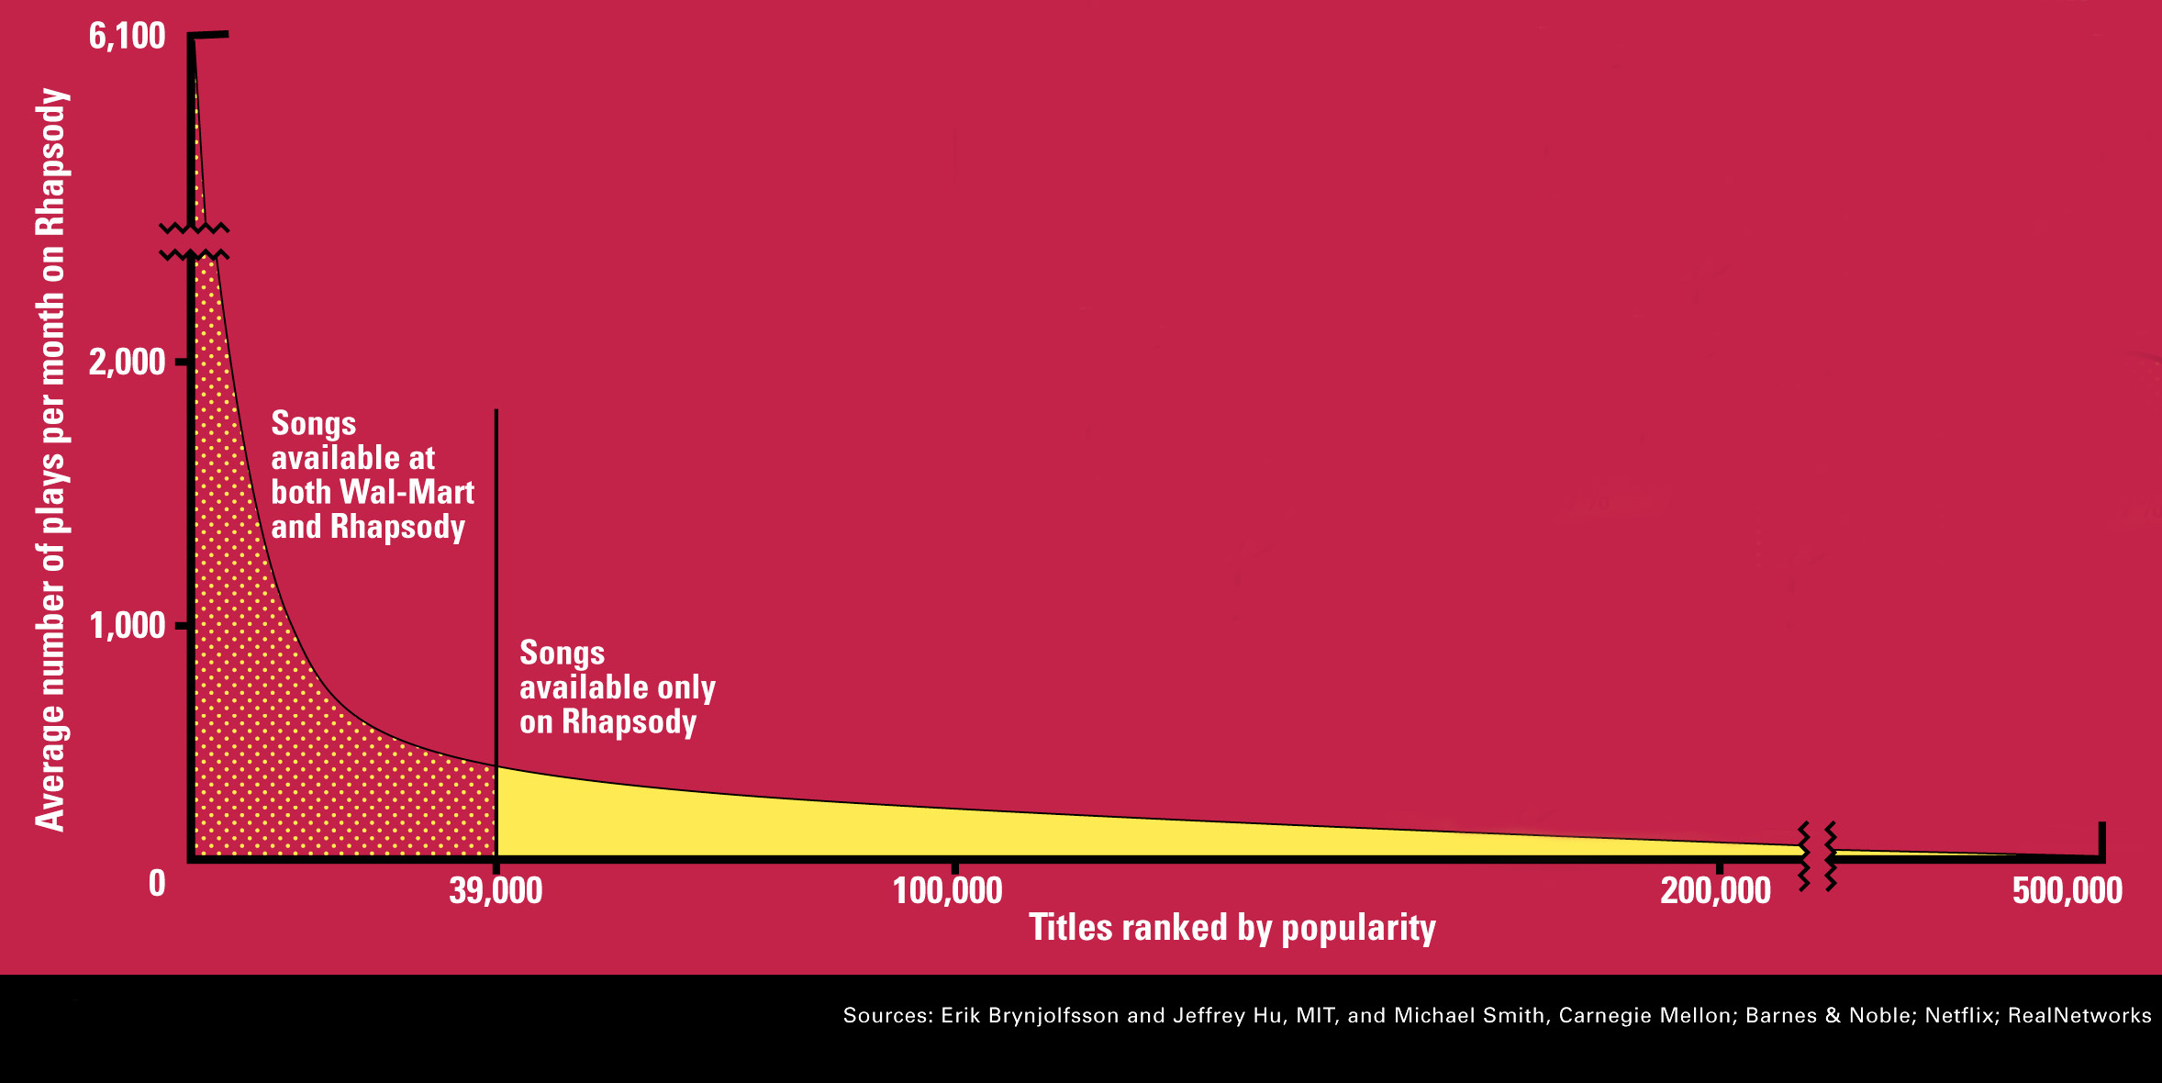
The Long Tail
Source: Chris Anderson (2004)

Slide 5
Recommendation Types
Editorial
Simple aggregates
  Top 10, Most Popular, Recent Uploads
Tailored to individual users
  Amazon, Netflix, …

Slide 6
Formal Model
C = set of Customers
S = set of Items
Utility function u: CXS->R
  R = set of ratings
  R is a totally ordered set
  e.g., 0-5 stars, real number in [0,1]

Slide 7
Utility Matrix
King Kong
LOTR
Matrix
Nacho Libre
Alice
Bob
Carol
David

Slide 8
Key Problems
Gathering “known” ratings for matrix
Extrapolate unknown ratings from known ratings
  Mainly interested in high unknown ratings
Evaluating extrapolation methods

Slide 9
Gathering Ratings
Explicit
  Ask people to rate items
  Doesn’t work well in practice – people can’t be bothered
Implicit
  Learn ratings from user actions
  e.g., purchase implies high rating
  What about low ratings?

Slide 10
Extrapolating Utilities
Key problem: matrix U is sparse
  most people have not rated most items
Three approaches
  Content-based
  Collaborative
  Hybrid

Slide 11
Content-based recommendations
Main idea: recommend items to customer C similar to previous items rated highly by C
Movie recommendations
  recommend movies with same actor(s), director, genre, …
Websites, blogs, news
  recommend other sites with “similar” content

Slide 12
Plan of action
Item profiles
likes
build
recommend
match
Red
Circles
Triangles
User profile

Slide 13
Item Profiles
For each item, create an item profile
Profile is a set of features
  movies: author, title, actor, director,…
  text: set of “important” words in document
How to pick important words?
  Usual heuristic is TF.IDF (Term Frequency times Inverse Doc Frequency)

Slide 14
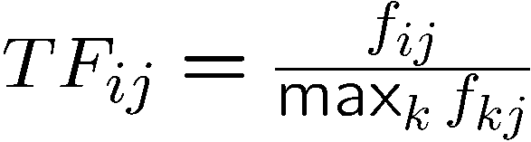
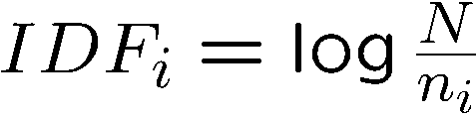
TF.IDF
f_{ij} = frequency of term t_{i} in document d_{j}
n_{i} = number of docs that mention term i
N = total number of docs
TF.IDF score w_{ij} = TF_{ij} * IDF_{i}
Doc profile = set of words with highest TF.IDF scores, together with their scores

Slide 15
User profiles and prediction
User profile possibilities:
  Weighted average of rated item profiles
  Variation: weight by difference from average rating for item
  …
Prediction heuristic
  Given user profile c and item profile s, estimate u(c,s) = cos(c,s) = c.s/(|c||s|)
  Need efficient method to find items with high utility: later

Slide 16
Model-based approaches
For each user, learn a classifier that classifies items into rating classes
  liked by user and not liked by user
  e.g., Bayesian, regression, SVM
Apply classifier to each item to find recommendation candidates
Problem: scalability
  Won’t investigate further in this class

Slide 17
Limitations of content-based approach
Finding the appropriate features
  e.g., images, movies, music
Overspecialization
  Never recommends items outside user’s content profile
  People might have multiple interests
Recommendations for new users
  How to build a profile?

Slide 18
Collaborative Filtering
Consider user c
Find set D of other users whose ratings are “similar” to c’s ratings
Estimate user’s ratings based on ratings of users in D

Slide 19
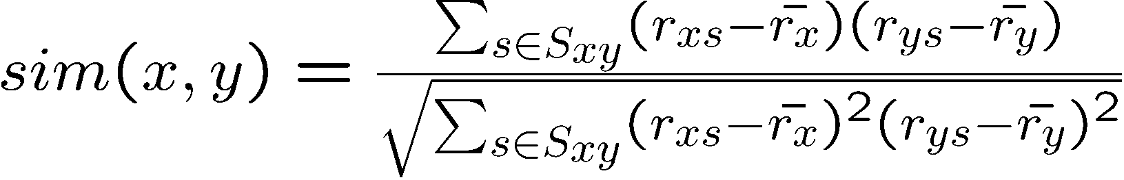
Similar users
Let r_{x} be the vector of user x’s ratings
Cosine similarity measure
  sim(x,y) = cos(r_{x} , r_{y})
Pearson correlation coefficient
  S_{xy} = items rated by both users x and y

Slide 20
Rating predictions
Let D be the set of k users most similar to c who have rated item s
Possibilities for prediction function (item s):
  r_{cs} = 1/k ∑_{d in} _{D} r_{ds}
  r_{cs} = (∑_{d in} _{D} sim(c,d) * r_{ds})/(∑_{d in D} sim(c,d))
  Other options?
Many tricks possible…

Slide 21
Complexity
Expensive step is finding k most similar customers
  O(|U|)
Too expensive to do at runtime
  Need to pre-compute
Naïve precomputation takes time O(N|U|)
  Simple trick gives some speedup
Can use clustering, partitioning as alternatives, but quality degrades

Slide 22
Item-Item Collaborative Filtering
So far: User-user collaborative filtering
Another view
  For item s, find other similar items
  Estimate rating for item based on ratings for similar items
  Can use same similarity metrics and prediction functions as in user-user model
In practice, it has been observed that item-item often works better than user-user

Slide 23
Pros and cons of collaborative filtering
Works for any kind of item
  No feature selection needed
New user problem
New item problem
Sparsity of rating matrix
  Cluster-based smoothing?

Slide 24
Hybrid Methods
Implement two separate recommenders and combine predictions
Add content-based methods to collaborative filtering
  item profiles for new item problem
  demographics to deal with new user problem

Slide 25
Evaluating Predictions
Compare predictions with known ratings
  Root-mean-square error (RMSE)
Another approach: 0/1 model
  Coverage
    Number of items/users for which system can make predictions
  Precision
    Accuracy of predictions
  Receiver operating characteristic (ROC)
    Tradeoff curve between false positives and false negatives

Slide 26
Problems with Measures
Narrow focus on accuracy sometimes misses the point
  Prediction Diversity
  Prediction Context
  Order of predictions
In practice, we care only to predict high ratings
  RMSE might penalize a method that does well for high ratings and badly for others

Slide 27
Tip: Add data
Leverage all the Netflix data
  Don’t try to reduce data size in an effort to make fancy algorithms work
  Simple methods on large data do best
Add more data
  e.g., add IMDB data on genres
More Data Beats Better Algorithms
http://anand.typepad.com/datawocky/2008/03/more-data-usual.html

Slide 28
Finding similar vectors
Common problem that comes up in many settings
Given a large number N of vectors in some high-dimensional space (M dimensions), find pairs of vectors that have high cosine-similarity
  e.g., user profiles, item profiles

