Slide 1
Classification Evaluation
And Model Selection

Slide 2
Testing
Training set
  Sample data for which truth is known
  Used to develop classifier
Independent test data
  Sample data
  Not part of training set
  Sampled from a real population

Slide 3
Testing
Classification error = misclassification
Empirical error rate = % misclassified

Slide 4
Two-class problems
Good or bad?
Present or absent?
Diseased or not?

Slide 5
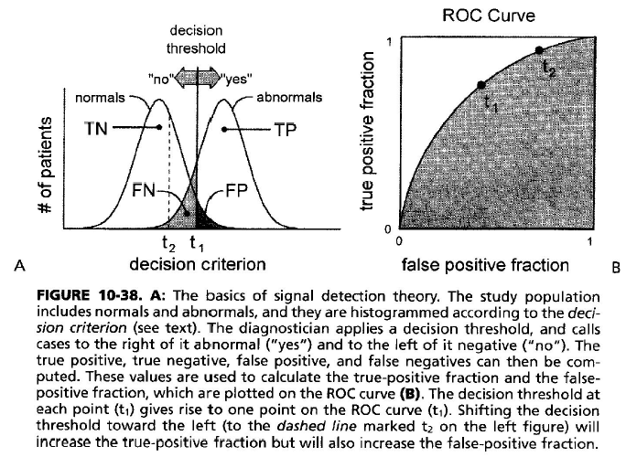
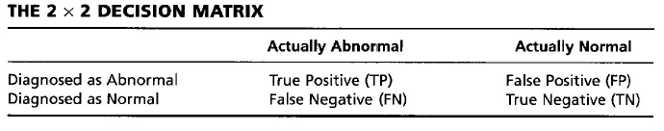

Slide 6
Evaluating errors
Different costs are associated with different errors!
  Ex. Mammography
    Say 99% of population N.A.D. (no apparent disease).
    So if we say “no disease,” we’ll be correct 99% of the time!
    But the cost is great (death) if we are wrong!
    So let’s say disease is always present.
      We’ll be wrong 99% of the time!
      We’ll need to follow up with biopsy.
      We’ll inflict psychological stress on the patient.

Slide 7
ROC Analysis
“The ROC curve was first developed by electrical engineers and radar engineers during World War II for detecting enemy objects in battle fields and was soon introduced to psychology to account for perceptual detection of stimuli.”
– from http://en.wikipedia.org/wiki/Receiver_operating_characteristic

Slide 8
ROC Analysis
“ROC analysis since then has been used in medicine, radiology, biometrics, and other areas for many decades and is increasingly used in machine learning and data mining research.”
– from http://en.wikipedia.org/wiki/Receiver_operating_characteristic

Slide 9
ROC Analysis History
“The ROC curve was first used during World War II for the analysis of radar signals before it was employed in signal detection theory. Following the attack on Pearl Harbor in 1941, the United States army began new research to increase the prediction of correctly detected Japanese aircraft from their radar signals.”
– from http://en.wikipedia.org/wiki/Receiver_operating_characteristic

Slide 10
ROC Analysis History
“In the 1950s, ROC curves were employed in psychophysics to assess human (and occasionally non-human animal) detection of weak signals. In medicine, ROC analysis has been extensively used in the evaluation of diagnostic tests. ROC curves are also used extensively in epidemiology and medical research and are frequently mentioned in conjunction with evidence-based medicine. In radiology, ROC analysis is a common technique to evaluate new radiology techniques. In the social sciences, ROC analysis is often called the ROC Accuracy Ratio, a common technique for judging the accuracy of default probability models.”
– from http://en.wikipedia.org/wiki/Receiver_operating_characteristic

Slide 11
ROC Analysis History
“ROC curves also proved useful for the evaluation of machine learning techniques. The first application of ROC in machine learning was by Spackman who demonstrated the value of ROC curves in comparing and evaluating different classification algorithms.”
– from http://en.wikipedia.org/wiki/Receiver_operating_characteristic

Slide 12
ROC curve analysis
We are given a number of test cases for which we know the “truth.”
For a single t (decision threshold) setting, we can calculate (test our method for) TP, TN, FP, and FN.
  TP = true positive = present and detected
  TN = true negative = not present and not detected
  FP = false positive = not present but detected
  FN = false negative = present but not detected
TP+TN+FP+FN = # of normals and abnormals in our study population.

Slide 13
Defn. accuracy
TP+TN+FP+FN = # of normals (TN+FP), and abnormals (TP+FN) in our study population.
Accuracy = (TP+TN) / (TP+TN+FP+FN)
  But this is greatly influenced by target (or disease) prevalence.

Slide 14
Problems w/ accuracy
Ex. Mammography
  The disease occurs < 1%.
  So let a trained monkey always say there is no disease (without even looking at the film/image)!
  Our monkey’s accuracy is (0+99)/(0+99+0+1) = 99% without even going to medical school!
We need a different measure!

Slide 15
ROC analysis
True Positive Fraction
  TPF = TP / (TP+FN)
  also called sensitivity
  true abnormals called abnormal
  by the observer
False Positive Fraction
  FPF = FP / (FP+TN)
Specificity = TN / (TN+FP)
  True normals called normal by the observer
  FPF = 1 - specificity

Slide 16
ROC analysis
True Positive Fraction
  TPF = TP / (TP+FN)
  also called sensitivity
  true abnormals called abnormal
  by the observer
False Positive Fraction
  FPF = FP / (FP+TN)
Specificity = TN / (TN+FP)
  True normals called normal by the observer
  FPF = 1 - specificity

Slide 18
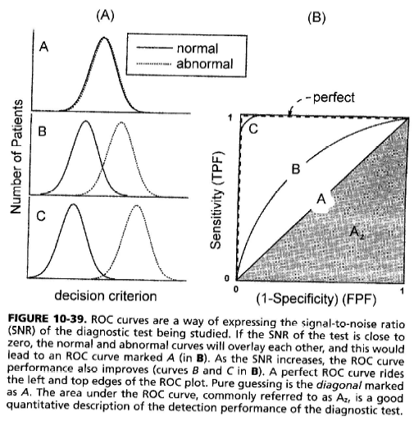
Evaluating classifiers (via their ROC curves)
Classifier A can’t distinguish between normal and abnormal.
B is better but makes some mistakes.
C makes very few mistakes.

Slide 19
“Perfect” means no false positives and no false negatives.

Slide 20
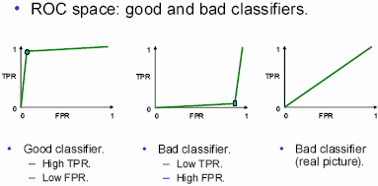
ROC analysis
ROC = receiver operator/operating characteristic/curve

Slide 21
ROC analysis
Positive predictive value
  PPV = TP / (TP+FP) (TPF = TP / (TP+FN))
  Probability that the patient is actually abnormal when the observer says that the patient is abnormal.
Negative predictive value
  NPV = TN / (TN+FN) (Specificity = TN / (TN+FP))
  Probability that the patient is actually normal when the observer says that the patient is normal.

Slide 22
Roc example

Slide 23
ROC example
“Pneumoconiosis (PNC) is an occupational lung disease and a restrictive lung disease caused by the inhalation of dust, often in mines.” – from wikipedia
FEV = Forced Expiratory Volume (how much air the individual can expel/exhale)
How good is FEV at indicating PNC?

Slide 24
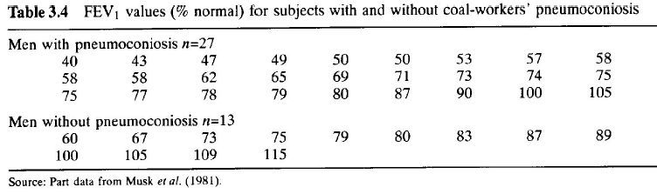
ROC example
FEV = Forced Expiratory Volume (how much air the individual can expel/exhale)
FEV is our measured “feature.”

Slide 25
For those with PNC, mean FEV was 68.
For those without PNC, mean was 86.

Slide 26
FEV values for those with and without PNC.
Counts of those with and without PNC for various FEV ranges.
. .
. .
. .
What’s this called?

Slide 28
ROC example
We will now set a threshold on our feature (FEV), and calculate our 2x2 matrix.
Let t=80%, and n=normal FEV (FEV of healthy person of same age and height).
If the FEV<t*n, then our classifier will say that the disease is present; otherwise, our classifier will say that the disease is absent.

Slide 29
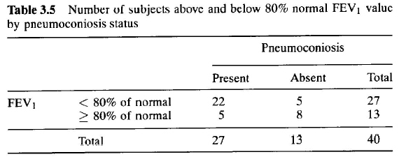
ROC example
TP FP

Slide 30
ROC example
From this, we get a single point on the ROC curve. For t=80%, sensitivity = 22/27 = 81% and specificity = 8/13 = 62%.
Do the same for t=40% and t=115% and plot the results.

Slide 31
Cross-validation for detecting and preventing overfitting

Slide 32
A Regression Problem
y = f(x) + noise
Can we learn f from this data?
Let’s consider three methods…
y
x

Slide 33
Linear Regression
y
x

Slide 34
Linear Regression
Univariate Linear regression with a constant term:
X | Y
3 | 7
1 | 3
: | :
X=
y=
3
1
:
7
3
:
x₁=(3)..
y₁=7..

Slide 35
Linear Regression
Univariate Linear regression with a constant term:
X | Y
3 | 7
1 | 3
: | :
X=
y=
3
1
:
7
3
:
x₁=(3)..
y₁=7..
Z=
y=
1 | 3
1 | 1
:
7
3
:
z₁=(1,3)..
z_{k}=(1,x_{k})
y₁=7..

Slide 36
Linear Regression
Univariate Linear regression with a constant term:
X | Y
3 | 7
1 | 3
: | :
X=
y=
3
1
:
7
3
:
x₁=(3)..
y₁=7..
Z=
y=
1 | 3
1 | 1
:
7
3
:
β=(Z^{T}Z)⁻¹(Z^{T}y)
y^{est} = β₀+ β₁ x
z₁=(1,3)..
z_{k}=(1,x_{k})
y₁=7..

Slide 37
Quadratic Regression
y
x

Slide 38
Quadratic Regression
Much more about this in the future Andrew Lecture: “Favorite Regression Algorithms”
X | Y
3 | 7
1 | 3
: | :
X=
y=
3
1
:
7
3
:
x₁=(3,2)..
y₁=7..
1 | 3 | 9
1 | 1 | 1
:
y=
Z=
7
3
:
β=(Z^{T}Z)⁻¹(Z^{T}y)
y^{est} = β₀+ β₁ x+ β₂ x²
z=(1 , x, x²,)

Slide 39
Join-the-dots
Also known as piecewise linear nonparametric regression if that makes you feel better
y
x

Slide 40
Which is best?
y
y
x
x
Why not choose the method with the best fit to the data?

Slide 41
What do we really want?
y
y
x
x
Why not choose the method with the best fit to the data?
“How well are you going to predict future data drawn from the same distribution?”

Slide 42
The test set method
1. Randomly choose 30% of the data to be in a test set
2. The remainder is a training set
y
x

Slide 43
The test set method
1. Randomly choose 30% of the data to be in a test set
2. The remainder is a training set
3. Perform your regression on the training set
y
x
(Linear regression example)

Slide 44
The test set method
1. Randomly choose 30% of the data to be in a test set
2. The remainder is a training set
3. Perform your regression on the training set
4. Estimate your future performance with the test set
y
x
(Linear regression example)
Mean Squared Error = 2.4

Slide 45
The test set method
1. Randomly choose 30% of the data to be in a test set
2. The remainder is a training set
3. Perform your regression on the training set
4. Estimate your future performance with the test set
y
x
(Quadratic regression example)
Mean Squared Error = 0.9

Slide 46
The test set method
1. Randomly choose 30% of the data to be in a test set
2. The remainder is a training set
3. Perform your regression on the training set
4. Estimate your future performance with the test set
y
x
(Join the dots example)
Mean Squared Error = 2.2

Slide 47
The test set method
Good news:
Very very simple
Can then simply choose the method with the best test-set score
Bad news:
What’s the downside?

Slide 48
The test set method
Good news:
Very very simple
Can then simply choose the method with the best test-set score
Bad news:
Wastes data: we get an estimate of the best method to apply to 30% less data
If we don’t have much data, our test-set might just be lucky or unlucky
We say the “test-set estimator of performance has high variance”

Slide 49
LOOCV (Leave-one-out Cross Validation)
For k=1 to R
  1. Let (x_{k},y_{k}) be the k^{th} record
y
x

Slide 50
LOOCV (Leave-one-out Cross Validation)
For k=1 to R
  1. Let (x_{k},y_{k}) be the k^{th} record
  2. Temporarily remove (x_{k},y_{k}) from the dataset
y
x

Slide 51
LOOCV (Leave-one-out Cross Validation)
For k=1 to R
  1. Let (x_{k},y_{k}) be the k^{th} record
  2. Temporarily remove (x_{k},y_{k}) from the dataset
  3. Train on the remaining R-1 datapoints
y
x

Slide 52
LOOCV (Leave-one-out Cross Validation)
For k=1 to R
  1. Let (x_{k},y_{k}) be the k^{th} record
  2. Temporarily remove (x_{k},y_{k}) from the dataset
  3. Train on the remaining R-1 datapoints
  4. Note your error (x_{k},y_{k})
y
x

Slide 53
LOOCV (Leave-one-out Cross Validation)
For k=1 to R
  1. Let (x_{k},y_{k}) be the k^{th} record
  2. Temporarily remove (x_{k},y_{k}) from the dataset
  3. Train on the remaining R-1 datapoints
  4. Note your error (x_{k},y_{k})
When you’ve done all points, report the mean error.
y
x

Slide 54
LOOCV (Leave-one-out Cross Validation)
For k=1 to R
  1. Let (x_{k},y_{k}) be the k^{th} record
  2. Temporarily remove (x_{k},y_{k}) from the dataset
  3. Train on the remaining R-1 datapoints
  4. Note your error (x_{k},y_{k})
When you’ve done all points, report the mean error.
y
y
y
x
x
x
y
y
y
x
x
x
MSE_{LOOCV} = 2.12
y
y
y
x
x
x

Slide 55
LOOCV for Quadratic Regression
For k=1 to R
  1. Let (x_{k},y_{k}) be the k^{th} record
  2. Temporarily remove (x_{k},y_{k}) from the dataset
  3. Train on the remaining R-1 datapoints
  4. Note your error (x_{k},y_{k})
When you’ve done all points, report the mean error.
y
y
y
x
x
x
y
y
y
x
x
x
MSE_{LOOCV}=0.962
y
y
y
x
x
x

Slide 56
LOOCV for Join The Dots
For k=1 to R
  1. Let (x_{k},y_{k}) be the k^{th} record
  2. Temporarily remove (x_{k},y_{k}) from the dataset
  3. Train on the remaining R-1 datapoints
  4. Note your error (x_{k},y_{k})
When you’ve done all points, report the mean error.
y
y
y
x
x
x
y
y
y
x
x
x
MSE_{LOOCV}=3.33
y
y
y
x
x
x

Slide 57
Which kind of Cross Validation?
 | Downside | Upside
Test-set | Variance: unreliable estimate of future performance | Cheap
Leave-one-out | Expensive. Has some weird behavior | Doesn’t waste data
..can we get the best of both worlds?

Slide 58
k-fold Cross Validation
Randomly break the dataset into k partitions (in our example we’ll have k=3 partitions colored Red Green and Blue)
y
x

Slide 59
k-fold Cross Validation
Randomly break the dataset into k partitions (in our example we’ll have k=3 partitions colored Red Green and Blue)
  For the red partition: Train on all the points not in the red partition. Find the test-set sum of errors on the red points.
y
x

Slide 60
k-fold Cross Validation
Randomly break the dataset into k partitions (in our example we’ll have k=3 partitions colored Red Green and Blue)
  For the red partition: Train on all the points not in the red partition. Find the test-set sum of errors on the red points.
  For the green partition: Train on all the points not in the green partition. Find the test-set sum of errors on the green points.
y
x

Slide 61
k-fold Cross Validation
Randomly break the dataset into k partitions (in our example we’ll have k=3 partitions colored Red Green and Blue)
  For the red partition: Train on all the points not in the red partition. Find the test-set sum of errors on the red points.
  For the green partition: Train on all the points not in the green partition. Find the test-set sum of errors on the green points.
  For the blue partition: Train on all the points not in the blue partition. Find the test-set sum of errors on the blue points.
y
x

Slide 62
k-fold Cross Validation
Randomly break the dataset into k partitions (in our example we’ll have k=3 partitions colored Red Green and Blue)
  For the red partition: Train on all the points not in the red partition. Find the test-set sum of errors on the red points.
  For the green partition: Train on all the points not in the green partition. Find the test-set sum of errors on the green points.
  For the blue partition: Train on all the points not in the blue partition. Find the test-set sum of errors on the blue points.
  Then report the mean error
y
x
Linear Regression MSE_{3FOLD}=2.05

Slide 63
k-fold Cross Validation
Randomly break the dataset into k partitions (in our example we’ll have k=3 partitions colored Red Green and Blue)
  For the red partition: Train on all the points not in the red partition. Find the test-set sum of errors on the red points.
  For the green partition: Train on all the points not in the green partition. Find the test-set sum of errors on the green points.
  For the blue partition: Train on all the points not in the blue partition. Find the test-set sum of errors on the blue points.
  Then report the mean error
y
x
Quadratic Regression MSE_{3FOLD}=1.11

Slide 64
k-fold Cross Validation
Randomly break the dataset into k partitions (in our example we’ll have k=3 partitions colored Red Green and Blue)
  For the red partition: Train on all the points not in the red partition. Find the test-set sum of errors on the red points.
  For the green partition: Train on all the points not in the green partition. Find the test-set sum of errors on the green points.
  For the blue partition: Train on all the points not in the blue partition. Find the test-set sum of errors on the blue points.
  Then report the mean error
y
x
Joint-the-dots MSE_{3FOLD}=2.93

Slide 65
Which kind of Cross Validation?
 | Downside | Upside
Test-set | Variance: unreliable estimate of future performance | Cheap
Leave-one-out | Expensive. Has some weird behavior | Doesn’t waste data
10-fold | Wastes 10% of the data. 10 times more expensive than test set | Only wastes 10%. Only 10 times more expensive instead of R times.
3-fold | Wastier than 10-fold. Expensivier than test set | Slightly better than test-set
R-fold | Identical to Leave-one-out

Slide 66
Which kind of Cross Validation?
 | Downside | Upside
Test-set | Variance: unreliable estimate of future performance | Cheap
Leave-one-out | Expensive. Has some weird behavior | Doesn’t waste data
10-fold | Wastes 10% of the data. 10 times more expensive than testset | Only wastes 10%. Only 10 times more expensive instead of R times.
3-fold | Wastier than 10-fold. Expensivier than testset | Slightly better than test-set
R-fold | Identical to Leave-one-out
But note: One of Andrew’s joys in life is algorithmic tricks for making these cheap

Slide 67
CV-based Model Selection
We’re trying to decide which algorithm to use.
We train each machine and make a table…
i | f_{i} | TRAINERR | 10-FOLD-CV-ERR | Choice
1 | f₁
2 | f₂
3 | f₃ |  |  | 
4 | f₄
5 | f₅
6 | f₆

Slide 68
CV-based Model Selection
Example: Choosing number of hidden units in a one-hidden-layer neural net.
Step 1: Compute 10-fold CV error for six different model classes:
Algorithm | TRAINERR | 10-FOLD-CV-ERR | Choice
0 hidden units
1 hidden units
2 hidden units |  |  | 
3 hidden units
4 hidden units
5 hidden units
Step 2: Whichever model class gave best CV score: train it with all the data, and that’s the predictive model you’ll use.

Slide 69
CV-based Model Selection
Example: Choosing “k” for a k-nearest-neighbor regression.
Step 1: Compute LOOCV error for six different model classes:
Algorithm | TRAINERR | 10-fold-CV-ERR | Choice
K=1
K=2
K=3
K=4 |  |  | 
K=5
K=6
Step 2: Whichever model class gave best CV score: train it with all the data, and that’s the predictive model you’ll use.

