Slide 1
CS 485G:
Special Topics in Data Mining
BiClustering Analysis
Jinze Liu

Slide 2
http://www.onmyphd.com/?p=k-means.clustering&ckattempt=1
http://www.jstor.org/stable/2330417?seq=2#page_scan_tab_contents

Slide 4
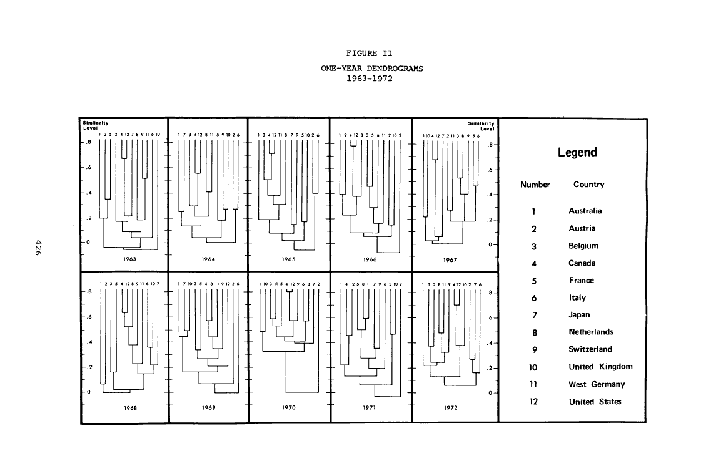

Slide 5
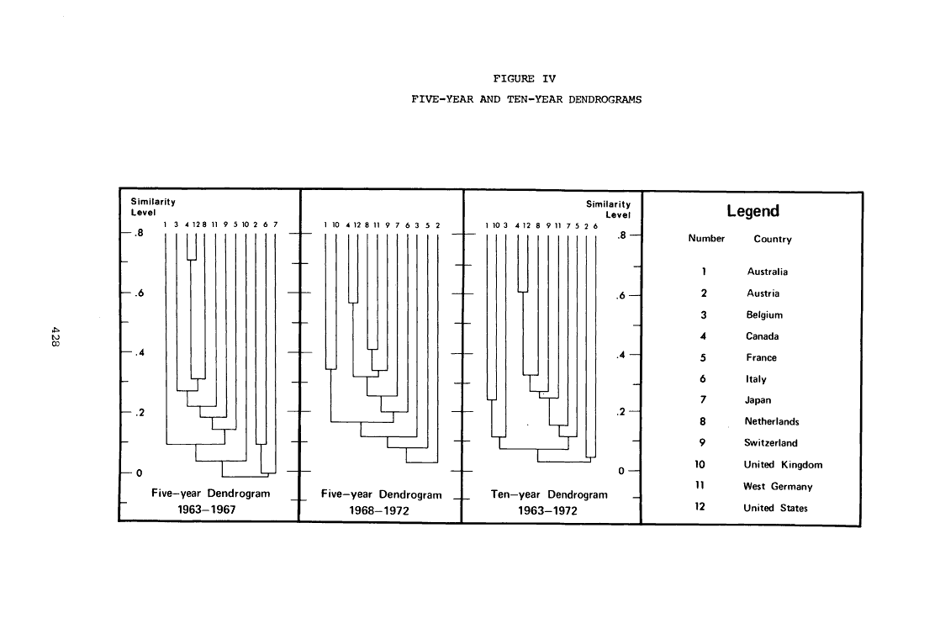

Slide 6
Outline
The Curse of Dimensionality
Co-Clustering
  Partition-based hard clustering
Subspace-Clustering
  Pattern-based

Slide 7
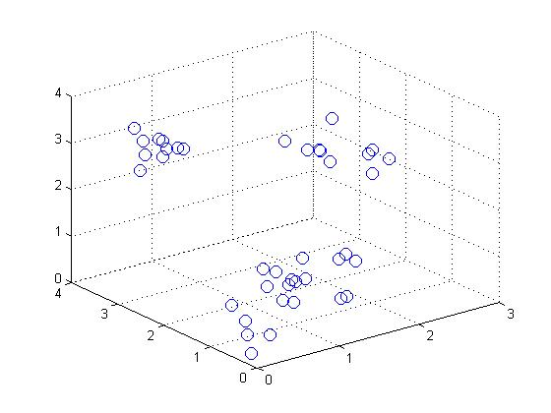
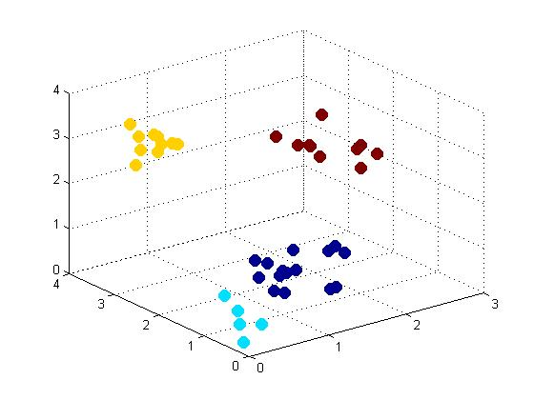
Clustering
K-means clustering minimizes
Where

Slide 8
The Curse of Dimensionality
The dimension of a problem refers to the number of input variables (actually, degrees of freedom).
1–D
2–D
3–D
The curse of dimensionality
The exponential increase in data required to densely populate space as the dimension increases.
The points are equally far apart in high dimensional space.

Slide 9
Motivation
Document Clustering:
  Define a similarity measure
  Clustering the documents using e.g. k-means
Term Clustering:
  Symmetric with Doc Clustering

Slide 10
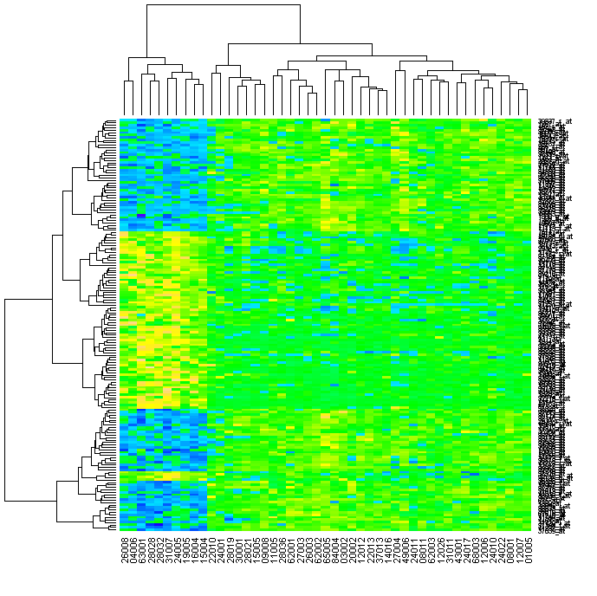
Motivation
Hierarchical Clustering of Genes
Hierarchical Clustering of Patients
Genes
Patients

Slide 11
Contingency Tables
Let X and Y be discrete random variables
  X and Y take values in {1, 2, …, m} and {1, 2, …, n}
  p(X, Y) denotes the joint probability distribution—if not known, it is often estimated based on co-occurrence data
  Application areas: text mining, market-basket analysis, analysis of browsing behavior, etc.
Key Obstacles in Clustering Contingency Tables
  High Dimensionality, Sparsity, Noise
  Need for robust and scalable algorithms

Slide 12
Co-Clustering
Simultaneously
  Cluster rows of p(X, Y) into k disjoint groups
  Cluster columns of p(X, Y) into l disjoint groups
Key goal is to exploit the “duality” between row and column clustering to overcome sparsity and noise

Slide 13
Co-clustering Example for Text Data
Co-clustering clusters both words and documents simultaneously using the underlying co-occurrence frequency matrix
document
document clusters
word
clusters
word

Slide 14
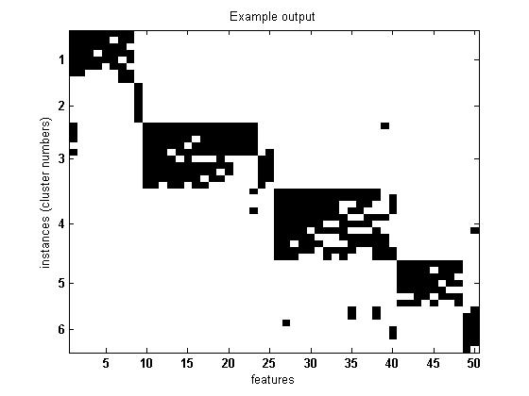
Result of Co-Clustering
http://adios.tau.ac.il/SpectralCoClustering/
http://adios.tau.ac.il/SpectralCoClustering/

Slide 15
Clustering by Patterns

Slide 16
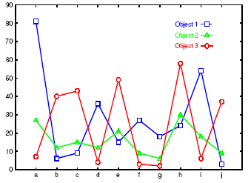
Clustering by Pattern Similarity
(p-Clustering)
The micro-array “raw” data shows 3 genes and their values in a multi-dimensional space
  Parallel Coordinates Plots
  Difficult to find their patterns
“non-traditional”
clustering

Slide 17
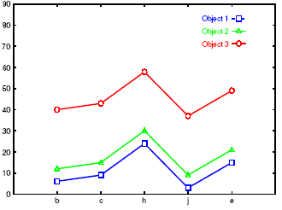
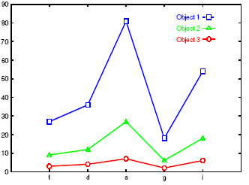
Clusters Are Clear After Projection

Slide 18
Motivation
E-Commerce: collaborative filtering
 | Movie 1 | Movie 2 | Movie 3 | Movie 4 | Movie 5 | Movie 6 | Movie 7
Viewer 1 | 1 | 2 | 4 | 3 |  | 5
Viewer 2 | 4 |  |  | 6 | 7 |  | 1
Viewer 3 | 2 | 3 |  | 4 |  | 6 | 3
Viewer 4 | 3 | 4 |  | 5 |  | 7
Viewer 5 |  |  | 5 | 5 | 3 | 4

Slide 19
Motivation

Slide 20
Motivation
 | Movie 1 | Movie 2 | Movie 3 | Movie 4 | Movie 5 | Movie 6 | Movie 7
Viewer 1 | 1 | 2 | 4 | 3 |  | 5
Viewer 2 | 4 |  |  | 6 | 7 |  | 1
Viewer 3 | 2 | 3 |  | 4 |  | 6 | 3
Viewer 4 | 3 | 4 |  | 5 |  | 7
Viewer 5 |  |  | 5 | 5 | 3 | 4

Slide 21
Motivation

Slide 22
Motivation
DNA microarray analysis
 | CH1I | CH1B | CH1D | CH2I | CH2B
CTFC3 | 4392 | 284 | 4108 | 280 | 228
VPS8 | 401 | 281 | 120 | 275 | 298
EFB1 | 318 | 280 | 37 | 277 | 215
SSA1 | 401 | 292 | 109 | 580 | 238
FUN14 | 2857 | 285 | 2576 | 271 | 226
SP07 | 228 | 290 | 48 | 285 | 224
MDM10 | 538 | 272 | 266 | 277 | 236
CYS3 | 322 | 288 | 41 | 278 | 219
DEP1 | 312 | 272 | 40 | 273 | 232
NTG1 | 329 | 296 | 33 | 274 | 228

Slide 23
Motivation

Slide 24
Motivation
Strong coherence exhibits by the selected objects on the selected attributes.
  They are not necessarily close to each other but rather bear a constant shift.
  Object/attribute bias

Slide 25
bi-cluster
Consists of a (sub)set of objects and a (sub)set of attributes
  Corresponds to a submatrix
  Occupancy threshold α
    Each object/attribute has to be filled by a certain percentage.
  Volume: number of specified entries in the submatrix
  Base: average value of each object/attribute (in the bi-cluster)

Slide 26
bi-cluster
 | CH1I | CH1B | CH1D | CH2I | CH2B | Obj base
CTFC3
VPS8 | 401 |  | 120 |  | 298 | 273
EFB1 | 318 |  | 37 |  | 215 | 190
SSA1
FUN14
SP07
MDM10
CYS3 | 322 |  | 41 |  | 219 | 194
DEP1
NTG1
Attr base | 347 |  | 66 |  | 244 | 219

Slide 27
bi-cluster
Perfect δ-cluster
Imperfect δ-cluster
  Residue:
d_{iJ}
d_{ij}
d_{IJ}
d_{Ij}

Slide 28
bi-cluster
The smaller the average residue, the stronger the coherence.
Objective: identify δ-clusters with residue smaller than a given threshold

Slide 29
Cheng-Church Algorithm
Find one bi-cluster.
Replace the data in the first bi-cluster with random data
Find the second bi-cluster, and go on.
The quality of the bi-cluster degrades (smaller volume, higher residue) due to the insertion of random data.

Slide 30
The FLOC algorithm
Generating initial clusters
Determine the best action for
each row and each column
Perform the best action of each
row and column sequentially
Improved?
Y
N

Slide 31
The FLOC algorithm
Action: the change of membership of a row(or column) with respect to a cluster
column
M=4
row
1
2
3
4
1
3
4
2
2
M+N actions are
Performed at
each iteration
N=3
2
1
3
2
3
3
4
2
0
4

Slide 32
The FLOC algorithm
Gain of an action: the residue reduction incurred by performing the action
Order of action:
  Fixed order
  Random order
  Weighted random order
Complexity: O((M+N)MNkp)


Slide 33
The FLOC algorithm
Additional features
  Maximum allowed overlap among clusters
  Minimum coverage of clusters
  Minimum volume of each cluster
Can be enforced by “temporarily blocking” certain action during the mining process if such action would violate some constraint.

Slide 34
Performance
Microarray data: 2884 genes, 17 conditions
  100 bi-clusters with smallest residue were returned.
  Average residue = 10.34
    The average residue of clusters found via the state of the art method in computational biology field is 12.54
  The average volume is 25% bigger
  The response time is an order of magnitude faster

Slide 35
Conclusion Remark
The model of bi-cluster is proposed to capture coherent objects with incomplete data set.
  base
  residue
Many additional features can be accommodated (nearly for free).

