Slide 1
CS 485G:
Special Topics in Data Mining
Hierarchical Clustering Analysis
Jinze Liu

Slide 2
Outline
What is clustering
Partitioning methods
Hierarchical methods
Density-based methods
Grid-based methods
Model-based clustering methods
Outlier analysis

Slide 3
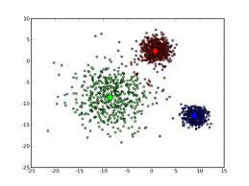
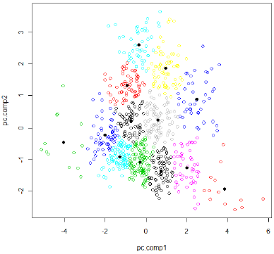
Recap of K-Means

Slide 4

Family Tree

Slide 5
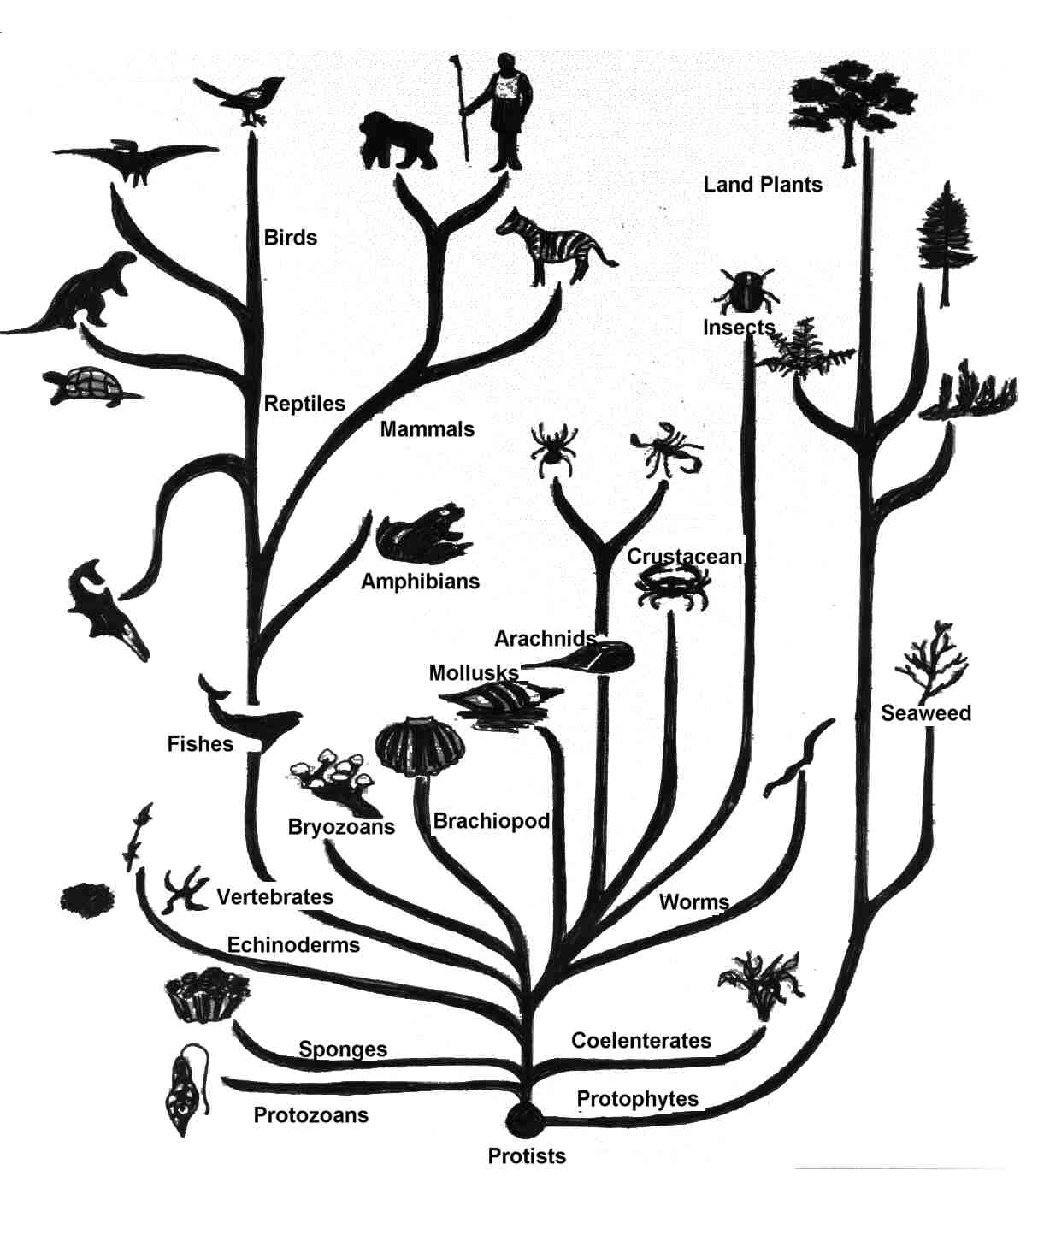
Evolution Tree

Slide 6
Hierarchical Clustering
Group data objects into a tree of clusters
Step 0
Step 1
Step 2
Step 3
Step 4
agglomerative
(AGNES)
a
a b
b
a b c d e
c
c d e
d
d e
e
divisive
(DIANA)
Step 4
Step 3
Step 2
Step 1
Step 0

Slide 7
AGNES (Agglomerative Nesting)
Initially, each object is a cluster
Step-by-step cluster merging, until all objects form a cluster
  Single-link approach
  Each cluster is represented by all of the objects in the cluster
  The similarity between two clusters is measured by the similarity of the closest pair of data points belonging to different clusters

Slide 8
Dendrogram
Show how to merge clusters hierarchically
Decompose data objects into a multi-level nested partitioning (a tree of clusters)
A clustering of the data objects: cutting the dendrogram at the desired level
  Each connected component forms a cluster

Slide 9
DIANA (DIvisive ANAlysis)
Initially, all objects are in one cluster
Step-by-step splitting clusters until each cluster contains only one object

Slide 10
Distance Measures
Minimum distance
Maximum distance
Mean distance
Average distance
m: mean for a cluster
C: a cluster
n: the number of objects in a cluster

Slide 11
Challenges of Hierarchical Clustering Methods
Hard to choose merge/split points
  Never undo merging/splitting
  Merging/splitting decisions are critical
Do not scale well: O(n³)
What is the bottleneck when the data cannot fit in memory?

Slide 12
Comparison
 | Partitioning Clustering | Hierarchical Clustering
Time Complexity | O(n) | O(n²) or O(n³)
Pros | Easy to use and Relatively efficient | Outputs a dendrogram that is desired in many applications.
Cons | Sensitive to initialization; bad initialization might lead to bad results. Need to store all data in memory. | higher time complexity; Need to store all data in memory.
Notes:
1.The time complexity of computing the distance between every pair of data instances is O(n²).
2. The time complexity to create the sorted list of inter-cluster distances is O(n²log n).
Obviously, the algorithms in these regards are failed to effectively handle large datasets that space and time are considered.

Slide 13
Other Alternatives
Integrating hierarchical clustering with other techniques
  BIRCH, CURE, CHAMELEON, ROCK

Slide 14
BIRCH
Balanced Iterative Reducing and Clustering using Hierarchies

Slide 15
Introduction to BIRCH
Designed for very large data sets
  Time and memory are limited
  Incremental and dynamic clustering of incoming objects
  Only one scan of data is necessary
  Does not need the whole data set in advance
Two key phases:
  Scans the database to build an in-memory tree
  Applies clustering algorithm to cluster the leaf nodes

Slide 16
BIRCH: The Idea by example
Data Objects
Clustering Process (build a tree)
1
Leaf node
2
3
4
1
2
5
Cluster1
6
If cluster 1 becomes too large (not compact) by adding object 2,
then split the cluster

Slide 17
BIRCH: The Idea by example
Data Objects
Clustering Process (build a tree)
1
entry 1
entry 2
Leaf node
2
3
4
1
2
5
Cluster1
Cluster2
6
Leaf node with two entries

Slide 18
BIRCH: The Idea by example
Data Objects
Clustering Process (build a tree)
1
entry 1
entry 2
Leaf node
2
3
4
1
3
2
5
Cluster1
Cluster2
6
entry1 is the closest to object 3
If cluster 1 becomes too large by adding object 3,
then split the cluster

Slide 19
BIRCH: The Idea by example
Data Objects
Clustering Process (build a tree)
1
entry 1
entry 2
entry 3
Leaf node
2
3
4
1
3
2
5
Cluster1
Cluster3
Cluster2
6
Leaf node with three entries

Slide 20
BIRCH: The Idea by example
Data Objects
Clustering Process (build a tree)
1
entry 1
entry 2
entry 3
Leaf node
2
3
4
1
3
2
4
5
Cluster2
Cluster1
Cluster3
Cluster2
6
entry3 is the closest to object 4
Cluster 2 remains compact when adding object 4
then add object 4 to cluster 2

Slide 21
BIRCH: The Idea by example
Data Objects
Clustering Process (build a tree)
1
entry 1
entry 2
entry 3
Leaf node
2
3
4
1
3
5
2
4
5
Cluster1
Cluster3
Cluster2
6
entry2 is the closest to object 5
Cluster 3 becomes too large by adding object 5
then split cluster 3?
BUT there is a limit to the number of entries a node can have
Thus, split the node

Slide 22
BIRCH: The Idea by example
Data Objects
Clustering Process (build a tree)
1
Non-Leaf node
2
entry 1
entry 2
3
4
entry 1.1
entry 1.2
entry 2.1
entry 2.2
5
Leaf node
Leaf node
6
1
3
5
2
4
Cluster1
Cluster3
Cluster4
Cluster2

Slide 23
BIRCH: The Idea by example
Data Objects
Clustering Process (build a tree)
1
Non-Leaf node
2
entry 1
entry 2
3
4
entry 1.1
entry 1.2
entry 2.1
entry 2.2
5
Leaf node
Leaf node
6
1
3
6
5
2
4
Cluster3
Cluster4
Cluster2
Cluster1
Cluster3
entry1.2 is the closest to object 6
Cluster 3 remains compact when adding object 6
then add object 6 to cluster 3

Slide 24
BIRCH: Key Components
Clustering Feature (CF)
  Summary of the statistics for a given cluster: the 0-th, 1st and 2nd moments of the cluster from the statistical point of view
  Used to compute centroids, and measures the compactness and distance of clusters
CF-Tree
  height-balanced tree
  two parameters:
    number of entries in each node
    The diameter of all entries in a leaf node
  Leaf nodes are connected via prev and next pointers

Slide 25
Clustering Feature
Clustering Feature (CF): CF = (N, LS, SS)
N: Number of data points
LS: linear sum of N points:
SS: square sum of N points:
CF3=CF1+CF2= ⟨3+3, (9+35, 10+36), (29+417 , 38+440)⟩ = ⟨6, (44,46), (446 ,478)⟩
Cluster3
Cluster 1
(2,5)
(3,2)
(4,3)
Cluster 2
CF₂= ⟨3, (35,36), (417 ,440)⟩
CF₁= ⟨3, (2+3+4 , 5+2+3), (2²+3²+4² , 5²+2²+3²)⟩ = ⟨3, (9,10), (29 ,38)⟩

Slide 26
Some Characteristics of CFVs
Two CFVs can be aggregated.
  Given CF1=(N1, LS1, SS1), CF2 = (N2, LS2, SS2),
  If combined into one cluster, CF=(N1+N2, LS1+LS2, SS1+SS2).
The centroid and radius can both be computed from CF.
  centroid is the center of the cluster
  radius is the average distance between an object and the centroid.
  X0 = LS/N
  R = 1/N * sqrt(N*SS-LS^2)

Slide 27



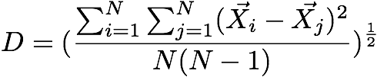
Similarity Metric(1)
Given a cluster of instances , we define:
Centroid:
Radius: average distance from member points to centroid
Diameter: average pair-wise distance within a cluster

Slide 28
Clustering Feature
Clustering feature:
  Summarize the statistics for a subcluster
    the 0th, 1st and 2nd moments of the subcluster
  Register crucial measurements for computing cluster and utilize storage efficiently

Slide 29
CF-tree in BIRCH
A CF tree: a height-balanced tree storing the clustering features for a hierarchical clustering
  A nonleaf node in a tree has descendants or “children”
  The nonleaf nodes store sums of the CFs of children

Slide 30
CF Tree
CF₁
CF₂
CF₃
CF₆
Root
B = 7
L = 6
child₁
child₂
child₃
child₆
Non-leaf node
CF₁
CF₂
CF₃
CF₅
child₁
child₂
child₃
child₅
Leaf node
Leaf node
prev
CF₁
CF₂
CF₆
next
prev
CF₁
CF₂
CF₄
next

Slide 31
Parameters of A CF-tree
Branching factor: the maximum number of children
Threshold: max diameter of sub-clusters stored at the leaf nodes

Slide 32
CF Tree Insertion
Identifying the appropriate leaf: recursively descending the CF tree and choosing the closest child node according to a chosen distance metric
Modifying the leaf: test whether the leaf can absorb the node without violating the threshold. If there is no room, split the node
Modifying the path: update CF information up the path.

Slide 33
Example of the BIRCH Algorithm
New subcluster
sc4
sc5
sc8
sc6
sc7
sc3
LN3
sc1
LN2
sc2
Root
LN1
LN2
LN3
LN1
sc8
sc3
sc5
sc6
sc7
sc1
sc2
sc4

Slide 34
Insertion Operation in BIRCH
If the branching factor of a leaf node can not exceed 3, then LN1 is split
sc1
sc4
sc5
sc3
sc6
sc2
sc7
sc8
LN2
LN1”
LN3
LN1’
Root
LN1’
LN2
LN3
LN1”
sc8
sc3
sc5
sc6
sc7
sc1
sc2
sc4

Slide 35
Insertion Operation in BIRCH
If the branching factor of a non-leaf node can not exceed 3, then the root is split and the height of the CF Tree increases by one
sc3
sc1
sc4
sc6
Root
sc2
sc7
NLN1
sc5
sc8
LN3
LN2
NLN2
LN1’
LN1”
LN1’
LN1”
LN2
LN3
sc8
sc1
sc3
sc4
sc6
sc7
sc2
sc5

Slide 36
Birch Clustering Algorithm (1)
Phase 1: Scan all data and build an initial in-memory CF tree.
Phase 2: condense into desirable length by building a smaller CF tree.
Phase 3: Global clustering
Phase 4: Cluster refining – this is optional, and requires more passes over the data to refine the results

Slide 37
Pros & Cons of BIRCH
Linear scalability
  Good clustering with a single scan
  Quality can be further improved by a few additional scans
Can handle only numeric data
Sensitive to the order of the data records

Slide 38
3.3.4 ROCK: for Categorical Data
Experiments show that distance functions do not lead to high quality clusters when clustering categorical data
Most clustering techniques assess the similarity between points to create clusters
At each step, points that are similar are merged into a single cluster
Localized approach prone to errors
ROCK: used links instead of distances

Slide 39
Example: Compute Jaccard Coefficient
  Transaction items: a,b,c,d,e,f,g
  Two clusters of transactions
  Compute Jaccard coefficient between transactions
  Cluster1. <a, b, c, d, e>
  {a, b, c}
  {a, b, d}
  {a, b, e}
  {a, c, d}
  {a, c, e}
  {a, d, e}
  {b, c, d}
  {b, c, e}
  {b, d, e}
  {c, d, e}
  Sim({a,b,c},{b,d,e})=1/5=0.2
  Jaccard coefficient between transactions of Cluster1 ranges from 0.2 to 0.5
  Jaccard coefficient between transactions belonging to different clusters can also reach 0.5
  Sim({a,b,c},{a,b,f})=2/4=0.5
  Cluster2. <a, b, f, g>
  {a, b, f}
  {a, b, g}
  {a, f, g}
  {b, f, g}

Slide 40
Example: Using Links
  Transaction items: a,b,c,d,e,f,g
  Two clusters of transactions
  The number of links between T_{i} and T_{j} is the number of common neighbors
  T_{i} and T_{j} are neighbors if
  Sim(Ti,Tj)>θ
  Consider θ=0.5
  Link({a,b,f}, {a,b,g}) = 5
  (common neighbors)
  Link({a,b,f},{a,b,c})=3
  (common neighbors)
  Cluster1. <a, b, c, d, e>
  {a, b, c}
  {a, b, d}
  {a, b, e}
  {a, c, d}
  {a, c, e}
  {a, d, e}
  {b, c, d}
  {b, c, e}
  {b, d, e}
  {c, d, e}
  Cluster2. <a, b, f, g>
  {a, b, f}
  {a, b, g}
  {a, f, g}
  {b, f, g}
Link is a better measure
than Jaccard coefficient

Slide 41
ROCK
ROCK: Robust Clustering using linKs
Major Ideas
  Use links to measure similarity/proximity
  Not distance-based
  Computational complexity
    m_{a}: average number of neighbors
    m_{m}: maximum number of neighbors
    n: number of objects
Algorithm
  Sampling-based clustering
  Draw random sample
  Cluster with links
  Label data in disk

Slide 42
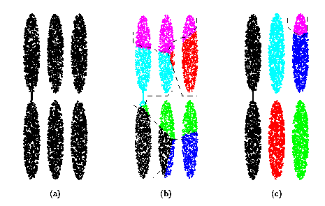
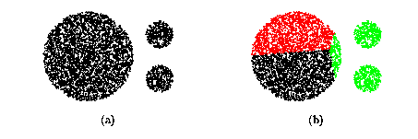
Drawbacks of Square Error Based Methods
One representative per cluster
  Good only for convex shaped having similar size and density
A number of clusters parameter k
  Good only if k can be reasonably estimated

Slide 43
CURE: the Ideas
Each cluster has c representatives
  Choose c well scattered points in the cluster
  Shrink them towards the mean of the cluster by a fraction of α
  The representatives capture the physical shape and geometry of the cluster
Merge the closest two clusters
  Distance of two clusters: the distance between the two closest representatives

Slide 44
Drawback of Distance-based Methods
Hard to find clusters with irregular shapes
Hard to specify the number of clusters
Heuristic: a cluster must be dense

Slide 45
Directly Density Reachable
p
MinPts = 3 Eps = 1 cm
q
Parameters
  Eps: Maximum radius of the neighborhood
  MinPts: Minimum number of points in an Eps-neighborhood of that point
  NEps(p): {q | dist(p,q) ≤Eps}
Core object p: |Neps(p)|≥MinPts
Point q directly density-reachable from p iff q ∈Neps(p) and p is a core object

Slide 46
Density-Based Clustering: Background (II)
p
p₁
Density-reachable
  Directly density reachable p₁→p₂, p₂→p₃, …, p_{n-1}→ p_{n} ➔ p_{n} density-reachable from p₁
Density-connected
  Points p, q are density-reachable from o ➔ p and q are density-connected
q
p
q
o

Slide 47
DBSCAN
A cluster: a maximal set of density-connected points
  Discover clusters of arbitrary shape in spatial databases with noise
Outlier
Border
Eps = 1cm
MinPts = 5
Core

Slide 48
DBSCAN: the Algorithm
Arbitrary select a point p
Retrieve all points density-reachable from p wrt Eps and MinPts
If p is a core point, a cluster is formed
If p is a border point, no points are density-reachable from p and DBSCAN visits the next point of the database
Continue the process until all of the points have been processed

Slide 49
Problems of DBSCAN
Different clusters may have very different densities
Clusters may be in hierarchies

Slide 50
OPTICS: A Cluster-ordering Method
OPTICS: ordering points to identify the clustering structure
“Group” points by density connectivity
  Hierarchies of clusters
Visualize clusters and the hierarchy

Slide 51
DENCLUE: Using Density Functions
DENsity-based CLUstEring
Major features
  Solid mathematical foundation
  Good for data sets with large amounts of noise
  Allow a compact mathematical description of arbitrarily shaped clusters in high-dimensional data sets
  Significantly faster than existing algorithms (faster than DBSCAN by a factor of up to 45)
  But need a large number of parameters

