Slide 1
Mining Optimal Decision Trees from Itemset Lattices
Dr, Siegfried Nijssen
Dr. Elisa Fromont
KDD 2007

Slide 2
Introduction
Decision Trees
  Popular prediction mechanism
  Efficient, easy to understand algorithms
  Easily interpreted models
Surprisingly, mining decision trees under constraints has not received much attention.

Slide 3
Introduction
Finding the most accurate tree on training data in which each leaf covers at least n examples.
Finding the k most accurate trees on training data in which the majority class in each leaf covers at least n examples more than any of the minority classes.
Finding the smallest decision tree in which each leaf contains at least n examples and the expected accuracy is maximized for unseen examples.
Finding the smallest or shallowest decision tree which has accuracy higher than minacc.

Slide 4
Motivation
Algorithms do exist, so what’s the problem?
  Heuristics are used to decide when to split the tree, in line, from top down.
  Sometimes the heuristic is off!
  A tree can be produced, but it might be sub-optimal.
  Maybe a different heuristic will be better?
  How do we know?

Slide 5
Motivation
What is needed is an exact method for recognizing these optimal decision trees while functioning under various constraints.
  Prove of a heuristic’s goodness.
  Prove trends and theories in small, simple data sets hold true in larger, more complex data sets.

Slide 6
Motivation
Authors suggest that problem complexity has been a deterrent.
  Hardness is NP-Complete
  Small problems could still be computable
  Frequent itemset mining

Slide 7
Model
Frequent itemset terminology
  Items : I = {i₁, i₂, …, i_{m}}
  Transactions : D = {T₁, T₂, …, T_{n}}
  TID-Set : t(I) = {1, 2, …, n}
  Frequency : freq(I) = |t(I)|
  Support: support(I) = freq(I) / |D|
  “frequent itemset” : support(I) ≥ minsup

Slide 8
Model
Interested in finding the frequent item sets from databases containing examples labeled with classes.
Formation of class association rules
I → c(I)
where c is the class with highest frequency from set of classes C

Slide 9
Model
Decision Tree Classification
  Examples are sorted down the tree
  Each node tests an attribute of an example
  Each edge represents a value of the attribute
  Assumed binary attributes
  Input to a decision tree learner is a matrix B where B_{ij} contains the value of attribute i in example j

Slide 10
Model
Observation: Transform a binary matrix B into transactional form D s.t.
T_{j} = { i | B_{ij} = 1 } U { ⌐i | B_{ij} = 0 }
then examples sorted by B are sorted by items corresponding to itemsets occuring in D

Slide 11
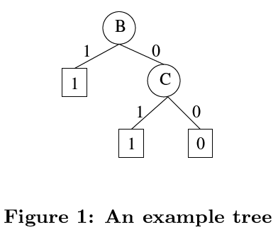
Model
Paths in the tree correspond to itemsets.
Leaves identify the classes.
If an example contains the itemset given by a path, then the example belongs to that class.

Slide 12
Model
Decision tree learning typically specifies coverage requirements.
Corresponds to setting a minimum threshold on support for association rules.

Slide 13
Model
Accuracy of a tree is derived from the number of misclassified examples.
accuracy(T) = |D| - e(T) / |D|, where
e(T) = Sum(e(I)) for I in leaves(T)
e(I) = freq(I) – freq_{c(I)}(I)

Slide 14
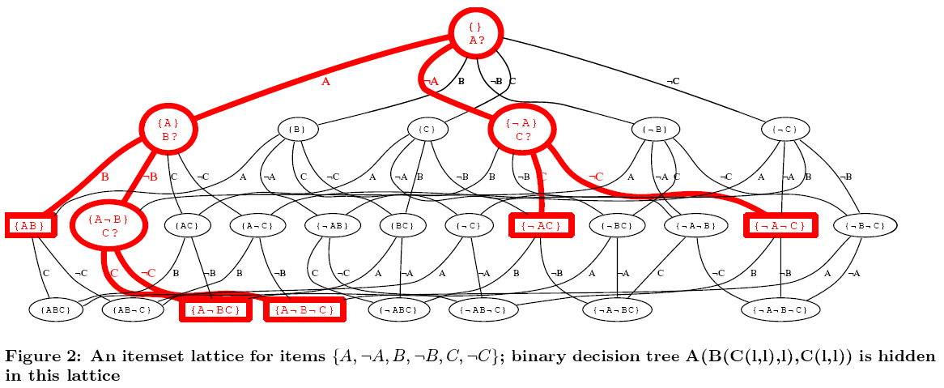
Model
Itemsets form a lattice containing many decision trees.

Slide 15
Method
Finding decision trees under contraints is similar to querying a database.
Query has three parts
  Constraints on individual nodes
  Constraints on the overall tree
  Preference for a specific tree instance

Slide 16
Method
Individual node constraints
  Q₁ : { T | T belongs to DecisionTrees, for all I belonging to paths(T), p(I) }
  Locally constrained decision tree
  Predicate p(I) represents the constraint.
  Simple case: p(I) := (freq(I) ≥ minfreq)
  Two types of local constraints
    Coverage: frequency
    Pattern: itemset size

Slide 17
Method
Constraints on the overall tree
  Q₂ : { T | T belongs to Q₁, q(T) }
  Globally constrained decision trees
  q(T) is a conjunction of the following four constraints:
    e(T): error of a tree on training data
    ex(T): expected error on unseen examples
    size(T): number of nodes in the tree
    depth(T): longest path permitted from root to leaf
Optional

Slide 18
Method
Preference for a specific tree instance
  Q₃ : output minarg_{T in T2}[ r₁(T), r₂(T), …, r_{n}(T) ]
where r_{i} = { e, ex, size, depth }
Tuples of r are compared lexicographically, and define a ranking.
Since the function is minimization, ordering of r is not relevant.

Slide 19
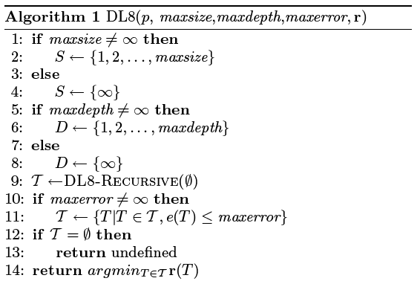
Algorithm

Slide 20
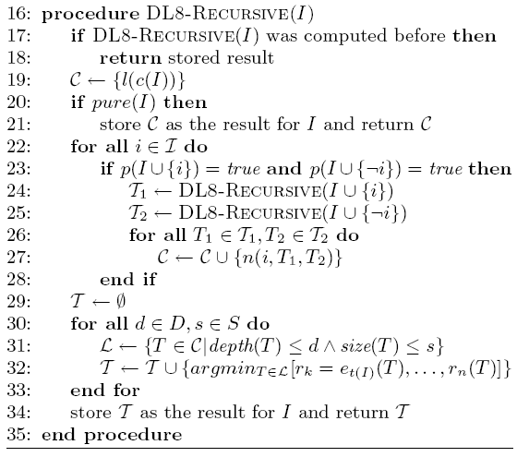
Algorithm (Part 2)

Slide 21
Contributions
Dynamic programming solution
When an optimal tree (may or may not eventually become a subtree) is computed, that tree is stored.
Requests for identical trees result in fetches to the stored set of trees.
Accessing data can be implemented in one of four ways.

Slide 22
Contributions
Data access is required to compute frequency counts needed at three key points in the algorithm.
Four approaches:
  Simple
  FIM
  Constrained FIM
  Closure based single step

Slide 23
Contributions
Simple Method
  Itemset frequencies are computed while the algorithm is executing.
  Calling DL8-Recursive for an itemset I results in a scan of the data for I, during which frequency for I can be calculated.

Slide 24
Contributions
FIM
  Frequent Itemset Miners
  Every itemset must satisfy p.
  If p is a minimum frequency constraint, then preprocess the data using a FIM to determine the itemsets that qualify.
  Use only these itemsets in the algorithm.

Slide 25
Contributions
Constrained FIM
  Involves the identification of an itemset’s relevancy while using a frequent itemset miner.
  Some itemsets, if assumed to be frequently, have infrequent counterparts, yet some tree will still contain these frequent itemsets.
  This method removes these itemset.

Slide 26
Contributions
Closure based single step

Slide 27
Experiments

Slide 28
Related Work

