Slide 1
Co-clustering based classification for Out-of-domain Documents
Wenyuan Dai Gui-Rong Xue
Qiang Yang Yong Yu
by
Venkata Ramana Reddy Banda

Slide 2
ABSTRACT
To learn from the in-domain and apply the learned knowledge to out-of –domain.
We propose a Co-clustering based classification(CoCC) algorithm to tackle this problem.
Co-clustering is used as a bridge to propagate the class structure and knowledge from the in-domain to the out-of-domain.

Slide 3
INTRODUCTION
In-domain(D_{i})
Out-of-Domain(D₀)
Class label set(C)
Documents in Di
1.Word clustering
2.Co-clustering
Documents in D0
word

Slide 4
RELATED WORK
Classification Learning
Multi-task and Multi-domain Learning
Semi-supervised Clustering

Slide 5
PRELIMINARIES
Let X and Y be random variable sets with a joint distribution p(X, Y ) and marginal distributions p(X) and p(Y ).
The mutual information I(X; Y ) is defined as
I(X; Y ) =∑_{x} ∑_{y} p(x, y) log(p(x, y)÷p(x)p(y)).
Kullback-Leibler (KL) divergence or relative entropy
measures, defined for two probability mass functions p(x) and q(x),
D(p||q) =∑_{x} p(x) log(p(x)÷q(x)).

Slide 6
PROBLEM FORMULATION
Let ˆDo denote the out-of-domain document clustering, and ˆW denote the word clustering, where | ˆ W| = k. The document cluster-partition function CDo and the word clusterpartition function CW can be defined as
CDo (d) = ˆ d, where d ∈ ˆ d ∧ ˆ d ∈ ˆDo (3)
CW(w) = ˆ w, where w ∈ ˆ w ∧ ˆ w ∈ ˆW (4)
where ˆ d represents the document cluster that d belongs
to and ˆ w represents the word cluster that w belongs to.
Then, the co-clustering can be represented by (CDo, CW) or (ˆDo, ˆW ).

Slide 7
PROBLEM FORMULATION
we define the loss for co-clustering in mutual information as
I(Do;W) − I(ˆDo; ˆW). (5)
We define the loss in mutual information
for a word clustering as
I(C;W) − I(C; ˆW). (6)
Integrating Equations (5) and (6), the loss function for
co-clustering based classification can be obtained:
I(Do;W) − I(ˆDo; ˆW) + λ · (I(C;W) − I(C; ˆW )) . (7)
where λ is a trade-off parameter that balances the effect
to word clusters from co-clustering (see Equation (5)) and
word clustering (see Equation (6)).
The objective is to find a
co-clustering that minimizes the function value of Equation(7).
we will rewrite the objective function in Equation (7) into another form that is represented
by KL-divergence
D(f(Do,W)|| ˆ f(Do,W)) + λ · D(g(C,W)||ˆg(C,W)). (8)

Slide 8
CO-CLUSTERING BASED
CLASSIFICATION
The objective function described in (8) is a multi-part function.
Lemma 2.
D(f(Do,W)|| ˆ f(Do,W))
=∑ _{ˆ d∈ ˆ Do} ∑_{d∈ ˆ d}f(d)D(f(W|d)|| ˆ f(W|ˆd))
D(f(Do,W)|| ˆ f(Do,W))
= ∑ _{ˆ w∈ ˆ W} ∑_{w∈ ˆ w}f(w)D(f(Do|w)|| ˆ f(Do| ˆ w))
Lemma 3.
D(g(C,W)||ˆg(C,W))
=∑ _{ˆ w∈ ˆ W} ∑_{w∈ ˆ w}g(w)D(g(C|w)||ˆg(C| ˆ w)).

Slide 9
ALGORITHM
Input:A labeled in-domain data set Di; an unlabeled out-of-domain data set Do;
a set C of all the class labels; a set W of all the word features;
initial co-clustering (C(⁰⁾Do, C⁽⁰⁾W);
the number of iterations T.
Initialize the joint probability distribution f, ˆ f, g and ˆg
based on Equations (8), (9), (10) and (11), respectively.
For t ← 1, 3, 5, . . . , 2T + 1
1: Compute the document cluster:
C^{(t)}_{Do}(d) = argmin_{ˆ d}D(f(W|d)|| ˆ f^{(t−1)}(W|ˆ d))
2: Update the probability distribution ˆ f^{(t)} based on C^{(t)}_{Do ,}C^{(t−1)}_{W}, and Equation (9).
C^{(t)}W= C^{(t−1)}W and ˆg^{(t)} =ˆg^{(t−1)}.
3: Compute the word cluster:
C^{(t+1)}_{W}(w) = argmin_{ˆ w} f(w)D(f(Do|w)|| ˆ f^{(t)}(Do| ˆ w))+ λ · g(w)D(g(C|w)||ˆg^{(t)}(C|ˆ w))
4: Update the probability distribution ˆg^{(t+1)} based on
C^{(t+1)}_{W}, and Equation (11). ˆ f^{(t+1)} = ˆ f^{(t)} and C^{(t+1)}_{Do}=C^{(t)}_{Do}.
End For
Output: the partition functions C^{(T)}_{Do} and C^{(T)}_{W}.

Slide 10
This algorithm converges in a finite number
of iterations.
The time complexity of our co-clustering based classification algorithm is
O((|C|+| ˆ W|)·T·N).
The space complexity is O(N).

Slide 11
EXPERIMENTS
Data Sets
Comparision Methods
Implementation Details
Evaluation Metrics
Experimental Results

Slide 12
EVALUATION METRICS
The performance of the proposed methods was evaluated by test error rate. Let C be the function which maps from document d to its true class label c = C(d), and F be the function which maps from document d to its prediction label
c = F(d) given by the classifiers. Test error rate is defined
as
ε = |{d|d ∈ Do ∧ C(d) = F(d)}|÷|Do|.

Slide 13
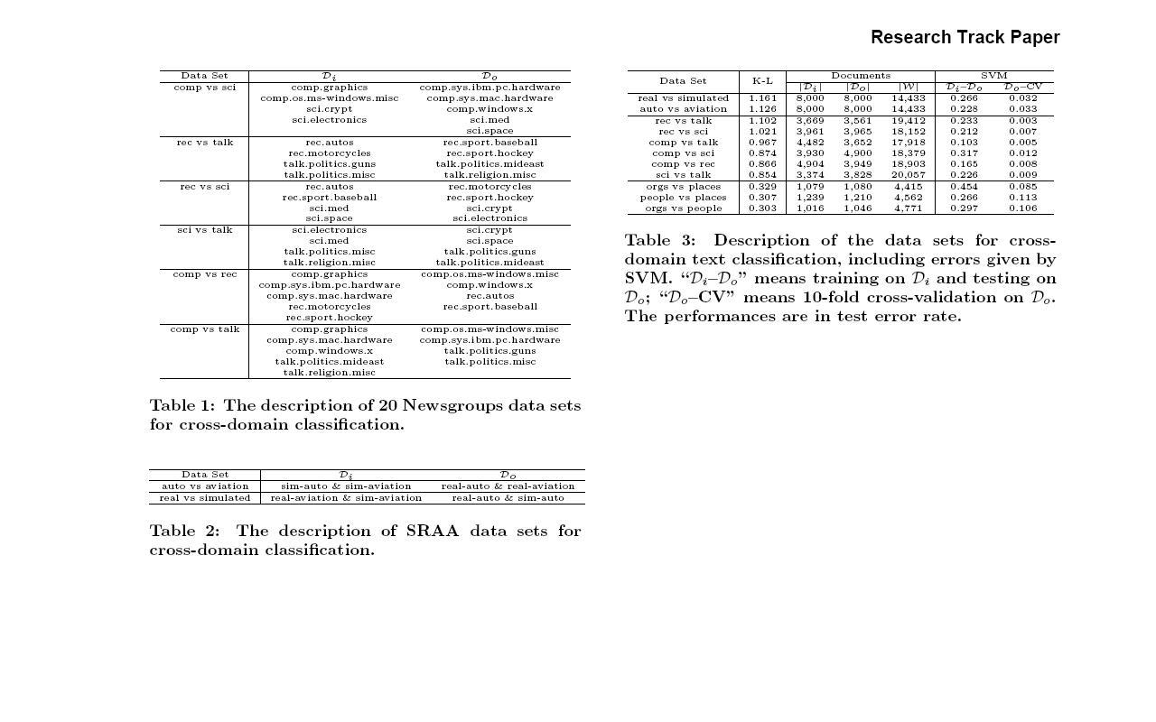

Slide 14
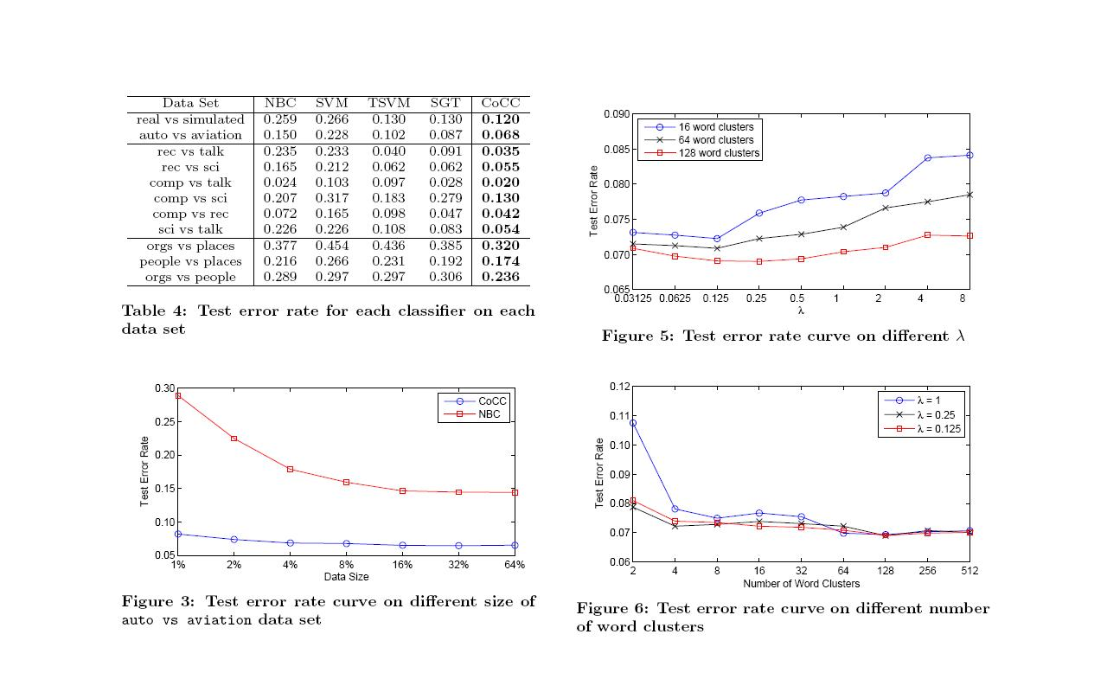
PERFORMANCE

Slide 15
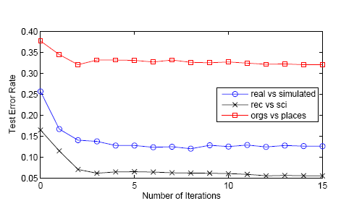
Convergence
Parameters tuning
KL-divergence and Improvement

Slide 16
Conclusions
CoCC can monotonically reduce the objective
function value and outperforms traditional supervised and semisupervised classification algorithms when classifying out-of-domain
documents.
The number of word clusters are quite large (128 clusters in the experiments) to obtain good performance.
Since the time complexity of CoCC depends on the number of word clusters, it can inefficient.
Parameters in CoCC are tuned manually.

Slide 17
QUERIES
Thank You

