Slide 1
Lecture 3:
Algorithms and Complexity
COMP 555 Bioalgorithms
Fall 2014
Study Chapter 2.1-2.8

Slide 2
Topics
Algorithms
  Correctness
  Complexity
Some algorithm design strategies
  Exhaustive
  Greedy
  Recursion
Asymptotic complexity measures

Slide 3
What is an algorithm?
An algorithm is a sequence of instructions that one must perform in order to solve a well-formulated problem.
input
algorithm
Problem: Complexity
problem
Algorithm: Correctness
Complexity
output

Slide 4
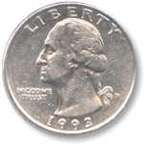


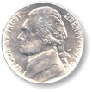
Problem: US Coin Change
Input
  an amount of money
  0 ≤ M < 100 in cents
Output:
  M cents in US coins using the minimal number of coins
Example
72 cents
Is it correct?
Two quarters
Two dimes
Two pennies
Notes:
Note: I am assuming integer division here. 72/25 = 2 with a remainder of 22

Slide 5
Algorithm 1: Greedy strategy
72 cents
Algorithm
description
Greedy coin alg
Use large denominations
as long as possible
Two quarters, 22 cents left
Is it correct?
Two dimes, 2 cents left
Can we
generalize it?
Two pennies
Notes:
Note: I am assuming integer division here. 72/25 = 2 with a remainder of 22

Slide 6
Algorithm 2: Exhaustive strategy
Enumerate all combinations of coins. Record the combination totaling to M with fewest coins
  All is impossible. Limit the multiplicity of each coin!
  First try (80,000 combinations)
  Better (200 combinations)
coin | Quarter | Dime | Nickel | Penny
multiplicity | 0..3 | 0..9 | 0..19 | 0..99
coin | Quarter | Dime | Nickel | Penny
multiplicity | 0 .. 3 | 0 .. 4 | 0 .. 1 | 0 .. 4
Is it correct?
Notes:
Anytime we have 5 or more pennies in a potential solution we can do better by replacing 5 pennies by a nickel. For same reason we need not check for solutions with more than two nickels. We cannot make a quarter out of an integral number of dimes, but we can replace 5 dimes with 2 quarters. So only consider solutions with 4 or fewer dimes.

Slide 7
Correctness
An algorithm is correct only if it produces correct result for all input instances.
  If the algorithm gives an incorrect answer for one or more input instances, it is an incorrect algorithm.
US coin change problem
  It is easy to show that the exhaustive algorithm is correct
  The greedy algorithm is correct but we didn’t really show it

Slide 8
Observations
Given a problem, there may be many correct algorithms.
  They give identical outputs for the same inputs
  They give the expected outputs for any valid input
The costs to perform different algorithms may be different.
US coin change problem
  The exhaustive algorithm checks 200 combinations
  The greedy algorithm performs just a few arithmetic operations

Slide 9
Change Problem: generalization
Input:
  an amount of money M
  an array of denominations c = (c₁, c₂, …,c_{d})
  in order of decreasing value
Output: the smallest number of coins
To show an algorithm was incorrect we showed an input for which it produced the wrong result. How do
we show that an
algorithm is correct?
Incorrect algorithm!
M = 40
c = (25, 20, 10, 5, 1)
M
c = (c₁, c₂, …,c_{d})
?
n
3
The correct answer should be 2.
Is it correct?
Notes:
Generally algorithms are shown to be correct by proving that they provide the correct answer for every input.
Technique 1. Enumeration
Test every possible input. Is it doable here? Yes. Only consider 1-99 cents. Generate a table.
Technique 2. More sophisticated proof methods
Induction, Diagonalization, etc.

Slide 10
How to Compare Algorithms?
Complexity — the cost of an algorithm can be measured in either time and space
  Correct algorithms may have different complexities.
How do we assign “cost” for time?
  Roughly proportional to number of instructions performed by computer
  Exact cost is difficult to determine and not very useful
    Varies with computer, particular input, etc.
How to analyze an algorithm’s complexity
  Depends on algorithm design

Slide 11
Recursive Algorithms
Recursion is an algorithm design technique for solving problems in terms of simpler subproblems
  The simplest versions, called base cases, are merely declared.
  Easy to analyze
Thinking recursively…
Recursive definition:
Base case:

Slide 12
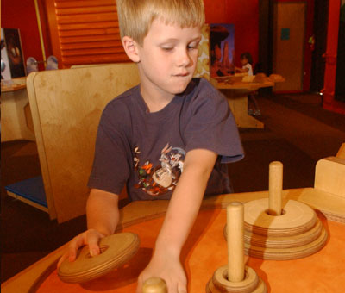
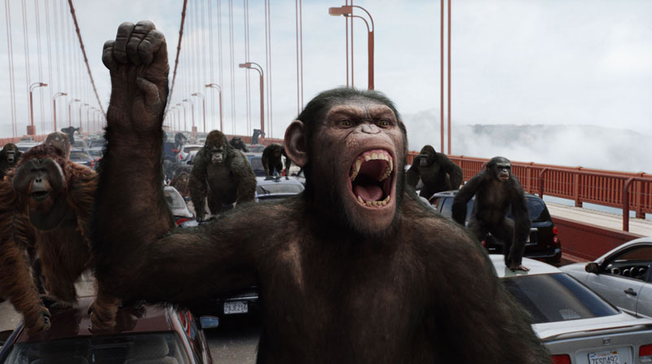
Towers of Hanoi
There are three pegs and a number of disks with decreasing radii (smaller ones on top of larger ones) stacked on Peg 1.
Goal: move all disks to Peg 3.
Rules:
  When a disk is moved from one
  peg it must be placed on another
  peg.
  Only one disk may be moved at a
  time, and it must be the top disk
  on a tower.
  A larger disk may never be placed
  upon a smaller disk.
Notes:
In Rise of the Planet of the Apes this puzzle was called the “Lucas Tower” after it’s inventor Edouard Lucas, a 19th century mathematician.

Slide 13
A single disk tower
1
2
3

Slide 14
A single disk tower
1
2
3

Slide 15
A two disk tower
1
2
3

Slide 16
Move 1
1
2
3

Slide 17
Move 2
1
2
3

Slide 18
Move 3
1
2
3

Slide 19
A three disk tower
1
2
3

Slide 20
Move 1
1
2
3

Slide 21
Move 2
1
2
3

Slide 22
Move 3
1
2
3

Slide 23
Move 4
1
2
3

Slide 24
Move 5
1
2
3

Slide 25
Move 6
1
2
3

Slide 26
Move 7
1
2
3

Slide 27
Simplifying the algorithm for 3 disks
1
2
3
Step 1. Move the top 2 disks from 1 to 2 using 3 as intermediate

Slide 28
Simplifying the algorithm for 3 disks
1
2
3
Step 2. Move the remaining disk from 1 to 3

Slide 29
Simplifying the algorithm for 3 disks
1
2
3
Step 3. Move 2 disks from 2 to 3 using 1 as intermediate

Slide 30
Simplifying the algorithm for 3 disks
1
2
3

Slide 31
The problem for N disks becomes
A base case of a one-disk move.
A recursive step for moving n-1 disks.
To move n disks from Peg 1 to Peg 3, we need to
  Move (n-1) disks from Peg 1 to Peg 2
  Move the n^{th} disk from Peg 1 to Peg 3
  Move (n-1) disks from Peg 2 to Peg 3
  The number of disk moves is
We move the n-1 stack twice
Exponential algorithm

Slide 32

Towers of Hanoi
If you play HanoiTowers with . . . it takes . . .
  1 disk … 1 move
  2 disks … 3 moves
  3 disks … 7 moves
  4 disks … 15 moves
  5 disks … 31 moves
  .
  .
  .
  20 disks . . . 1,048,575 moves
  32 disks . . . 4,294,967,295 moves

Slide 33

Sorting
A very common problem is to arrange data into either ascending or descending order
  Viewing, printing
  Faster to search, find min/max,
  compute median/mode, etc.
Lots of sorting algorithms
  From the simple to very complex
  Some optimized for certain
  situations (lots of duplicates,
  almost sorted, etc.)

Slide 34
Selection Sort
Find the smallest element and
swap it with the first:
27
12
3
18
11
7
Find the next smallest element
and swap it with the second:
3
12
27
18
11
7
Do the same for the third element:
3
7
27
18
11
12
“In-place” sort
And the fourth:
3
7
11
18
27
12
Finally, the fifth:
3
7
11
12
27
18
Completely sorted:
3
7
11
12
18
27

Slide 35
Selection sort
def selectionSortRecursive(a,first,last):
if (first < last):
index = indexOfMin(a,first,last)
temp = a[index]
a[index] = a[first]
a[first] = temp
a = selectionSortRecursive(a,first+1,last)
return a
(n -1) swaps
Quadratic in time
def indexOfMin(arr,first,last):
index = first
for k in xrange(index+1,last):
if (arr[k] < arr[index]):
index = k
return index
comparisons

Slide 36
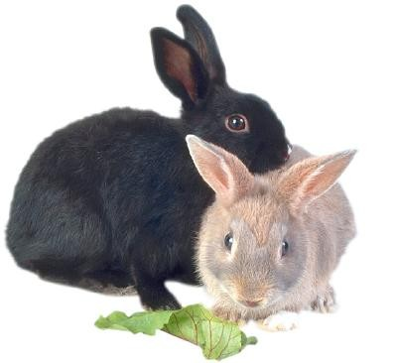
Year 1202: Leonardo Fibonacci
He asked the following question:
  How many pairs of rabbits are
  produced from a single pair in n
  months if every month each pair of
  rabbits more than 1 month old
  produces a new pair?
  Here we assume that each pair born has one male and one female and breeds indefinitely
  The initial pair at month 0 are newborns
  Let f(n) be the number of rabbit pairs present at the beginning of month n

Slide 37
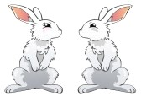
Fibonacci Number
month
rabbit pairs
0
(newborn)
1
1
1
2
2
3
3
4
5

Slide 38
Fibonacci Number
Clearly, we have:
  f(0) = 1 (the original pair, as newborns)
  f(1) = 1 (still the original pair because newborns need to mature a month before they reproduce)
  f(n) = f(n-1) + f(n-2) in month n we have
    the f(n-1) rabbit pairs present in the previous month, and
    newborns from the f(n-2) rabbit pairs present 2 months earlier
  f: 1, 1, 2, 3, 5, 8, 13, 21, 34, 55, …
  The solution for this recurrence is (n > 0):

Slide 39
Fibonacci Number
Exponential time!
def fibonacciRecursive(n):
if (n <= 1):
  return 1
  else:
  a = fibonacciRecursive(n-1)
  b = fibonacciRecursive(n-2)
  return a+b
Recursive Algorithm
n
n - 1
n - 2
n - 2
n - 3
n - 3
n - 4
n - 3
n - 4
n - 4
n - 5
n - 4
n - 5
n - 5
n - 6
Notes:
The number of evaluations of fib grows exponentially, but most of them are redundantly recomputed. There are only n unique invocatios in total

Slide 40
Fibonacci Number
Linear time!
def fibonacciIterative(n):
f0, f1 = 1, 1
for i in xrange(0,n):
f0, f1 = f1, f0 + f1
return f0
Iterative
Algorithm
n
n - 1
n - 2
n - 2
n - 3
n - 3
n - 4
n - 3
n - 4
n - 4
n - 5
n - 4
n - 5
n - 5
n - 6

Slide 41
Orders of magnitude
10^1
10^2 Number of students in computer science department
10^3 Number of students in the college of art and science
10^4 Number of students enrolled at UNC
…
…
10^10 Number of stars in the galaxy
10^20 Total number of all stars in the universe
10^80 Total number of particles in the universe
10^100 << Number of moves needed for 400 disks in the Towers of Hanoi puzzle
Towers of Hanoi puzzle is computable but it is NOT feasible.

Slide 42
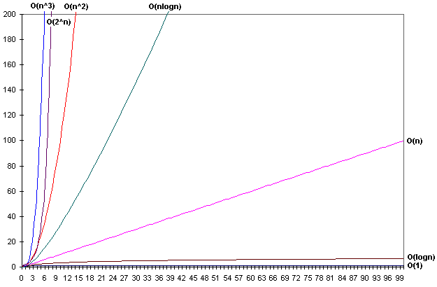
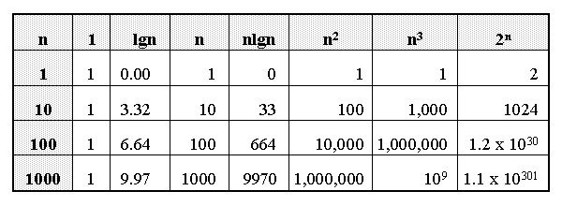
Is there a “real” difference?
Growth of functions

Slide 43
Asymptotic Notation
Order of growth is the interesting measure:
  Highest-order term is what counts
    As the input size grows larger it is the high order term that dominates
Θ notation: Θ(n²) = “this function grows similarly to n²”.
Big-O notation: O (n²) = “this function grows no faster than n²”.
  Describes an upper bound.
Notes:
Big-O (Omicron) <=, omega >

Slide 44
Big-O Notation
What does it mean?
  If f(n) = O(n²), then:
    f(n) can be larger than n² sometimes, but…
    We can choose some constant c and some value n₀ such that for every value of n larger than n₀ : f(n) < cn²
    That is, for values larger than n₀, f(n) is never more than a constant multiplier greater than n²
    Or, in other words, f(n) does not grow more than a constant factor faster than n².

Slide 45
Visualization of O(g(n))
cg(n)
f(n)
n₀

Slide 46
Big-O Notation

Slide 47
Big-O Notation
Prove that:
Let c = 21 and n₀ = 4
21n² > 20n² + 2n + 5 for all n > 4
n² > 2n + 5 for all n > 4
TRUE

Slide 48
Θ-Notation
Big-O is not a tight upper bound. In other words n = O(n²)
Θ provides a tight bound
n = O(n²) ≠ Θ(n²)
200n² = O(n²) = Θ(n²)
n^{2.5} ≠ O(n²) ≠ Θ(n²)

Slide 49
Visualization of Θ(g(n))
c₂g(n)
f(n)
c₁g(n)
n₀

Slide 50
Some Other Asymptotic Functions
Little o – A non-tight asymptotic upper bound
  n = o(n²), n = O(n²)
  3n² ≠ o(n²), 3n² = O(n²)
Ω – A lower bound
  n² = Ω(n)
ω – A non-tight asymptotic lower bound
f(n) = Θ(n) ⇔ f(n) = O(n) and f(n) = Ω(n)
The difference between “big-O” and “little-o” is subtle. For f(n) = O(g(n)) the bound 0 ≤ f(n) ≤ c g(n), n > n₀ holds for any c. For f(n) = o(g(n)) the bound
0 ≤ f(n) < c g(n), n > n₀ holds for all c.

Slide 51
Visualization of Asymptotic Growth
o(f(n))
O(f(n))
Θ(f(n))
f(n)
Ω(f(n))
ω(f(n))
n₀

Slide 52
Analogy to Arithmetic Operators

Slide 53
Measures of complexity
Best case
  Super-fast in some limited situation is not very valuable information
Worst case
  Good upper-bound on behavior
  Never gets worse than this
Average case
  Averaged over all possible inputs
  Most useful information about overall performance
  Can be hard to compute precisely

Slide 54
Complexity
Space Complexity Sp(n) : how much memory an algorithm needs (as a function of n)
Space complexity Sp(n) is not necessarily the same as the time complexity T(n)
  T(n) ≥ Sp(n)

Slide 55
Next Time
Our first “bio” algorithm
Read book 4.1 – 4.3

