Slide 1
Lecture 2:
High-Throughput Biology
COMP 555 Bioalgorithms
Fall 2014
Study Chapter 3.8-3.11
Notes:
Last time we discussed some “basic” biology and how it can be interpreted as information. This time we will discuss how recent technological breakthroughs have made computation a major tool for biology.

Slide 2
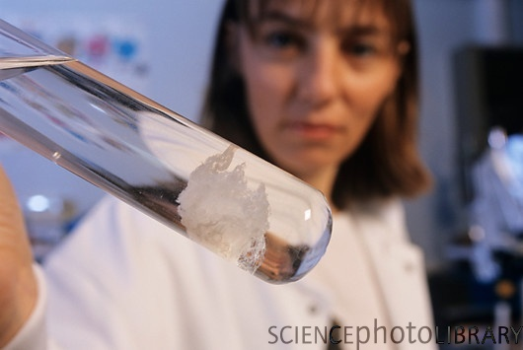
Analyzing DNA
Recall DNA is the essential
information determining the
function of living organisms
In order to understand the
biological machinery we’d
like to read the “code” of
the genome
How can we get access to DNA?
An organism’s genome can be millions to billions of base pairs long…
There are about 40 picograms (small) and 2 meters (long) of DNA per cell
Currently, technology to read the sequence has limitations
PHILIPPE PSAILA / SCIENCE PHOTO LIBRARY
Notes:
This is fundamentally (organic) chemistry. All you need to extract DNA is a little Dawn dishwashing detergent in Salt water.

Slide 3
Four Steps to Recover a Genome
Cut it
  Use enzymes to break DNA into fragments
Copy it
  Make millions of identical copies of each fragment
Read it
  Determine every base-pair in each fragment
Reassemble it
  Reconnect all of the fragements in the correct order
Notes:
But can read it in little pieces.

Slide 4
Cutting DNA
In a bit of serendipity, while studying how bacteria defend against viral infections, Hamilton Smith found certain enzymes that break DNA whenever they encounter specific base sequences.
Such enzymes are called restriction enzymes
The first one found was EcoRI, it breaks DNA at a GA boundary when it encounters the palindromic sequence 5’-GAATTC-3’
These exposed single strands are called the “sticky ends”
G
A
A
T
T
C
C
T
T
A
A
G
Notes:
This is a special definition of palindromic. Both strands have the same sequence when read 5’-to-3’. Palindromic strings may have odd or even length, but what about a palindromic DNA sequence? Rotational symmetry is a more accurate description.

Slide 5
Cutting DNA
Others include KpnI, which cuts 5’-GGTACC-3’ at C-C
And, ScaI, cuts the sequence 5’-AGTACT-3’ at T-A and leaves a blunt end
G
G
T
A
C
C
G
G
T
A
C
+
C
C
C
A
T
G
G
C
C
A
T
G
G
Blunt ends
T
+
A
C
T
A
G
T
A
C
T
A
G
T
C
A
T
G
A
T
C
A
T
G
A

Slide 6
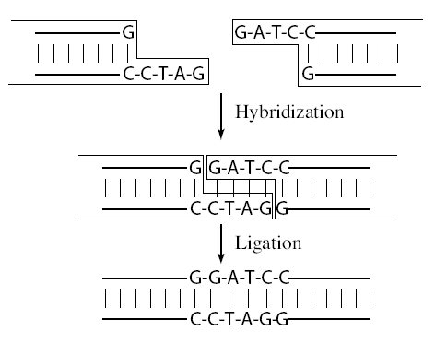
Pasting Together DNA
Two pieces of DNA can be reconnected by replacing broken chemical bonds
Two primary methods
  Hybridization – constructing a
  double strand from a single strand
  by taking advantage of DNA’s
  desire to form complementary
  base-pairings
  Ligation – gluing together DNA
  fragments with single-strand
  “sticky” ends, perhaps from
  different sources. Special enzymes
  (DNA ligase) repair the broken
  phosphate backbone

Slide 7
Copying DNA
While cells are able to extract information from only a single strand of DNA, molecular assays often require large quantities of material.
One solution, cloning, involves using cells to do the work of replication
DNA Cloning
  Various organisms contain small circular DNA molecules called plasmids
  Plasmids can be cut using a restriction enzyme to form a vector, and the sequence to be copied, called the insert, is placed into the gap using ligation.
  The modified plasmid is then inserted into a living cell that is left to multiply into a colony.
  The DNA is harvested from the colony and the plasmids of interest are isolated.
Notes:
In vivo replication of DNA is more accurate than in vitro

Slide 8
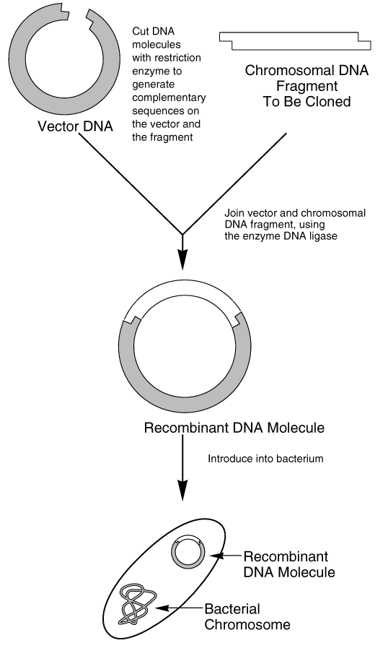
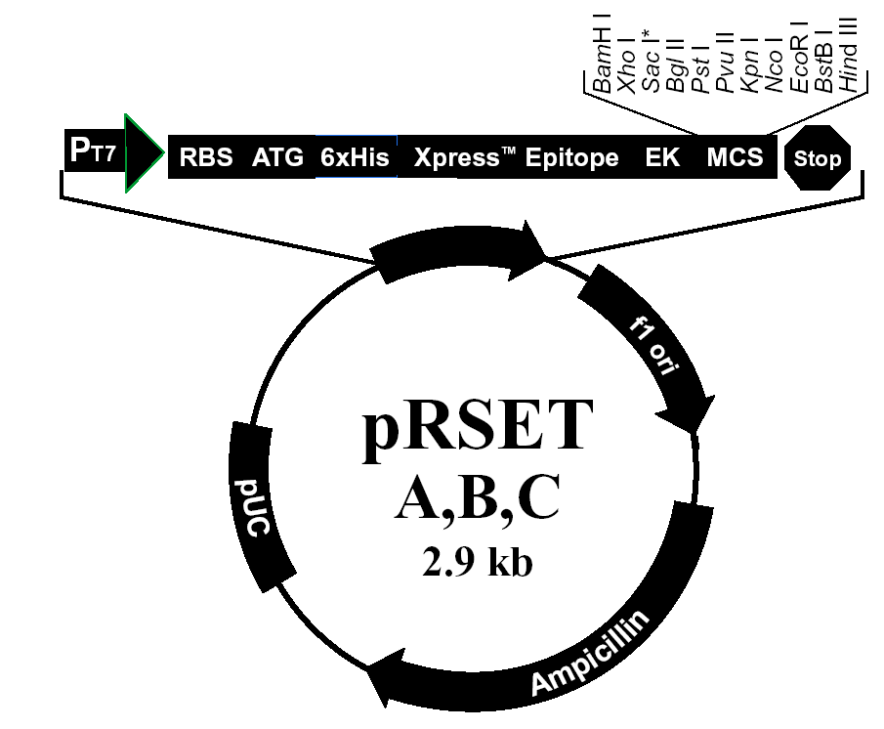
Cloning Process
Bacterial vectors are good for
sequences ~25 kB
Yeast-based 100 kB to 1MB
Vector DNA
Notes:
In addition, to the desired sequence for replication, a second “antibody” sequence is often attached to the target sequence, which is useful for selection later on.

Slide 9
High-Volume DNA Copying
Polymerase Chain Reaction (PCR)
  Polymerases are enzymes responsible for replicating DNA during cell division
  Extend a double-stranded region bonded to a longer, single DNA strand in the 5’-to-3’ direction
How PCR works:
  Separate DNA strands, which happens naturally at high temps
  Add small single-strand DNA sequence (primer) and DNA Polymerase
  Let the primers hybridize (sometimes called anneal)
  Let the “heat activated” Polymerase extend the sequence
  Produces two copies, just by cycling the temperature
  Repeat.
Notes:
In vitro

Slide 10
Denature DNA
Raise temperature to 94ºC to separate the double strands of DNA into single strands

Slide 11
Design Primers
To perform PCR, a 10-20bp sequence on either side of the subsequence to be amplified must be known
Notes:
“Design”? Why 10-20? Any constraints ?

Slide 12
Annealing
Anneal primers at 50-65ºC
(exact temperature depends on primer sequence)
Notes:
The primers are complementary to the identified sequences and have a place where polymerase would like to attach

Slide 13
Extension
Extend primers: raise temp to 72°C, allowing a
temperature stable polymerase (Taq) to attach at each
priming site and extend a new DNA strand
Taq
Taq

Slide 14
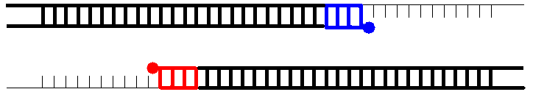
Extension
Extend primers: raise temp to 72°C, allowing a
temperature stable polymerase (Taq) to attach at each
priming site and extend a new DNA strand

Slide 15
Repeat
Repeat the Denature, Anneal, Extension steps at their respective temperatures…
Taq
Taq
Taq
Taq

Slide 16
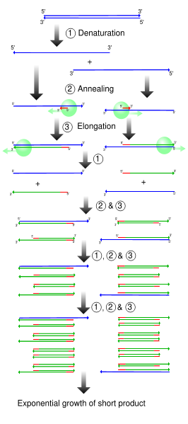
High-Volume DNA Copying
PCR Products
  Many copies (~2^{Cycles}) of the
  desired “short” DNA fragment
  Polymerases always extend in
  the 5’-3’ direction
  Typical Polymerases extend the
  sequence about the primer
  ~1000 base pairs in 10 secs
  Replication fidelity (the possibility
  of the polymerase copying an
  incorrect nucleotide ) is about
  1 in 9000

Slide 17
Reading DNA Sequences
The process of reading off sequential DNA bases is called sequencing
Sequencing strategies involve 3 steps
  Generate successive subfragments that differ in length by a single nucleotide
  Label each fragment with one of 4 different tags
  Sort the fragments according to size
Tags are usually fluorescent dyes or radioisotopes
Sequencing speed is ≈ 10⁴ – 10⁵ bases/day
How many days to sequence 3 Billion?
30000 days,
82 years!

Slide 18
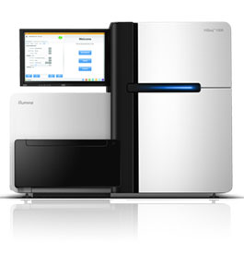
High-Throughput Sequencing
Parallelism is the key to speeding up this process
Rather than reading one sequence at a time one can read millions
Peak Throughput
  8 * 1.6x10⁶ * 10⁴ = 128 billion/day
In practice:
  55 billion base pairs /day for
  2x100 bp reads
  18x coverage of a 3 Gb genome in a day
Illumina HiSeq 2000

Slide 19
DNA Sorting
DNA fragments can be very accurately sorted according to size using gel electrophoresis
DNA is a negatively charged molecule that can be coerced into motion under an electric field
DNA is placed into a gel and the speed of motion is proportional to the strand’s size
(Large molecules more slower, small ones faster)
Usually florescent markers are attached to each strand (e.g. at the sticky ends) and used to detect the various strand sizes

Slide 20
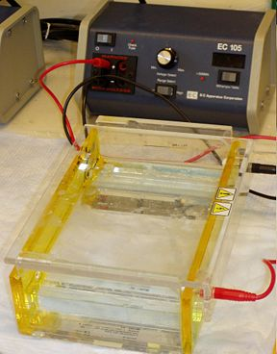
Gel Electrophoresis
Gel electrophoresis is also commonly used to measure the relative sizes of other molecules, such as RNA and proteins
Electrophoresis is also used to separate out particular strands
Often just the number of fragments conveys information about small genetic variations (allele’s)

Slide 21
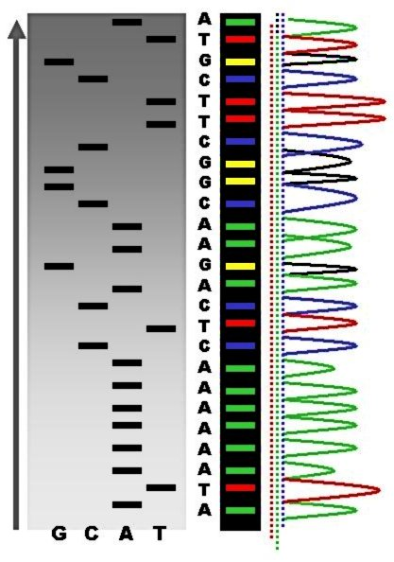
Reading DNA
Electrophoresis
  Sequencing is done by separating subsequences by size (and, in a 2D gel, by size and charge).
  The DNA molecules are either labeled with radioisotopes or tagged with fluorescent dyes.
  Given a DNA molecule it is then possible to obtain all fragments from it that end in either A, or T, or G, or C and these can be sorted in a gel experiment.

Slide 22
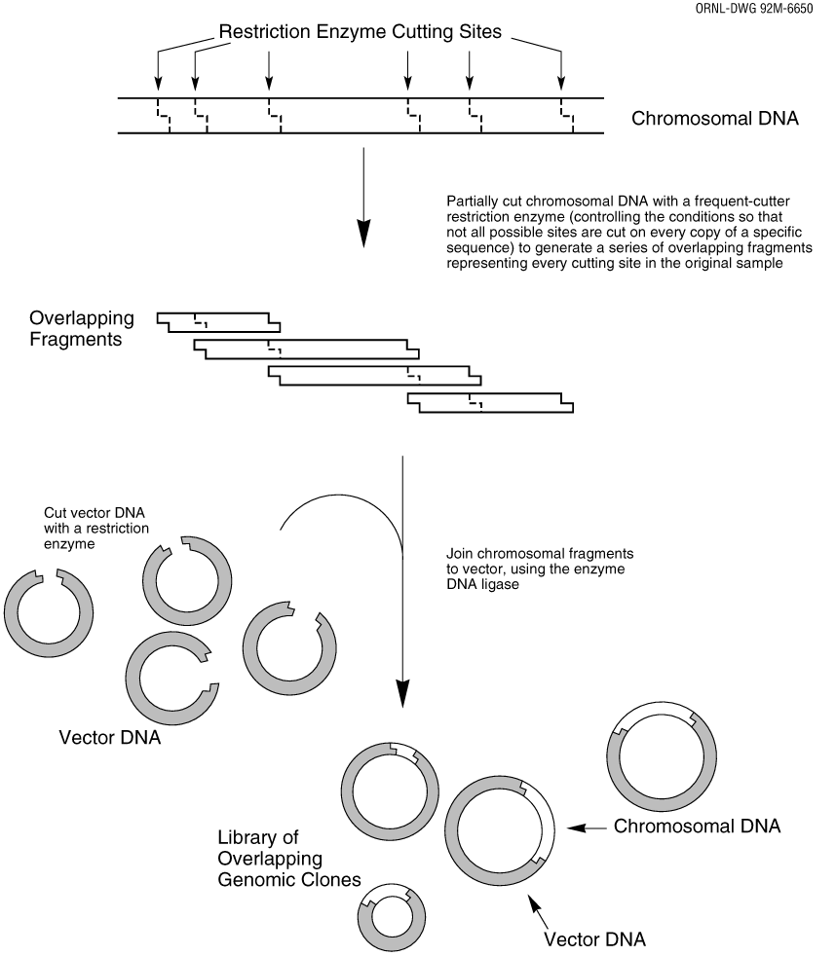
Assembling Genomes
Must take the fragments and put them back together
Not as easy as it sounds
Some of the fragments will overlap
Fit overlapping sequences together to get the shortest possible sequence that includes all fragment sequences

Slide 23
Assembling Genomes
DNA fragments contain sequencing errors
Two complementary strands of DNA
  Need to consider that DNA comes in two parts
  Don’t want to confuse one side of the chain with the other when we reassemble
Repeat problem
  50% of human DNA is just repeats
  If you have repeating DNA, how do you know where it goes? How many copies?
Notes:
ACTACTACTACTACT

Slide 24
DNA probes
Oligonucleotides: short single-strands of DNA usually 20-30 nucleotides long
Oligonucleotides can be used to find complementary DNA segments, via hybridization
Also used to determine the concentration of specific mRNA strands within a cell (gene expression)
Made by automated DNA synthesizers and tagged with a radioactive isotope.
Anchored onto glass slides

Slide 25
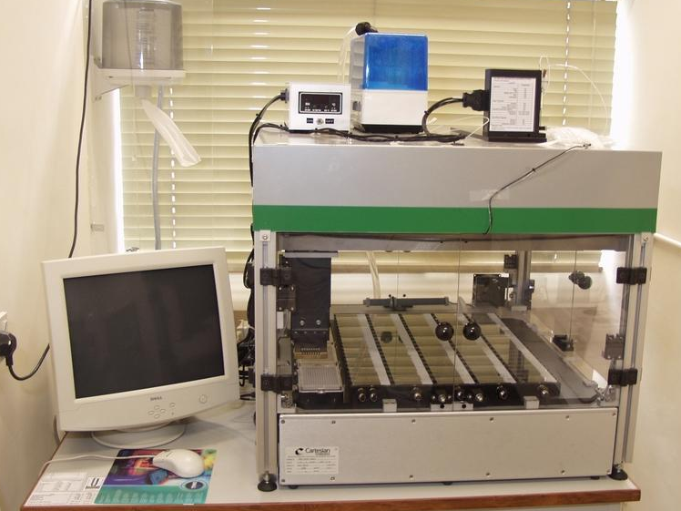
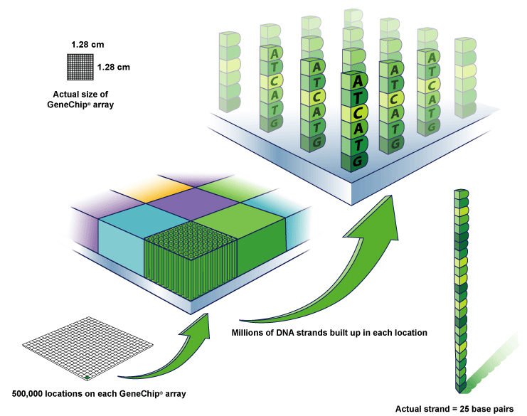
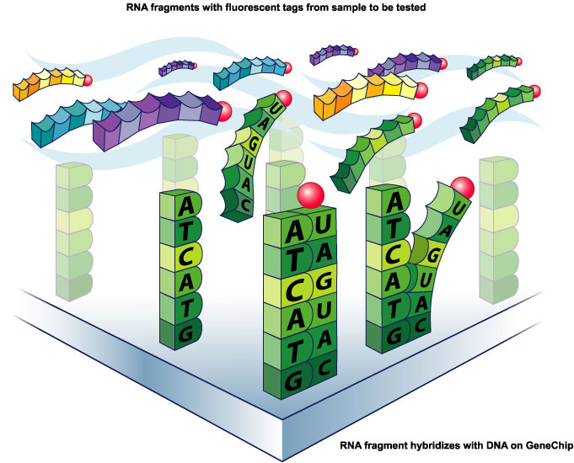
DNA Microarray
Millions of DNA strands
build up on each location.
Tagged probes become hybridized
to the DNA chip’s microarray.

Slide 26
Gene Expression Arrays
An gene expression array works by exploiting the ability of a given mRNA molecule to hybridize to the DNA template.
Using an array containing many DNA samples in an experiment, the expression levels of hundreds or thousands genes within a cell by measuring the amount of mRNA bound to each site on the array.
With the aid of a computer, the amount of mRNA bound to the spots on the microarray is precisely measured, generating a profile of gene expression in the cell.

Slide 27
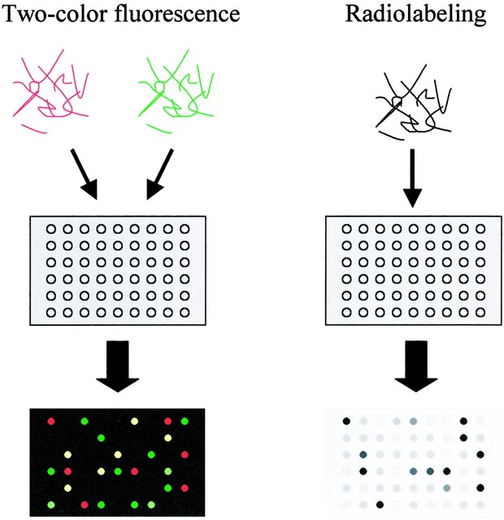
Labeling DNA arrays
RNA samples are labeled using fluorescent nucleotides (left) or
radioactive nucleotides (right), and hybridized to arrays. For fluorescent
labeling, two or more samples labeled with differently colored fluorescent
markers are hybridized to an array. Level of RNA for each gene in the
sample is measured as intensity of fluorescence or radioactivity binding
to the specific spot. With fluorescence labeling, relative levels of expressed
genes in two samples can be directly compared with a single array.

Slide 28
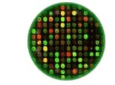
An experiment on a microarray
In this schematic:
GREEN represents Control DNA
RED represents Sample DNA
YELLOW represents a combination
of Control and Sample DNA
BLACK represents neither the
Control nor Sample DNA
Each color in an array represents either healthy (control) or diseased (sample) tissue. The location and intensity of a color tell us whether the gene, or mutation, is present in the control and/or sample DNA.

Slide 29
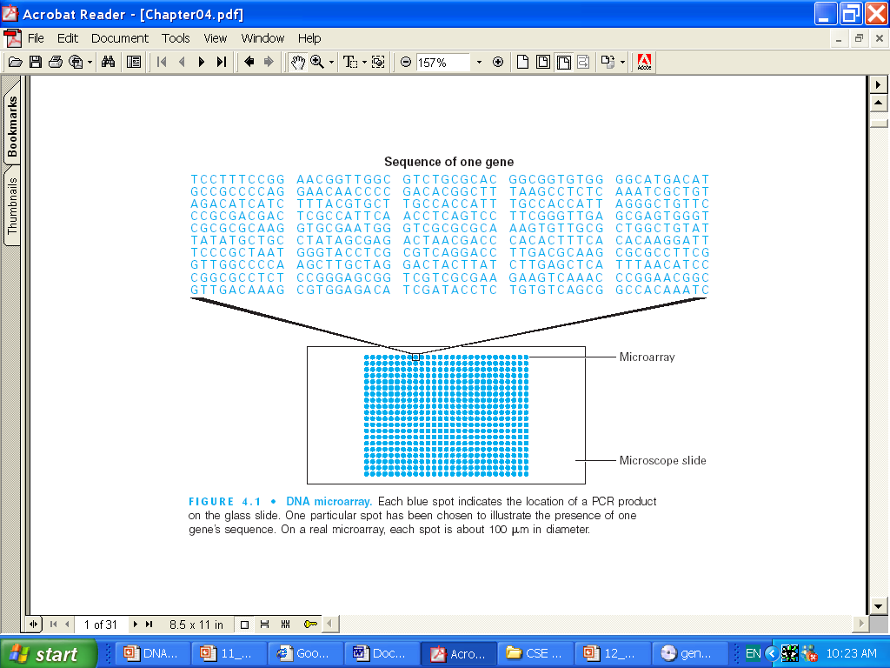
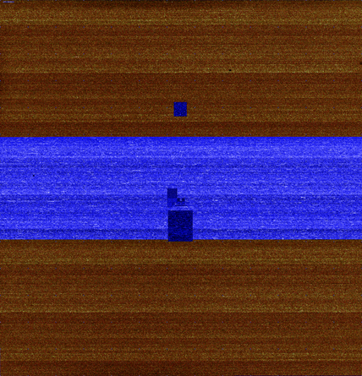
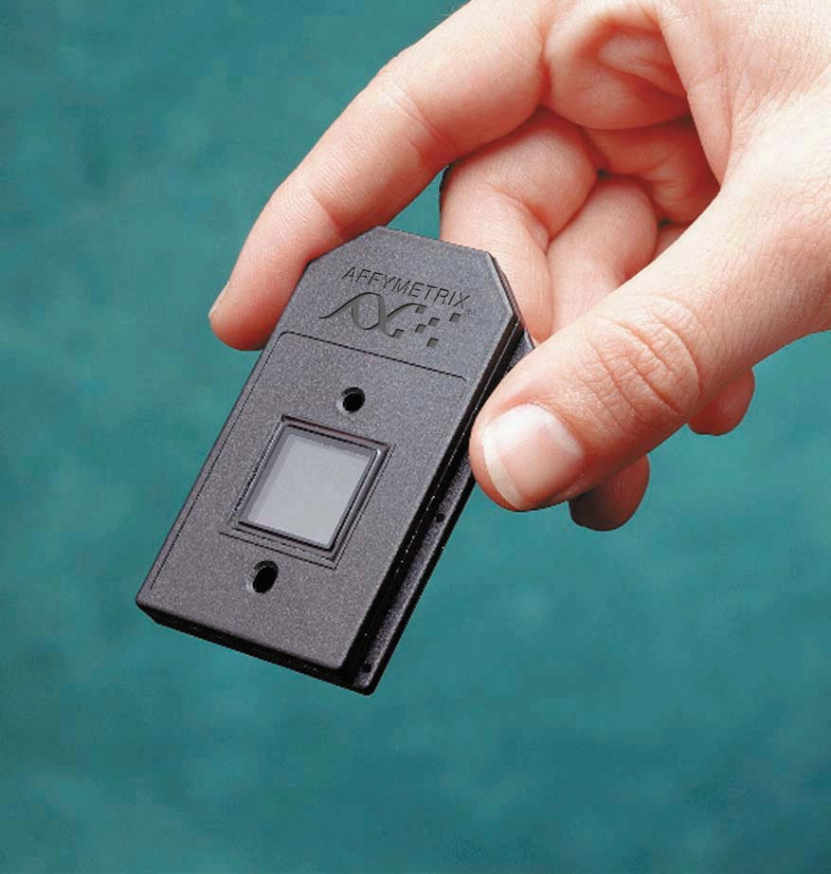
DNA Microarray
Affymetrix
Microarray is a tool for measuring and analyzing DNA fragments. It consists of a glass slide, with template DNA patterns anchored to it. (25-64 bps)
Each blue spot indicates the location of a PCR product. On a real microarray, each spot is about 100um in diameter.

Slide 30
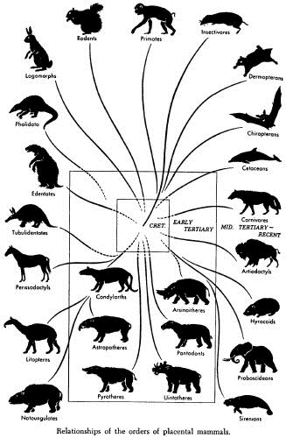
The Diversity of Life
Not only do different species have different genomes, but also different individuals of the same species have different genomes.
No two individuals of a species are quite the same – this is clear in humans but is also true in every other sexually reproducing species.
Imagine the difficulty of biologists – sequencing and studying only one genome is not enough because every individual is genetically different!

Slide 31
How do Individuals Differ?
Genetic makeup of an individual is manifested in traits, which are caused by variations in genes
While only 0.1% of the 3 billion nucleotides in the human genome differ, these small variations can affect a large range of phenotypic expressions
Traits make individuals more or less susceptible to disease, and the demystification of these mutations will hopefully reveal the links between genetics and susceptibility to diseases
Genetics also determines how effective a particular disease treatment might be.

Slide 32
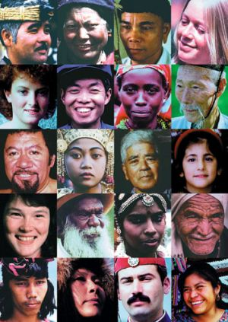
Physical Traits and Variances
Individual variation within a species occurs in populations of all sexually reproducing organisms.
Individual variations range from hair and eye color to less subtle traits such as susceptibility to malaria.
Physical variation is the reason we can pick out our friends in a crowd, however most physical traits are difficult to detect at a cellular and molecular level.

Slide 33
Sources of Physical Variation
Physical Variation and the manifestation of traits are caused by variations in the genes and environmental influences.
An example is height, which is dependent on genes as well as the nutrition of the individual.
Not all variation is inheritable – only genetic variation can be passed to offspring.
Separating genetic and environmental effects and interactions is one of the major challenges of biology.
Both sorts of interactions can be complex…
  Interactions of multiple genes
  Order of exposures
Notes:
It’s not just genes, it’s environment too

Slide 34
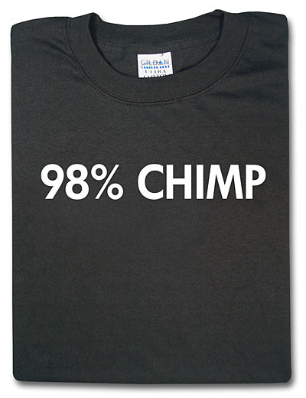
Genetic Variation
Despite the wide range of physical variation, the genomic differences between two individuals is small.
Out of 3 billion nucleotides, only roughly 3 million base pairs (0.1%) are different between individual genomes of humans.
Although there is a finite number of
possible variations, the number is so
high (4^{3,000,000}) that one can safely
assume that no two individuals have
the same genome by chance.
Related individuals have more similar
genomes
What is the cause of this genetic variation?

Slide 35
Sources of Genetic Variation
Mutations are rare changes to genomic sequence.
Common mutations (in order of frequency)
  Bases in the sequence change (polymorphism)
  A subsequence of bases is removed (deletions)
  A subsequence of bases is repeated (copy number variation)
  A subsequence changes position (transposition)
  A subsequence is reversed (inversion)
Most mutations do not create beneficial changes and actually kill the individual.
Although mutations are the source of all new genes in a population, they are so rare that there must be another process at work to account for the large amount of diversity.

Slide 36
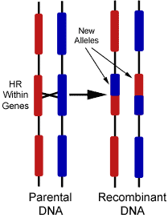
Sources of Genetic Variation
Recombination is the shuffling of genes that occurs through sexual mating and is the main source of genetic variation.
In mammals, and other higher organisms, there are two complete copies of the DNA sequence (recall this is the source of the “dormant,” “hidden,” or “recessive” traits discussed last lecture.
During meiosis (germ-line cell division)
these two DNA sequences can exchange
subsequences
This brings together differ gene-variant
combinations rather modifying genes as
in mutation.

Slide 37
How Do Different Species Differ?
As many as 99% of human genes are conserved across all mammals based in terms of function, with >85% having high sequence similarity (>95% bp agreement)
The functionality of many genes is virtually the same among many organisms
It is highly unlikely that the same gene with the same function would spontaneously develop among all currently living species
The theory of evolution suggests all living things evolved from incremental change over millions of years

Slide 38
Mouse and Human overview
Mouse genome has 2.7 x 10⁹ base pairs versus
3.1 x 10⁹ in human.
About 95% of genetic material is shared.
99% of genes shared of about 30,000 total.
The 300 genes that have no homologue in either species deal largely with immunity, detoxification, smell, and sex*
*Scientific American Dec. 5, 2002

Slide 39
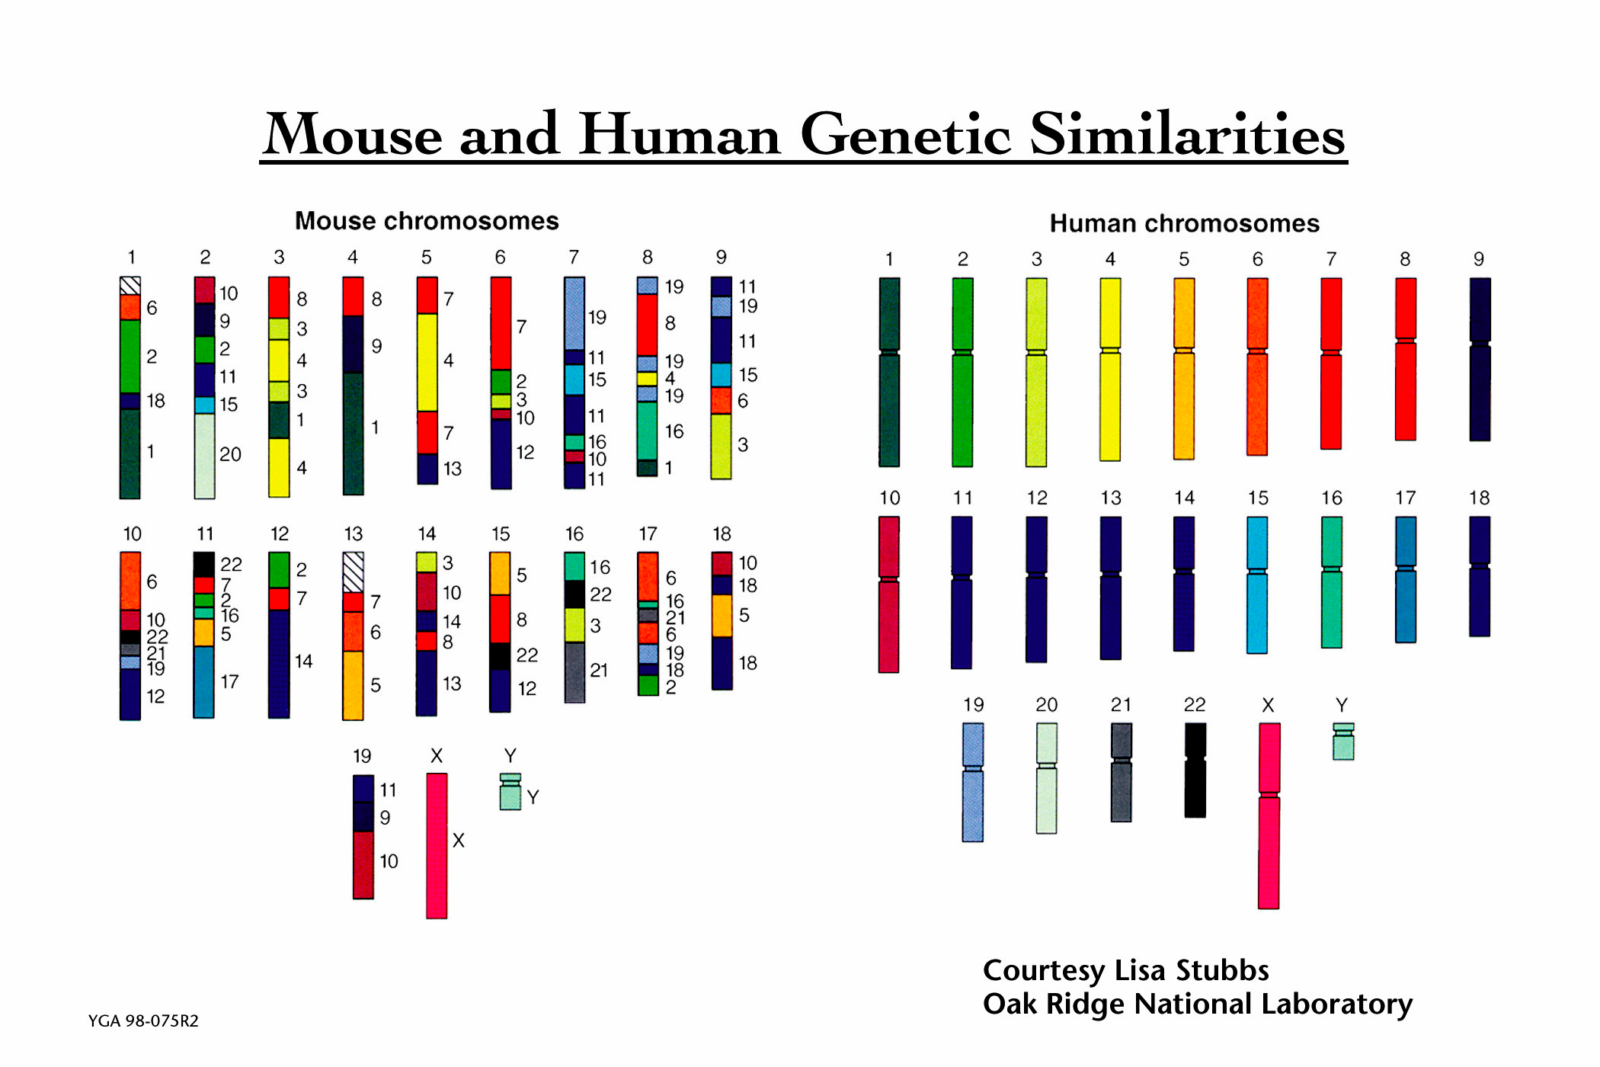
Genome Structure
Significant chromosomal rearranging occurred between the diverging point of humans and mice.

Slide 40
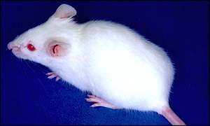
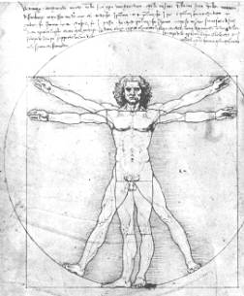
Comparative Genomics
What can be done comparatively between Human and Mouse Genomes?
One possibility is to create “knockout” mice – mice lacking one or more genes. Study the phenotypes of these mice gives predictions that gene’s function in both mice and humans.

Slide 41
Summary
DNA sequences are extracted by first cutting up the DNA into small segments using restriction enzymes
Many copies of a target DNA can be generated by either cloning or Polymerase Chain Reaction
Individual bases can be read from DNA using sequencing techniques or by DNA microarrays
Bioinformatics algorithms attempt to reconstruct the original sequence from the fragements
Evolution and individual variation are the result of molecular differences in DNA that lead to different phenotypes

Slide 42
Next Time
Concentrate on computer science
  Algorithms & Complexity
  Correctness and efficiency
  Space and time complexity
  Algorithmic strategies
  Tractable vs. intractable problems

