Slide 1
Lecture 1: Biology Background
CS 685
Computational Genomics
Fall 2014

Slide 2
Biology topic: Molecular biology
In 1944, Oswald Avery showed that DNA, not proteins, carries hereditary information.
In the late 1940’s and early 50’s Linus Pauling and associates develop modeling methods for simultaneously determining structure and chemical make-up of proteins and other large molecules.
In 1952, James Watson and Francis Crick, are able to determine the structure and chemical makeup of DNA, using X-ray crystallography data collected by Rosalind Franklin and Maurice Wilkins.
Beginning of Molecular Biology!

Slide 3
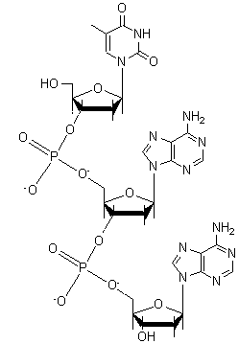
Biology topic: Molecular biology
The information stored in DNA organizes inanimate molecules into living organisms and orchestrates their lifelong function
A long complementary chain of nucleotides
Each nucleotide has 3 components
  A phosphate group
  A ribose sugar
  One of four nitrogenous bases
The sequence of nucleotides
encodes information!

Slide 4
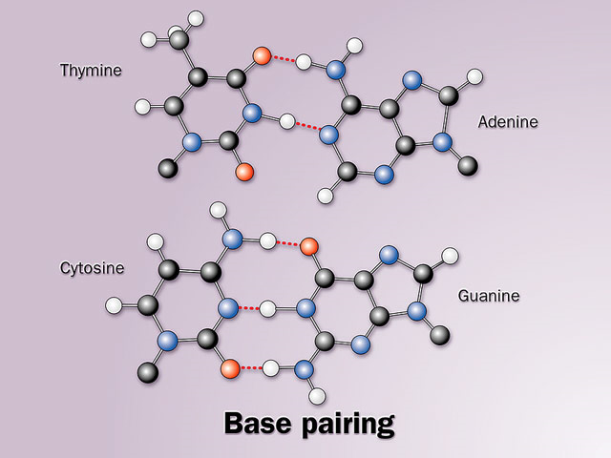
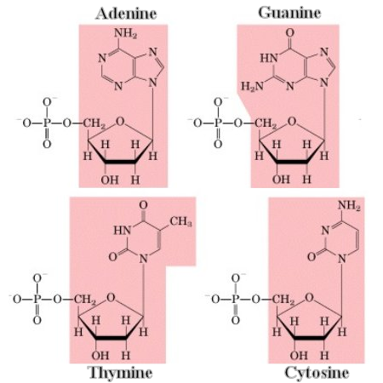
DNA Components
DNA appears in all living organisms
Different code sequences distinguish
  Plants from animals
  Species
  Individuals
A complete DNA sequence
for an organism is called
its genome
Code sequences are
composed of 4 bases
(Adenine, Cytosine,
Guanine, Thymine)
Each base binds with
another specific base
(Thymine with Adenine
and Cytosine with Guanine)
A DNA molecule is comprised of primary sequence and a redundant “complementary” copy that allows it to self replicate (each acts like a template for the other sequence)

Slide 5
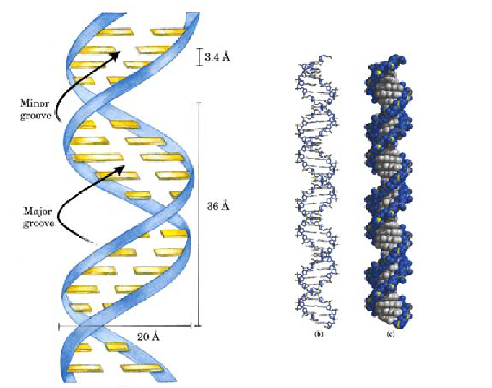

Schematic DNA
Many more details are required to give a complete picture of DNA
  Complementary strands are
  antiparallel and, thus, oriented
  (5’-bbbb-3’)
  Not a simple twist, but has a major
  and minor grooves which are
  important for interacting with proteins
Rather than keep track of all the details we will often consider DNA as a string of nucleotides
Notes:
By convention DNA sequences are always ordered in the 5’-to-3’ direction. Not coincidentally, this is also the order in which they can be synthesized using an important class of molecules call polymerases, which we will discuss in more detail in the next lecture.

Slide 6
Biological Computing Machines
DNA can be viewed as a “program” to
  Collect raw materials and convert chemicals to energy
  Perform specialized functions
  (neurons, muscle, retinal cones)
  Protect and repair itself
  Replicate itself, or duplicate
  entire organism
Questions
  How is the program encoded?
  What biological machinery “executes” this program?
  How is the program’s execution sequenced?
Notes:
Sequencing = Chemical pathways

Slide 7
Genes are key parts of the Program
A gene is a specific subsequences of DNA that controls specific functions of a cell
  Genes are distributed throughout a genome
  Not all DNA sequence sections contain genes
Genes provide instructions for assembling proteins, which are the machinery within and beyond the cell
  how are these instructions encoded?
  how are the instructions carried out?

Slide 8
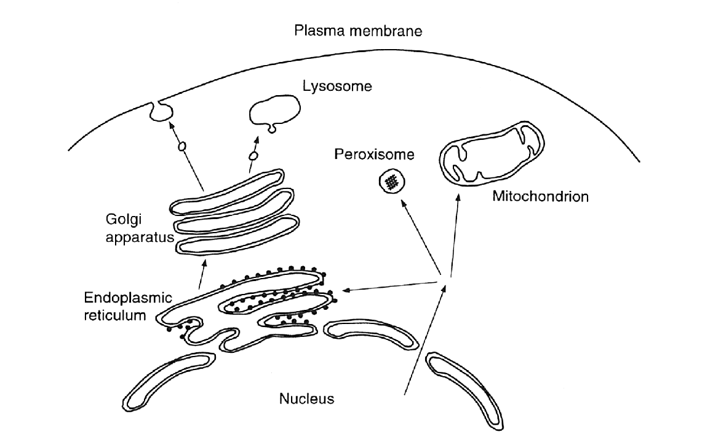
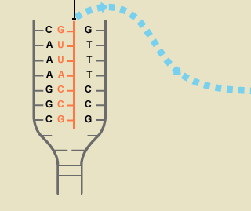
Genome, Transcriptome, Proteome
Schematic illustration
of a eukaryotic cell
Proteins
Proteome
The transcriptome is
all RNA molecules
transcribed from DNA
RNA
cell
nucleus
DNA
Genome
Notes:
Eukaryotic cell has a cell nucleus holding genetic material. Different kinds of RNA. Translation into protein (including mRNA, tRNA) , and noncoding RNA with regulation, post-transcriptional modification (catalytic) functions. DNA as program, RNA as execution analogy. The DNA is the genotype and the RNA is a most basic phenotype. i.e. reflects behavior of the cell as a result of interaction with its environment.

Slide 9
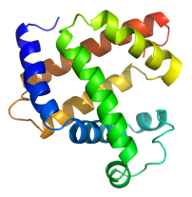
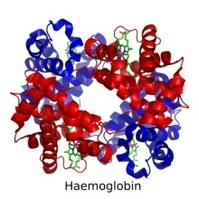
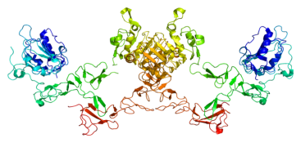
Execution of the gene “programs”
Cells with the same genome may produce a different transcriptome … how?
  Two main mechanisms controlled by external conditions
gene expression
gene splicing
DNA
Exon 1
Intron A
Exn 2
Intrn B
Exon 3
DNA
Transcription
mRNA transcripts
Exon 1
Intron A
Exn 2
Intrn B
Exon 3
pre-mRNA
Splicing
Exon 1
Exn 2
Exon 3
transcript
isoforms
Exon 1
Exon 3
Proteins
Proteins
Notes:
Example: Hemoglobin protein is made in red blood cells, while Myosins are made in muscle cells.
Differential Gene expression – a variety of temporary and permanent conditions influence the ability for polymerase to start transcription at the promotor site for a gene. Which programs run.
Differential gene transcription - the size and selection of introns and exons spliced can vary by regulation through regulation of the spliceosome (code modification!)

Slide 10
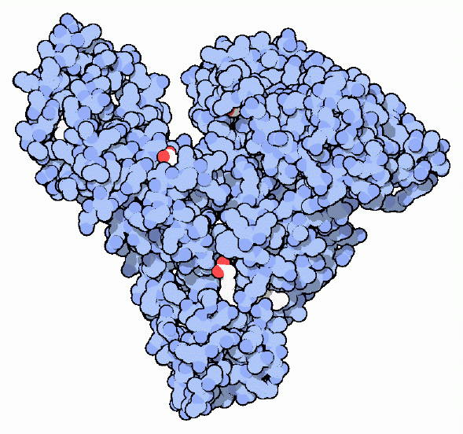
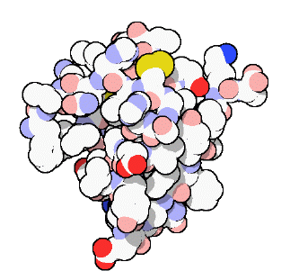
What are Proteins
Proteins are incredibly diverse
  Structural proteins (collagen) provide structural support and rigidity
  Enzymes act as biological catalysts (pepsin) that hasten critical reactions without taking part in them
  Proteins transport small molecules and minerals to where they are needed within an organism (hemoglobin)
  Used for signaling and intercellular communication (insulin)
  Absorb photons to enable vision (rhodopsin)
Proteins are assembled from simple molecules, called amino acids.

Slide 11
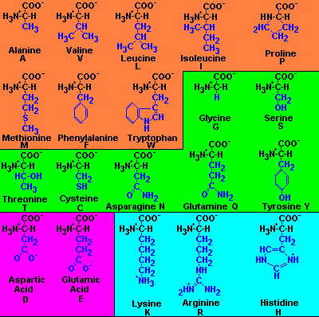
Amino Acids
20 ingredients of proteins
Varying side chain is
shown in blue
Orange indicates non-
polar and hydrophobic,
the remainder are
polar or hydrophilic
Magenta indicates acidic
Cyan indicates a base
A hydrophobic amino acid avoids water whereas a hydrophillic amino acid is attracted to water. This influences the shape that proteins fold into.
Notes:
COO – Carboxyl group
NH3 – Amino group
Peptide reaction

Slide 12
Encoding Protein Assembly
Each DNA base can be one of 4 values (G,C,A,T)
Proteins are polymer chains of amino acids ranging in length from tens to millions
There are 20 amino acids
How do you encode variable length chains of 20 amino acids using only 4 bases?
Do you need other codings?
Clearly, we can’t encode 20 different amino acids using only one base. How many encodings are possible using a pair of bases? How many with three?

Slide 13
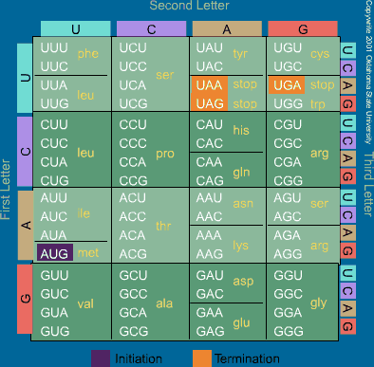
Codons
Triplets of nucleotide
bases determine the
amino acid sequence
of a protein
All genes begin with
a particular code, AUG,
for the amino acid
Methonine
Three codes are used
to indicate STOP, and
thus end the
transcription process
for the gene
Most amino acids have
redundant encodings
Why are there Us in this table?
Before a DNA sequence is translated into a
protein, a copy is first made. This copy is made
from RNA. In RNA, the nucleotide “Uracil”
replaces “Thymine”. Uracil and Thymine are
both chemically and structurally very similar.

Slide 14
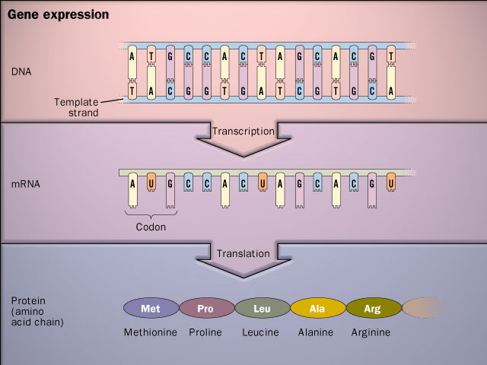
From Genes to Proteins
The central dogma of molecular biology is that information encoded by the bases of DNA are transcribed by RNA and then converted into proteins

Slide 15
Is the Code Perfect?
Proteins are generally unaffected by small variations in their code sequence, particularly changes to a small number of bases
Minor variations in genes, called alleles, are responsible for individual variations (blood-type, hair color, etc.)
Errors in translation (the substitution for one amino acid for the one encoded by the gene), occur at roughly 0.1% of all residues. This means that a single large protein will have at least one incorrect amino acid somewhere! Many of these will still function, in part because the substituted residue will often be adequate. Still, is a bit curious that this level of error is acceptable.

Slide 16
How Big is a Genome?
The human genome is roughly 3 billion bases
  A typical RNA transcript is roughly 3000 bases
  The largest known human gene (dystrophin) has 2.4 million bases
  The estimated number of human genes is roughly 30K
  The genome is nearly identical for every human (99.9%)
  Human DNA is 98% identical to chimpanzee DNA.
  The functions are unknown for more than 50% of discovered genes.
  Genes appear to be concentrated in random areas along the genome, with vast expanses of noncoding DNA between.

Slide 17
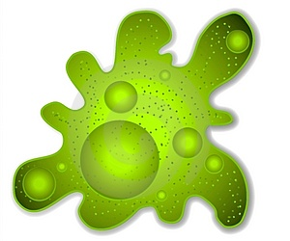
Is Bigger Better?
The genome size of a species is constant
Large variations can occur across species lines
Not strictly correlated with organism complexity
Genome lengths can vary as much as 100 fold between similar species
Length and variability are more of an indications of a phylum’s susceptibility to mutation
13 Bbp
670 Bbp
118 Bbp
Notes:
Karyotype Amoeba (Amoeba dubia) ~ 670 Bbp
Salamander (120.60pg, Necturus lewisi, Gulf coast waterdog) ~118 Bbase pairs
Frog (13.40pg, Ceratophrys ornata (8n), Ornate horned frog) ~13 Bbase pairs
Marbled Lung fish (130pg 130 Bbp)
Orchids (angiosperms) have the the largest variation within a species (stains that can interbreed and generate fertile progeny) with a range that varies at least 168-fold.

Slide 18
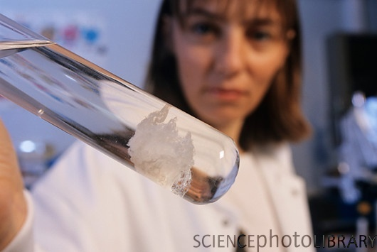
Analyzing DNA
Recall DNA is the essential
information determining the
function of living organisms
In order to understand the
biological machinery we’d
like to read the “code” of
the genome
How can we get access to DNA?
An organism’s genome can be millions to billions of base pairs long…
There are about 40 picograms (small) and 2 meters (long) of DNA per cell
Currently, technology to read the sequence has limitations
PHILIPPE PSAILA / SCIENCE PHOTO LIBRARY
Notes:
This is fundamentally (organic) chemistry. All you need to extract DNA is a little Dawn dishwashing detergent in Salt water.

Slide 19
Four Steps to Recover a Genome
Cut it
  Use enzymes to break DNA into fragments
Copy it
  Make millions of identical copies of each fragment
Read it
  Determine every base-pair in each fragment
Reassemble it
  Reconnect all of the fragements in the correct order
Notes:
But can read it in little pieces.

Slide 20
Cutting DNA
In a bit of serendipity, while studying how bacteria defend against viral infections, Hamilton Smith found certain enzymes that break DNA whenever they encounter specific base sequences.
Such enzymes are called restriction enzymes
The first one found was EcoRI, it breaks DNA at a GA boundary when it encounters the palindromic sequence 5’-GAATTC-3’
These exposed single strands are called the “sticky ends”
G
A
A
T
T
C
C
T
T
A
A
G
Notes:
This is a special definition of palindromic. Both strands have the same sequence when read 5’-to-3’. Palindromic strings may have odd or even length, but what about a palindromic DNA sequence? Rotational symmetry is a more accurate description.

Slide 21
Cutting DNA
Others include KpnI, which cuts 5’-GGTACC-3’ at C-C
And, ScaI, cuts the sequence 5’-AGTACT-3’ at T-A and leaves a blunt end
G
G
T
A
C
C
G
G
T
A
C
+
C
C
C
A
T
G
G
C
C
A
T
G
G
Blunt ends
T
+
A
C
T
A
G
T
A
C
T
A
G
T
C
A
T
G
A
T
C
A
T
G
A

Slide 22
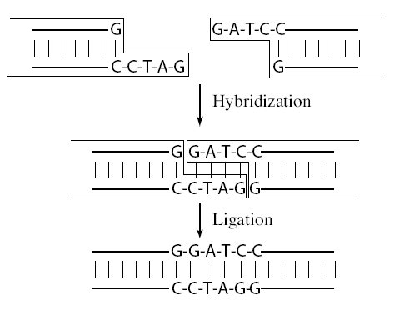
Pasting Together DNA
Two pieces of DNA can be reconnected by replacing broken chemical bonds
Two primary methods
  Hybridization – constructing a
  double strand from a single strand
  by taking advantage of DNA’s
  desire to form complementary
  base-pairings
  Ligation – gluing together DNA
  fragments with single-strand
  “sticky” ends, perhaps from
  different sources. Special enzymes
  (DNA ligase) repair the broken
  phosphate backbone

Slide 23
Copying DNA
While cells are able to extract information from only a single strand of DNA, molecular assays often require large quantities of material.
One solution, cloning, involves using cells to do the work of replication
DNA Cloning
  Various organisms contain small circular DNA molecules called plasmids
  Plasmids can be cut using a restriction enzyme to form a vector, and the sequence to be copied, called the insert, is placed into the gap using ligation.
  The modified plasmid is then inserted into a living cell that is left to multiply into a colony.
  The DNA is harvested from the colony and the plasmids of interest are isolated.
Notes:
In vivo replication of DNA is more accurate than in vitro

Slide 24
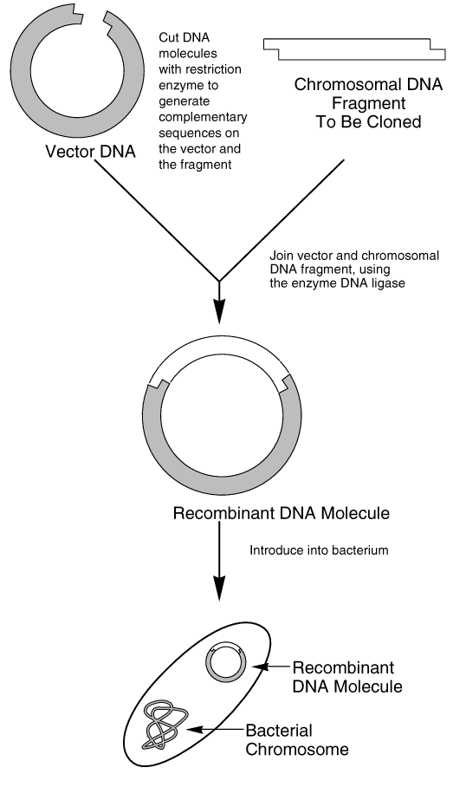
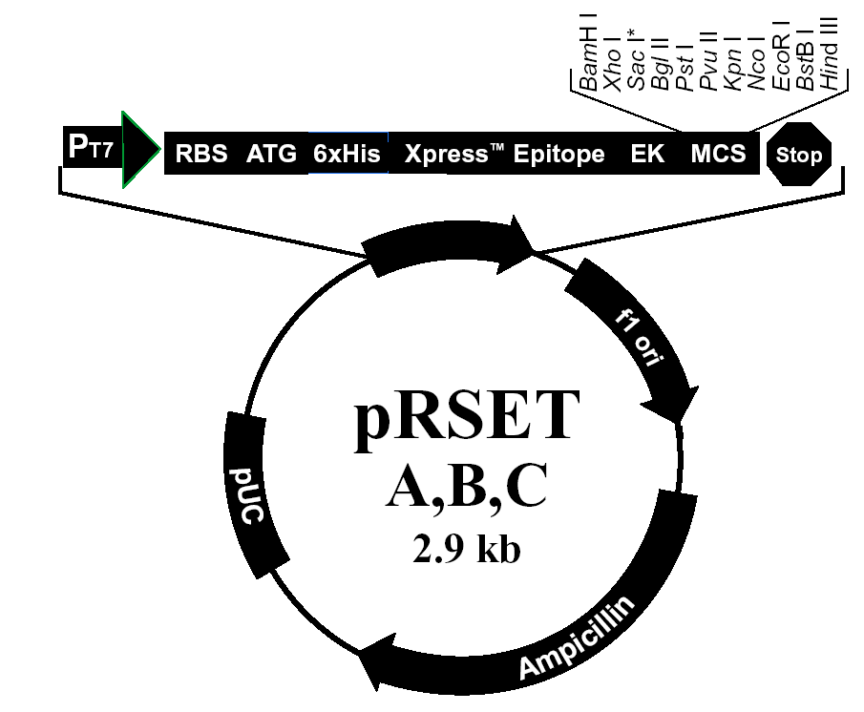
Cloning Process
Bacterial vectors are good for
sequences ~25 kB
Yeast-based 100 kB to 1MB
Vector DNA
Notes:
In addition, to the desired sequence for replication, a second “antibody” sequence is often attached to the target sequence, which is useful for selection later on.

Slide 25
High-Volume DNA Copying
Polymerase Chain Reaction (PCR)
  Polymerases are enzymes responsible for replicating DNA during cell division
  Extend a double-stranded region bonded to a longer, single DNA strand in the 5’-to-3’ direction
How PCR works:
  Separate DNA strands, which happens naturally at high temps
  Add small single-strand DNA sequence (primer) and DNA Polymerase
  Let the primers hybridize (sometimes called anneal)
  Let the “heat activated” Polymerase extend the sequence
  Produces two copies, just by cycling the temperature
  Repeat.
Notes:
In vitro

Slide 26
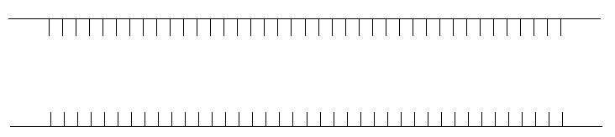
Denature DNA
Raise temperature to 94ºC to separate the double strands of DNA into single strands

Slide 27
Design Primers
To perform PCR, a 10-20bp sequence on either side of the subsequence to be amplified must be known
Notes:
“Design”? Why 10-20? Any constraints ?

Slide 28

Annealing
Anneal primers at 50-65ºC
(exact temperature depends on primer sequence)
Notes:
The primers are complementary to the identified sequences and have a place where polymerase would like to attach

Slide 29
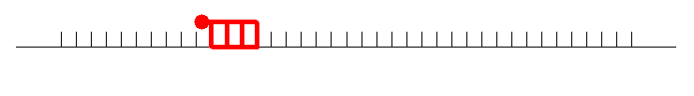
Extension
Extend primers: raise temp to 72°C, allowing a
temperature stable polymerase (Taq) to attach at each
priming site and extend a new DNA strand
Taq
Taq

Slide 30
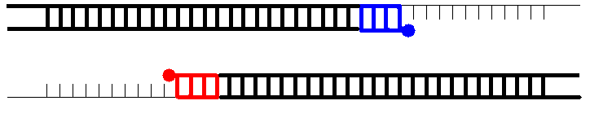
Extension
Extend primers: raise temp to 72°C, allowing a
temperature stable polymerase (Taq) to attach at each
priming site and extend a new DNA strand

Slide 31
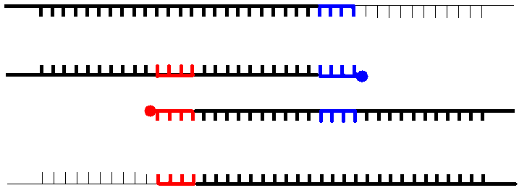
Repeat
Repeat the Denature, Anneal, Extension steps at their respective temperatures…
Taq
Taq
Taq
Taq

Slide 32
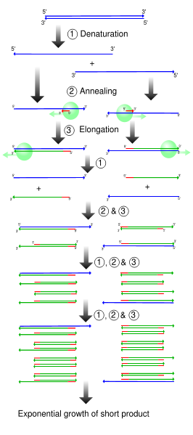
High-Volume DNA Copying
PCR Products
  Many copies (~2^{Cycles}) of the
  desired “short” DNA fragment
  Polymerases always extend in
  the 5’-3’ direction
  Typical Polymerases extend the
  sequence about the primer
  ~1000 base pairs in 10 secs
  Replication fidelity (the possibility
  of the polymerase copying an
  incorrect nucleotide ) is about
  1 in 9000

Slide 33
Reading DNA Sequences
The process of reading off sequential DNA bases is called sequencing
Sequencing strategies involve 3 steps
  Generate successive subfragments that differ in length by a single nucleotide
  Label each fragment with one of 4 different tags
  Sort the fragments according to size
Tags are usually fluorescent dyes or radioisotopes
Sequencing speed is ≈ 10⁴ – 10⁵ bases/day
How many days to sequence 3 Billion?
30000 days,
82 years!

Slide 34
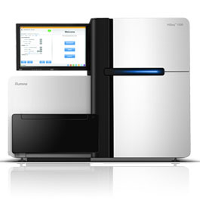
High-Throughput Sequencing
Parallelism is the key to speeding up this process
Rather than reading one sequence at a time one can read millions
Peak Throughput
  8 * 1.6x10⁶ * 10⁴ = 128 billion/day
In practice:
  55 billion base pairs /day for
  2x100 bp reads
  18x coverage of a 3 Gb genome in a day
Illumina HiSeq 2000

Slide 35
DNA Sorting
DNA fragments can be very accurately sorted according to size using gel electrophoresis
DNA is a negatively charged molecule that can be coerced into motion under an electric field
DNA is placed into a gel and the speed of motion is proportional to the strand’s size
(Large molecules more slower, small ones faster)
Usually florescent markers are attached to each strand (e.g. at the sticky ends) and used to detect the various strand sizes

Slide 36
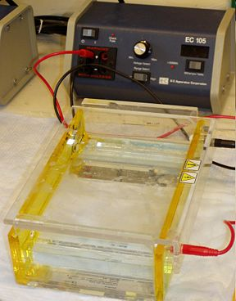
Gel Electrophoresis
Gel electrophoresis is also commonly used to measure the relative sizes of other molecules, such as RNA and proteins
Electrophoresis is also used to separate out particular strands
Often just the number of fragments conveys information about small genetic variations (allele’s)

Slide 37
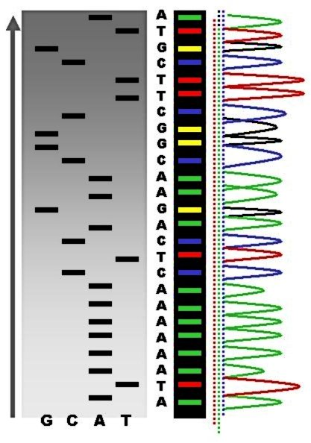
Reading DNA
Electrophoresis
  Sequencing is done by separating subsequences by size (and, in a 2D gel, by size and charge).
  The DNA molecules are either labeled with radioisotopes or tagged with fluorescent dyes.
  Given a DNA molecule it is then possible to obtain all fragments from it that end in either A, or T, or G, or C and these can be sorted in a gel experiment.

Slide 38
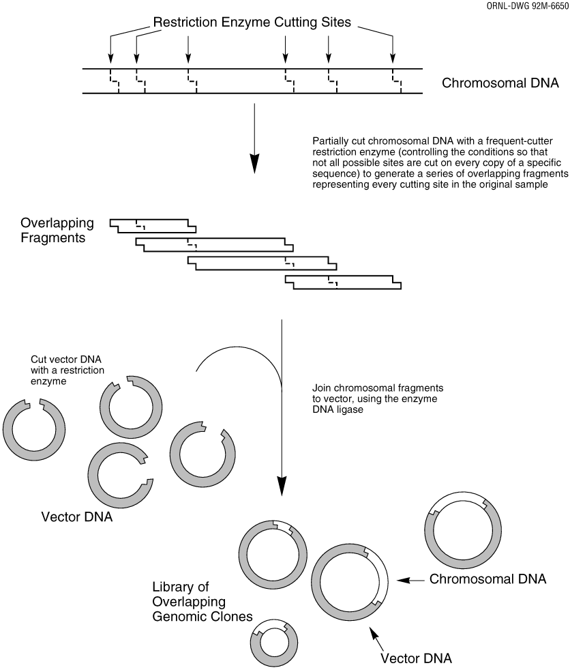
Assembling Genomes
Must take the fragments and put them back together
Not as easy as it sounds
Some of the fragments will overlap
Fit overlapping sequences together to get the shortest possible sequence that includes all fragment sequences

Slide 39
Assembling Genomes
DNA fragments contain sequencing errors
Two complementary strands of DNA
  Need to consider that DNA comes in two parts
  Don’t want to confuse one side of the chain with the other when we reassemble
Repeat problem
  50% of human DNA is just repeats
  If you have repeating DNA, how do you know where it goes? How many copies?
Notes:
ACTACTACTACTACT

Slide 40
DNA probes
Oligonucleotides: short single-strands of DNA usually 20-30 nucleotides long
Oligonucleotides can be used to find complementary DNA segments, via hybridization
Also used to determine the concentration of specific mRNA strands within a cell (gene expression)
Made by automated DNA synthesizers and tagged with a radioactive isotope.
Anchored onto glass slides

Slide 41
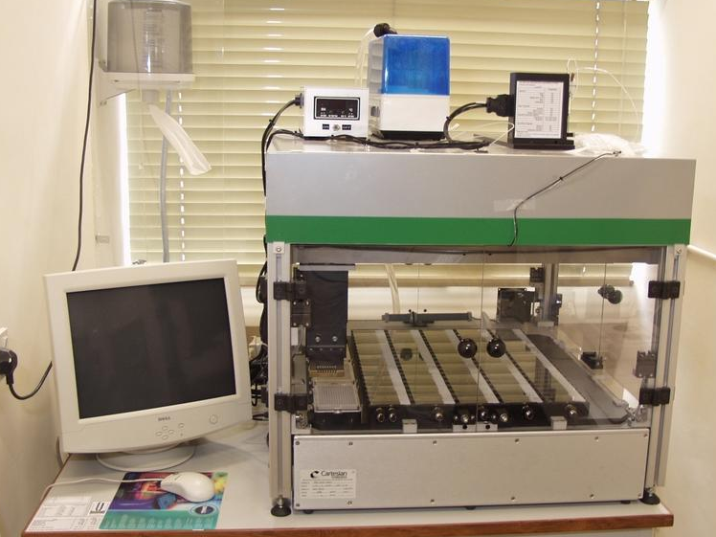
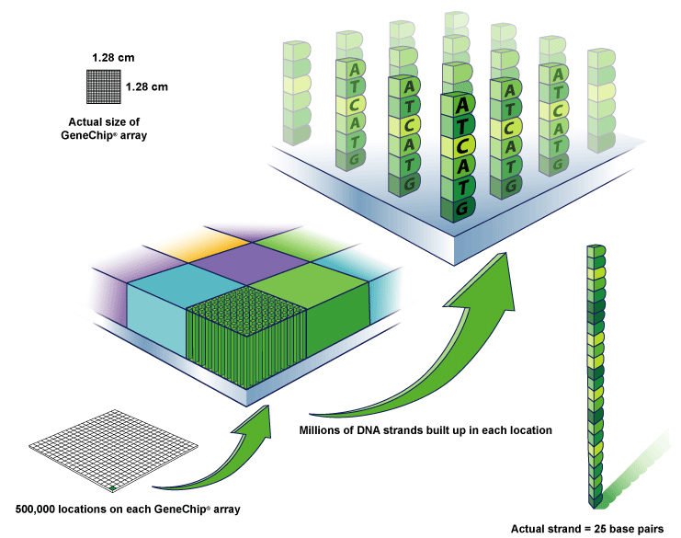
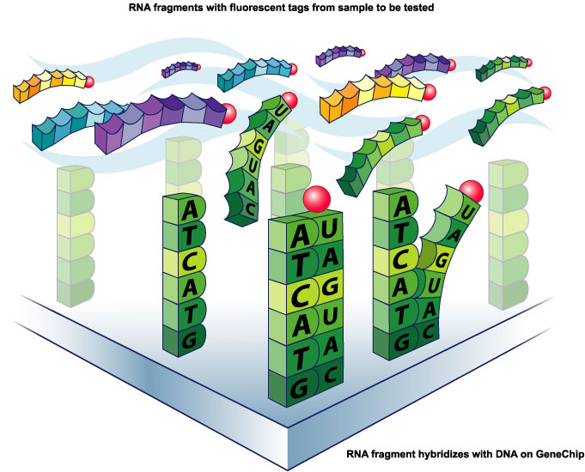
DNA Microarray
Millions of DNA strands
build up on each location.
Tagged probes become hybridized
to the DNA chip’s microarray.

Slide 42
Gene Expression Arrays
An gene expression array works by exploiting the ability of a given mRNA molecule to hybridize to the DNA template.
Using an array containing many DNA samples in an experiment, the expression levels of hundreds or thousands genes within a cell by measuring the amount of mRNA bound to each site on the array.
With the aid of a computer, the amount of mRNA bound to the spots on the microarray is precisely measured, generating a profile of gene expression in the cell.

Slide 43
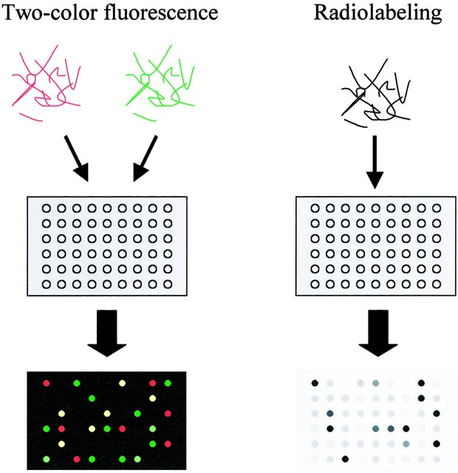
Labeling DNA arrays
RNA samples are labeled using fluorescent nucleotides (left) or
radioactive nucleotides (right), and hybridized to arrays. For fluorescent
labeling, two or more samples labeled with differently colored fluorescent
markers are hybridized to an array. Level of RNA for each gene in the
sample is measured as intensity of fluorescence or radioactivity binding
to the specific spot. With fluorescence labeling, relative levels of expressed
genes in two samples can be directly compared with a single array.

Slide 44
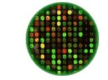
An experiment on a microarray
In this schematic:
GREEN represents Control DNA
RED represents Sample DNA
YELLOW represents a combination
of Control and Sample DNA
BLACK represents neither the
Control nor Sample DNA
Each color in an array represents either healthy (control) or diseased (sample) tissue. The location and intensity of a color tell us whether the gene, or mutation, is present in the control and/or sample DNA.

Slide 45
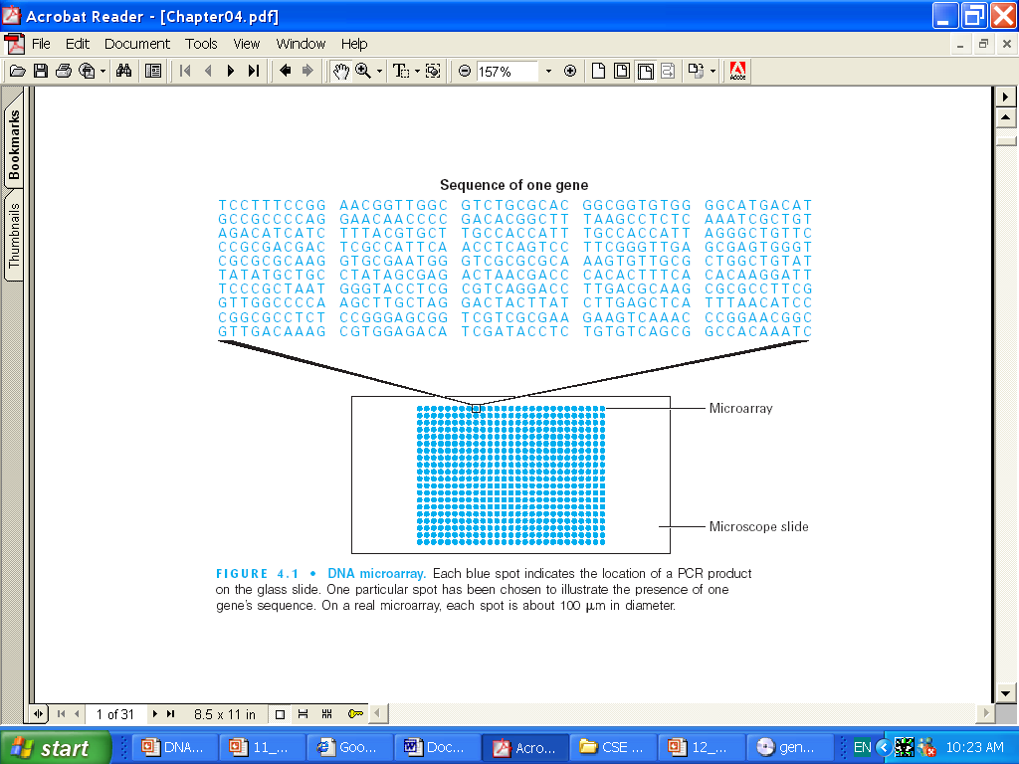
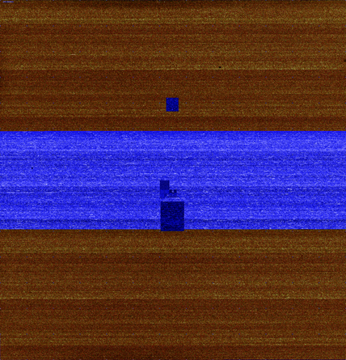
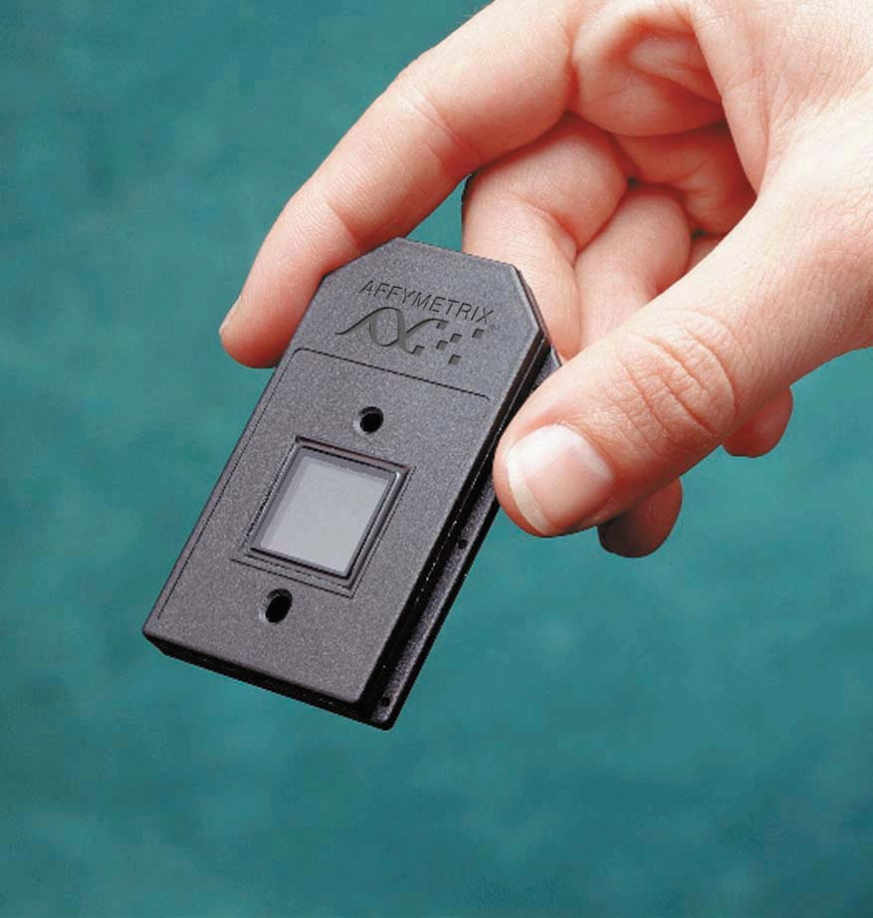
DNA Microarray
Affymetrix
Microarray is a tool for measuring and analyzing DNA fragments. It consists of a glass slide, with template DNA patterns anchored to it. (25-64 bps)
Each blue spot indicates the location of a PCR product. On a real microarray, each spot is about 100um in diameter.

Slide 46
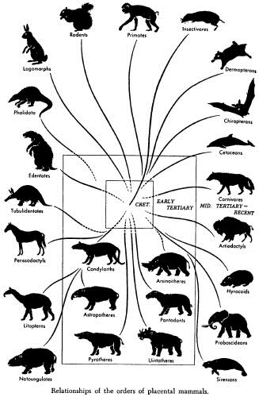
The Diversity of Life
Not only do different species have different genomes, but also different individuals of the same species have different genomes.
No two individuals of a species are quite the same – this is clear in humans but is also true in every other sexually reproducing species.
Imagine the difficulty of biologists – sequencing and studying only one genome is not enough because every individual is genetically different!

Slide 47
How do Individuals Differ?
Genetic makeup of an individual is manifested in traits, which are caused by variations in genes
While only 0.1% of the 3 billion nucleotides in the human genome differ, these small variations can affect a large range of phenotypic expressions
Traits make individuals more or less susceptible to disease, and the demystification of these mutations will hopefully reveal the links between genetics and susceptibility to diseases
Genetics also determines how effective a particular disease treatment might be.

Slide 48
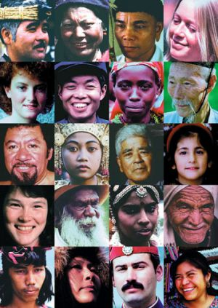
Physical Traits and Variances
Individual variation within a species occurs in populations of all sexually reproducing organisms.
Individual variations range from hair and eye color to less subtle traits such as susceptibility to malaria.
Physical variation is the reason we can pick out our friends in a crowd, however most physical traits are difficult to detect at a cellular and molecular level.

Slide 49
Sources of Physical Variation
Physical Variation and the manifestation of traits are caused by variations in the genes and environmental influences.
An example is height, which is dependent on genes as well as the nutrition of the individual.
Not all variation is inheritable – only genetic variation can be passed to offspring.
Separating genetic and environmental effects and interactions is one of the major challenges of biology.
Both sorts of interactions can be complex…
  Interactions of multiple genes
  Order of exposures
Notes:
It’s not just genes, it’s environment too

Slide 50
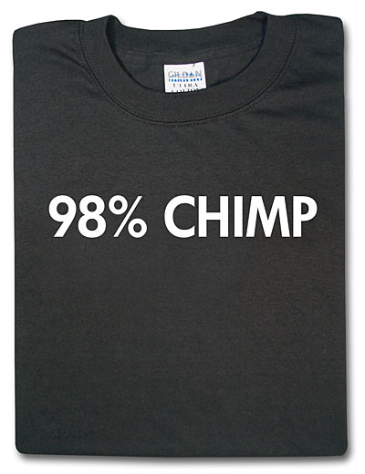
Genetic Variation
Despite the wide range of physical variation, the genomic differences between two individuals is small.
Out of 3 billion nucleotides, only roughly 3 million base pairs (0.1%) are different between individual genomes of humans.
Although there is a finite number of
possible variations, the number is so
high (4^{3,000,000}) that one can safely
assume that no two individuals have
the same genome by chance.
Related individuals have more similar
genomes
What is the cause of this genetic variation?

Slide 51
Sources of Genetic Variation
Mutations are rare changes to genomic sequence.
Common mutations (in order of frequency)
  Bases in the sequence change (polymorphism)
  A subsequence of bases is removed (deletions)
  A subsequence of bases is repeated (copy number variation)
  A subsequence changes position (transposition)
  A subsequence is reversed (inversion)
Most mutations do not create beneficial changes and actually kill the individual.
Although mutations are the source of all new genes in a population, they are so rare that there must be another process at work to account for the large amount of diversity.

Slide 52
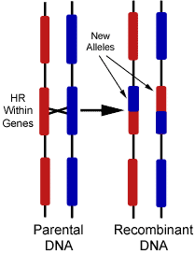
Sources of Genetic Variation
Recombination is the shuffling of genes that occurs through sexual mating and is the main source of genetic variation.
In mammals, and other higher organisms, there are two complete copies of the DNA sequence (recall this is the source of the “dormant,” “hidden,” or “recessive” traits discussed last lecture.
During meiosis (germ-line cell division)
these two DNA sequences can exchange
subsequences
This brings together differ gene-variant
combinations rather modifying genes as
in mutation.

Slide 53
How Do Different Species Differ?
As many as 99% of human genes are conserved across all mammals based in terms of function, with >85% having high sequence similarity (>95% bp agreement)
The functionality of many genes is virtually the same among many organisms
It is highly unlikely that the same gene with the same function would spontaneously develop among all currently living species
The theory of evolution suggests all living things evolved from incremental change over millions of years

Slide 54
Mouse and Human overview
Mouse genome has 2.7 x 10⁹ base pairs versus
3.1 x 10⁹ in human.
About 95% of genetic material is shared.
99% of genes shared of about 30,000 total.
The 300 genes that have no homologue in either species deal largely with immunity, detoxification, smell, and sex*
*Scientific American Dec. 5, 2002

Slide 55
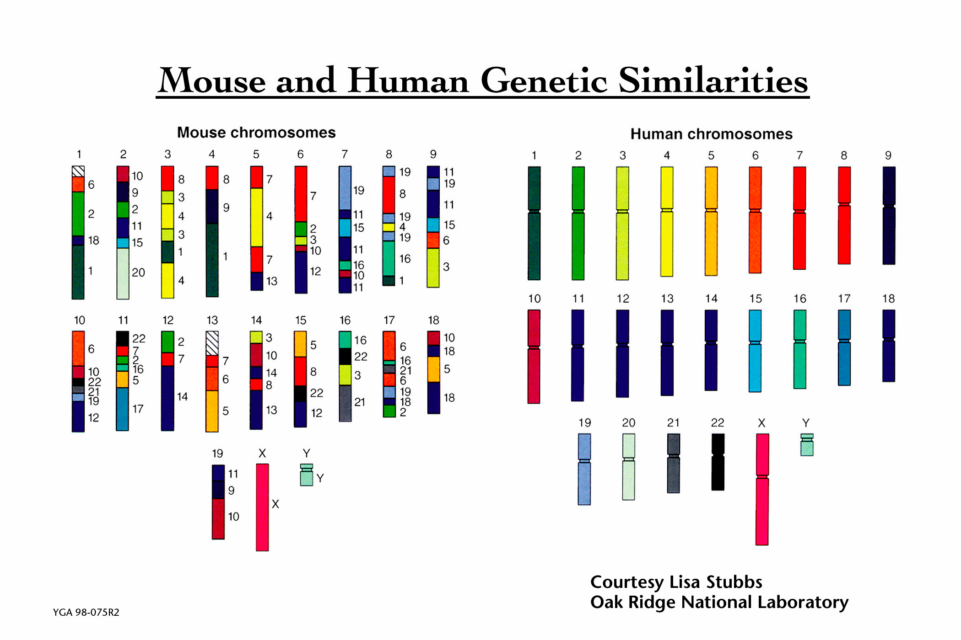
Genome Structure
Significant chromosomal rearranging occurred between the diverging point of humans and mice.

Slide 56
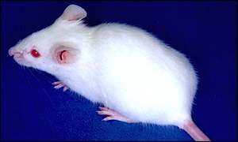
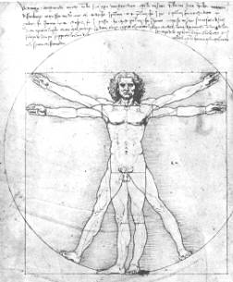
Comparative Genomics
What can be done comparatively between Human and Mouse Genomes?
One possibility is to create “knockout” mice – mice lacking one or more genes. Study the phenotypes of these mice gives predictions that gene’s function in both mice and humans.

Slide 57
Summary
DNA sequences are extracted by first cutting up the DNA into small segments using restriction enzymes
Many copies of a target DNA can be generated by either cloning or Polymerase Chain Reaction
Individual bases can be read from DNA using sequencing techniques or by DNA microarrays
Bioinformatics algorithms attempt to reconstruct the original sequence from the fragements
Evolution and individual variation are the result of molecular differences in DNA that lead to different phenotypes

Slide 58
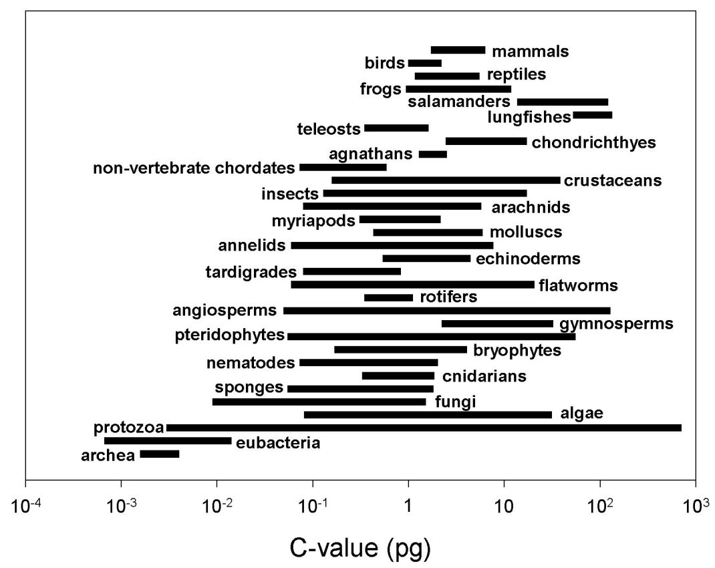
Genome Variation
Length and variability are more of an indications of a phylum’s susceptibility to mutation than complexity
Notes:
C-value = the Amount of DNA in an unreplicated gametic nucleus. It is measures in pico Grams, and 1pg = 978M base pairs.

Slide 59
Algorithm Topic
Rocks: a simple game
  Two piles of rocks A,B
  Two players, alternating turns
  A turn consists of
    Take one rock from either pile
    OR
    Take one rock from both piles
  The game must end. Why?
  Player that takes the last turn wins the game!
  Rocks(i,j) = state of the game with i rocks in pile A, and j rocks in pile B
  Can the player whose turn it is win Rocks(i,j)?
A
B

Slide 60
Solution Strategy
Solve the simplest cases
Reduce more complex cases to simpler cases
Game State | Player move | Player prospects
Rocks(0,0) | - | Loses
Rocks(0,1)
Rocks(1,0)

Slide 61
Programming Topic
Sample python program
def total(v):
“yields the sum of values in list v”
n = len(v)
sum = 0
for i in xrange(0,n)
sum += v[i]
return sum
Notes:
total([1,2,3])
6.
The power of python is that it has sophisticated data structures built in to represent tuples, lists, dictionaries so you can use these directly and know that they will be reasonably efficient

Slide 62
Analysis Topic
Asymptotic time complexity of programs
  What is the running time T(n) of the python program for a list of length n?
    Graph it
  How should we characterize the running time
    Approximately, with accurate scaling in the limit

Slide 63
Expected Learning Outcomes
Students completing this class should …
  have an understanding of key algorithms used in bioinformatics and know their capabilities and limitations
  have knowledge of algorithmic strategies that can be employed to design new algorithms for bioinformatics applications
  be able to analyze the correctness and asymptotic time complexity of algorithms
  have a working knowledge of concepts and terminology in molecular biology and understand the key challenges
  be able to write bioinformatics programs using python and python bioinformatics libraries

