Slide 1
Lecture 1: Course Introduction
COMP 555 Bioalgorithms
Fall 2014
Jan Prins
Read Chapter 1 and Chapter 3, Secns 3.1-3.7

Slide 2
Intended Audience
COMP 555: Bioalgorithms
  Suitable for both undergraduate and graduate students
  CS majors who want to learn bioinformatics
  Non CS majors from the biological sciences who are interested in algorithms used in bioinformatics.
  Graduate students in the Computer Science department, the BCB curriculum
  or other departments with orientation
  to bioinformatics methods in research
Notes:
This course is suitable for both undergraduate and graduate students. Assuming that undergrads will have completed their core CS-requirements.

Slide 3
Why?
Benefits for Computer Scientists
  See CS fundamentals applied to real problems
  What computer scientists can learn from biology
    Robust, parallel, self-repairing, and energy efficient
Benefits for Biologists
  Help to close the CS-Bio “language” gap
  Appreciate CS as more than “coding”
  What is a correct algorithm? An efficient one?
Growth Potential
  Bioinformatics is a very marketable skill
  Future of CS and Biology
Notes:
Emphasize “real” and “opportune” problems
Thinking “algorithmically”

Slide 4
Some details
Comp Sci undergraduates
  COMP 555 does not substitute for the COMP 550 requirement, but both courses may be taken for credit.
Comp Sci graduates
  COMP 555 can count toward the Theory category in the distribution requirements
    Subject to limitation on number of 500-level classes

Slide 5
What Will We Learn?
Algorithm and data structures Data Abstraction Classic Data Structures Lists, Queues, Heaps, Graphs, Trees, Hash tables Program Correctness and Efficiency Time and Space Complexity Intractable Problems Molecular Biology Basics Biological systems as machines Information in biological systems DNA, nucleotides, codons, & genes mRNA transcription and translation Protein folding and function Genetic variation Gene expression and regulation | Algorithm Design Approaches Exhaustive Search, Branch & Bound, Greedy Algorithms, Dynamic Programming, Divide-and-Conquer, Data-driven Probabilistic Modeling, Randomized Algorithms Bioinformatics Problems Restriction Mapping Motif Finding Sequence Alignment Gene Prediction Sequencing by Hybridization Spectrum Graphs Gene Expression Analysis
Notes:
Mention prereqs – programming, some exposure to data structures and discrete math and probability

Slide 6
Course Logistics
Website:
http://www.cs.unc.edu/~prins/Classes/555/
look here first for
  News, hints, and helpful resources
  Revisions, solutions, and corrections to problem sets
Office Hours: TBA
Grading
  5 problem sets (worth 10% each)
  Midterm Exam (worth 23%)
  Final Exam (worth 25%)
  Class participation (worth 2%)
Problem Sets
  Roughly one every two weeks
  Will include a short program to write
Notes:
Preview Web site.

Slide 7
Bioinformatics = Biology + Information
What is information?
  Information: that which resolves uncertainty
  We measure information in bits
  Information = -log₂(probability)
    The coin I tossed landed heads. How many bits?
    You rolled a 7 on a pair of dice. How many bits? You roll a 3?
  Concrete systems need mechanisms for
    Reliably storing information (memory)
    Reliably processing information (logic)
    Reliably transporting information (connectivity)
  The focus of computer science is information
How about biological systems?
6 ways out of 36 to
roll a 7. Thus, 7 conveys
-log(6/36) = 2.58 bits.
A roll of 3 conveys
-log(2/36)= 4.17 bits

Slide 8
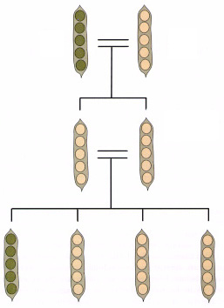
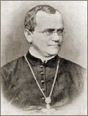
There Must Be Information!
In biological systems…
Information is somehow passed between successive generations of plants and animals
Distinguishable traits are inherited (phenotypes)
Latent (recessive) traits
can be masked by
dominant traits, yet
reappear in later
generations
Heredity
gg
YY
Yg
Yg
Gregor Mendel
1822-1884
gg
Yg
Yg
YY
Notes:
Pea color, g is recessive Y is dominant

Slide 9
Where is the Information?
Enter the Age of Microbiology
Cells: the smallest structural unit of a living organism capable of functioning independently
Cell composition by weight
  70% water
  7% small molecules
  salts, amino acids, nucleotides, lipids (fats, oils, waxes)
  23% larger polymers
  proteins, polysaccharides
Two types
  Prokaryotes: bacteria (no nucleus)
  Eukaryotes: yeast, plants, and animals (with nucleus)
Notes:
Even single-celled animals have distinguishable traits that can be transferred from generation to generation. A the beginning of the last century, one of the fundamental open questions of biology was what is the source of this “information” that is passed on.

Slide 10
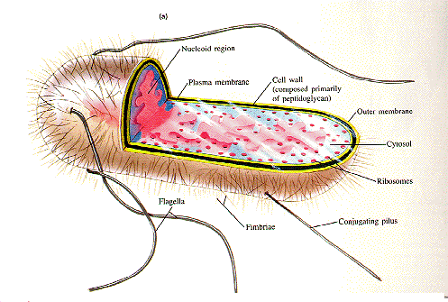
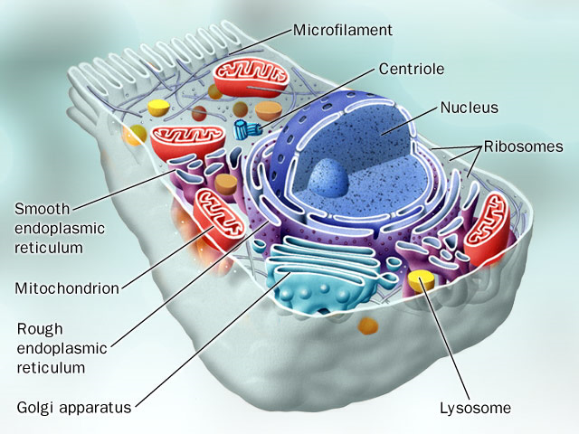
Looking for the Source of Heredity
In 1879 Walther Fleming, a German anatomist, discovered threadlike structures clearly visible during cell division. He called this material 'chromatin,' which was later called 'chromosomes‘
Zoologists Oskar Hertwig and Herman Fol first observed the process of fertilization in detail in the early 1880s. In 1881, Edward Zacharias showed that chromosomes contained nucleic acids. In 1884, Hertwig wrote “nucleic acid is the substance that is responsible not only for fertilization but also for the transmission of hereditary characteristics.”
Prokaryote
Eukaryote

Slide 11
Early 20th Century Genetics
In 1908, Thomas Hunt Morgan and Alfred H. Sturtevant showed that genes were located on chromosomes. Experimenting with Drosophila (fruit flies) they found sex chromosomes, sex-linked traits, and crossing-over. They were able to associate mutations to specific chromosomal regions, thus mapping gene locations.
By the 1930's biochemists knew that the nucleic acid
present in chromosomes was DeoxyriboNucleic Acid, DNA. They also knew that chromosomes contained proteins in addition to DNA. DNA appeared to be long repetitive chains, and therefore, it seemed unlikely to carry information. Proteins, however, looked more interesting and were generally assumed to contain genetic materials. DNA was
considered as just some sort of glue.
Notes:
“Crossing over” is a form of mixing of the ancestral genetic information.

Slide 12
Inferring Genetic Maps
Even without knowing the mechanisms of how heredity information is represented, clever scientists (Morgan) were able to “map” genes…
Normal
Alien
Alien with 4
Recessive Traits
First Generation: F1
Normal | 201 | Short-fingered | 9
Brown | 64 | Brown, blue-eyed, & triangle nosed | 6
Blue-eyed | 58 | Triangle-nosed | 5
Short fingered & triangle-nosed | 54 | Short-fingered & Brown | 5
Short fingered, triangle-nosed, & brown | 21 | Brown, short fingered, triangle-nosed, & blue-eyed | 4
Short fingered, triangle-nosed, & blue-eyed | 20 | Short-fingered & blue-eyed | 4
Brown & blue-eyed | 19 | Triangle-nosed & brown | 1
Blue-eyed & triangle-nosed | 12 | Brown, short fingered, & blue-eyed | 1
 | S | S
w | Sw | Sw
w | Sw | Sw
X
SecondGeneration: F2
 | S | w
S | SS | Sw
w | Sw | ww
X
Seemingly Normal Alien
Seemingly Normal Alien
Notes:
Map in this context means to place sets of genes within a relative spatial ordering to one another.
They used a technique call constructing a linkage map. This involved paying attention to how frequently inherited phenotypes co-occur.
Discuss recessiveness, which was discovered by Mendel.
It was known that parental traits can apparently disappear in one generation, only to reappear in later generations. Mendel’s hypothesis was that many organisms carry multiple copies of a gene, one inherited from each parent. However, one version of the gene might “dominate” over the other (For example round peas dominated wrinkled ones). So it you took a pure-breed plant with round seeds and crossed it with a pure-breed plant with wrinkled ones, in the first generation all plants would have round seeds.
One way of seeing this is by constructing a Punnett square:
Consider an example pair of aliens, with four observable variant traits (eye-color, a short second filter, skin-color, and nose shape).
Suppose we do an initial cross of two maximally diverse aliens (i.e. they differ in every trait), and the children all appear the same (a dominance model). In the next generation we cross two siblings and the resulting 484 children appear in all varieties.

Slide 13
Steps to Infer a Genetic Map
Verify Mendelian ratios
  Brown (64 + 21 + 19 + 6 + 5 + 4 + 1 + 1) /484 = 0.250
  Blue-eyes (58 + 20 + 19 + 12 + 6 + 4 + 4 + 1) / 484 = 0.256
  Triangle-nose (54 + 21 + 20 + 12 + 6 + 5 + 4 + 1) / 484 = 0.254
  Short-finger (54 + 21 + 20 + 9 + 5 + 4 + 4 + 1) / 484 = 0.244
Test for pairwise linkages
(we’d expect ¼ × ¼ × 484 ≈ 30 if independent)
  Short-finger & triangle-nose 54 + 21 + 20 + 4 = 99
  Triangle nose & brown 21 + 6 + 4 + 1 = 32
  Short-finger & brown 21 + 5 + 4 + 1 = 31
  Blue-eyes & triangle-nose 20 + 12 + 6 + 4 = 42
  Short-finger & blue-eyes 20 + 4 + 4 + 1 = 29
  Brown & blue-eyes 19 + 6 + 4 + 1 = 30
Indicates
  Short-fingers & triangle-nose are closely linked
  Blue-eyes & triangle-nose are probably linked
  Short-finger & blue-eyes appear independent, thus
  the triangle nose gene should lie between them
  Brown gene is likely to be on another chromosome.
Blue eyes
Brown
Triangle nose
Short fingers
Morgan came up with even more clever techniques that were able to precisely locate the relative positions of genes on chromosomes. Even today chromosomal gene positions are measured in units of centiMorgans

Slide 14
Today
A few short examples of what we will study
  Biology topic
    Molecular biology
  Algorithm topic
    Finding the winning strategy for a simple game
  Programming topic
    Tiny program in python
  Analysis topic
    Asymptotic time complexity

Slide 15
Biology topic: Molecular biology
In 1944, Oswald Avery showed that DNA, not proteins, carries hereditary information.
In the late 1940’s and early 50’s Linus Pauling and associates develop modeling methods for simultaneously determining structure and chemical make-up of proteins and other large molecules.
In 1952, James Watson and Francis Crick, are able to determine the structure and chemical makeup of DNA, using X-ray crystallography data collected by Rosalind Franklin and Maurice Wilkins.
Beginning of Molecular Biology!

Slide 16
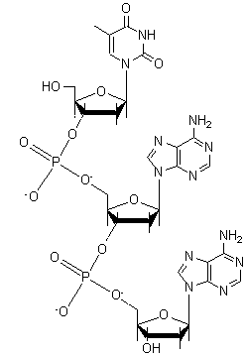
Biology topic: Molecular biology
The information stored in DNA organizes inanimate molecules into living organisms and orchestrates their lifelong function
A long complementary chain of nucleotides
Each nucleotide has 3 components
  A phosphate group
  A ribose sugar
  One of four nitrogenous bases
The sequence of nucleotides
encodes information!

Slide 17
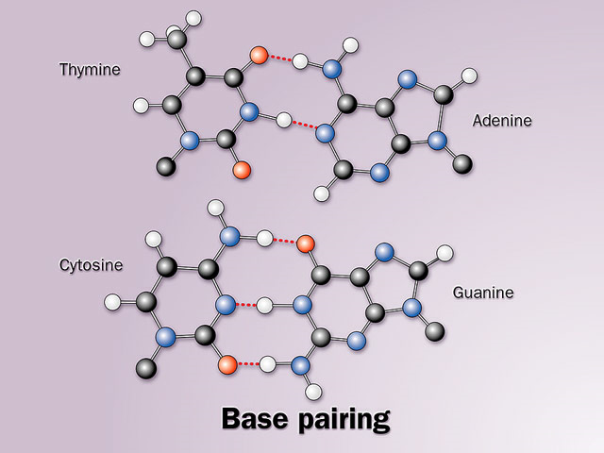
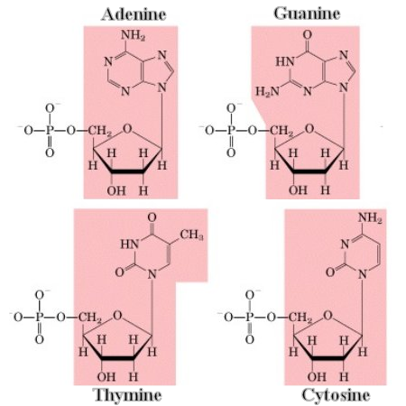
DNA Components
DNA appears in all living organisms
Different code sequences distinguish
  Plants from animals
  Species
  Individuals
A complete DNA sequence
for an organism is called
its genome
Code sequences are
composed of 4 bases
(Adenine, Cytosine,
Guanine, Thymine)
Each base binds with
another specific base
(Thymine with Adenine
and Cytosine with Guanine)
A DNA molecule is comprised of primary sequence and a redundant “complementary” copy that allows it to self replicate (each acts like a template for the other sequence)

Slide 18
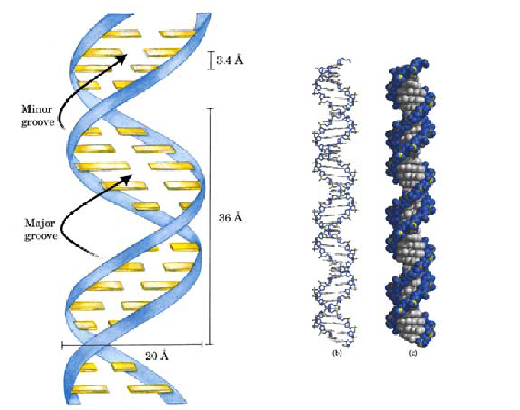

Schematic DNA
Many more details are required to give a complete picture of DNA
  Complementary strands are
  antiparallel and, thus, oriented
  (5’-bbbb-3’)
  Not a simple twist, but has a major
  and minor grooves which are
  important for interacting with proteins
Rather than keep track of all the details we will often consider DNA as a string of nucleotides
Notes:
By convention DNA sequences are always ordered in the 5’-to-3’ direction. Not coincidentally, this is also the order in which they can be synthesized using an important class of molecules call polymerases, which we will discuss in more detail in the next lecture.

Slide 19
Biological Computing Machines
DNA can be viewed as a “program” to
  Collect raw materials and convert chemicals to energy
  Perform specialized functions
  (neurons, muscle, retinal cones)
  Protect and repair itself
  Replicate itself, or duplicate
  entire organism
Questions
  How is the program encoded?
  What biological machinery “executes” this program?
  How is the program’s execution sequenced?
Notes:
Sequencing = Chemical pathways

Slide 20
Genes are key parts of the Program
A gene is a specific subsequences of DNA that controls specific functions of a cell
  Genes are distributed throughout a genome
  Not all DNA sequence sections contain genes
Genes provide instructions for assembling proteins, which are the machinery within and beyond the cell
  how are these instructions encoded?
  how are the instructions carried out?

Slide 21
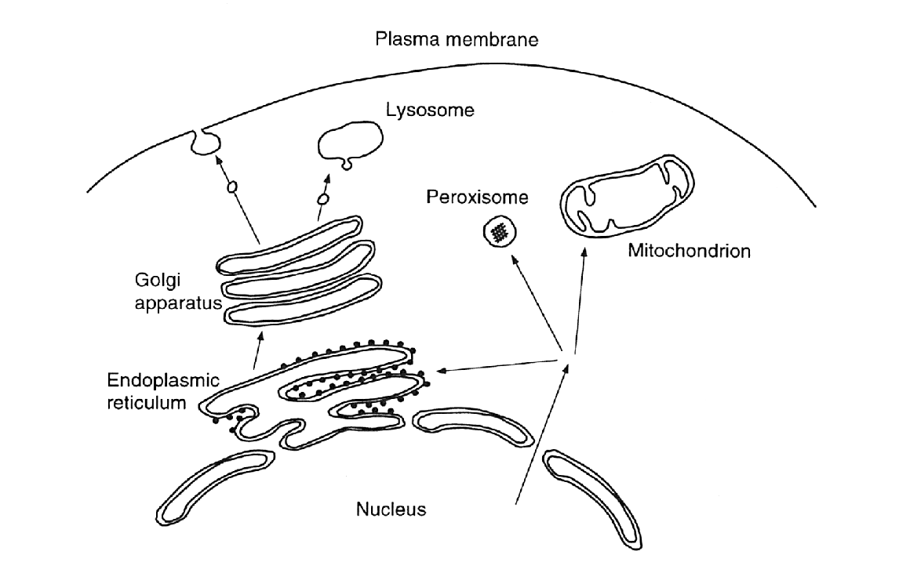
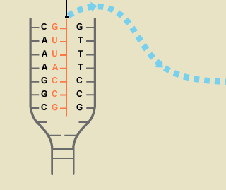
Genome, Transcriptome, Proteome
Schematic illustration
of a eukaryotic cell
Proteins
Proteome
The transcriptome is
all RNA molecules
transcribed from DNA
RNA
cell
nucleus
DNA
Genome
Notes:
Eukaryotic cell has a cell nucleus holding genetic material. Different kinds of RNA. Translation into protein (including mRNA, tRNA) , and noncoding RNA with regulation, post-transcriptional modification (catalytic) functions. DNA as program, RNA as execution analogy. The DNA is the genotype and the RNA is a most basic phenotype. i.e. reflects behavior of the cell as a result of interaction with its environment.

Slide 22
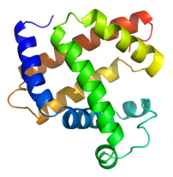
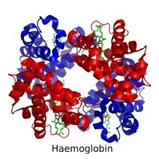
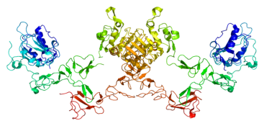
Execution of the gene “programs”
Cells with the same genome may produce a different transcriptome … how?
  Two main mechanisms controlled by external conditions
gene expression
gene splicing
DNA
Exon 1
Intron A
Exn 2
Intrn B
Exon 3
DNA
Transcription
mRNA transcripts
Exon 1
Intron A
Exn 2
Intrn B
Exon 3
pre-mRNA
Splicing
Exon 1
Exn 2
Exon 3
transcript
isoforms
Exon 1
Exon 3
Proteins
Proteins
Notes:
Example: Hemoglobin protein is made in red blood cells, while Myosins are made in muscle cells.
Differential Gene expression – a variety of temporary and permanent conditions influence the ability for polymerase to start transcription at the promotor site for a gene. Which programs run.
Differential gene transcription - the size and selection of introns and exons spliced can vary by regulation through regulation of the spliceosome (code modification!)

Slide 23
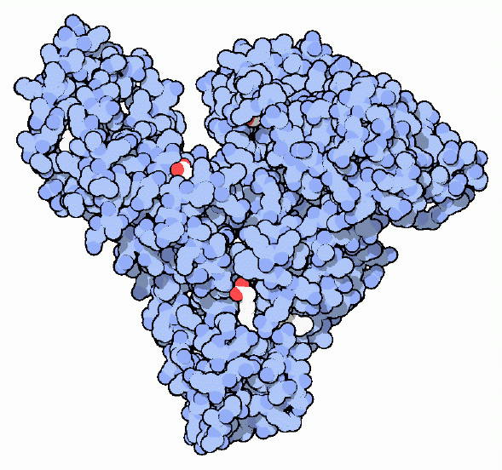
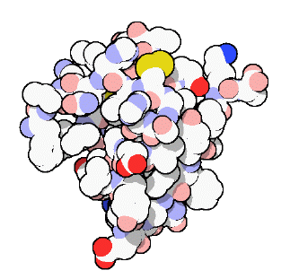
What are Proteins
Proteins are incredibly diverse
  Structural proteins (collagen) provide structural support and rigidity
  Enzymes act as biological catalysts (pepsin) that hasten critical reactions without taking part in them
  Proteins transport small molecules and minerals to where they are needed within an organism (hemoglobin)
  Used for signaling and intercellular communication (insulin)
  Absorb photons to enable vision (rhodopsin)
Proteins are assembled from simple molecules, called amino acids.

Slide 24
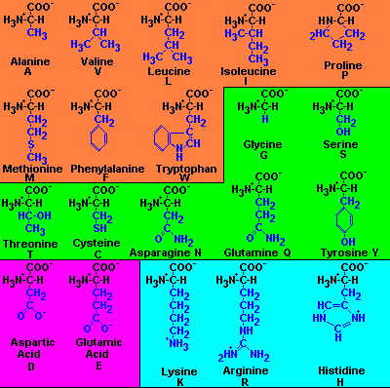
Amino Acids
20 ingredients of proteins
Varying side chain is
shown in blue
Orange indicates non-
polar and hydrophobic,
the remainder are
polar or hydrophilic
Magenta indicates acidic
Cyan indicates a base
A hydrophobic amino acid avoids water whereas a hydrophillic amino acid is attracted to water. This influences the shape that proteins fold into.
Notes:
COO – Carboxyl group
NH3 – Amino group
Peptide reaction

Slide 25
Encoding Protein Assembly
Each DNA base can be one of 4 values (G,C,A,T)
Proteins are polymer chains of amino acids ranging in length from tens to millions
There are 20 amino acids
How do you encode variable length chains of 20 amino acids using only 4 bases?
Do you need other codings?
Clearly, we can’t encode 20 different amino acids using only one base. How many encodings are possible using a pair of bases? How many with three?

Slide 26
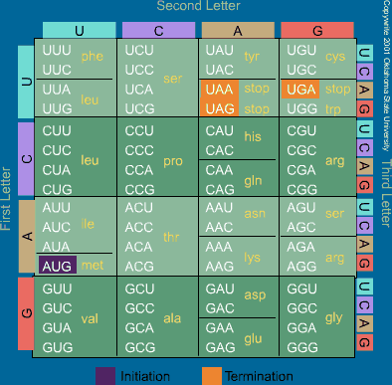
Codons
Triplets of nucleotide
bases determine the
amino acid sequence
of a protein
All genes begin with
a particular code, AUG,
for the amino acid
Methonine
Three codes are used
to indicate STOP, and
thus end the
transcription process
for the gene
Most amino acids have
redundant encodings
Why are there Us in this table?
Before a DNA sequence is translated into a
protein, a copy is first made. This copy is made
from RNA. In RNA, the nucleotide “Uracil”
replaces “Thymine”. Uracil and Thymine are
both chemically and structurally very similar.

Slide 27
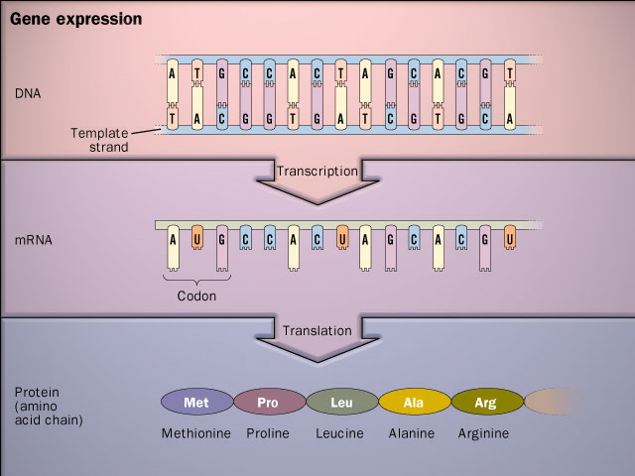
From Genes to Proteins
The central dogma of molecular biology is that information encoded by the bases of DNA are transcribed by RNA and then converted into proteins

Slide 28
Is the Code Perfect?
Proteins are generally unaffected by small variations in their code sequence, particularly changes to a small number of bases
Minor variations in genes, called alleles, are responsible for individual variations (blood-type, hair color, etc.)
Errors in translation (the substitution for one amino acid for the one encoded by the gene), occur at roughly 0.1% of all residues. This means that a single large protein will have at least one incorrect amino acid somewhere! Many of these will still function, in part because the substituted residue will often be adequate. Still, is a bit curious that this level of error is acceptable.

Slide 29
How Big is a Genome?
The human genome is roughly 3 billion bases
  A typical RNA transcript is roughly 3000 bases
  The largest known human gene (dystrophin) has 2.4 million bases
  The estimated number of human genes is roughly 30K
  The genome is nearly identical for every human (99.9%)
  Human DNA is 98% identical to chimpanzee DNA.
  The functions are unknown for more than 50% of discovered genes.
  Genes appear to be concentrated in random areas along the genome, with vast expanses of noncoding DNA between.

Slide 30
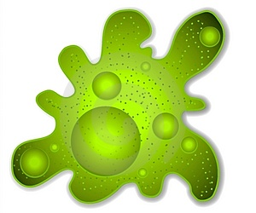
Is Bigger Better?
The genome size of a species is constant
Large variations can occur across species lines
Not strictly correlated with organism complexity
Genome lengths can vary as much as 100 fold between similar species
Length and variability are more of an indications of a phylum’s susceptibility to mutation
13 Bbp
670 Bbp
118 Bbp
Notes:
Karyotype Amoeba (Amoeba dubia) ~ 670 Bbp
Salamander (120.60pg, Necturus lewisi, Gulf coast waterdog) ~118 Bbase pairs
Frog (13.40pg, Ceratophrys ornata (8n), Ornate horned frog) ~13 Bbase pairs
Marbled Lung fish (130pg 130 Bbp)
Orchids (angiosperms) have the the largest variation within a species (stains that can interbreed and generate fertile progeny) with a range that varies at least 168-fold.

Slide 31
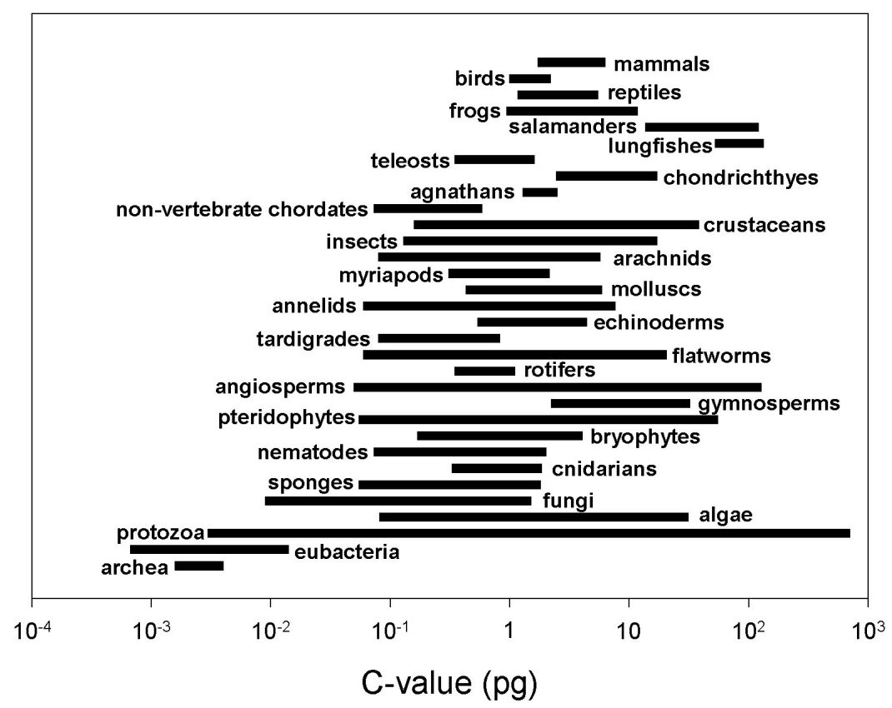
Genome Variation
Length and variability are more of an indications of a phylum’s susceptibility to mutation than complexity
Notes:
C-value = the Amount of DNA in an unreplicated gametic nucleus. It is measures in pico Grams, and 1pg = 978M base pairs.

Slide 32
Algorithm Topic
Rocks: a simple game
  Two piles of rocks A,B
  Two players, alternating turns
  A turn consists of
    Take one rock from either pile
    OR
    Take one rock from both piles
  The game must end. Why?
  Player that takes the last turn wins the game!
  Rocks(i,j) = state of the game with i rocks in pile A, and j rocks in pile B
  Can the player whose turn it is win Rocks(i,j)?
A
B

Slide 33
Solution Strategy
Solve the simplest cases
Reduce more complex cases to simpler cases
Game State | Player move | Player prospects
Rocks(0,0) | - | Loses
Rocks(0,1)
Rocks(1,0)

Slide 34
Programming Topic
Sample python program
def total(v):
“yields the sum of values in list v”
n = len(v)
sum = 0
for i in xrange(0,n)
sum += v[i]
return sum
Notes:
total([1,2,3])
6.
The power of python is that it has sophisticated data structures built in to represent tuples, lists, dictionaries so you can use these directly and know that they will be reasonably efficient

Slide 35
Analysis Topic
Asymptotic time complexity of programs
  What is the running time T(n) of the python program for a list of length n?
    Graph it
  How should we characterize the running time
    Approximately, with accurate scaling in the limit

Slide 36
Expected Learning Outcomes
Students completing this class should …
  have an understanding of key algorithms used in bioinformatics and know their capabilities and limitations
  have knowledge of algorithmic strategies that can be employed to design new algorithms for bioinformatics applications
  be able to analyze the correctness and asymptotic time complexity of algorithms
  have a working knowledge of concepts and terminology in molecular biology and understand the key challenges
  be able to write bioinformatics programs using python and python bioinformatics libraries

Slide 37
For next time
Text
  Read Chapter 1 Introduction (6 pp)
  Read Chapter 3 Molecular Biology Primer
  Secns 3.1 – 3.7 (10 pp)

