Slide 1
CS-485 Final project
Corrine Elliott
Data Mining / Liu
28 April 2016

Slide 2
Problem Overview
Research Question: Given information on a shelter cat or dog’s breed, color, sex and age, can we predict the animal’s fate?
Data-Mining Approaches:
  Naïve Bayes Classifier
  C4.5 Decision Tree
  A priori
  Frequent-Pattern (FP) Growth
Existing Kaggle submissions:
  Random Forest
  Conditional probabilities, e.g., P(outcome|age)

Slide 3
Dataset: Shelter Animals
Training Data-set:
Test Data-set:
26729 animals
Attributes:
  ID: A######
  Name
  Date / Time
  Outcome / subtype
  Species: Cat or Dog
  Sex: Intact, Neutered or Spayed + M/F
  Age: # + units
  Breed and Color
11456 animals
Attributes:
  ID: 1 - 11456
  Name
  Date / Time
  Species: Cat or Dog
  Sex: Intact, Neutered or Spayed + M/F
  Age: # + units
  Breed and Color
Notes:
Classification of interest = Outcome: adopted, died, euthanized, returned, transferred
Sub-outcomes not incorporated [RFI]
Age converted to years and histogram plotted to determine ordinal cutoffs: < 1 year, 1-3 years, >3 years
Training data used to compile lexicographical arrays for Breed (397 values) and Color (57 values)
Multiple values reported -> only first (assumed primary) employed in model [RFI]
New color or breed reported in test data (i.e., no prior data) -> treated as missing data

Slide 4
Naïve Bayes Classifier
Missing data omitted when computing conditional probabilities
Analysis:
  k-fold cross-validation
  Assigned highest-probability classification
  C4.5 Decision Tree: 37.9 %
k | Expected Error Rate | Variance in Error Rate
2 | 0.469619874289 | 2.90263253541e-05
4 | 0.46905866507 | 9.53140200466e-05
6 | 0.471448884897 | 4.986052551e-05
8 | 0.466252618976 | 1.99723963229e-05
10 | 0.468163448586 | 0.000100299847022
Notes:
Results not pictured:
Generates probability of each outcome and thence most-likely classification for each unknown animal

Slide 5
A priori / FP Growth
“Take A Look at the Data” ^{[1]}
Minimum support: 20 %
Maximal itemsets:
  {Transfer, Cat} : 20.60 %
  {Adoption, <1 year} : 21.47 %
  {Adoption, Dog} : 24.31 %
    Relative to 15.98 % for {Adoption, Cat}
Association Rules:
  {Transfer, Cat} -> Domestic Shorthair Mix
    Support : 20.60 %
    Confidence : 82.4342 %
“Dogs tend to be returned to owner more often than cats … and cats are transferred more often than dogs.”
“Young cats and dogs [tend] to be adopted or transferred, while older animals with approximately equal probability can be adopted, transferred or returned.”
“Neutered animals have high chances to be adopted, while intact animals are more likely to be transferred.”
[1] https://www.kaggle.com/uchayder/shelter-animal-outcomes/take-a-look-at-the-data

Slide 6
A priori / FP Growth
“Take A Look at the Data” ^{[1]}
Minimum support: 20 %
Maximal itemsets:
  {Transfer, Cat} : 20.60 %
  {Adoption, <1 year} : 21.47 %
  {Adoption, Dog} : 24.31 %
    Relative to 15.98 % for {Adoption, Cat}
Association Rules:
  {Transfer, Cat} -> Domestic Shorthair Mix
    Support : 20.60 %
    Confidence : 82.4342 %
“Dogs tend to be returned to owner more often than cats … and cats are transferred more often than dogs.”
“Young cats and dogs [tend] to be adopted or transferred, while older animals with approximately equal probability can be adopted, transferred or returned.”
“Neutered animals have high chances to be adopted, while intact animals are more likely to be transferred.”
[1] https://www.kaggle.com/uchayder/shelter-animal-outcomes/take-a-look-at-the-data

Slide 7
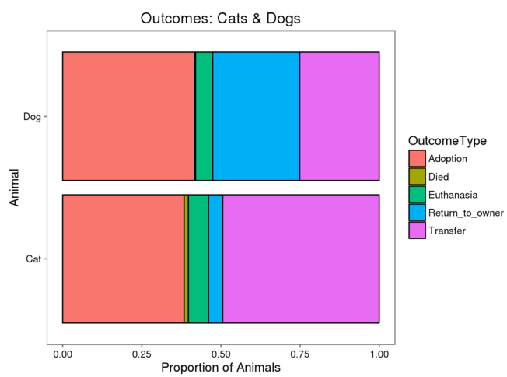
Room for improvement:
Incorporate name data
Subset by species
Categorize breeds
Reassess age categories
Visualize the data
Figure source: Megan L. Risdal’s “Quick & Dirty Random Forest” Kaggle submission
https://www.kaggle.com/mrisdal/shelter-animal-outcomes/quick-dirty-randomforest

