Slide 1
CS 485G:
Special Topics in Data Mining
Clustering Analysis
Jinze Liu

Slide 2
Cluster Analysis
What is Cluster Analysis?
Types of Data in Cluster Analysis
A Categorization of Major Clustering Methods
Partitioning Methods
Hierarchical Methods
Density-Based Methods
Grid-Based Methods
Subspace Clustering/Bi-clustering
Model-Based Clustering

Slide 3
What is Cluster Analysis?
Finding groups of objects such that the objects in a group will be similar (or related) to one another and different from (or unrelated to) the objects in other groups
Inter-cluster distances are maximized
Intra-cluster distances are minimized

Slide 4
What is Cluster Analysis?
Cluster: a collection of data objects
  Similar to one another within the same cluster
  Dissimilar to the objects in other clusters
Cluster analysis
  Grouping a set of data objects into clusters
Clustering is unsupervised classification: no predefined classes
Clustering is used:
  As a stand-alone tool to get insight into data distribution
    Visualization of clusters may unveil important information
  As a preprocessing step for other algorithms
    Efficient indexing or compression often relies on clustering

Slide 5
Some Applications of Clustering
Pattern Recognition
Image Processing
  cluster images based on their visual content
Bio-informatics
WWW and IR
  document classification
  cluster Weblog data to discover groups of similar access patterns

Slide 6
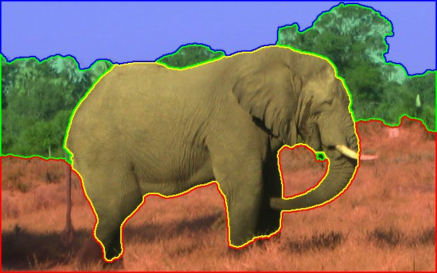
Image Segmentation

Slide 7
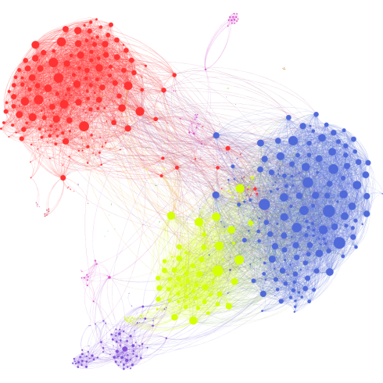
Clusters in Social Network

Slide 8
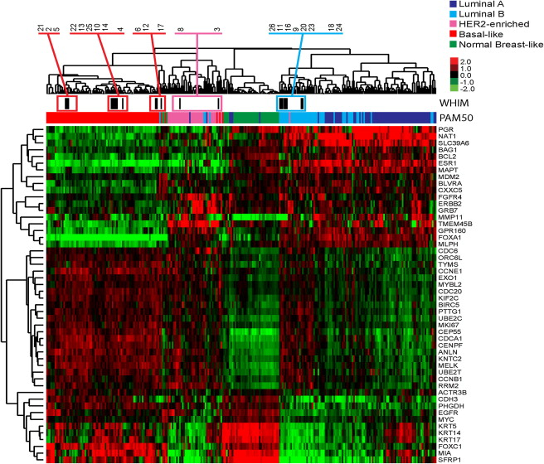
Clustering of Microarray (Bioinformatics)

Slide 9
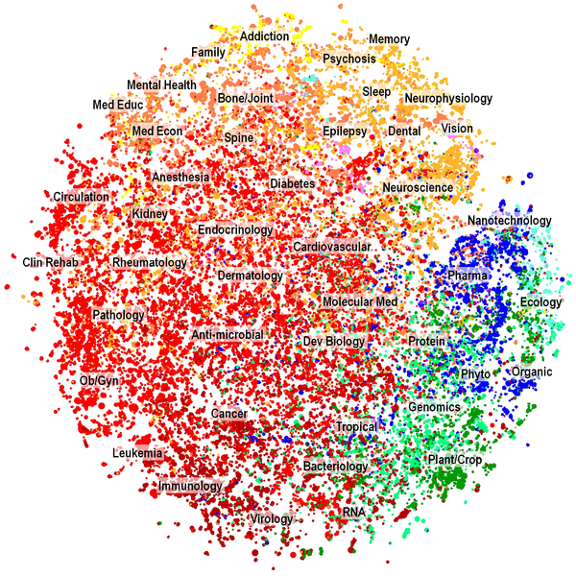
Document Clustering

Slide 10
What Is Good Clustering?
A good clustering method will produce high quality clusters with
  high intra-class similarity
  low inter-class similarity
The quality of a clustering result depends on both the similarity measure used by the method and its implementation.
The quality of a clustering method is also measured by its ability to discover some or all of the hidden patterns.

Slide 11
Outliers
Outliers are objects that do not belong to any cluster or form clusters of very small cardinality
In some applications we are interested in discovering outliers, not clusters (outlier analysis)
cluster
outliers

Slide 12
Requirements of Clustering in Data Mining
Scalability
Ability to deal with different types of attributes
Discovery of clusters with arbitrary shape
Minimal requirements for domain knowledge to determine input parameters
Able to deal with noise and outliers
Insensitive to order of input records
High dimensionality
Incorporation of user-specified constraints
Interpretability and usability

Slide 13
Data Structures
attributes/dimensions
data matrix
  (two modes)
dissimilarity or distance matrix
  (one mode)
the “classic” data input
tuples/objects
objects
Assuming simmetric distance d(i,j) = d(j, i)
objects

Slide 14
Measuring Similarity in Clustering
Dissimilarity/Similarity metric:
  The dissimilarity d(i, j) between two objects i and j is expressed in terms of a distance function, which is typically a metric:
  d(i, j)≥0 (non-negativity)
  d(i, i)=0 (isolation)
  d(i, j)= d(j, i) (symmetry)
  d(i, j) ≤ d(i, h)+d(h, j) (triangular inequality)
The definitions of distance functions are usually different for interval-scaled, boolean, categorical, ordinal and ratio-scaled variables.
Weights may be associated with different variables based on applications and data semantics.

Slide 15
Type of data in cluster analysis
Interval-scaled variables
  e.g., salary, height
Binary variables
  e.g., gender (M/F), has_cancer(T/F)
Nominal (categorical) variables
  e.g., religion (Christian, Muslim, Buddhist, Hindu, etc.)
Ordinal variables
  e.g., military rank (soldier, sergeant, lutenant, captain, etc.)
Ratio-scaled variables
  population growth (1,10,100,1000,...)
Variables of mixed types
  multiple attributes with various types

Slide 16
Similarity and Dissimilarity Between Objects
Distance metrics are normally used to measure the similarity or dissimilarity between two data objects
The most popular conform to Minkowski distance:
  where i = (x_{i1}, x_{i2}, …, x_{in}) and j = (x_{j1}, x_{j2}, …, x_{jn}) are two n-dimensional data objects, and p is a positive integer
If p = 1, L₁ is the Manhattan (or city block) distance:

Slide 17
Similarity and Dissimilarity Between Objects (Cont.)
If p = 2, L₂ is the Euclidean distance:
  Properties
    d(i,j) ≥ 0
    d(i,i) = 0
    d(i,j) = d(j,i)
    d(i,j) ≤ d(i,k) + d(k,j)
Also one can use weighted distance:

Slide 18
Binary Variables
A binary variable has two states: 0 absent, 1 present
A contingency table for binary data
Simple matching coefficient distance (invariant, if the binary variable is symmetric):
Jaccard coefficient distance (noninvariant if the binary variable is asymmetric):
object j
i= (0011101001)
J=(1001100110)
object i

Slide 19
Binary Variables
Another approach is to define the similarity of two objects and not their distance.
In that case we have the following:
  Simple matching coefficient similarity:
  Jaccard coefficient similarity:
Note that: s(i,j) = 1 – d(i,j)

Slide 20
Dissimilarity between Binary Variables
Example (Jaccard coefficient)
  all attributes are asymmetric binary
  1 denotes presence or positive test
  0 denotes absence or negative test

Slide 21
A simpler definition
Each variable is mapped to a bitmap (binary vector)
  Jack: 101000
  Mary: 101010
  Jim: 110000
Simple match distance:
Jaccard coefficient:

Slide 22
Variables of Mixed Types
A database may contain all the six types of variables
  symmetric binary, asymmetric binary, nominal, ordinal, interval and ratio-scaled.
One may use a weighted formula to combine their effects.

Slide 23
Major Clustering Approaches
Partitioning algorithms: Construct random partitions and then iteratively refine them by some criterion
Hierarchical algorithms: Create a hierarchical decomposition of the set of data (or objects) using some criterion
Density-based: based on connectivity and density functions
Grid-based: based on a multiple-level granularity structure
Model-based: A model is hypothesized for each of the clusters and the idea is to find the best fit of that model to each other

Slide 24
Partitioning Algorithms: Basic Concept
Partitioning method: Construct a partition of a database D of n objects into a set of k clusters
  k-means (MacQueen’67): Each cluster is represented by the center of the cluster
  k-medoids or PAM (Partition around medoids) (Kaufman & Rousseeuw’87): Each cluster is represented by one of the objects in the cluster

Slide 25
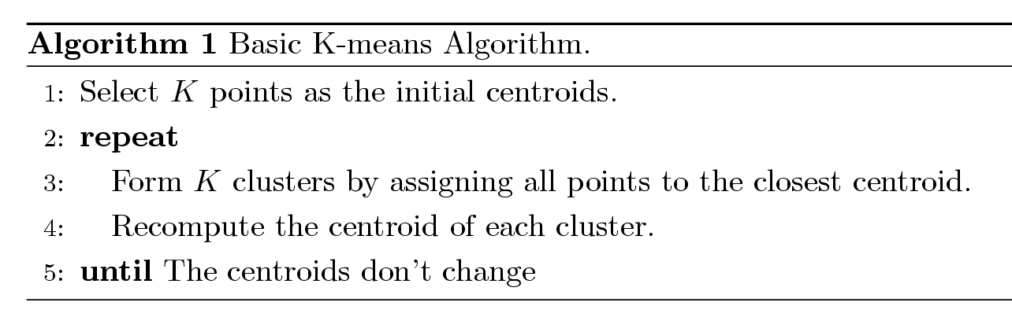
K-means Clustering
Partitional clustering approach
Each cluster is associated with a centroid (center point)
Each point is assigned to the cluster with the closest centroid
Number of clusters, K, must be specified
The basic algorithm is very simple

Slide 26
K-means Clustering – Details
Initial centroids are often chosen randomly.
  Clusters produced vary from one run to another.
The centroid is (typically) the mean of the points in the cluster.
‘Closeness’ is measured by Euclidean distance, cosine similarity, correlation, etc.
Most of the convergence happens in the first few iterations.
  Often the stopping condition is changed to ‘Until relatively few points change clusters’
Complexity is O( n * K * I * d )
  n = number of points, K = number of clusters,
  I = number of iterations, d = number of attributes

Slide 27
Two different K-means Clusterings
Original Points
Optimal Clustering
Sub-optimal Clustering

Slide 28
Evaluating K-means Clusters
  For each point, the error is the distance to the nearest cluster
  To get SSE, we square these errors and sum them.
  x is a data point in cluster C_{i} and m_{i} is the representative point for cluster C_{i}
    can show that m_{i} corresponds to the center (mean) of the cluster
  Given two clusters, we can choose the one with the smallest error

Slide 29
Solutions to Initial Centroids Problem
Multiple runs
  Helps, but probability is not on your side
Sample and use hierarchical clustering to determine initial centroids
Select more than k initial centroids and then select among these initial centroids
  Select most widely separated
Postprocessing
Bisecting K-means
  Not as susceptible to initialization issues

Slide 30
Limitations of K-means
K-means has problems when clusters are of differing
  Sizes
  Densities
  Non-spherical shapes
K-means has problems when the data contains outliers. Why?

Slide 31
The K-Medoids Clustering Method
Find representative objects, called medoids, in clusters
PAM (Partitioning Around Medoids, 1987)
  starts from an initial set of medoids and iteratively replaces one of the medoids by one of the non-medoids if it improves the total distance of the resulting clustering
  PAM works effectively for small data sets, but does not scale well for large data sets
CLARA (Kaufmann & Rousseeuw, 1990)
CLARANS (Ng & Han, 1994): Randomized sampling

Slide 32
PAM (Partitioning Around Medoids) (1987)
PAM (Kaufman and Rousseeuw, 1987), built in statistical package S+
Use a real object to represent the a cluster
  Select k representative objects arbitrarily
  For each pair of a non-selected object h and a selected object i, calculate the total swapping cost TC_{ih}
  For each pair of i and h,
    If TC_{ih} < 0, i is replaced by h
    Then assign each non-selected object to the most similar representative object
  repeat steps 2-3 until there is no change

Slide 33
PAM Clustering: Total swapping cost TC_{ih}=∑_{j}C_{jih}
i is a current medoid, h is a non-selected object
Assume that i is replaced by h in the set of medoids
TC_{ih} = 0;
For each non-selected object j ≠ h:
  TC_{ih} += d(j,new_med_{j})-d(j,prev_med_{j}):
    new_med_{j} = the closest medoid to j after i is replaced by h
    prev_med_{j} = the closest medoid to j before i is replaced by h

Slide 34
PAM Clustering: Total swapping cost TC_{ih}=∑_{j}C_{jih}
t
j
t
j
i
h
h
i
h
j
i
i
t
h
j
t

Slide 35
CLARA (Clustering Large Applications)
CLARA (Kaufmann and Rousseeuw in 1990)
  Built in statistical analysis packages, such as S+
It draws multiple samples of the data set, applies PAM on each sample, and gives the best clustering as the output
Strength: deals with larger data sets than PAM
Weakness:
  Efficiency depends on the sample size
  A good clustering based on samples will not necessarily represent a good clustering of the whole data set if the sample is biased

Slide 36
CLARANS (“Randomized” CLARA)
CLARANS (A Clustering Algorithm based on Randomized Search) (Ng and Han’94)
CLARANS draws sample of neighbors dynamically
The clustering process can be presented as searching a graph where every node is a potential solution, that is, a set of k medoids
If the local optimum is found, CLARANS starts with new randomly selected node in search for a new local optimum
It is more efficient and scalable than both PAM and CLARA
Focusing techniques and spatial access structures may further improve its performance (Ester et al.’95)

