Slide 1
Introduction to PHP

Slide 2
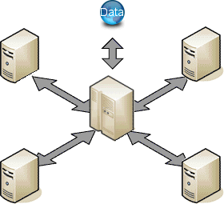
Server & Client
Client: Your computer
Server: Powerful & Expensive computer. Requires network access

Slide 3
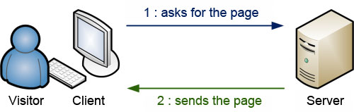
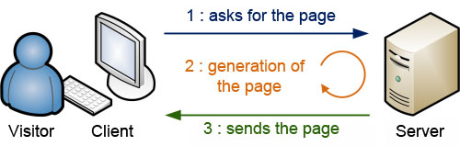
Static vs Dynamic
Static
Dynamic
Show case web sites
The client asks the server for a web page
The server answers back by sending the web page
Static web pages are made by (X)HTML & CSS
Most of web sites we use nowadays
The client asks the server for a web page
The server creates the page specially for the client
The server sends the page that has been generated
Dynamic web pages are made by (X)HTML, CSS
PHP and MySQL
http://blog.europcsolutions.com/php-introduction-to-php/

Slide 4
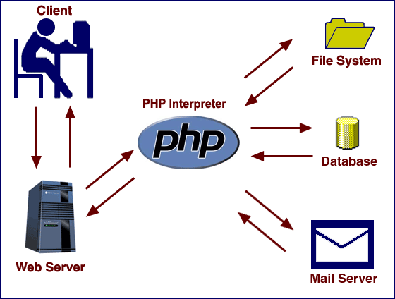
How PHP Works
1. User request
2. The request goes to web server
3. The request goes to PHP interpreter
4. The request is interpreted by PHP interpreter
5. PHP interpreter process the page by communicating with file system, databases and email servers
6. Deliver a web page to web server to return to the user browser
1
5
4
2
6
5
3
6
5

Slide 5
PHP: Hypertext Preprocessor
PHP is the Hypertext Preprocessor
  Script language
  Embedded into HTML
  Run as Apache module
  Can use DB (MySQL, Oracle, Microsoft SQL, PostgreSQL)
  Rich features: XML, PDF etc.,

Slide 6
Advantages of PHP
Free
Pre-installed in Linux distributions
Open Source
Multiplatform
Simple, easy to learn and use
Procedural language
  Compare with JavaScript which is event-driven
C-like syntax - { } ;
Extensive Function Library
Good Web-server integration
  Script embedded in HTML
  Easy access to form data and output of HTML pages
Not fully object-oriented
  Java is fully object oriented – all functions have to be in a class
  In PHP, classes are additional but quite simple to use

Slide 7
Architecture
touch
Browser
(IE, FireFox,
Opera)
HTTP
PHP script
SQL
Database
Web Server
(Apache, IIS)
Database
Server
vision
HTML
tables
Desktop
(PC or MAC)

Slide 8
PHP: Variables, constant, operators and Control structures
Variable
  $var = 123;
Constant
  define(“Zipcode", 40508);
Operators
  Assignment (e.g. =, +=, *=)
  Arithmetic (e.g. +, -, *)
  Comparison (e.g. <, >, >=, ==)
  Logical (e.g. !, &&, ||)
Control Structures
  Conditional (branching) structures (e.g. if/else)
  Repetition structures (e.g. while loops).

Slide 9
Datatypes
Boolean
  true
  false
Integer
  100
  0x34
Floating point
Array
  array(“lexington", “hanoi", "london")
  array(“kentucky" => “lexington", "vietnam" => "hanoi", "england" => "london")
  $a[2]
  $a["vietnam"]

Slide 10
String Data type
A string is a sequence of chars
$stringTest = “this is a sequence of chars”;
echo $stringTest[0]; //output: t
echo $stringTest; //output: this is a sequence of chars
A single quoted strings is displayed “as-is”
$age = 37;
$stringTest = 'I am $age years old'; // output: I am $age years old
$stringTest = “I am $age years old”; // output: I am 37 years old
Concatenation
$conc = ”is “.”a “.”composed “.”string”;
echo $conc; // output: is a composed string
$newConc = 'Also $conc '.$conc;
echo $newConc; // output: Also $conc is a composed string

Slide 11
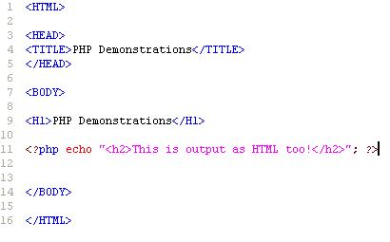
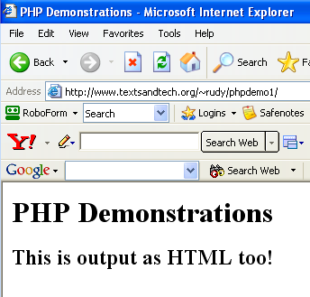
Example
<?php
PHP CODE GOES IN HERE
?>
IP address: 172.31.40.119 (Need to be in UK network to access)

Slide 12
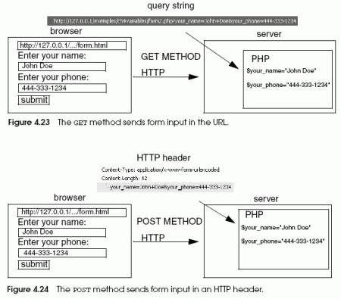
FORM Handling
GET
  $_GET['name']
POST
  $_POST['name']

Slide 13
FORM Handling Example
<form action="test.php" method="post">
<table>
<tr>
<th>Name:</th>
<td><input type="text" name="name"></td>
</tr>
<tr>
<th>Age:</th>
<td><input type="text" name="age"></td>
</tr>
…
</table>
</form>
test.php
<?
<p>Hello <?=$_POST['name']?>.
You are <?=$_POST['age']?> years old.</p>
?>
HTML FORM
PHP
name:
Kausalya
Hello Kausalya.
You are 22 years old.
age:
22
submit

Slide 14
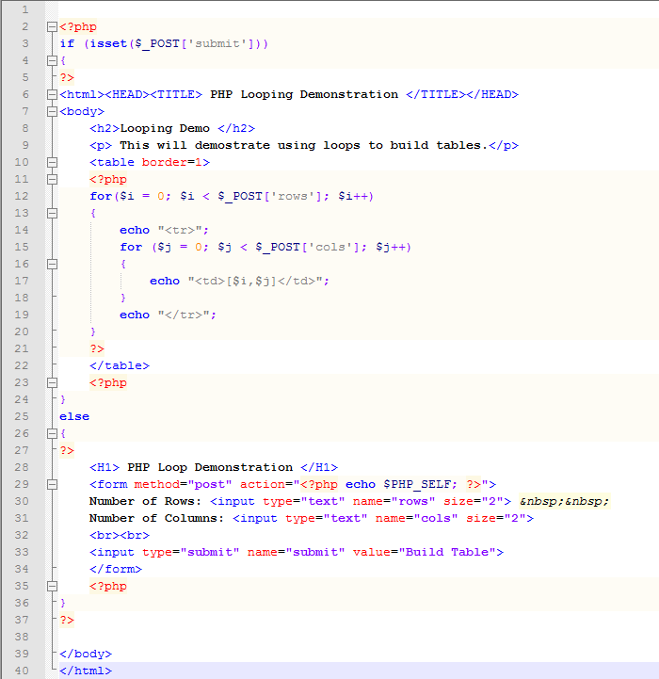
Example(2) – Loop manipulations

Slide 15
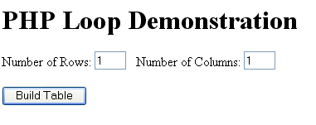
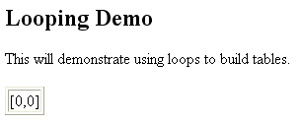
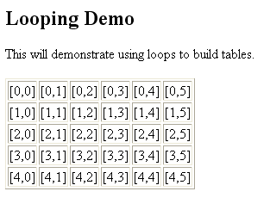
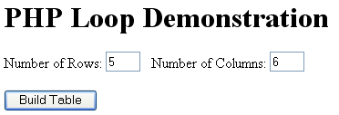
Output

Slide 16
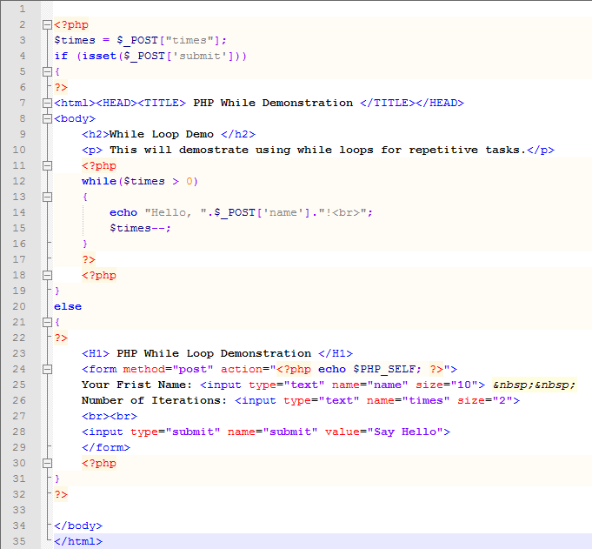
While Loops

Slide 17
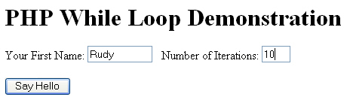
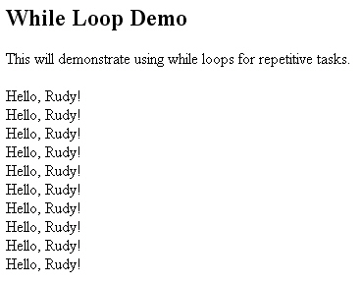

Slide 18
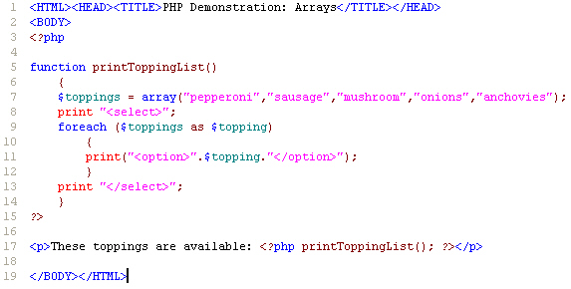
Arrays and Functions

Slide 19
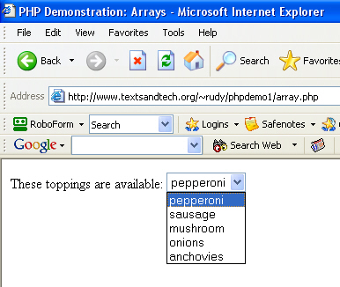
Output

Slide 20
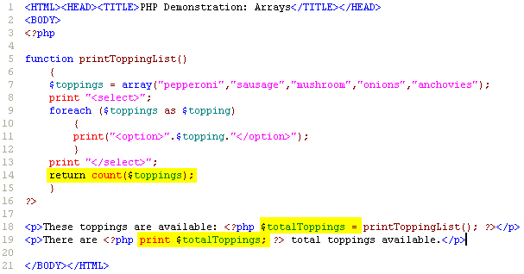
Returning Values from Functions

Slide 21
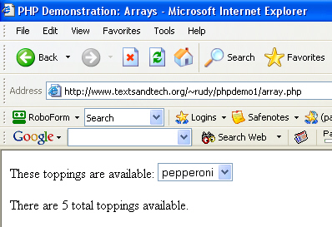
New Output

Slide 22
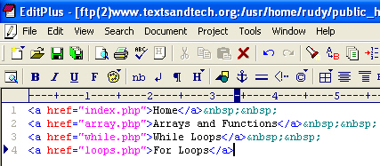
Including Files
Simple use the include keyword and use the path to the file you wish to include.
Step 1: Create the file you wish to include. This example holds navigational links.

Slide 23
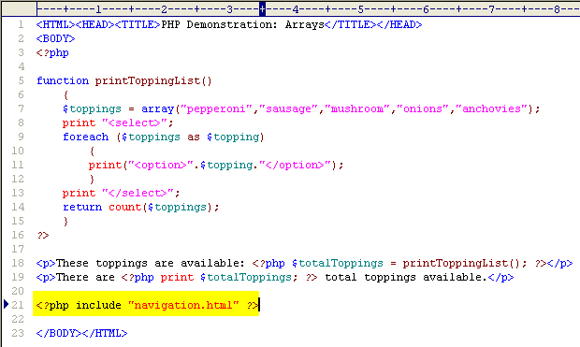
Step 2: Include the File in Code

Slide 24
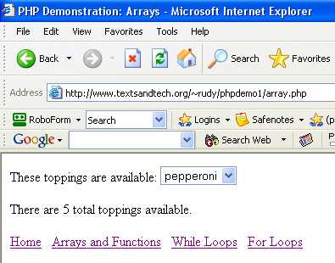
New, Consistent Output

Slide 25
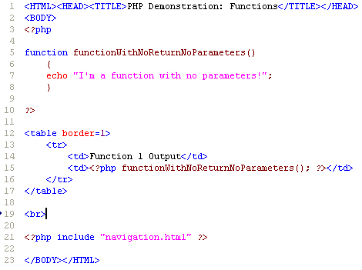
Function 1 (No Parameters)

Slide 26
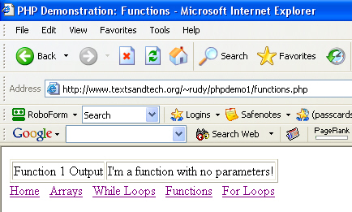
Output (Function 1)

Slide 27
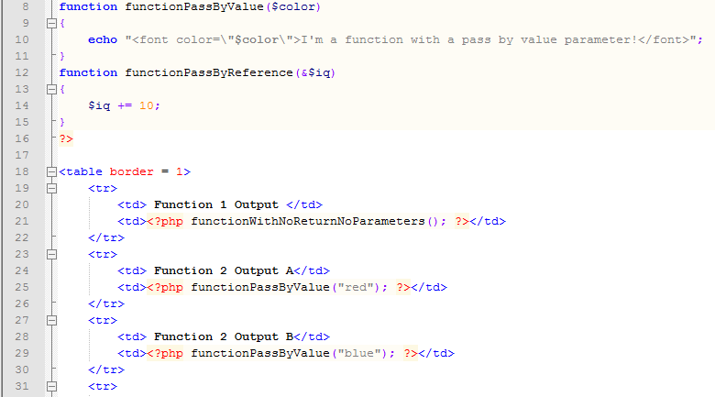
Function 2 (Pass by Value)

Slide 28

Output (Function 2)

Slide 29

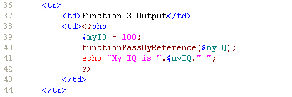
Function 3 (Pass by Reference)

Slide 30
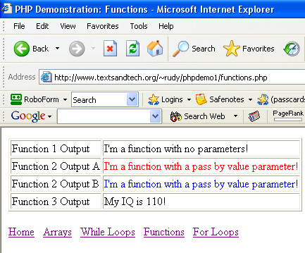
Output (Function 3)

Slide 31
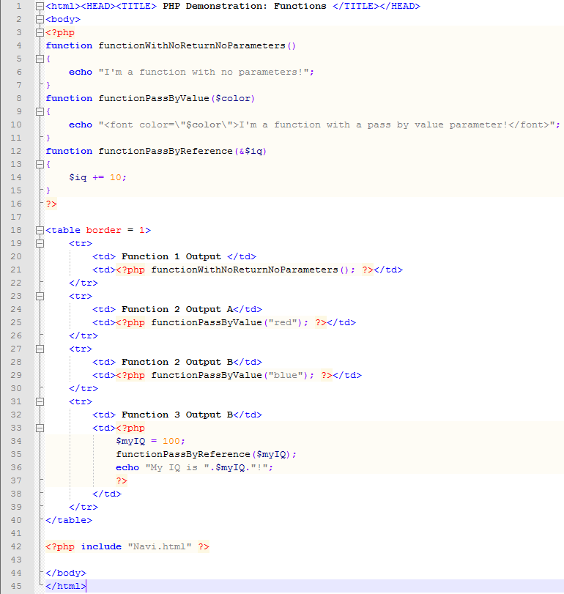

Slide 32
References
Websites
  http://www.acm-ou.org
  www.php.net
  www.phparchitect.com
  www.google.com
  www.tom.sfc.keio.ac.jp/~hagino/itss/
  csmaster.sxu.edu/appel/web550
  http://www.phpbuilder.com/
  http://www.devshed.com/
  http://www.phpmyadmin.net/
  http://www.hotscripts.com/PHP/
  http://www.mysql.com/
  http://www.owasp.org/
  www.textsandtech.org/~rudy/phpdemo1
  http://www.webreference.com/programming/php/by_example2/5.html
Books
  PHP and MySQL Web Development 2nd Edition, Welling & Thomson
  Web Database Applications with PHP & MySQL, O’Reilly Publishers
  PHP Cookbook, O’Reilly Publishers
  MySQL Cookbook, O’Reilly Publishers
  “PHP and MySQL Web Development”, Luke Welling and Laura Thomson, SA
Listservs
  thelist, http://lists.evolt.org/ (Note: very general and large volume of email)

