Slide 1
Introduction
Jinze Liu
Fall 2018
CS 405G Introduction to Database Systems

Slide 2
Topics
Course introduction and syllabus
What is a database?
What is a database management system?
Why take a database course?
How to take the class?
Preview of class contents

Slide 3
Who am I?
Instructor
  Jinze Liu
  Associate Professor @ CS.UKY
  Research area: Database, Data mining and Bioinformatics
  Email: liuj@cs.uky.edu

Slide 4
About the course: Information
Canvas will be used for the class
  Notes
  Assignments
  Forum
Textbook
  Fundamentals of database systems
  Ramez Elmasri and Shamkant B. Navathe
Jinze’s Office Hours:
  235 Hardymon building, Friday 10:00am
  Email: please include CS405G in the subject line for fast response
Class mailing list
  Will send emails to everyone once set up.
  Will be used for announcement/clarification of assignments/answering questions

Slide 5
About the Course – Workload
6 homework assignments
  Including programming assignment
  Building blocks for your project
1 Programming project
Exams
  1 Midterm & 1 Final
Cheating policy: zero tolerance
  We have the technology…

Slide 6
About the course: Grading
Weights
  6 Homework assignments 25%
  Project 20%
  Midterm exam 25%
  Final exam 25%
  Quizzes 5%
More information is in the syllabus
  Final grade
  Canvas will be used as assignment and project submission.
  Academic mis-conduct
    You are expected to do the assignment independently
    Discussions if allowed should be acknowledged

Slide 7
About the course: Workload
Programming projects have a practical, hands-on focus:
  A relational DBMS for a particular application
    To be named (let me know your interest!)
  Projects are to be done in teams of 2
  Pick your partner ASAP!

Slide 8
Database Systems?
Name a few!

Slide 9
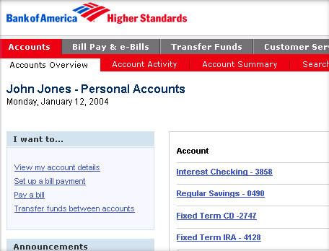
Database Systems: Bank Systems

Slide 10
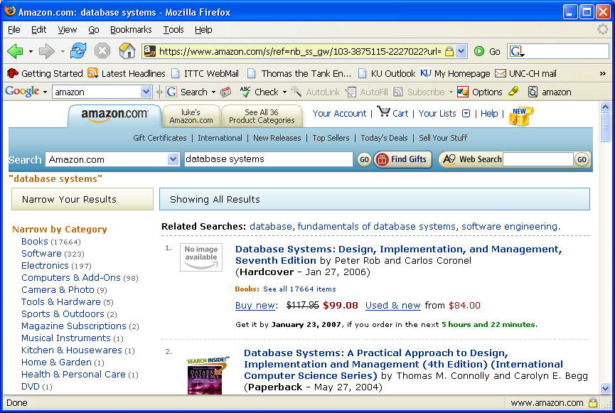
Database Systems - Ecommerce

Slide 11
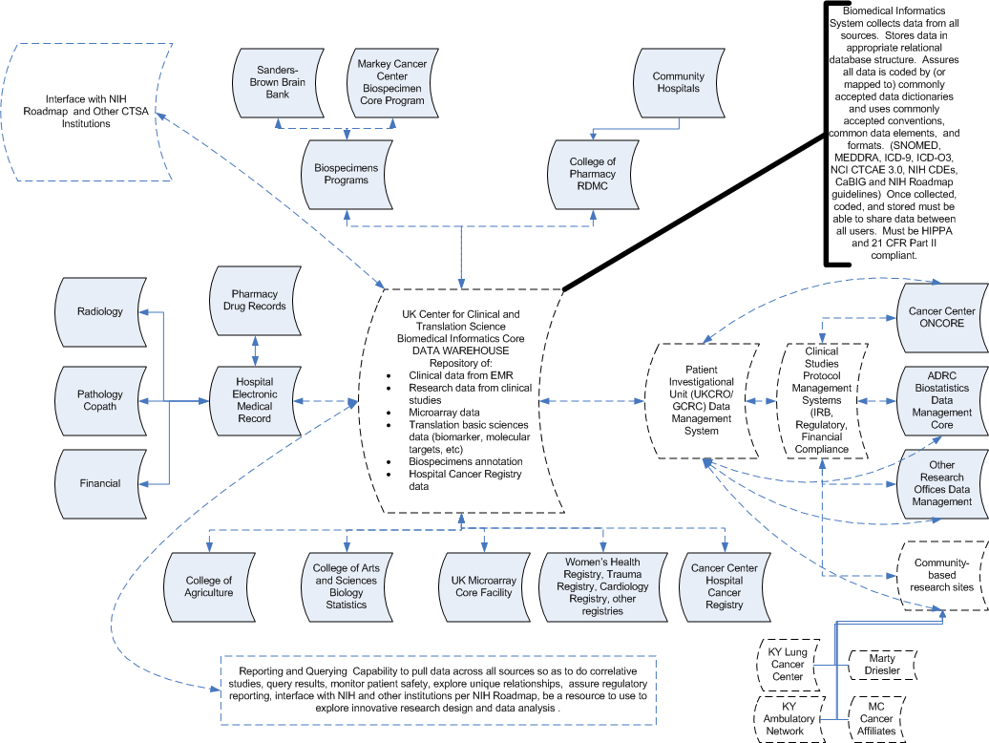
Database Systems: Clinical Databases

Slide 12
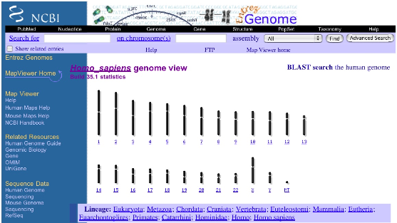
Database Systems: Genome Bank

Slide 13
What is a Database?
A database is an integrated collection of data.
  Data is a group of facts that can be recorded.
Typically a database is used to model a real-world “enterprise” (or a miniworld)
  Entities (e.g., basketball teams, games)
  Relationships (e.g. UK’s basketball team beat <you name it> last week)
Might surprise you how flexible this is
  Web search:
    Entities: words, documents
    Relationships: word in document, document links to document.
  P2P filesharing:
    Entities: words, filenames, hosts
    Relationships: word in filename, file available at host

Slide 14
What is a Database Management System?
A Database Management System (DBMS) is a collection of programs that enable users to create and maintain databases
  store, manage, and access data in a databases.
Typically this term is used narrowly
  Relational databases with transactions
    E.g. Oracle, DB2, SQL Server
  Mostly because they predate other large repositories
    Also because of technical richness
  When we say DBMS in this class we will usually follow this convention
    But keep an open mind about applying the ideas!

Slide 15
Main Characteristics of Databases
Self-describing nature of a database system
  A DBMS catalog stores the description of the database. The description is called meta-data.
Insulation between programs and data
  Allows changing data storage structures and operations without having to change the DBMS access
Data Abstraction
  Use data model to hide storage details and present the users with a conceptual view of the database
Support of multiple views of the data
  Each user may see a different view of the database, which describes only the data of interest to that user.
Sharing of data and multi-user transaction processing

Slide 16
Databases make these folks happy ...
End users in many fields
  Business, education, science, …
DB application programmers
  Build data entry & analysis tools on top of DBMSs
  Build web services that run off DBMSs
Database administrators (DBAs)
  Design logical/physical schemas
  Handle security and authorization
  Data availability, crash recovery
  Database tuning as needs evolve
DBMS vendors, programmers
  Oracle, IBM, MS …
…must understand how a DBMS works
Notes:
21

Slide 17
What: Is the WWW a DBMS?
Fairly sophisticated search available
  Crawler indexes pages on the web
  Keyword-based search for pages
But, currently
  data is mostly unstructured and untyped
  search only:
    can’t modify the data
    can’t get summaries, complex combinations of data
  few guarantees provided for freshness of data, consistency across data items, fault tolerance, …
  web sites typically have a (relational) DBMS in the background to provide these functions.

Slide 18
What: Is the WWW a DBMS?
The picture is changing quickly
  Information Extraction to get structure data from unstructured data
  New standards e.g., XML, Semantic Web can help data modeling

Slide 19
What: Is a File System a DBMS?
Thought Experiment 1:
  You and your project partner are editing the same file.
  You both save it at the same time.
  Whose changes survive?
Q: How do you write
programs over a
subsystem when it
promises you only “???” ?
A: Very, very carefully!!
A) Yours
B) Partner’s
C) Both
D) Neither
E) ???
Thought Experiment 2:
  You’re updating a file.
  The power goes out.
  Which changes survive?
A) All
B) None
C) All Since Last Save
D) ???

Slide 20
OS Support for Data Management
Data can be stored in RAM
  This is what every programming language offers!
  RAM is fast, and random access
  Isn’t this heaven?
Every OS includes a File System
  manages files on a magnetic disk
  allows open, read, seek, close on a file
  allows protections to be set on a file
  drawbacks relative to RAM?

Slide 21
Database Management Systems
What more could we want than a file system?
  Simple, efficient ad hoc¹ queries
  concurrency control
  recovery
  benefits of good data modeling
S.M.O.P.²? Not really…
  as we’ll see this semester
  in fact, the OS often gets in the way!
¹ad hoc: formed or used for specific or immediate problems or needs
²SMOP: Small Matter Of Programming

Slide 22
Current Commercial Outlook
A major part of the software industry:
  Oracle, IBM, Microsoft
  also Sybase, Informix (now IBM), Teradata
  smaller players: java-based dbms, devices, OO, …
Lots of related industries
  data warehouse, document management, storage, backup, reporting, business intelligence, ERP, CRM, app integration
Traditional Relational DBMS products dominant and evolving
  adapted for extensibility (user-defined types), native XML support.
  Microsoft merger of file system/DB…?

Slide 23
Advantages of a DBMS: a short list
Controlling redundancy
Restrict unauthorized access
Providing persistent storage for program objects
Providing storage structure for efficient query processing
Providing backup and crash recovery
….
And many many others that are going to be explored in this class

Slide 24
What database systems will we cover?
We will try to be broad and touch upon
  Relational DBMS (e.g. Oracle, SQL Server, DB2, Postgres)
  “Semi-structured” DB systems (e.g. XML repositories like Xindice)
  Data mining: transfer data into knowledge!
Starting point
  We assume you have used web search engines
  We assume you don’t know relational databases
    Yet they pioneered many of the key ideas
  So focus will be on relational DBMSs
    With frequent side-notes on search engines, XML issues

Slide 25
Why take this class?
Database systems are at the core of CS
They are incredibly important to society
The topic is intellectually rich
It isn’t that much work
Looks good on your resume
Let’s spend a little time on each of these

Slide 26
Why take this class?
A. Database systems are the core of CS
Shift from computation to information
  True in corporate computing for years
  Web, p2p made this clear for personal computing
  Increasingly true of scientific computing
Need for DB technology has exploded in the last years
  Corporate: retail swipe/clickstreams, “customer relationship mgmt”, “supply chain mgmt”, “data warehouses”, etc.
  Web:not just “documents”. Search engines, e-commerce, blogs, wikis, other “web services”.
  Scientific: digital libraries, genomics, satellite imagery, physical sensors, simulation data
  Personal: Music, photo, & video libraries. Email archives. File contents (“desktop search”).

Slide 27

Why take this class?
B. DBs are incredibly important to society
“Knowledge is power.” -- Sir Francis Bacon
“With great power comes great responsibility.” -- SpiderMan’s Uncle Ben
Policy-makers should understand technological possibilities.
Informed Technologists needed in public discourse on usage.

Slide 28
Why take this class?
C. The topic is intellectually rich.
representing information
  data modeling
languages and systems for querying data
  complex queries & query semantics*
  over massive data sets
concurrency control for data manipulation
  controlling concurrent access
  ensuring transactional semantics
reliable data storage
  maintain data semantics even if you pull the plug
data mining
  Let your data speak
  * semantics: the meaning or relationship of meanings of a sign or set of signs

Slide 29
Why take this class?
D. It isn’t that much work.
Bad news: It is a lot of work.
  You may need to learn a language you are not familiar with like PHP for the project
  Besides SQL which is considered the most fun part, you will also need to learn the theoretical side of relational database
Good news: the course is front loaded
  Most of the hard work is in the first half of the semester
  Load balanced with most other classes

Slide 30
Why take this class?
E. Looks good on my resume.
Yes, but why? This is not a course for:
  Oracle administrators
  IBM DB2 engine developers
    Though it’s useful for both!
It is a course for well-educated computer scientists
  Database system concepts and techniques increasingly used “outside the box”
    Ask your friends at Microsoft, Yahoo!, Google, Apple, etc.
    Actually, they may or may not realize it!
  A rich understanding of these issues is a basic and (un?)fortunately unusual skill.

