Slide 1
Web Programming with PHP
Rashmie Abeysinghe
rashmie.abeysinghe@uky.edu

Slide 2
What is PHP?
PHP = “PHP: Hypertext Preprocessor”
Server-side scripting language, Open-source
Source-code not visible to client
Used to generate dynamic web-pages
Runs on various platforms (Windows, Mac OS X, Linux etc.)

Slide 3
PHP
PHP code is executed on the server, generating HTML which is then sent to the client. The client would receive the results of running that script, but would not know what the underlying code was.

Slide 4
PHP

Slide 5
Download LAMP Stack
Download and install Apache.
sudo apt-get update
sudo apt-get install apache2
sudo ufw allow in “Apache Full”

Slide 6
Check the Server
Find public IP address

Slide 7
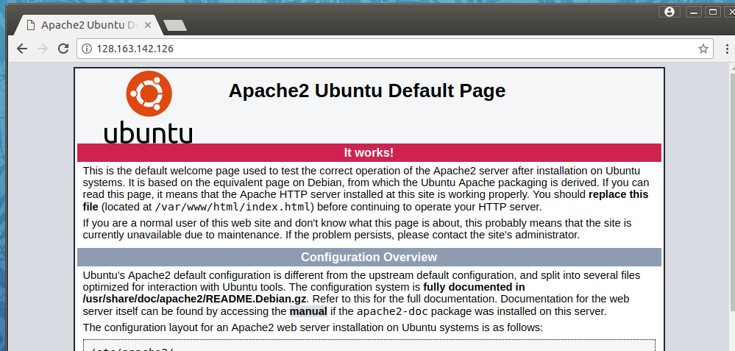
http://128.163.142.126

Slide 8
Install PHP
Type the following command to install
Change file index, restart to apply changes

Slide 9
Our First PHP Script
All files must be in a specific directory!!!
cd /var/www/html/
Create the script
sudo vim info.php

Slide 10
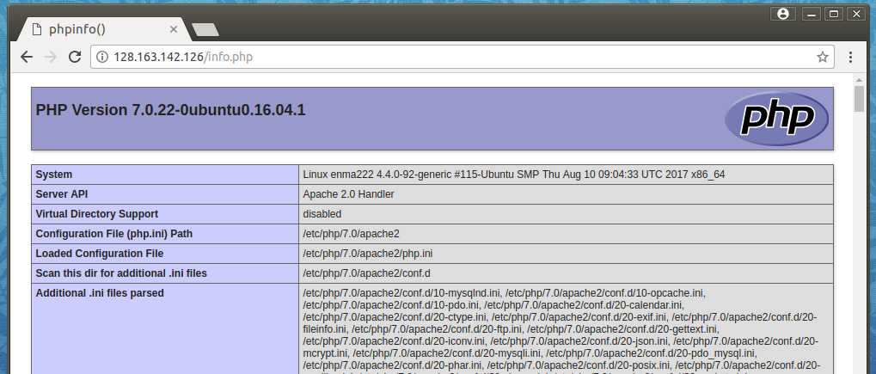
http://128.163.142.126/info.php

Slide 11
Our Second PHP Script
Download these files from Canvas
homepage.php, search_query.php
Move scripts into proper directory
cd ~/Downloads
mv *.php /var/www/html/
Let’s open the files and see what’s happening

Slide 12
Basic Syntax
A PHP script starts with <?php and ends with ?>:
<?php
// PHP code goes here
?>
Extension of the file should be “.php”.

Slide 13
PHP Hello World

Slide 14
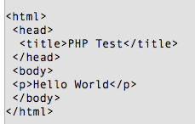
PHP Hello World
On the client-side, it renders as HTML like the following.

Slide 15
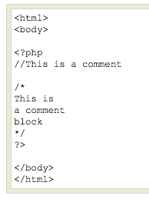
Comments
// - single-line comments
/* and */ multiple line
comment blocks.

Slide 16
Variables
Starts with the $ sign, followed by the name of the variable.
Must start with a letter or the underscore character.
Cannot start with a number.
Can only contain alpha-numeric characters and underscores (A-z, 0-9, and _ ).
Case-sensitive.
Loosely typed.

Slide 17
Echo
used to output data to the screen.
<?php
$foo = 25; // Numerical variable
$bar = “Hello”; // String variable
echo $bar; // Outputs Hello
echo $foo,$bar; // Outputs 25Hello
echo “5x5=”,$foo; // Outputs 5x5=25
echo “5x5=$foo”; // Outputs 5x5=25
echo ‘5x5=$foo’; // Outputs 5x5=$foo
?>

Slide 18
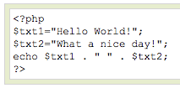
Concatenation
Concatenation operator (.) is used to combine two strings together.
Output:

Slide 19
Arithmetic Operations
<?php
$a=15;
$b=30;
$total=$a+$b;
Print $total;
Print “<p><h1>$total</h1>”; // total is 45
?>
$a - $b // subtraction
$a * $b // multiplication
$a / $b // division
$a += 5 // $a = $a+5

Slide 20
Conditional Statements (IF/ELSE)
If (condition)
{
Statements;
}
Else
{
Statement;
}
if ($foo == 0)
{
echo ‘The variable foo is equal to 0’;
}
else if (($foo > 0) && ($foo <= 5))
{
echo ‘The variable foo is between 1 and 5’;
}
else
{
echo ‘The variable foo is equal to ‘.$foo;
}

Slide 21
While loop
While (condition)
{
Statements;
}
<?php
$count=0;
While($count<3)
{
Print “hello PHP. ”;
$count ++;
}
?>

Slide 22
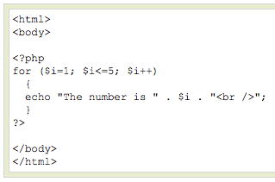
For loop

Slide 23
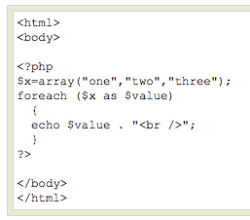
Foreach loop

Slide 24
Numeric Array
Stores each array element with a numeric index.
OR

Slide 25
Numeric Array
Can be accessed using the index in the following way.

Slide 26
Associative Array
Here each ID key is associated with a value.
OR

Slide 27
Functions
A function is a block of statements that can be used repeatedly in a program.
A function will not execute immediately when a page loads.
A function will be executed by a call to the function.

Slide 28
Functions
function functionName() { code to be executed; }
A function name can start with a letter or underscore (not a number).

Slide 29
Functions
<?php
function writeMsg()
{
echo "Hello world!";
}
writeMsg(); // call the function
?>

Slide 30
Functions – with parameters
<?php
function sum($x, $y)
{
$z = $x + $y;
return $z;
}
echo "5 + 10 = " . sum(5, 10) . "<br>";
echo "7 + 13 = " . sum(7, 13) . "<br>";
echo "2 + 4 = " . sum(2, 4);
?>

Slide 31
PHP form handling
In the below HTML, the form data is sent for processing to a PHP file named "welcome.php“ with the HTTP POST method.
<html>
<body>
<form action="welcome.php" method="post">
Name: <input type="text" name="name"><br>
E-mail: <input type="text" name="email"><br>
<input type="submit">
</form>
</body>
</html>

Slide 32
PHP form handling
The user input from the form could be handled in the “welcome.php” like this.
<html>
<body>
Welcome <?php echo $_POST["name"]; ?><br>
Your email address is: <?php echo $_POST["email"]; ?>
</body>
</html>
Output:

Slide 33
PHP form handling
Can do the same with GET method too.
Both GET and POST create an array. This array holds key/value pairs.
Keys: names of form controls
Values: input data from the user

Slide 34
PHP connect to MySQL
PHP 5 and later can connect to a MySQL database with:
MySQLi extension
PDO (PHP Data Objects)
We will discuss MySQLi
MySQLi is a relational driver used in PHP to provide an interface with MySQL databases.
MySQLi - “i” stands for “improved”. Older MySQL extension is deprecated now.
MySQLi is automatically installed in most cases, when php5 mysql package is installed (Once you install XAMPP this is also installed)

Slide 35
PHP connect to MySQL
Some commonly used functions:
mysqli_connect() Function: Open a new connection to the MySQL server
mysqli_query() Function: Perform queries against the database
mysqli_num_rows() Function: Return the number of rows in a result set
mysqli_fetch_assoc() Function:Fetch a result row as an associative array
mysqli_close() Function:Close a previously opened database connection
More function can be found at: http://php.net/manual/en/book.mysqli.php

Slide 36
PHP connect to MySQL
Connecting to the database server.
<?php
$servername = "localhost";
$username = "username";
$password = "password";
// Create connection
$conn = mysqli_connect($servername, $username, $password);
// Check connection
if (!$conn){
die("Connection failed: " . mysqli_connect_error());
}
echo "Connected successfully";
?>

Slide 37
PHP connect to MySQL
Inserting data to a table
<?php $servername = "localhost";
$username = "username";
$password = "password";
$dbname = "myDB";
$conn = mysqli_connect($servername, $username, $password, $dbname);
if (!$conn){
die("Connection failed: " . mysqli_connect_error());
}
$sql = "INSERT INTO MyGuests (firstname, lastname, email) VALUES ('John', 'Doe', 'john@example.com')";
if (mysqli_query($conn, $sql)) {
echo "New record created successfully";
}else {
echo "Error: " . $sql . "<br>" . mysqli_error($conn);
}
mysqli_close($conn);
?>

Slide 38
PHP connect to MySQL
Retrieving data from a table
<?php $servername = "localhost";
$username = "username";
$password = "password";
$dbname = "myDB"; $conn = mysqli_connect($servername, $username, $password, $dbname);
if (!$conn) {
die("Connection failed: " . mysqli_connect_error());
}
$sql = "SELECT id, firstname, lastname FROM MyGuests";
$result = mysqli_query($conn, $sql);
if (mysqli_num_rows($result) > 0) {
// output data of each row
while($row = mysqli_fetch_assoc($result)) {
echo "id: " . $row["id"]. " - Name: " . $row["firstname"]. " " . $row["lastname"]. "<br>";
}
} else {
echo "0 results";
}
mysqli_close($conn);
?>

Slide 39
Thank you!

