Slide 1
CS 405G: Introduction to Database Systems
Storage

Slide 2
Outline
It’s all about disks!
That’s why we always draw databases as
And why the single most important metric in database processing is the number of disk I/O’s performed
Storing data on a disk
Record layout
Block layout

Slide 3
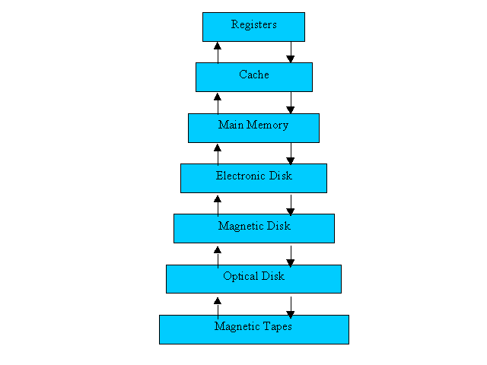
The Storage Hierarchy
Smaller, Faster
Main memory (RAM) for currently used data
Disk for the main database (secondary storage).
Tapes for archiving older versions of the data (tertiary storage).
Bigger, Slower
Source: Operating Systems Concepts 5th Edition

Slide 4
Jim Gray’s Storage Latency Analogy: How Far Away is the Data?
Andromeda
10
9
Tape /Optical
2,000 Years
Robot
10
6
Disk
Pluto
2 Years
Lexington
1.5 hr
100
Memory
10
On Board Cache
This Lecture Hall
10 min
2
On Chip Cache
This Room
1
Registers
My Head
1 min

Slide 5
A typical disk
Tracks
Disk arm
Platter
Spindle
Cylinders
Disk head
Arm movement
Spindle rotation
“Moving parts” are slow

Slide 6
Top view
Higher-density sectors on inner tracks and/or more sectors on outer tracks
Track
Track
Track
Sectors
A block is a logical unit of transfer consisting of one or more sectors
Notes:
So why use a block as a unit of transfer?
Why not just bits? Write a bit at location a, another at location b, etc?
Want economy of scale.
Recall that it’s pluto. Maybe just grocery shop. Compare this with getting a book from a bookshelf in your room.
This happens throughout the memory hierarchy.
When fetching from cache, probably just one address.
When fetching from memory, what really happens is that an entire cache line is transferred.

Slide 7
Disk access time
Sum of:
Seek time: time for disk heads to move to the correct cylinder
Rotational delay: time for the desired block to rotate under the disk head
Transfer time: time to read/write data in the block (= time for disk to rotate over the block)

Slide 8
Random disk access
Seek time + rotational delay + transfer time
Average seek time
Time to skip one half of the cylinders?
Not quite; should be time to skip a third of them (why?)
“Typical” value: 5 ms
Average rotational delay
Time for a half rotation (a function of RPM)
“Typical” value: 4.2 ms (7200 RPM)
Typical transfer time
.08msec per 8K block

Slide 9
Sequential Disk Access Improves Performance
Seek time + rotational delay + transfer time
Seek time
0 (assuming data is on the same track)
Rotational delay
0 (assuming data is in the next block on the track)
Easily an order of magnitude faster than random disk access!

Slide 10
Performance tricks
Disk layout strategy
Keep related things (what are they?) close together: same sector/block ! same track ! same cylinder ! adjacent cylinder
Double buffering
While processing the current block in memory, prefetch the next block from disk (overlap I/O with processing)
Disk scheduling algorithm
Track buffer
Read/write one entire track at a time
Parallel I/O
More disk heads working at the same time

Slide 11
Files
Blocks are the interface for I/O, but…
Higher levels of DBMS operate on records, and files of records.
FILE: A collection of pages, each containing a collection of records. Must support:
insert/delete/modify record
fetch a particular record (specified using record id)
scan all records (possibly with some conditions on the records to be retrieved)

Slide 12
Unordered (Heap) Files
Simplest file structure contains records in no particular order.
As file grows and shrinks, disk pages are allocated and de-allocated.
To support record level operations, we must:
keep track of the pages in a file
keep track of free space on pages
keep track of the records on a page
There are many alternatives for keeping track of this.
We’ll consider 2

Slide 13
Heap File Implemented as a List
Data
Page
Data
Page
Data
Page
Full Pages
Header
Page
Data
Page
Data
Page
Data
Page
Pages with
Free Space
The header page id and Heap file name must be stored someplace.
Database “catalog”
Each page contains 2 `pointers’ plus data.

Slide 14
Heap File Using a Page Directory
Data
Page 1
Header
Page
Data
Page 2
Data
Page N
DIRECTORY
The entry for a page can include the number of free bytes on the page.
The directory is a collection of pages; linked list implementation is just one alternative.
Much smaller than linked list of all HF pages!

Slide 15
Record layout
Record = row in a table
Variable-format records
Rare in DBMS—table schema dictates the format
Relevant for semi-structured data such as XML
Focus on fixed-format records
With fixed-length fields only, or
With possible variable-length fields

Slide 16
Record Formats: Fixed Length
F1
F2
F3
F4
L1
L2
L3
L4
Base address (B)
Address = B+L1+L2
All field lengths and offsets are constant
Computed from schema, stored in the system catalog
Finding i’th field done via arithmetic.

Slide 17
Fixed-length fields
Example: CREATE TABLE Student(SID INT, name CHAR(20), age INT, GPA FLOAT);
0
4
24
28
36
142
Bart (padded with space)
10
2.3
Watch out for alignment
May need to pad; reorder columns if that helps
What about NULL?
Add a bitmap at the beginning of the record

Slide 18
Record Formats: Variable Length
Two alternative formats (# fields is fixed):
F1 F2 F3 F4
$
$
$
$
Fields Delimited by Special Symbols
F1 F2 F3 F4
Array of Field Offsets
Second offers direct access to i’th field, efficient storage
of nulls (special don’t know value); small directory overhead.

Slide 19
LOB fields
Example: CREATE TABLE Student(SID INT, name CHAR(20), age INT, GPA FLOAT, picture BLOB(32000));
Student records get “de-clustered”
Bad because most queries do not involve picture
Decomposition (automatically done by DBMS and transparent to the user)
Student(SID, name, age, GPA)
StudentPicture(SID, picture)

Slide 20
Block layout
How do you organize records in a block?
Fixed length records
Variable length records
NSM (N-ary Storage Model) is used in most commercial DBMS

Slide 21
Page Formats: Fixed Length Records
Slot 1
Slot 1
Slot 2
Slot 2
. . .
Free
Space
. . .
Slot N
Slot N
Slot M
N
1
. . .
0
1
1
M
number
of records
M ... 3 2 1
number
of slots
PACKED
UNPACKED, BITMAP
Record id = <page id, slot #>. In first alternative, moving records for free space management changes rid; may not be acceptable.

Slide 22
NSM
Store records from the beginning of each block
Use a directory at the end of each block
To locate records and manage free space
Necessary for variable-length records
142 Bart 10 2.3
123 Milhouse 10 3.1
857 Lisa 8 4.3
456 Ralph 8 2.3
Why store data and directory at two different ends?
Both can grow easily

Slide 23
Options
Reorganize after every update/delete to avoid fragmentation (gaps between records)
Need to rewrite half of the block on average
What if records are fixed-length?
Reorganize after delete
Only need to move one record
Need a pointer to the beginning of free space
Do not reorganize after update
Need a bitmap indicating which slots are in use

Slide 24
System Catalogs
For each relation:
name, file location, file structure (e.g., Heap file)
attribute name and type, for each attribute
index name, for each index
integrity constraints
For each index:
structure (e.g., B+ tree) and search key fields
For each view:
view name and definition
Plus statistics, authorization, buffer pool size, etc.
Catalogs are themselves stored as relations!

Slide 25
Attr_Cat(attr_name, rel_name, type, position)
attr_name
rel_name
type
position
attr_name
Attribute_Cat
string
1
rel_name
Attribute_Cat
string
2
type
Attribute_Cat
string
3
position
Attribute_Cat
integer
4
sid
Students
string
1
name
Students
string
2
login
Students
string
3
age
Students
integer
4
gpa
Students
real
5
fid
Faculty
string
1
fname
Faculty
string
2
sal
Faculty
real
3

Slide 26
Indexes (a sneak preview)
A Heap file allows us to retrieve records:
by specifying the rid, or
by scanning all records sequentially
Sometimes, we want to retrieve records by specifying the values in one or more fields, e.g.,
Find all students in the “CS” department
Find all students with a gpa > 3
Indexes are file structures that enable us to answer such value-based queries efficiently.

Slide 27
Summary
Disks provide cheap, non-volatile storage.
Random access, but cost depends on the location of page on disk; important to arrange data sequentially to minimize seek and rotation delays.

Slide 28
Summary (Contd.)
DBMS vs. OS File Support
DBMS needs features not found in many OS’s, e.g., forcing a page to disk, controlling the order of page writes to disk, files spanning disks, ability to control pre-fetching and page replacement policy based on predictable access patterns, etc.
Variable length record format with field offset directory offers support for direct access to i’th field and null values.

