Slide 1
CS 405G: Introduction to Database Systems
Instructor: Jinze Liu
SQL
Fall 2017

Slide 2
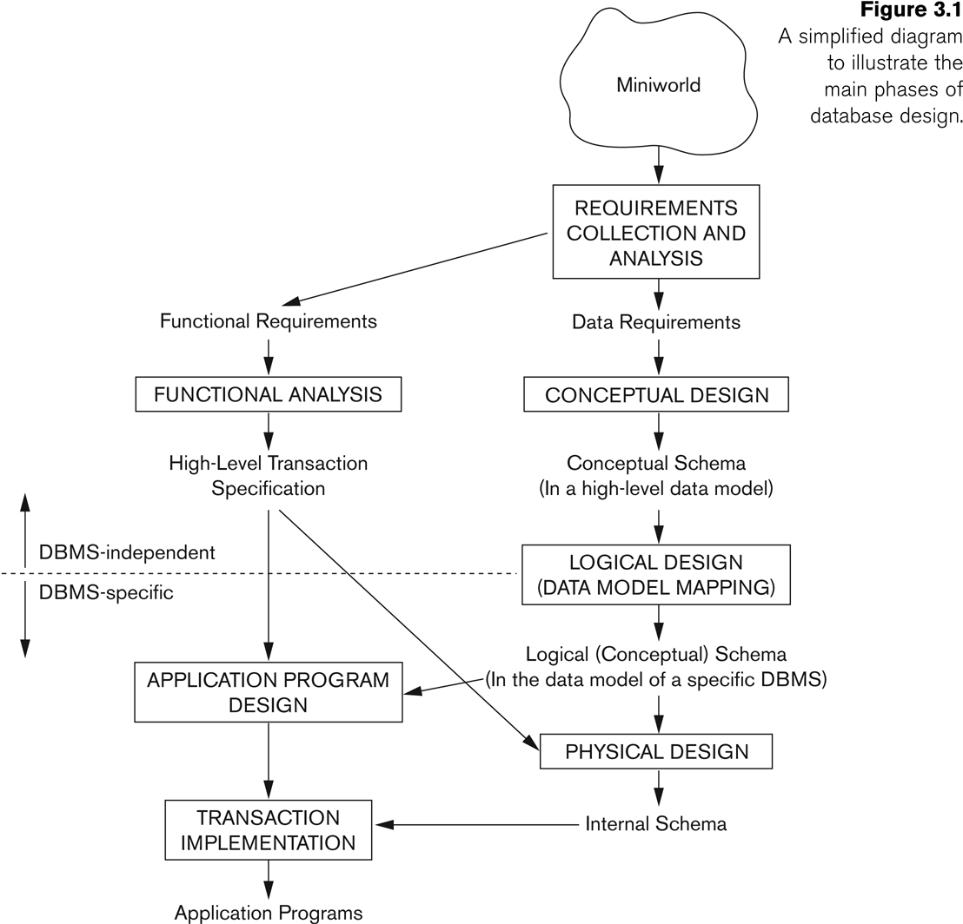
Database Design

Slide 3
SQL
SQL: Structured Query Language
Pronounced “S-Q-L” or “sequel”
The standard query language supported by most commercial DBMS
A brief history
IBM System R
ANSI SQL89
ANSI SQL92 (SQL2)
ANSI SQL99 (SQL3)
ANSI SQL 2003 (+OLAP, XML, etc.)

Slide 4
Creating and dropping tables
CREATE TABLE table_name (…, column_name_{i} column_type_{i}, …);
DROP TABLE table_name;
Examples
create table Student (SID integer, name varchar(30), email varchar(30), age integer, GPA float);
create table Course (CID char(10), title varchar(100));
create table Enroll (SID integer, CID char(10));
drop table Student;
drop table Course;
drop table Enroll;
-- everything from -- to the end of the line is ignored.
-- SQL is insensitive to white space.
-- SQL is insensitive to case (e.g., ...Course... is equivalent to
-- ...COURSE...)

Slide 5
Basic queries: SFW statement
SELECT A₁, A₂, …, A_{n} FROM R₁, R₂, …, R_{m} WHERE condition;
Also called an SPJ (select-project-join) query
(almost) Equivalent to relational algebra query π _{A1, A2, …, An} (σ _{condition} (R₁ X R₂ X … X R_{m}))

Slide 6
Semantics of SFW
SELECT E₁, E₂, …, E_{n} FROM R₁, R₂, …, R_{m} WHERE condition;
For each t₁ in R₁: For each t₂ in R₂: … … For each t_{m} in R_{m}: If condition is true over t₁, t₂, …, t_{m}: Compute and output E₁, E₂, …, E_{n} as a row
t₁, t₂, …, t_{m} are often called tuple variables
Not 100% correct, we will see

Slide 7
Example: selection and projection
Name of students under 18
SELECT name FROM Student WHERE age < 20;
π _{name} (σ _{age <20} (Student))
sid | name | age | gpa
1234 | John Smith | 21 | 3.5
1123 | Mary Carter | 19 | 3.8
1011 | Bob Lee | 22 | 2.6
1204 | Susan Wong | 22 | 3.4
1306 | Kevin Kim | 18 | 2.9
sid | name | age | gpa
1234 | John Smith | 21 | 3.5
1123 | Mary Carter | 19 | 3.8
1011 | Bob Lee | 22 | 2.6
1204 | Susan Wong | 22 | 3.4
1306 | Kevin Kim | 18 | 2.9

Slide 8
Example: Operations
When was Lisa born?
SELECT 2006 – age FROM Student WHERE name = ’Lisa’;
SELECT list can contain expressions
Can also use built-in functions such as SUBSTR, ABS, etc.
String literals (case sensitive) are enclosed in single quotes

Slide 9
Example: reading a table
SELECT * FROM Student;
Single-table query, so no cross product here
WHERE clause is optional
* is a short hand for “all columns”

Slide 10
Example: join
SID’s and names of students taking the “Database” courses
SELECT Student.SID, Student.name FROM Student, Enroll, Course WHERE Student.SID = Enroll.SID AND Enroll.CID = Course.CID AND title = ’Database’;
Okay to omit table_name in table_name.column_name if column_name is unique
A better way to deal with string is to use “LIKE” and % , which matches with any string with length 0 or more
AND title LIKE ’%Database%’;
\ is the escape operator
‘_’ is used for representing any a single character

Slide 11
ORDER BY
SELECT ... FROM … WHERE ORDER BY output_column [ASC | DESC], …;
ASC = ascending, DESC = descending
Operational semantics
After SELECT list has been computed, sort the output according to ORDER BY specification

Slide 12
ORDER BY example
List all students, sort them by GPA (descending) and name (ascending)
SELECT SID, name, age, GPA FROM Student ORDER BY GPA DESC, name;
ASC is the default option
Strictly speaking, only output columns can appear in ORDER BY clause (although some DBMS support more)
Can use sequence numbers instead of names to refer to output columns: ORDER BY 4 DESC, 2;

Slide 13
Example: rename
SID’s of all pairs of classmates
Relational algebra query: π_{e1.SID, e2.SID} ( …ρ_{e1} Enroll e1.CID = e2.CID^ e1.SID > e2.SID ρ _{e2} Enroll )
SQL: SELECT e1.SID AS SID1, e2.SID AS SID2 FROM Enroll AS e1, Enroll AS e2 WHERE e1.CID = e2.CID AND e1.SID > e2.SID;
AS keyword is optional

Slide 14
A more complicated example
Titles of all courses that Bart and Lisa are taking together
SELECT c.title
FROM Student sb, Student sl, Enroll eb, Enroll el, Course c
WHERE sb.name = ’Bart’ AND sl.name = ’Lisa’
AND eb.SID = sb.SID AND el.SID = sl.SID
AND eb.CID = c.CID AND el.CID = c.CID;
Tip: Write the FROM clause first, then WHERE, and then SELECT

Slide 15
Why SFW statements?
Out of many possible ways of structuring SQL statements, why did the designers choose SELECT-FROM-WHERE?
A large number of queries can be written using only selection, projection, and cross product (or join)
Any query that uses only these operators can be written in a canonical form: π_{L} (σ_{p} (R₁ X … X R_{m}))
Example: π _{R.A, S.B} (R _{p1} S) _{p2} (π_{T.C} σ_{p3} T) =
π_{R.A, S.B, T.C} σ_{p1 ^ p2^p3} ( R X S X T )
SELECT-FROM-WHERE captures this canonical form

Slide 16
Set versus bag semantics
Set
No duplicates
Relational model and algebra use set semantics
Bag
Duplicates allowed
Number of duplicates is significant
SQL uses bag semantics by default

Slide 17
Set versus bag example
π_{SID} Enroll
sid
1234
1124
1123
Enroll
sid | cid | grade
1234 | 647 | A
1234 | 108 | B
1124 | 647 | A
1123 | 108 | A
SELECT SID FROM Enroll;
sid
1234
1234
1124
1123

Slide 18
A case for bag semantics
Efficiency
Saves time of eliminating duplicates
Which one is more useful?
π_{GPA} Student
SELECT GPA FROM Student;
The first query just returns all possible GPA’s
The second query returns the actual GPA distribution
Besides, SQL provides the option of set semantics with DISTINCT keyword

Slide 19
Forcing set semantics
SID’s of all pairs of classmates
SELECT e1.SID AS SID1, e2.SID AS SID2 FROM Enroll AS e1, Enroll AS e2 WHERE e1.CID = e2.CID AND e1.SID > e2.SID;
Say Bart and Lisa both take CPS116 and CPS114
SELECT DISTINCT e1.SID AS SID1, e2.SID AS SID2 ...
With DISTINCT, all duplicate (SID1, SID2) pairs are removed from the output

Slide 20
Operational semantics of SFW
SELECT [DISTINCT] E₁, E₂, …, E_{n} FROM R₁, R₂, …, R_{m} WHERE condition;
For each t₁ in R₁: For each t₂ in R₂: … … For each t_{m} in R_{m}: If condition is true over t₁, t₂, …, t_{m}: Compute and output E₁, E₂, …, E_{n} as a row If DISTINCT is present Eliminate duplicate rows in output
t₁, t₂, …, t_{m} are often called tuple variables

Slide 21
Review
SELECT-FROM-WHERE statements (select-project-join queries)
Set and bag operations
Next: how to nest SQL queries

