Slide 1
CS 405G: Introduction to Database Systems
ER to Relations
Notes:
1

Slide 2
Review
A data model is
  a group of concepts for describing data.
What are the two terms used by ER model to describe a miniworld?
  Entity
  Relationship
What makes a good database design
Student (sid: string, name: string, login: string, age: integer, gpa:real)
1010111101
8/31/2017
8/31/2017
2
2
Notes:
2

Slide 3
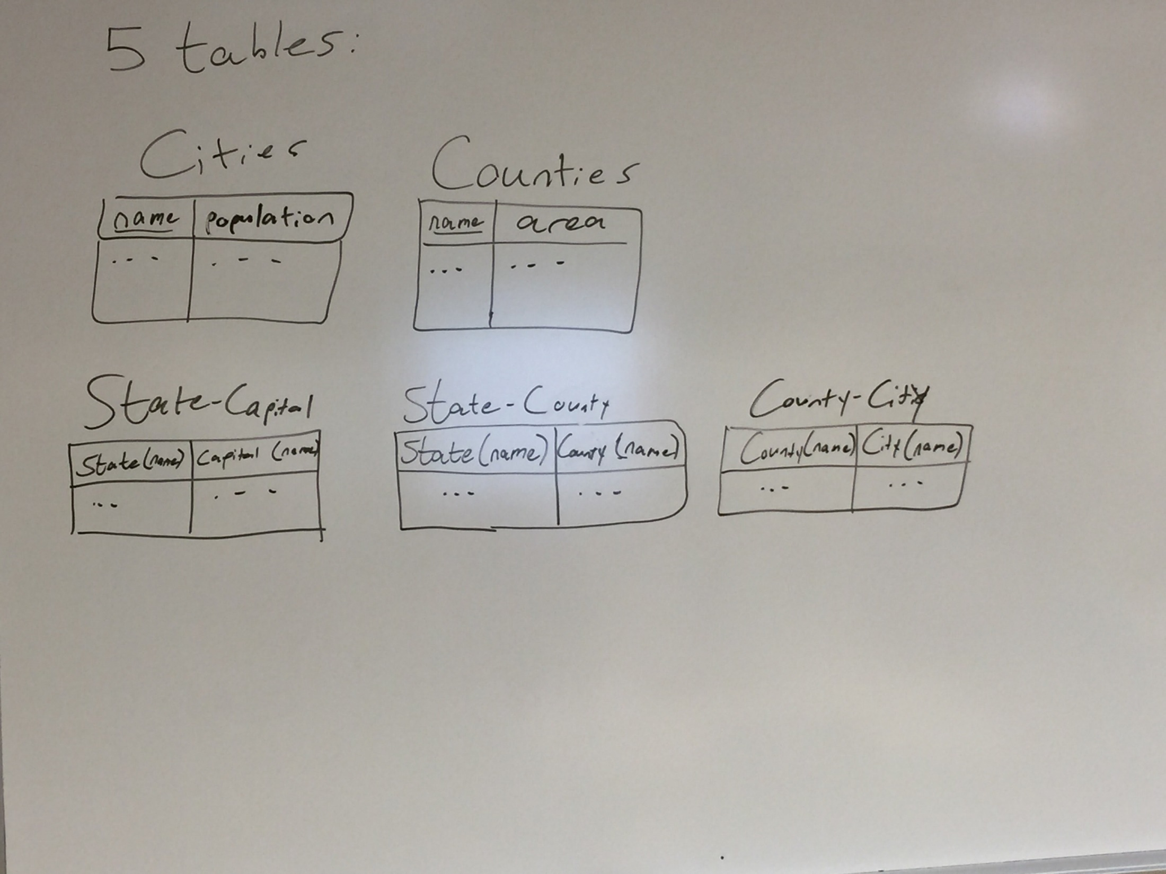
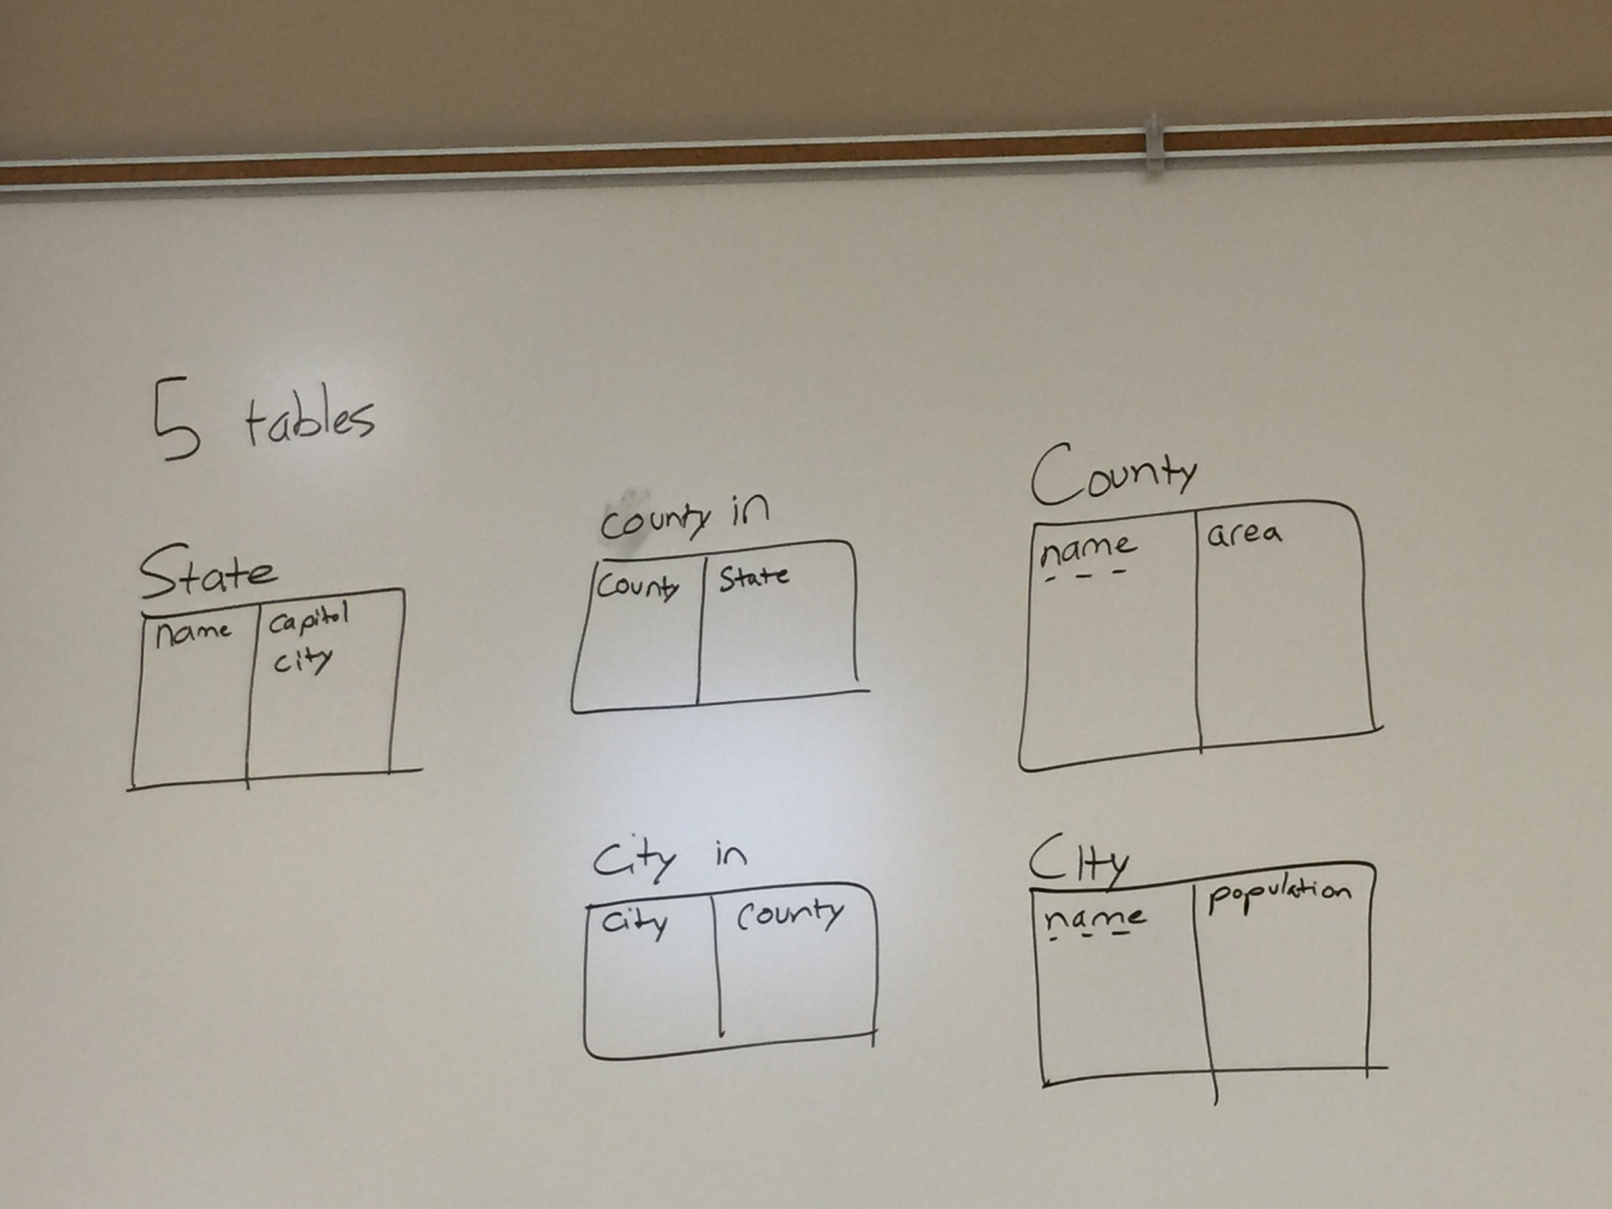
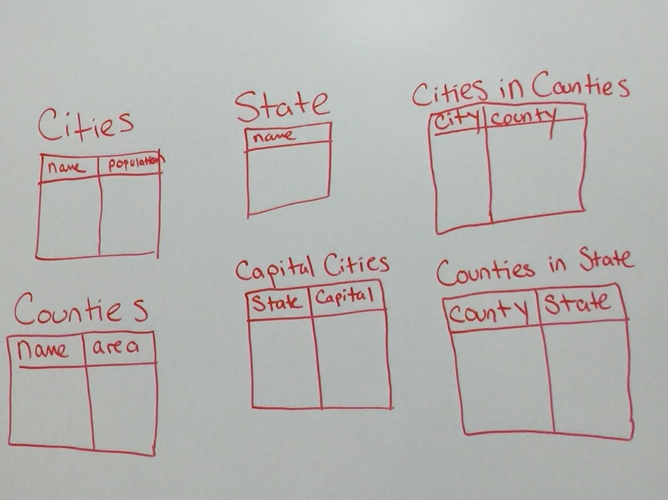

Slide 4



Slide 5


Slide 6
Topics Next
Conversion of ER models to Schemas
Reading Assignment
  Chapter 3.1, 3.2
8/31/2017
8/31/2017
6
6
Notes:
6

Slide 7
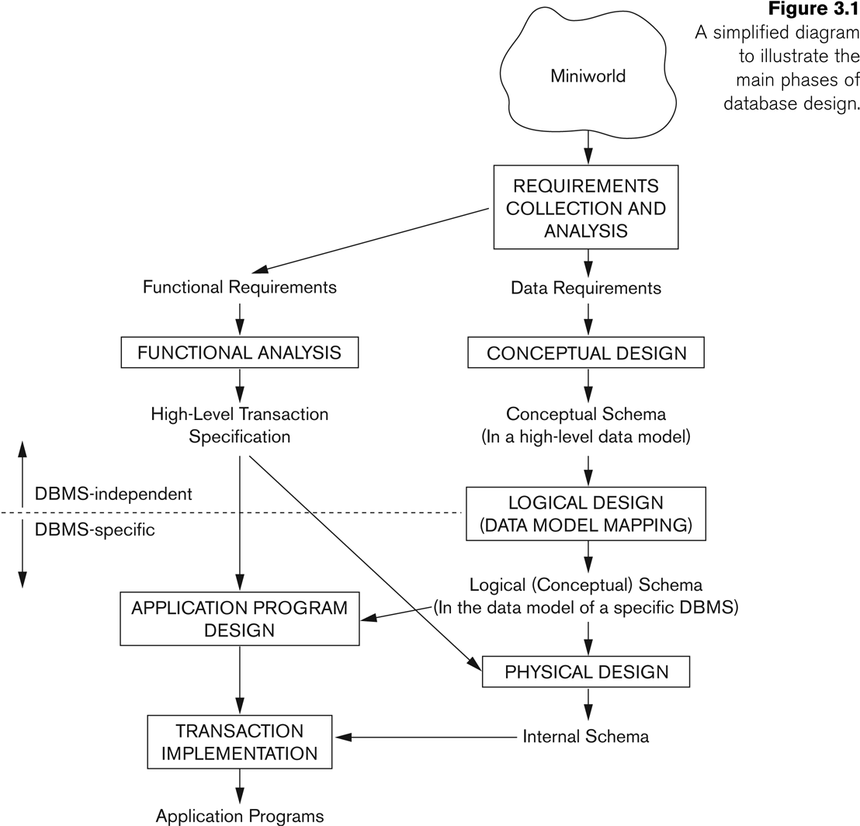
Database Design
8/31/2017
8/31/2017
7
7
Notes:
7

Slide 8
A Relation is a Table
name manf
Winterbrew Pete’s
Bud Lite Anheuser-Busch Beers
Attributes
(column
headers)
Tuples
(rows)

Slide 9
Schemas
Relation schema = relation name + attributes, in order (+ types of attributes).
  Example: Beers(name, manf) or Beers(name: string, manf: string)
Database = collection of relations.
Database schema = set of all relation schemas in the database.

Slide 10
Why Relations?
Very simple model.
Often matches how we think about data.
Abstract model that underlies SQL, the most important database language today.
  But SQL uses bags, while the relational model is a set-based model.

Slide 11
From E/R Diagrams to Relations
Entity sets become relations with the same set of attributes.
Relationships become relations whose attributes are only:
  The keys of the connected entity sets.
  Attributes of the relationship itself.

Slide 12
Entity Set -> Relation
Relation: Beers(name, manf)
name
manf
Beers

Slide 13
Relationship -> Relation
name
addr
name
manf
Drinkers
Likes
Beers
husband
1
2
Favorite
Buddies
Likes(drinker, beer)
wife
Favorite(drinker, beer)
Married
Buddies(name1, name2)
Married(husband, wife)

Slide 14
Combining Relations
It is OK to combine the relation for an entity-set E with the relation R for a many-one relationship from E to another entity set.
Example: Drinkers(name, addr) and Favorite(drinker, beer) combine to make Drinker1(name, addr, favBeer).

Slide 15
Risk with Many-Many Relationships
Combining Drinkers with Likes would be a mistake. It leads to redundancy, as:
name addr beer
Sally 123 Maple Bud
Sally 123 Maple Miller
Redundancy

Slide 16
Handling Weak Entity Sets
Relation for a weak entity set must include attributes for its complete key (including those belonging to other entity sets), as well as its own, nonkey attributes.
A supporting (double-diamond) relationship is redundant and yields no relation.

Slide 17
Example
name
name
Logins
At
Hosts
time

Slide 18
Example
name
name
Logins
At
Hosts
time
Hosts(hostName)
Logins(loginName, hostName, time)
At(loginName, hostName, hostName2)
Must be the same
At becomes part of
Logins

Slide 19
A (Slightly) Formal Definition
A database is a collection of relations (or tables)
Each relation is identified by a name and a list of attributes (or columns)
Each attribute has a name and a domain (or type)
  Set-valued attributes not allowed
19
19
Notes:
19

Slide 20
Schema versus instance
Schema (metadata)
  Specification of how data is to be structured logically
  Defined at set-up
  Rarely changes
Instance
  Content
  Changes rapidly, but always conforms to the schema
Compare to type and objects of type in a programming language
8/31/2017
8/31/2017
20
20
Notes:
20

Slide 21
Example
Schema
  Student (SID integer, name string, age integer, GPA float)
  Course (CID string, title string)
  Enroll (SID integer, CID integer)
Instance
  { h142, Bart, 10, 2.3i, h123, Milhouse, 10, 3.1i, ...}
  { hCPS116, Intro. to Database Systemsi, ...}
  { h142, CPS116i, h142, CPS114i, ...}
8/31/2017
8/31/2017
21
21
Notes:
21

