Slide 1
Introduction to Dynamic Web Programming
By Luan Pham
Sep. 30, 2016

Slide 2
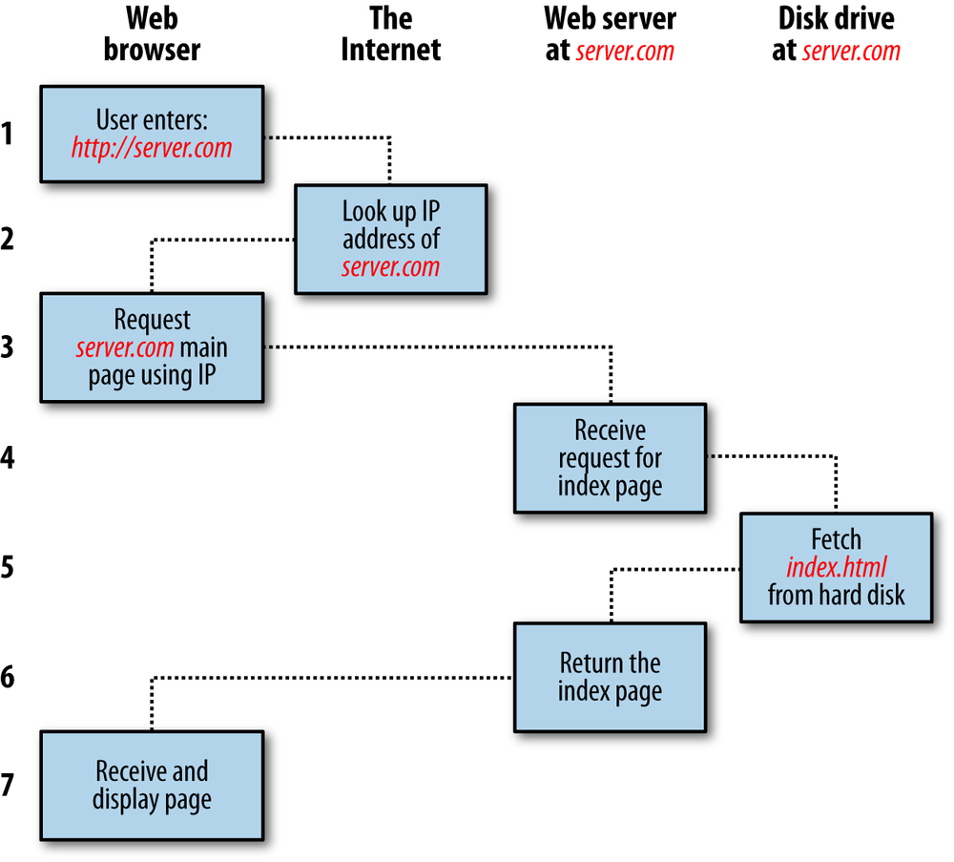
Overview (1)

Slide 3
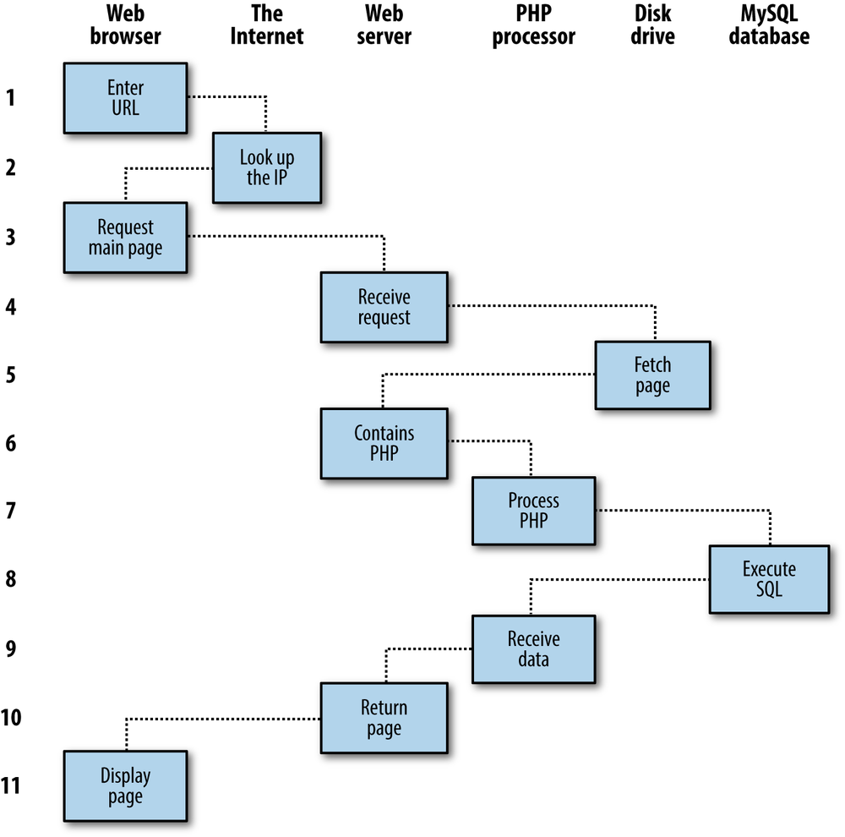
Overview (2)

Slide 4
Getting Started
Install Apache Web Server
Install PHP5+ (MYSQLi)
Review some basic HTML syntax
Learn PHP!
Bonuses:
- JavaScript
CSS

Slide 6
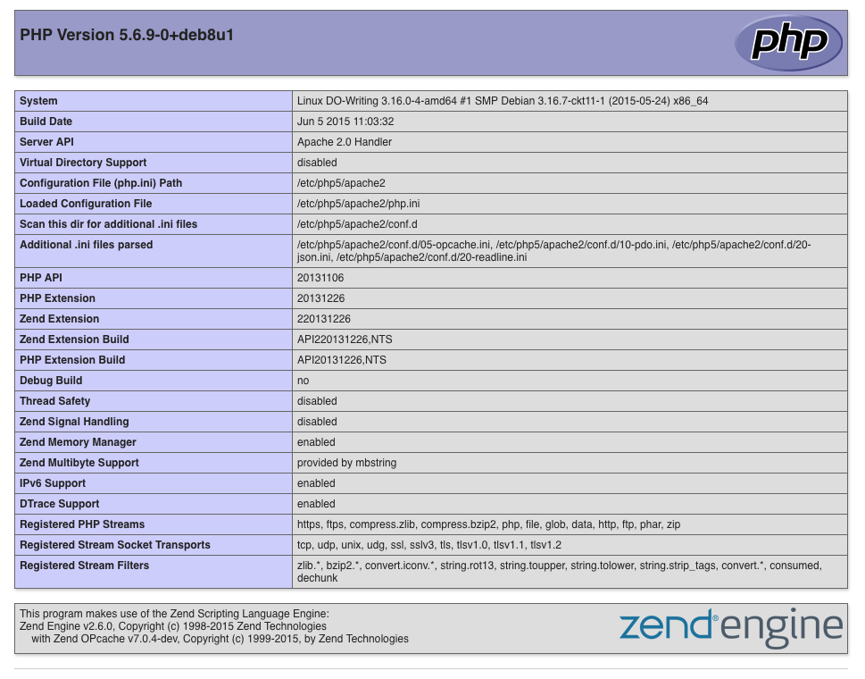
Apache Web Server
216.58.194.110/index.html
This is Apache’s default homepage named index.html locates at /var/www/html/

Slide 7
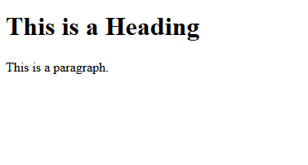
HTML (Hyper Text Markup Language)
HTML elements are the building block of HTML pages
HTML elements are represented by tags such as “heading”, “paragraph”, “table”, etc.
Browsers do not display the HTML tags, but use them to render the content of the page

Slide 8
PHP (Hypertext Preprocessor)
Scripting language
Can be Embedded into HTML
Run as Apache module
Can use with DB(MySQL, Oracle, Microsoft SQL, PostgreSQL)
Good for handling get/post requests and many other things (cookie, session)

Slide 9
PHP Syntax
All keywords (if, else, while, etc.), classes, functions, and user-defined functions are NOT case-sensitive.
However, all variable names are case-sensitive!
A variable starts with “$” sign, followed by the name of the variable ($var1 = 123, $var2 = “hello world”, $var3 = ‘hello “world” ’)
You do not need to assign a data type!
Echo statement is used to output text

Slide 10
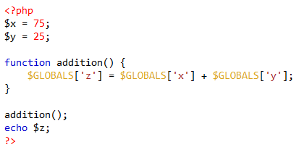
PHP Super global variable
$GLBOALS is a PHP super global variable which is used to access global variable from anywhere in the PHP script (also within functions)
PHP stores all global variables in an array called $GLOBALS[index]. The index holds the name of the variable.

Slide 11
PHP + HTML
Either configure the Apache webserver to handle .html file with embedded PHP codes or make a file extension .php
PHP codes are executed on the server side!
That means the client can not “see your PHP codes” (good, why? )

Slide 12
MySQL: How to…
Simply type “mysql –u username –p password” to use MySQL
First, create a new database using “create statement”
Second, type “use database Name” to select the database you want to access
Finally, you can create table and insert, update, or delete records to the table using MySQL standard commands

Slide 13
PHP + MySQL

Slide 14
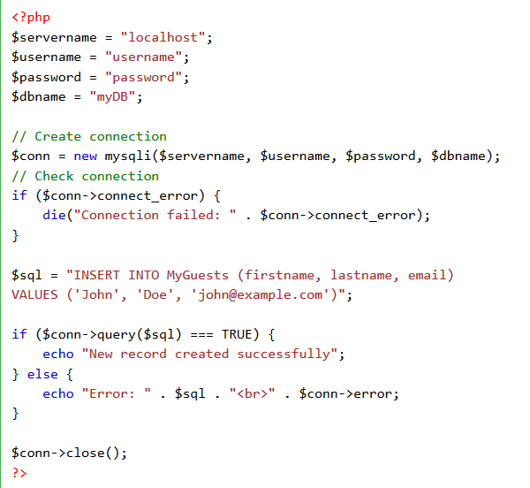

Slide 15
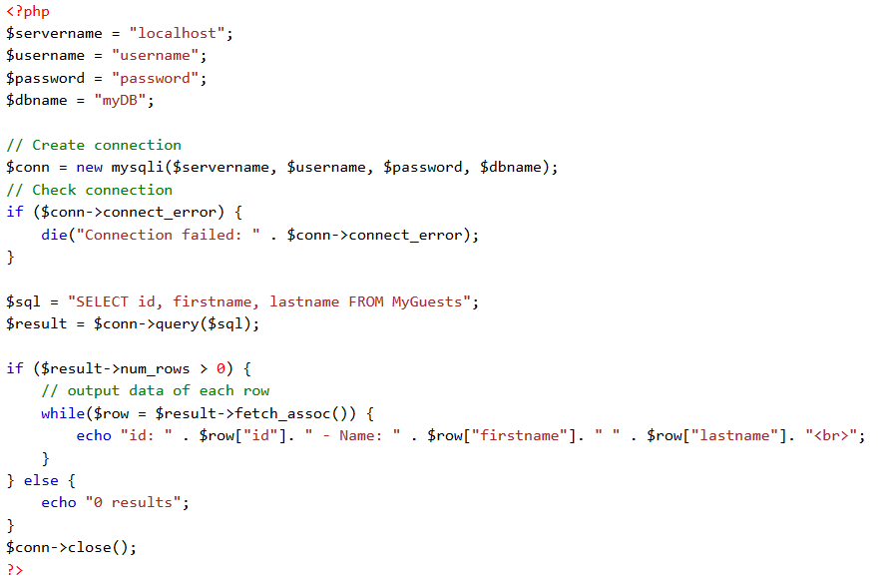

Slide 16
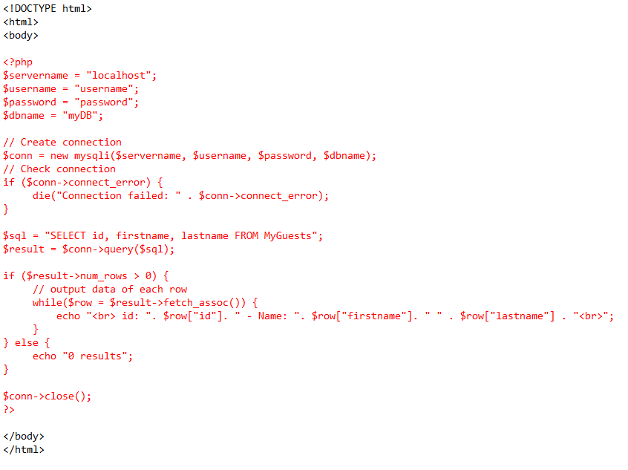

Slide 17
SQL injection attack
Consists of insertion or “injection” of a SQL query via the input data from the client to the application
A successful SQL injection exploit can read, modify, and execute administration operations on the database
Example:
$name = “ or 1 = 1”
$sql = “ SELECT * FROM Users WHERE UserName = $name”;
SELECT * FROM Users Where UserName = ‘ ‘ or 1 = 1;

Slide 18
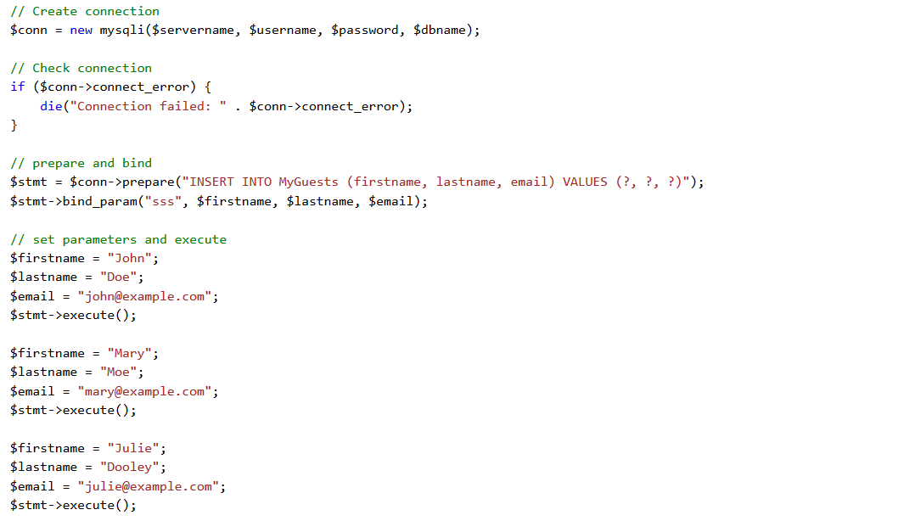
Prepared Statement

Slide 19
Client-Side (JavaScript)

Slide 20
Review

Slide 21
Sources
http://www.w3schools.com/
https://www.safaribooksonline.com/library/view/learning-php-mysql/9781491906910/ch01.html

