Slide 1
CS 405G: Introduction to Database Systems
Relations
Notes:
1

Slide 2
Review
A data model is
a group of concepts for describing data.
What are the two terms used by ER model to describe a miniworld?
Entity
Relationship
What makes a good database design
Student (sid: string, name: string, login: string, age: integer, gpa:real)
1010111101
9/7/2016
9/7/2016
2
2
Notes:
2

Slide 3
Topics Next
Conversion of ER models to Schemas
Reading Assignment
Chapter 3.1, 3.2
9/7/2016
9/7/2016
3
3
Notes:
3

Slide 4
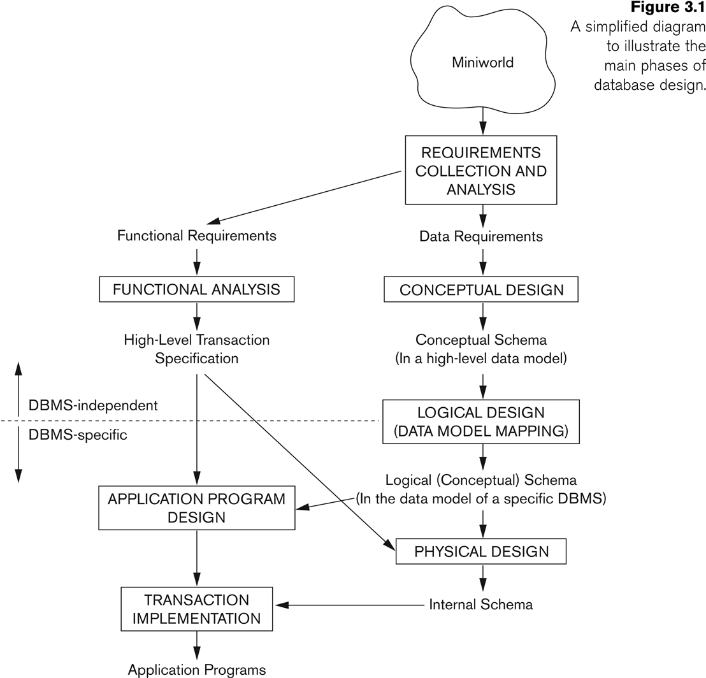
Database Design
9/7/2016
9/7/2016
4
4
Notes:
4

Slide 5
A Relation is a Table
name manf
Winterbrew Pete’s
Bud Lite Anheuser-Busch Beers
Attributes
(column
headers)
Tuples
(rows)

Slide 6
Schemas
Relation schema = relation name + attributes, in order (+ types of attributes).
Example: Beers(name, manf) or Beers(name: string, manf: string)
Database = collection of relations.
Database schema = set of all relation schemas in the database.

Slide 7
Why Relations?
Very simple model.
Often matches how we think about data.
Abstract model that underlies SQL, the most important database language today.
But SQL uses bags, while the relational model is a set-based model.

Slide 8
From E/R Diagrams to Relations
Entity sets become relations with the same set of attributes.
Relationships become relations whose attributes are only:
The keys of the connected entity sets.
Attributes of the relationship itself.

Slide 9
Entity Set -> Relation
Relation: Beers(name, manf)
name
manf
Beers

Slide 10
Relationship -> Relation
name
addr
name
manf
Drinkers
Likes
Beers
husband
1
2
Favorite
Buddies
Likes(drinker, beer)
wife
Favorite(drinker, beer)
Married
Buddies(name1, name2)
Married(husband, wife)

Slide 11
Combining Relations
It is OK to combine the relation for an entity-set E with the relation R for a many-one relationship from E to another entity set.
Example: Drinkers(name, addr) and Favorite(drinker, beer) combine to make Drinker1(name, addr, favBeer).

Slide 12
Risk with Many-Many Relationships
Combining Drinkers with Likes would be a mistake. It leads to redundancy, as:
name addr beer
Sally 123 Maple Bud
Sally 123 Maple Miller
Redundancy

Slide 13
Handling Weak Entity Sets
Relation for a weak entity set must include attributes for its complete key (including those belonging to other entity sets), as well as its own, nonkey attributes.
A supporting (double-diamond) relationship is redundant and yields no relation.

Slide 14
Example
name
name
Logins
At
Hosts
time

Slide 15
Example
name
name
Logins
At
Hosts
time
Hosts(hostName)
Logins(loginName, hostName, time)
At(loginName, hostName, hostName2)
Must be the same
At becomes part of
Logins

Slide 16
A (Slightly) Formal Definition
A database is a collection of relations (or tables)
Each relation is identified by a name and a list of attributes (or columns)
Each attribute has a name and a domain (or type)
Set-valued attributes not allowed
16
16
Notes:
16

Slide 17
Schema versus instance
Schema (metadata)
Specification of how data is to be structured logically
Defined at set-up
Rarely changes
Instance
Content
Changes rapidly, but always conforms to the schema
Compare to type and objects of type in a programming language
9/7/2016
9/7/2016
17
17
Notes:
17

Slide 18
Example
Schema
Student (SID integer, name string, age integer, GPA float)
Course (CID string, title string)
Enroll (SID integer, CID integer)
Instance
{ h142, Bart, 10, 2.3i, h123, Milhouse, 10, 3.1i, ...}
{ hCPS116, Intro. to Database Systemsi, ...}
{ h142, CPS116i, h142, CPS114i, ...}
9/7/2016
9/7/2016
18
18
Notes:
18

