Slide 1
CS 405G: Introduction to Database Systems
Instructor: Jinze Liu
Fall 2016

Slide 2
About the class
Class webpage is at
http://protocols.netlab.uky.edu/~liuj/teaching/
Annoucement
Course schedule
Slides
Homework
Project
Any questions?

Slide 3
Review
A database is
a large collection of integrated data
A miniworld is
some aspect of the real word, described by facts (data)

Slide 4
Today’s Topics
Database design
ER Model
Entities and Attributes
Entity Types, Value Sets, and Key Attributes
Relationships and Relationship Types
Weak Entity Types
Roles and Attributes in Relationship Types
ER Diagrams – Notation
Database schema
Case studies

Slide 5
Database Design
Understand the mini-world being modeled
Specify it using a database design model
A few popular ones are:
Entity/Relationship (E/R) model
UML (Unified Modeling Language)
Intuitive and convenient
But not necessarily implemented by DBMS
Translate specification to the data model of DBMS
Relational, XML, object-oriented, etc.
Create DBMS schema

Slide 6
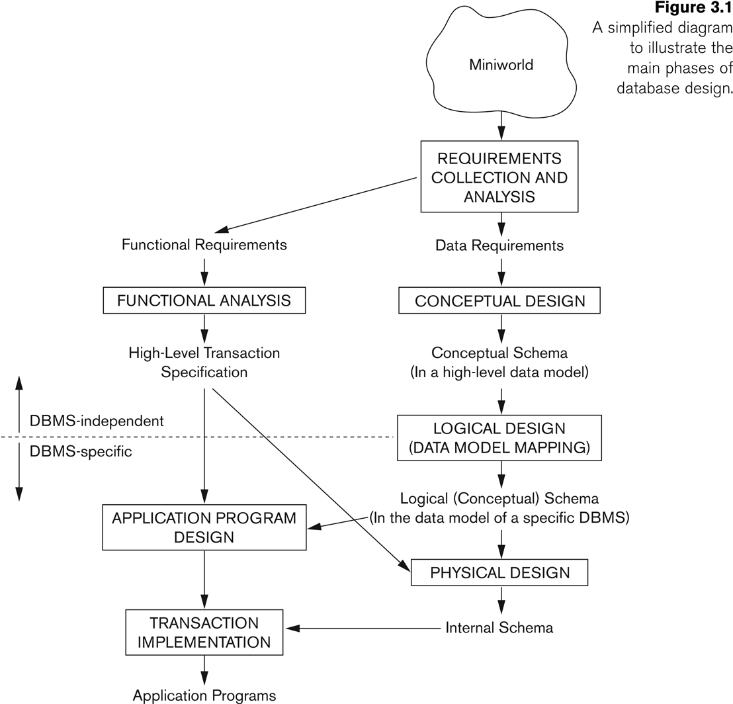
Database Design

Slide 7
A Database Design Example
The company is organized into DEPARTMENTs. Each department has a name, number and an employee who manages the department. We keep track of the start date of the department manager.
Each department controls a number of PROJECTs. Each project has a name, number and is located at a single location.
We store each EMPLOYEE’s social security number, address, salary, sex, and birthdate. Each employee works for one department but may work on several projects. We keep track of the number of hours per week that an employee currently works on each project. We also keep track of the direct supervisor of each employee.
Each employee may have a number of DEPENDENTs. For each dependent, we keep track of their name, sex, birthdate, and relationship to employee.

Slide 8
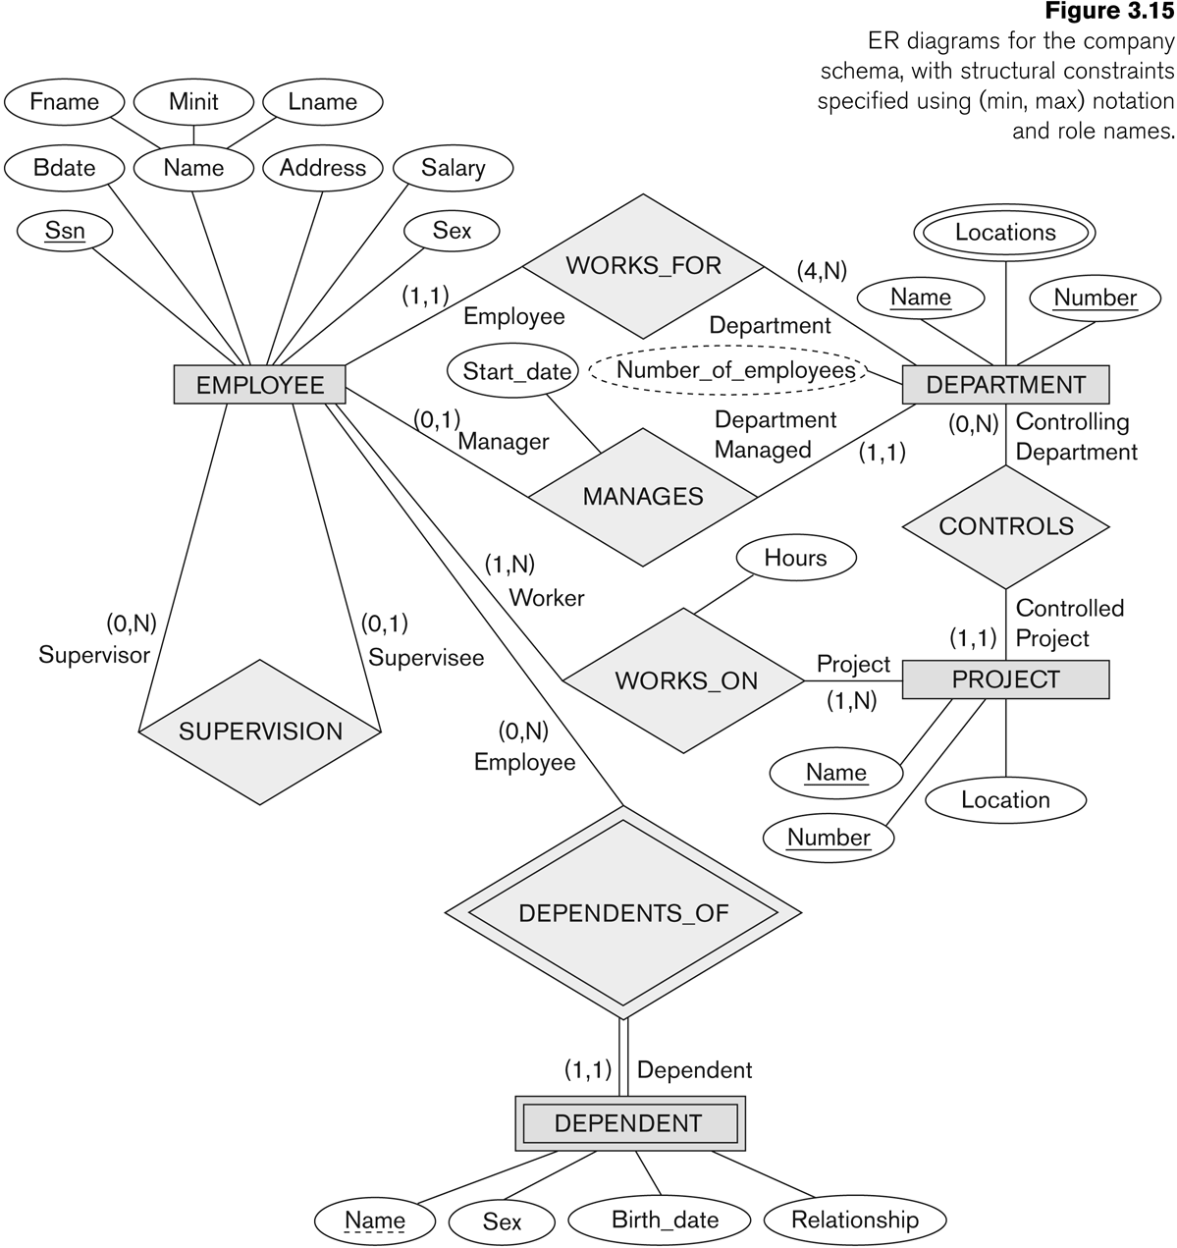

Slide 9
Entity-relationship (E/R) model
Historically and still very popular
Can think of as a “watered-down” object-oriented design model
Primarily a design model—not directly implemented by DBMS
Designs represented by E/R diagrams
there are other styles
Very similar to UML diagrams

Slide 10
Entities and Attributes
Entity: A specific object or “thing” in the mini-world that is represented in the database.
For example, the EMPLOYEE John Smith,
the Research DEPARTMENT, the ProductX PROJECT.
Attributes: properties used to describe an entity.
For example, an EMPLOYEE entity may have a Name, SSN, Address, Sex, BirthDate
A specific entity will have a value for each of its attributes.
For example, a specific employee entity may have Name='John Smith', SSN='123456789', Address ='731 Fondren, Houston, TX', Sex='M', BirthDate='09-JAN-55'

Slide 11
Types of Attributes
Simple vs. Composite Attributes
Simple: Each entity has a single atomic value for the attribute. For example, SSN or Sex.
Composite: The attribute may be composed of several components. For example, Name (FirstName, MiddleName, LastName).

Slide 12
Types of Attributes (cont.)
Single-valued vs. Multi-valued.
Single-valued: an entity may have at most one value for the attribute
Multi-valued: An entity may have multiple values for that attribute. For example, PreviousDegrees of a STUDENT. {PreviousDegrees}.
NULL values
What if the student does not hold a previous degree?
What if the student has a previous degree but the information is not provided?
Apartment number in an address

Slide 13
Types of Attributes (cont.)
Stored vs. derived
Number of credit hours a student took in a semester
GPA of a student in a semester

Slide 14
Key Attributes
Entities with the same basic attributes are grouped or typed into an entity type.
For example, the EMPLOYEE entity type or the PROJECT entity type.
An attribute of an entity type for which each entity must have a unique value is called a key attribute of the entity type. For example, SSN of EMPLOYEE.
A key attribute may be composite.
An entity type may have more than one key.

Slide 15
SUMMARY OF ER-DIAGRAM NOTATION
Symbol
Meaning
ENTITY TYPE
ATTRIBUTE
KEY ATTRIBUTE
MULTIVALUED ATTRIBUTE
COMPOSITE ATTRIBUTE
DERIVED ATTRIBUTE

Slide 16
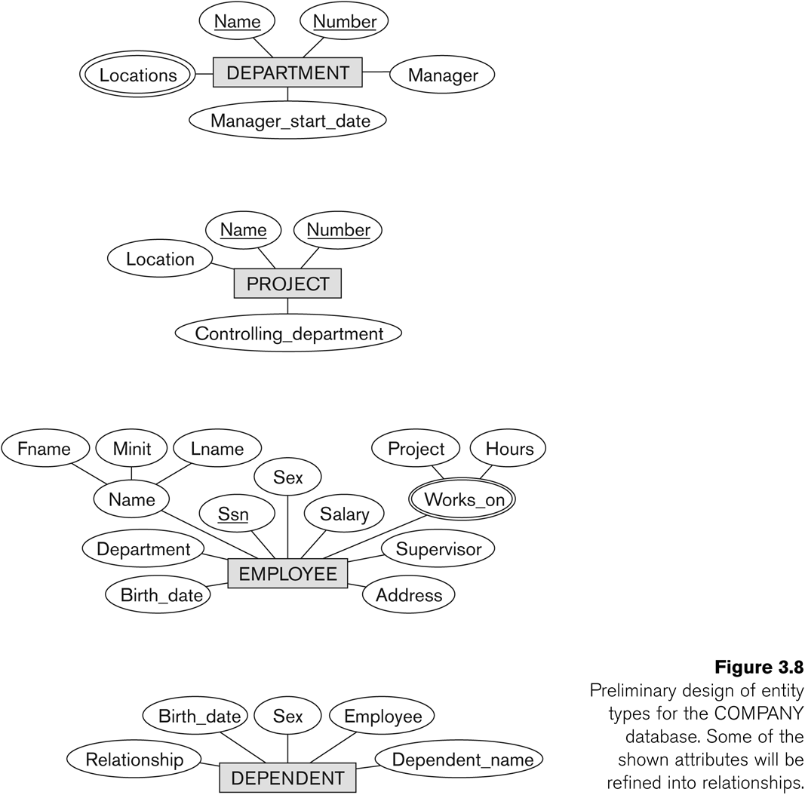
Summary (cont.)

Slide 17
Relationships
A relationship relates two or more distinct entities with a specific meaning.
For example, EMPLOYEE John Smith works on the ProductX PROJECT or EMPLOYEE Franklin Wong manages the Research DEPARTMENT.
Relationships of the same type are grouped or typed into a relationship type.
For example, the WORKS_ON relationship type in which EMPLOYEEs and PROJECTs participate, or the MANAGES relationship type in which EMPLOYEEs and DEPARTMENTs participate.
The degree of a relationship type is the number of participating entity types.
Both MANAGES and WORKS_ON are binary relationships.

Slide 18
Instances of a relationship
EMPLOYEE
WORKS_FOR
DEPARTMENT
e_{1 }
e_{2 }
e_{3 }
e_{4 }
e_{5 }
e_{6 }
e_{7 }
r₁
r₂
r₃
r₄
r₅
r₆
r₇
● d₁
● d₂
● d₃

Slide 19
Structural Constraints (I)
Maximum Cardinality
One-to-one (1:1)
One-to-many (1:N) or Many-to-one (N:1)
Many-to-many

Slide 20
Many-to-one (N:1) RELATIONSHIP
EMPLOYEE
WORKS_FOR
DEPARTMENT
e_{1 }
e_{2 }
e_{3 }
e_{4 }
e_{5 }
e_{6 }
e_{7 }
r₁
r₂
r₃
r₄
r₅
r₆
r₇
● d₁
● d₂
● d₃

Slide 21
Many-to-many (M:N) RELATIONSHIP
e_{1 }
e_{2 }
e_{3 }
e_{4 }
e_{5 }
e_{6 }
e_{7 }
r₉
r₁
r₂
r₃
r₄
r₅
r₆
r₇
● p₁
● p₂
● p₃
r₈

Slide 22
More Examples
Each student may have exactly one account.
Each faculty may teach many courses
Each student may enroll many courses
Students
Own
Ku Accounts
Courses
TaughtBy
Instructors
Students
Enroll
Courses

Slide 23
Structural Constraints (II)
Minimum Cardinality (also called participation constraint or existence dependency constraints)
Zero (partial participation)
One or more (total participation)

Slide 24
The (min,max) notation
relationship constraints
(0,1)
(1,1)
Employee
Manages
Department
(1,1)
(1,N)
Employee
Department
Works-for

Slide 25
Roles in relationships
An entity set may participate more than once in a relationship set
May need to label edges to distinguish roles
Examples
People are married as husband and wife; label needed
People are roommates of each other; label not needed
husband
Roommate
Persons
Marry
wife

Slide 26
Recursive relationship
We can also have a recursive relationship type.
Both participations are same entity type in different roles.
For example, SUPERVISION relationships between EMPLOYEE (in role of supervisor or boss) and (another) EMPLOYEE (in role of subordinate or worker).
In ER diagram, need to display role names to distinguish participations.

Slide 27
A RECURSIVE RELATIONSHIP SUPERVISION
EMPLOYEE
SUPERVISION
e_{1 }
e_{2 }
e_{3 }
e_{4 }
e_{5 }
e_{6 }
e_{7 }
r₁
r₂
r₃
r₄
r₅
r₆
2
1
1
2
2
1
2
1
1
2
1
2
© The Benjamin/Cummings Publishing Company, Inc. 1994, Elmasri/Navathe, Fundamentals of Database Systems, Second Edition

Slide 28
Weak Entity Types
A week entity is an entity that does not have a key attribute
A weak entity must participate in an identifying relationship type with an owner or identifying entity type
Entities are identified by the combination of:
A partial key of the weak entity type
The particular entity they are related to in the identifying entity type
Example:
Suppose that a DEPENDENT entity is identified by the dependent’s first name and birthdate, and the specific EMPLOYEE that the dependent is related to. DEPENDENT is a weak entity type with EMPLOYEE as its identifying entity type via the identifying relationship type DEPENDENT_OF

Slide 29
SUMMARY OF ER-DIAGRAM NOTATION FOR ER SCHEMAS
Symbol
Meaning
ENTITY TYPE
WEAK ENTITY TYPE
RELATIONSHIP TYPE
IDENTIFYING RELATIONSHIP TYPE
ATTRIBUTE
KEY ATTRIBUTE
MULTIVALUED ATTRIBUTE
COMPOSITE ATTRIBUTE
DERIVED ATTRIBUTE
TOTAL PARTICIPATION OF E₂ IN R
CARDINALITY RATIO 1:N FOR E₁:E₂ IN R
STRUCTURAL CONSTRAINT (min, max) ON PARTICIPATION OF E IN R
E₁
R
E₂
E₁
R
N
E₂
R
(min,max)
E

Slide 32
Case study
Design a database representing cities, counties, and states
For states, record name and capital (city)
For counties, record name, area, and location (state)
For cities, record name, population, and location (county and state)
Assume the following:
Names of states are unique
Names of counties are only unique within a state
Names of cities are only unique within a county
A city is always located in a single county
A county is always located in a single state

Slide 33
Case study : first design
name
name
Cities
In
States
population
capital
county_name
county_area
County area information is repeated for every city in the county
Redundancy is bad (why?)
State capital should really be a city
Should “reference” entities through explicit relationships

Slide 34
Case study : second design
name
Cities
population
In
IsCapitalOf
name
Counties
In
States
name
area
Technically, nothing in this design could prevent a city in state X from being the capital of another state Y, but oh well…

Slide 35
Summary: E-R model
Entity: A specific object or “thing” in the mini-world, whose properties were described by Attributes
A relationship relates two or more distinct entities with a specific meaning.
E-R model a popular database design model

Slide 36
Next Class
More E-R model case studies
More on E-R logic design

