Slide 1
CS 405G: Introduction to Database Systems
Database Design II

Slide 2
Assignment 1
Please check your canvas
  CS405G Fall 2016

Slide 3
Review
From Database Requirement to Relational Model
  Entity type(set)s
  Relationship types

Slide 4
Next: ER-Design Principles
Avoid redundancy.
Limit the use of weak entity sets.
Don’t use an entity set when an attribute will do.

Slide 5
Avoiding Redundancy
Redundancy occurs when we say the same thing in two different ways.
Redundancy
  wastes space
  (more importantly) encourages inconsistency.
  The two instances of the same fact may become inconsistent if we change one and forget to change the other, related version.

Slide 6
Example
Assume we would like to set up a database for a wine distribution company.
  Wine
  Manufacture

Slide 7
Example
name
name
addr
ManfBy
Beers
Manfs
manf

Slide 8
Example
name
name
addr
ManfBy
Beers
Manfs
manf
This design states the manufacturer of a beer twice: as an attribute and as a related entity.

Slide 9
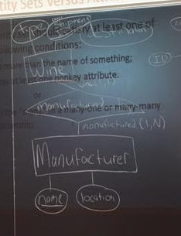

Slide 10
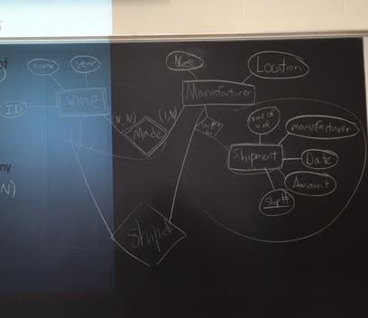

Slide 11
Example
name
manf
manfAddr
Beers

Slide 12
Example
name
manf
manfAddr
Beers
This design repeats the manufacturer’s address once for each beer; loses the address if there are temporarily no beers for a manufacturer.

Slide 13
Example
name
name
addr
ManfBy
Beers
Manfs

Slide 14
Example
name
name
addr
ManfBy
Beers
Manfs
This design gives the address of each manufacturer exactly once.

Slide 15
Entity Sets Versus Attributes
An entity set should satisfy at least one of the following conditions:
  It is more than the name of something;
  it has at least one nonkey attribute.
  or
  It is the “many” in a many-one or many-many relationship.

Slide 16
Example: Bad
name
name
ManfBy
Beers
Manfs

Slide 17
Example: Bad
name
name
ManfBy
Beers
Manfs
Since the manufacturer is nothing but a name, and is not at the “many” end of any relationship, it should not be an entity set.

Slide 18
Example: Good
name
manf
Beers
There is no need to make the manufacturer an entity set, because we record nothing about manufacturers besides their name.

Slide 19
Example: Good
name
name
addr
ManfBy
Beers
Manfs
Manfs deserves to be an entity set because of the nonkey attribute addr.
Beers deserves to be an entity set because it is the “many” of the many-one relationship ManfBy.

Slide 20
Don’t Overuse Weak Entity Sets
Beginning database designers often doubt that anything could be a key by itself.
  They make all entity sets weak, supported by all other entity sets to which they are linked.
In reality, we usually create unique ID’s for entity sets.
  Examples include social-security numbers, automobile VIN’s etc.

Slide 21
When Do We Need Weak Entity Sets?
The usual reason is that there is no global authority capable of creating unique ID’s.
  Example
  it is unlikely that there could be an agreement to assign unique player numbers across all football teams in the world.

Slide 22
ER Case Study I
Works_In does not allow an employee to work in a department for two or more periods.
We want to record several values of the descriptive attributes for each instance of this relationship.
from
to
name
dname
ssn
lot
did
budget
Employees
Works_In
Departments
name
dname
ssn
lot
did
budget
Employees
Works_In
Departments
from
Duration
to
22
Notes:
22

Slide 23
ER Case study II
Design a database representing cities, counties, and states
  For states, record name and capital (city)
  For counties, record name, area, and location (state)
  For cities, record name, population, and location (county and state)
Assume the following:
  Names of states are unique
  Names of counties are only unique within a state
  Names of cities are only unique within a county
  A city is always located in a single county
  A county is always located in a single state
Notes:
23

Slide 24
ER Case study
Design a database representing cities, counties, and states
  For states, record name and capital (city)
  For counties, record name, area, and location (state)
  For cities, record name, population, and location (county and state)
Assume the following:
  Names of states are unique
  Names of counties are only unique within a state
  Names of cities are only unique within a county
  A city is always located in a single county
  A county is always located in a single state
9/2/2016
24
Notes:
24

Slide 25
Case study : first design
County area information is repeated for every city in the county
  Redundancy is bad.
  What else?
State capital should really be a city
  Should “reference” entities through explicit relationships
name
name
Cities
In
States
population
capital
county_name
county_area
9/2/2016
9/2/2016
25
25
Notes:
25

Slide 26
Case study : second design
Technically, nothing in this design could prevent a city in state X from being the capital of another state Y, but oh well…
name
Cities
population
In
IsCapitalOf
name
Counties
In
States
name
area
9/2/2016
9/2/2016
26
26
Notes:
26

Slide 27
Homework
Assignment 1 due Wednesday 09/14
Reading assignment
  Chapter 3.1, 3.2 (6th edition)
Project
  Find your partner

