Slide 1
CS 405G: Introduction to Database Systems
Instructor: Jinze Liu
Fall 2016

Slide 2
Who am I?
Instructor
Jinze Liu
Associate Professor @ CS.UKY
Research area: Database, Data mining and Bioinformatics
Email: liuj@cs.uky.edu

Slide 3
Topics for Today
What is a database?
What is a database management system?
Why take a database course?
How to take the class?
Preview of class contents

Slide 4
Database Systems?
Name a few!

Slide 5
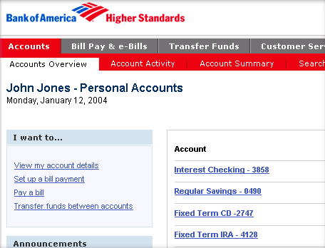
Database Systems: Bank Systems

Slide 6
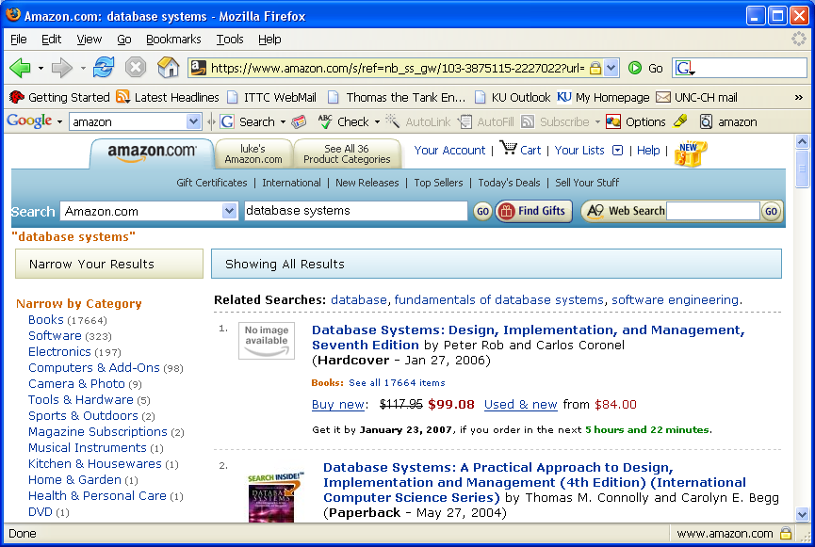
Database Systems - Ecommerce

Slide 7
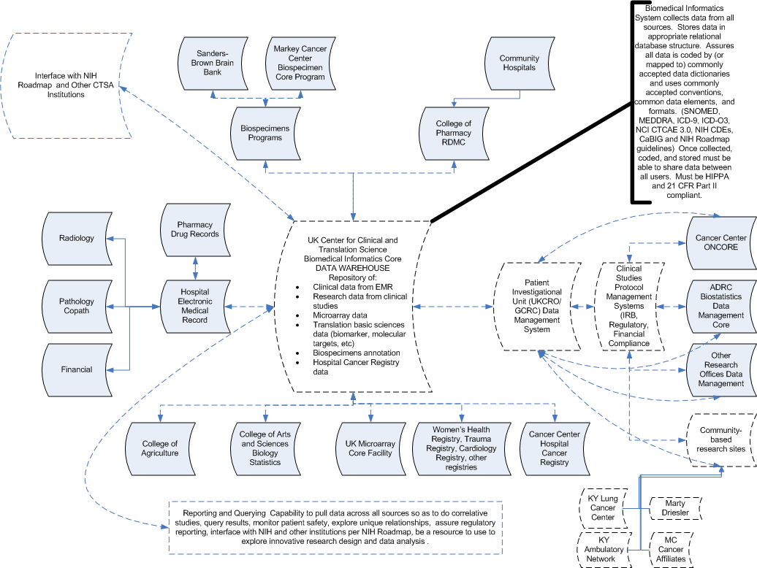
Database Systems: Clinical Databases

Slide 8
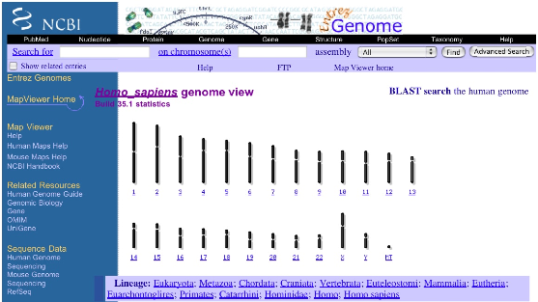
Database Systems: Genome Bank

Slide 9
What is a Database?
A database is an integrated collection of data.
Data is a group of facts that can be recorded.
Typically a database is used to model a real-world “enterprise” (or a miniworld)
Entities (e.g., basketball teams, games)
Relationships (e.g. UK’s basketball team beat <you name it> last week)
Might surprise you how flexible this is
Web search:
Entities: words, documents
Relationships: word in document, document links to document.
P2P filesharing:
Entities: words, filenames, hosts
Relationships: word in filename, file available at host

Slide 10
What is a Database Management System?
A Database Management System (DBMS) is a collection of programs that enable users to create and maintain databases
store, manage, and access data in a databases.
Typically this term is used narrowly
Relational databases with transactions
E.g. Oracle, DB2, SQL Server
Mostly because they predate other large repositories
Also because of technical richness
When we say DBMS in this class we will usually follow this convention
But keep an open mind about applying the ideas!

Slide 11
Main Characteristics of Databases
Self-describing nature of a database system
A DBMS catalog stores the description of the database. The description is called meta-data.
Insulation between programs and data
Allows changing data storage structures and operations without having to change the DBMS access
Data Abstraction
Use data model to hide storage details and present the users with a conceptual view of the database
Support of multiple views of the data
Each user may see a different view of the database, which describes only the data of interest to that user.
Sharing of data and multi-user transaction processing

Slide 12
Databases make these folks happy ...
End users in many fields
Business, education, science, …
DB application programmers
Build data entry & analysis tools on top of DBMSs
Build web services that run off DBMSs
Database administrators (DBAs)
Design logical/physical schemas
Handle security and authorization
Data availability, crash recovery
Database tuning as needs evolve
DBMS vendors, programmers
Oracle, IBM, MS …
…must understand how a DBMS works
Notes:
21

Slide 13
What: Is the WWW a DBMS?
Fairly sophisticated search available
Crawler indexes pages on the web
Keyword-based search for pages
But, currently
data is mostly unstructured and untyped
search only:
can’t modify the data
can’t get summaries, complex combinations of data
few guarantees provided for freshness of data, consistency across data items, fault tolerance, …
web sites typically have a (relational) DBMS in the background to provide these functions.

Slide 14
What: Is the WWW a DBMS?
The picture is changing quickly
Information Extraction to get structure data from unstructured data
New standards e.g., XML, Semantic Web can help data modeling

Slide 15
What: Is a File System a DBMS?
Thought Experiment 1:
You and your project partner are editing the same file.
You both save it at the same time.
Whose changes survive?
Q: How do you write programs over a subsystem when it promises you only “???” ?
A: Very, very carefully!!
A) Yours
B) Partner’s
C) Both
D) Neither
E) ???
Thought Experiment 2:
You’re updating a file.
The power goes out.
Which changes survive?
A) All
B) None
C) All Since Last Save
D) ???

Slide 16
OS Support for Data Management
Data can be stored in RAM
This is what every programming language offers!
RAM is fast, and random access
Isn’t this heaven?
Every OS includes a File System
manages files on a magnetic disk
allows open, read, seek, close on a file
allows protections to be set on a file
drawbacks relative to RAM?

Slide 17
Database Management Systems
What more could we want than a file system?
Simple, efficient ad hoc¹ queries
concurrency control
recovery
benefits of good data modeling
S.M.O.P.²? Not really…
as we’ll see this semester
in fact, the OS often gets in the way!
¹ad hoc: formed or used for specific or immediate problems or needs
²SMOP: Small Matter Of Programming

Slide 18
Current Commercial Outlook
A major part of the software industry:
Oracle, IBM, Microsoft
also Sybase, Informix (now IBM), Teradata
smaller players: java-based dbms, devices, OO, …
Lots of related industries
data warehouse, document management, storage, backup, reporting, business intelligence, ERP, CRM, app integration
Traditional Relational DBMS products dominant and evolving
adapted for extensibility (user-defined types), native XML support.
Microsoft merger of file system/DB…?

Slide 19
Advantages of a DBMS: a short list
Controlling redundancy
Restrict unauthorized access
Providing persistent storage for program objects
Providing storage structure for efficient query processing
Providing backup and crash recovery
….
And many many others that are going to be explored in this class

Slide 20
What database systems will we cover?
We will try to be broad and touch upon
Relational DBMS (e.g. Oracle, SQL Server, DB2, Postgres)
“Semi-structured” DB systems (e.g. XML repositories like Xindice)
Data mining: transfer data into knowledge!
Starting point
We assume you have used web search engines
We assume you don’t know relational databases
Yet they pioneered many of the key ideas
So focus will be on relational DBMSs
With frequent side-notes on search engines, XML issues

Slide 21
Why take this class?
Database systems are at the core of CS
They are incredibly important to society
The topic is intellectually rich
It isn’t that much work
Looks good on your resume
Let’s spend a little time on each of these

Slide 22
Why take this class?
A. Database systems are the core of CS
Shift from computation to information
True in corporate computing for years
Web, p2p made this clear for personal computing
Increasingly true of scientific computing
Need for DB technology has exploded in the last years
Corporate: retail swipe/clickstreams, “customer relationship mgmt”, “supply chain mgmt”, “data warehouses”, etc.
Web:not just “documents”. Search engines, e-commerce, blogs, wikis, other “web services”.
Scientific: digital libraries, genomics, satellite imagery, physical sensors, simulation data
Personal: Music, photo, & video libraries. Email archives. File contents (“desktop search”).

Slide 23
Why take this class?
B. DBs are incredibly important to society
“Knowledge is power.” -- Sir Francis Bacon
“With great power comes great responsibility.” -- SpiderMan’s Uncle Ben
Policy-makers should understand technological possibilities.
Informed Technologists needed in public discourse on usage.

Slide 24
Why take this class?
C. The topic is intellectually rich.
representing information
data modeling
languages and systems for querying data
complex queries & query semantics*
over massive data sets
concurrency control for data manipulation
controlling concurrent access
ensuring transactional semantics
reliable data storage
maintain data semantics even if you pull the plug
data mining
Let your data speak
* semantics: the meaning or relationship of meanings of a sign or set of signs

Slide 25
Why take this class?
D. It isn’t that much work.
Bad news: It is a lot of work.
You may need to learn a language you are not familiar with like PHP for the project
Besides SQL which is considered the most fun part, you will also need to learn the theoretical side of relational database
Good news: the course is front loaded
Most of the hard work is in the first half of the semester
Load balanced with most other classes

Slide 26
Why take this class?
E. Looks good on my resume.
Yes, but why? This is not a course for:
Oracle administrators
IBM DB2 engine developers
Though it’s useful for both!
It is a course for well-educated computer scientists
Database system concepts and techniques increasingly used “outside the box”
Ask your friends at Microsoft, Yahoo!, Google, Apple, etc.
Actually, they may or may not realize it!
A rich understanding of these issues is a basic and (un?)fortunately unusual skill.

Slide 27
About the course: Information
Canvas will be used for the class
Notes
Assignments
Forum
Textbook
Fundamentals of database systems
Ramez Elmasri and Shamkant B. Navathe
Can get it from the bookstore
Jinze’s Office Hours:
235 Hardymon building, Friday 10:00am
Email: please include CS405G in the subject line for fast response
Class mailing list
Will send emails to everyone once set up.
Will be used for announcement/clarification of assignments/answering questions

Slide 28
About the Course – Workload
6 homework assignments
Including programming assignment
Building blocks for your project
1 Programming project
Exams
1 Midterm & 1 Final
Cheating policy: zero tolerance
We have the technology…

Slide 29
About the course: Workload
Programming projects have a practical, hands-on focus:
A relational DBMS for a particular application
To be named (let me know your interest!)
Projects are to be done in teams of 2
Pick your partner ASAP!

Slide 30
About the course: Grading
Weights
6 Homework assignments 25%
Project 25%
Midterm exam 25%
Final exam 20%
Quizzes 5%
More information is in the syllabus
Final grade
Late homework
Will be accepted
Academic mis-conduct
You are expected to do the assignment independently
Discussions if allowed should be acknowledged

Slide 31
Challenges

Slide 32
Next Class
Database modeling
The ER (Entity-Relationship) model
Any Questions?
Any suggestions?

